Slide 1
Data Slides for 3 August 2019 during CapeEx19
Christian Nairy

Slide 2
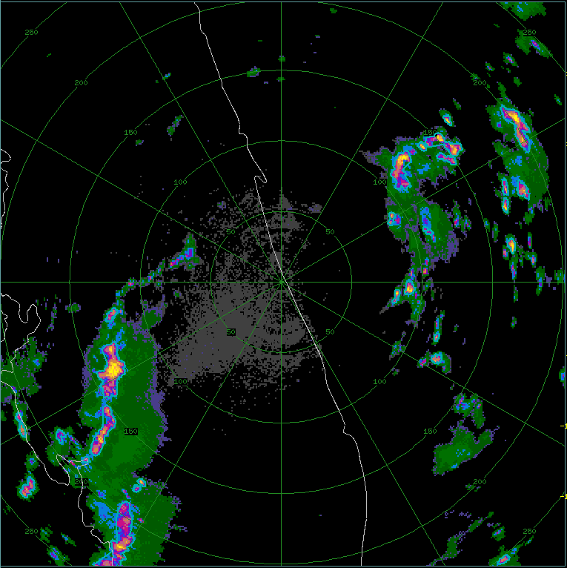
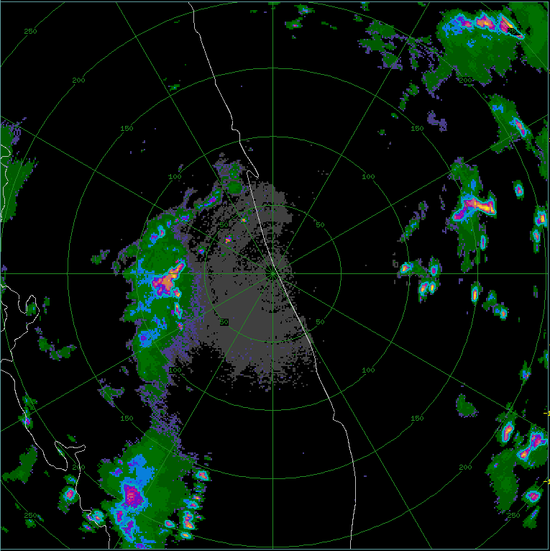
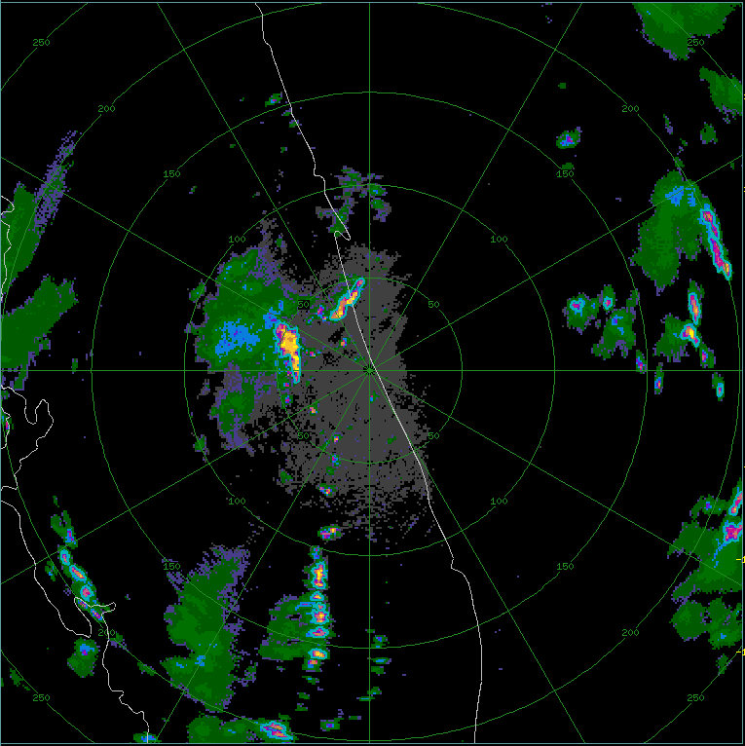
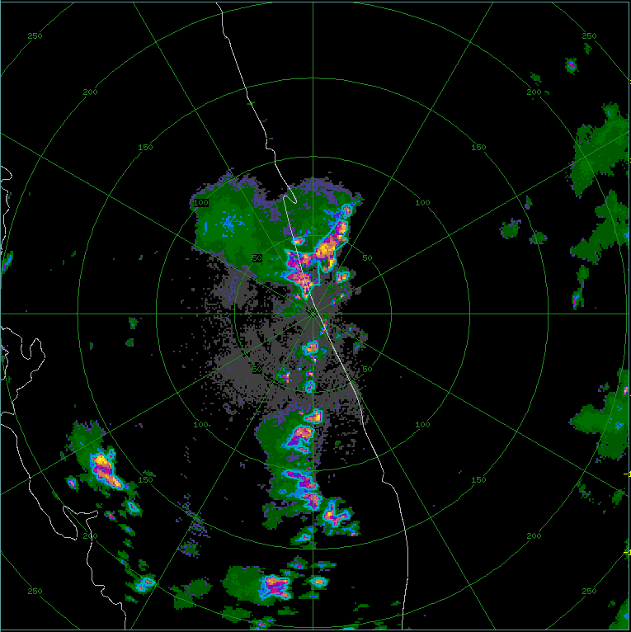
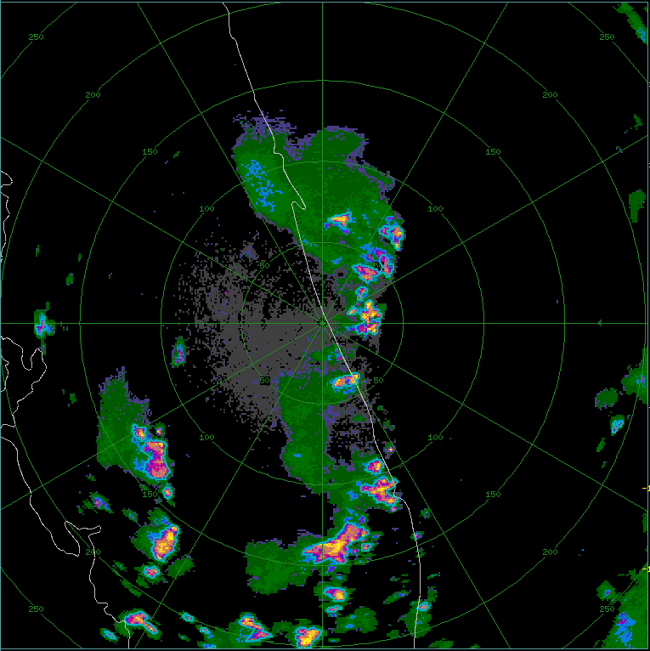
(a) – 12:29:24 UTC
(b) – 13:29:48 UTC
(c) – 14:29:12 UTC
(d) – 15:33:11 UTC
(e) – 16:32:38 UTC
(f) – 17:30:53 UTC

Slide 3
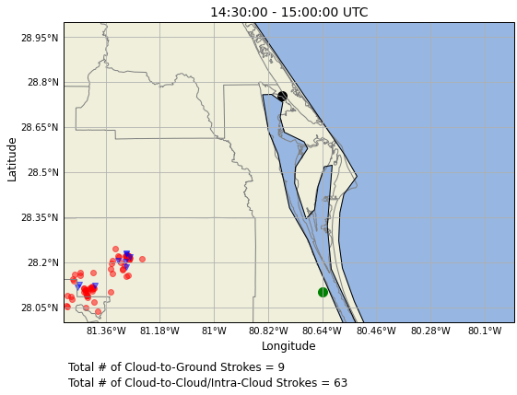
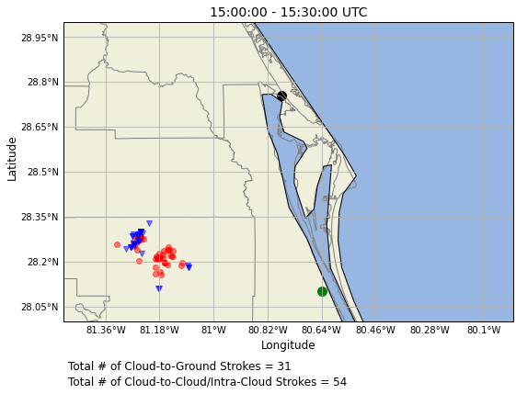
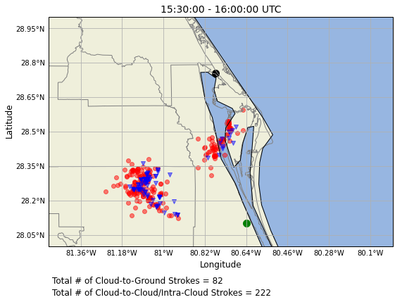
NLDN Lightning Strokes – 3 August 2019
(a)
(b)
(c)
(d)

Slide 4
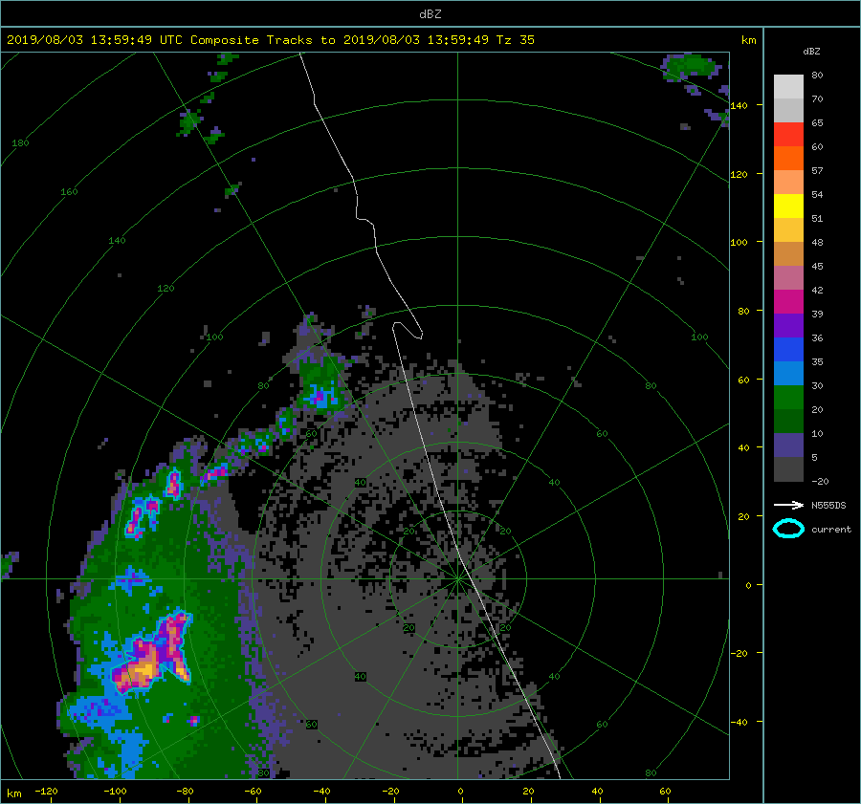

Slide 5
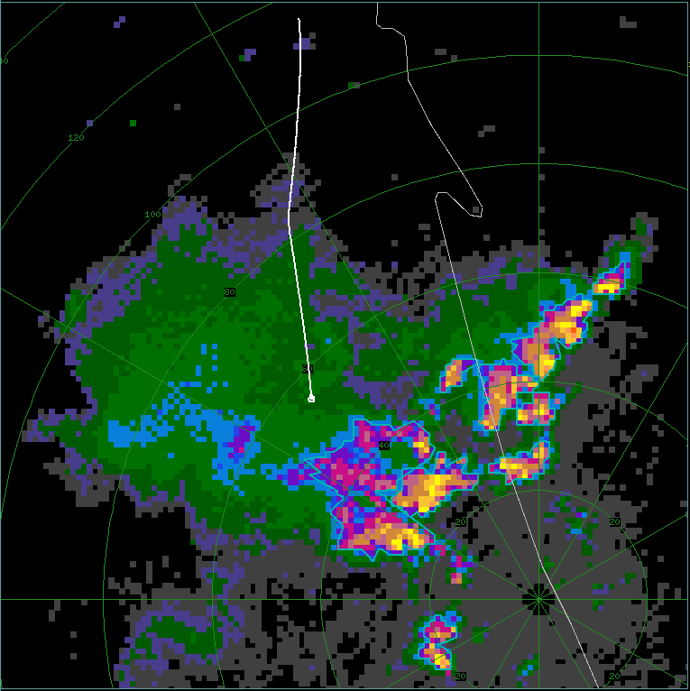
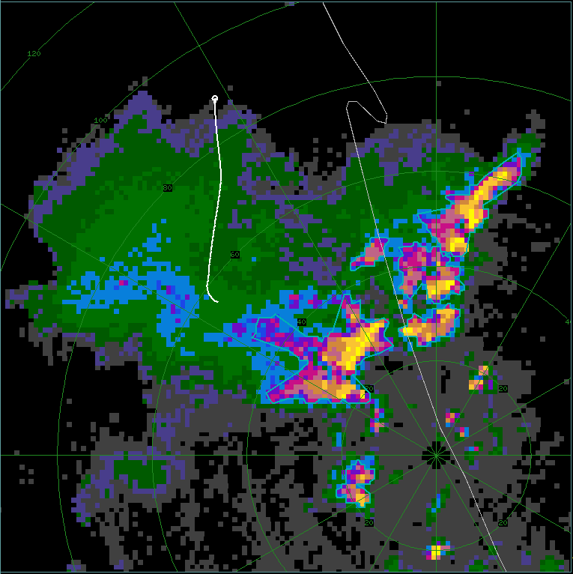
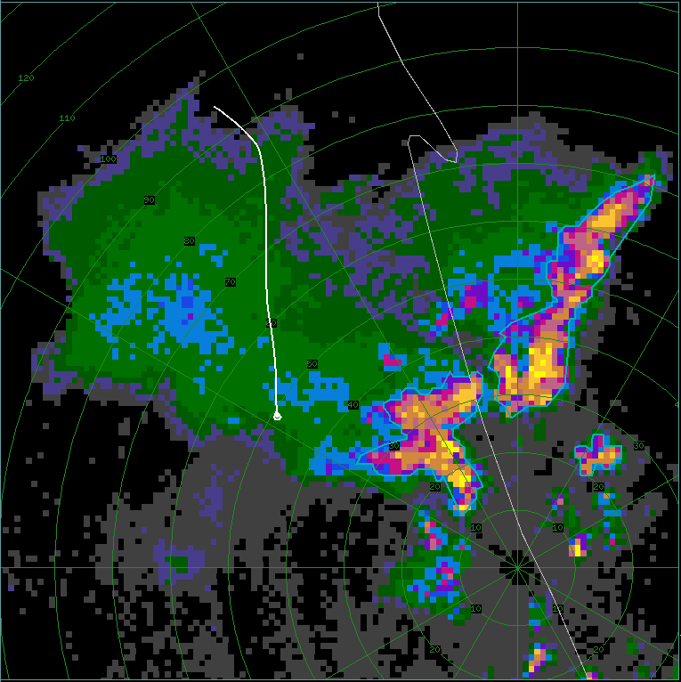
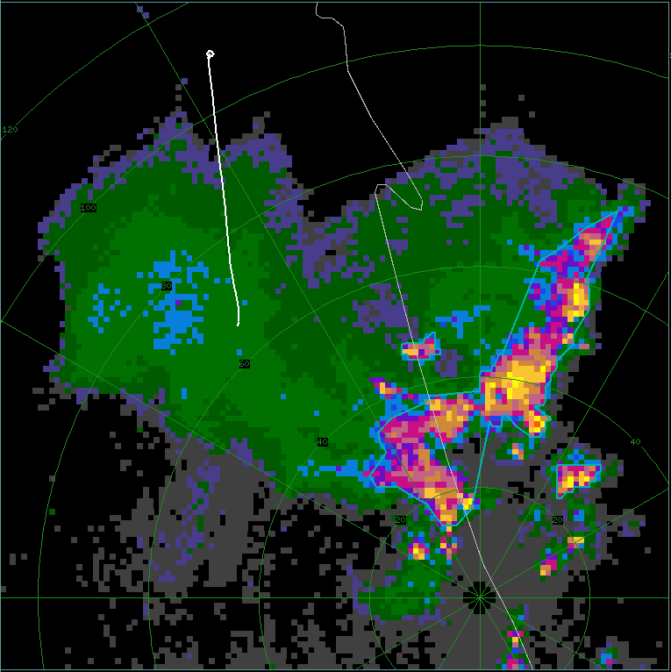
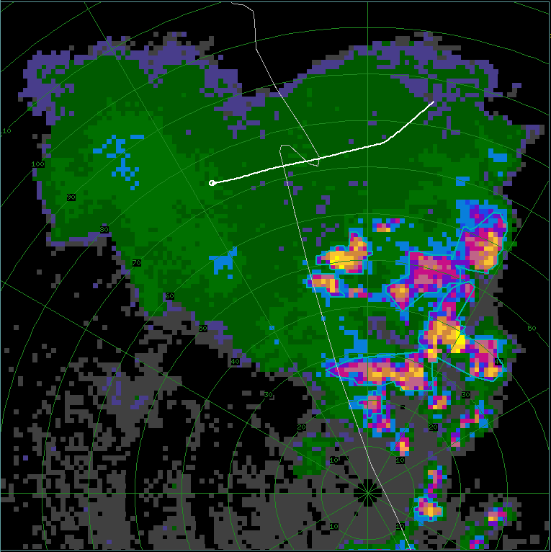
(a) – FL1: 15:51:15 - 16:01:00 UTC
(b) – FL2: 16:02:00 - 16:07:00 UTC
(c) – FL3: 16:09:00 - 16:17:00 UTC
KMLB: 16:02:01 UTC
KMLB: 16:07:52 UTC
KMLB: 16:19:25 UTC
(d) – FL4: 16:21:30 - 16:27:00 UTC
(e) – FL5: 16:40:00 - 16:46:00 UTC
KMLB: 16:28:16 UTC
KMLB: 16:50:03 UTC

Slide 6
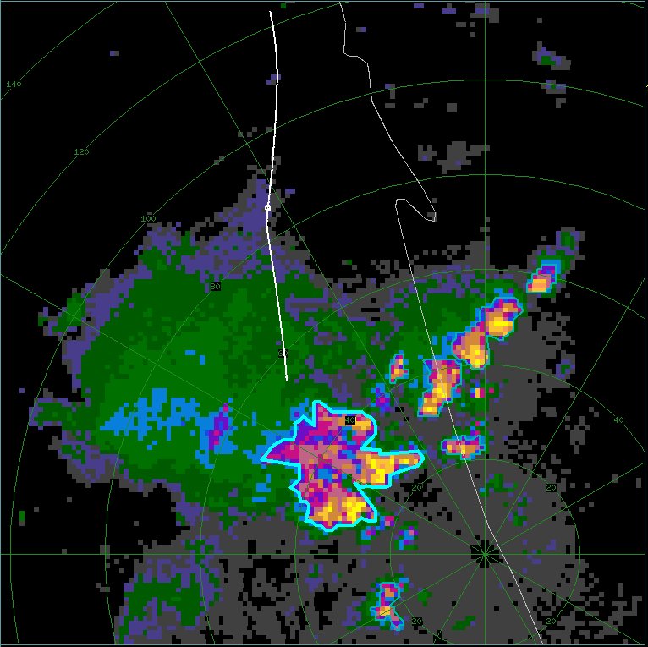
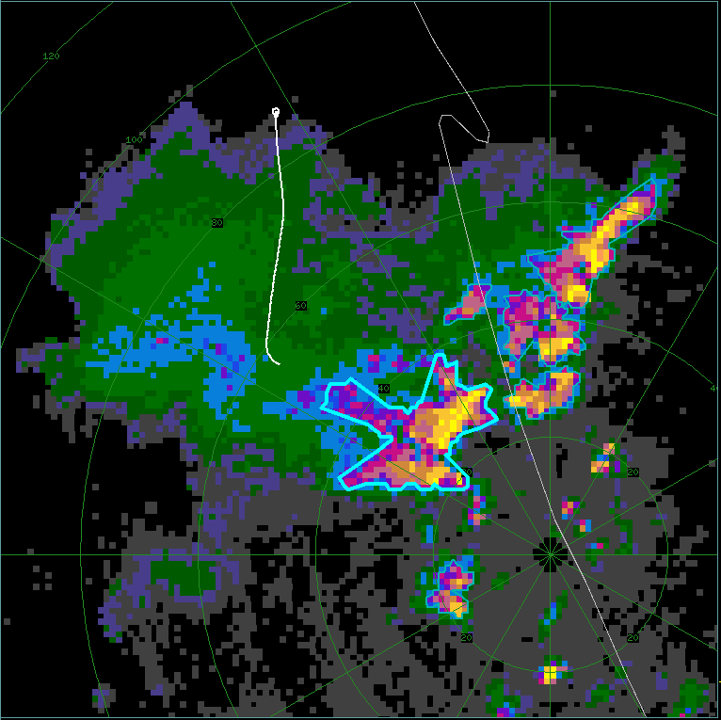
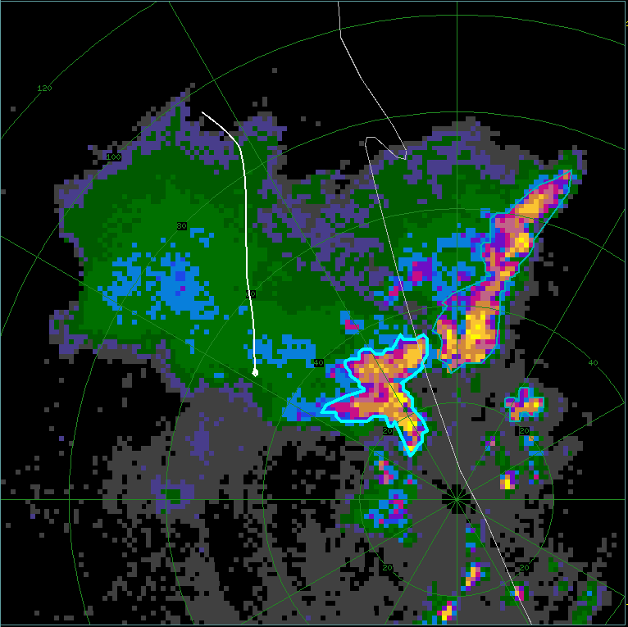
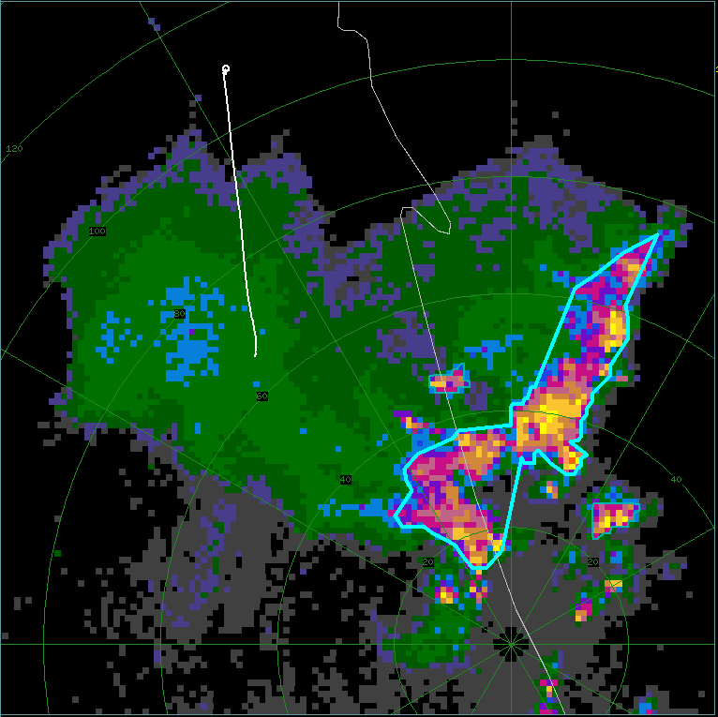
(a) – FL1: 15:51:15 - 16:01:00 UTC
(b) – FL2: 16:02:00 - 16:07:00 UTC
Omit FL5
KMLB: 15:56:16 UTC
KMLB: 16:07:52 UTC
(c) – FL3: 16:09:00 - 16:17:00 UTC
(d) – FL4: 16:21:30 - 16:27:00 UTC
KMLB: 16:19:25 UTC
KMLB: 16:28:16 UTC

Slide 7
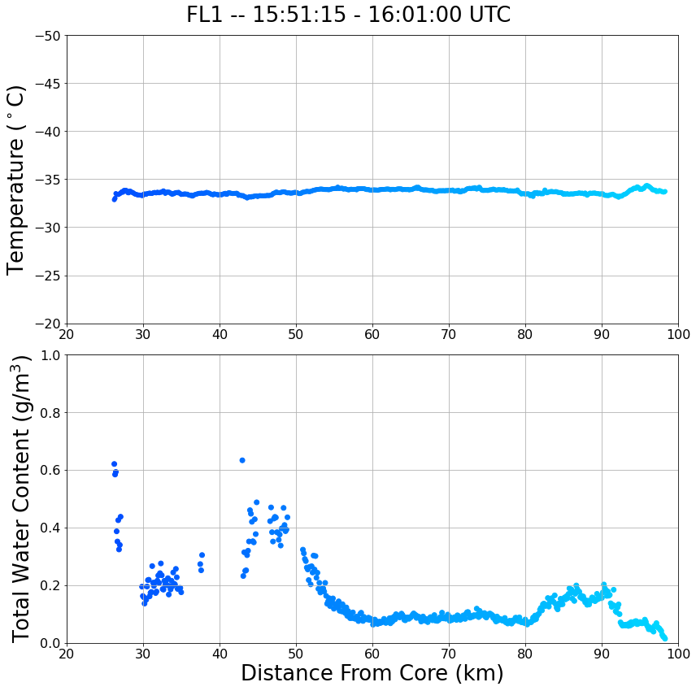
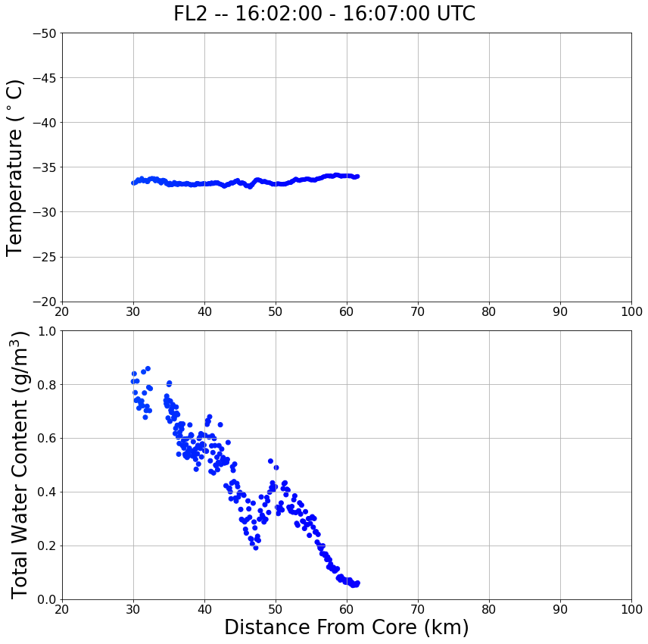
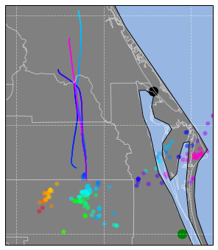
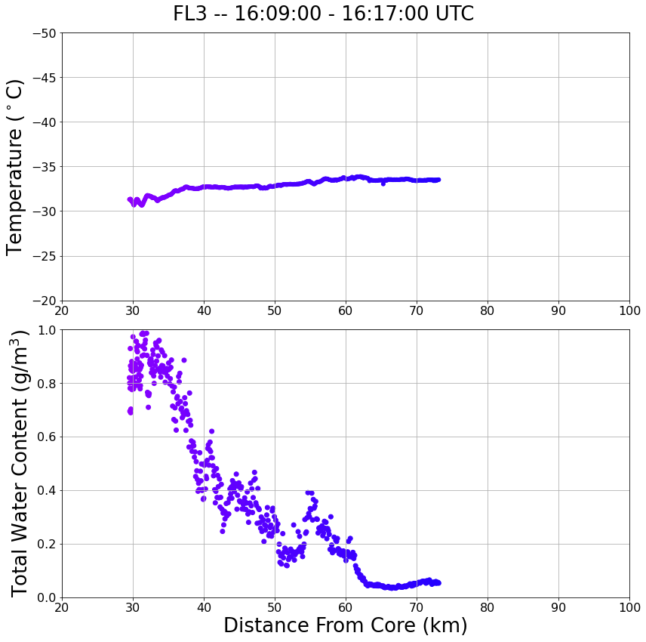
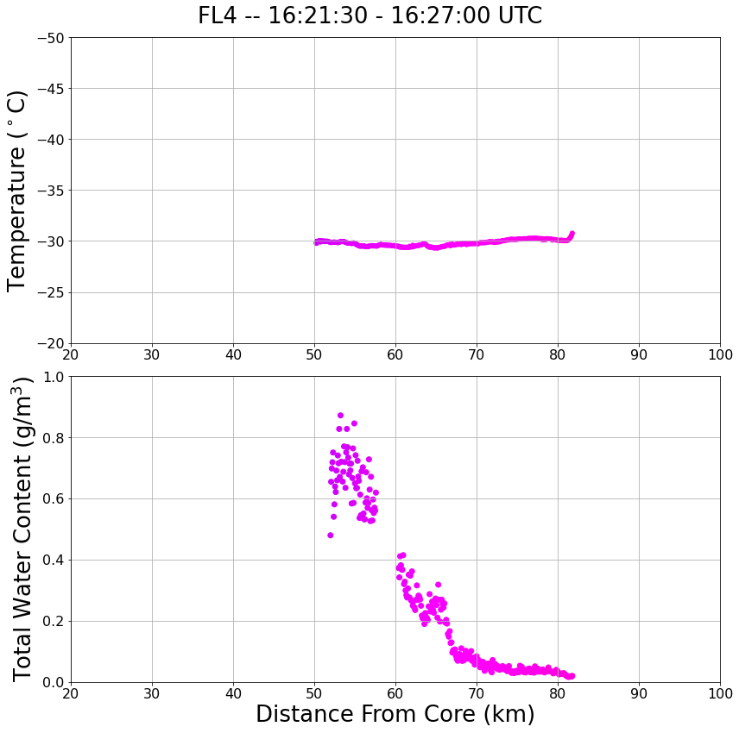
20 km
FL4
FL2
S
N
S
N
FL1
FL3
S
N
SR-Anvil Wind Direction
S
N

Slide 8
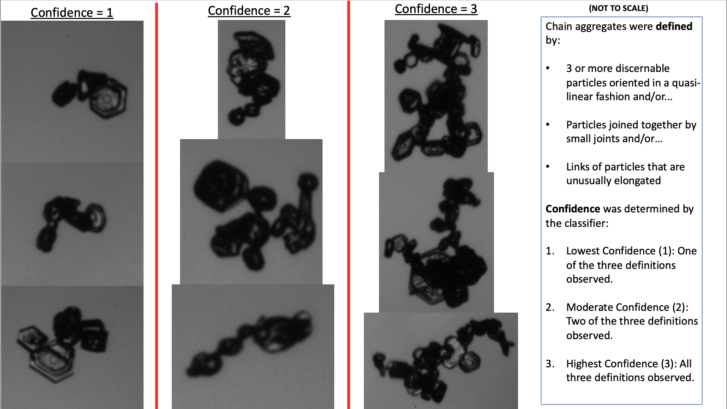

Slide 9
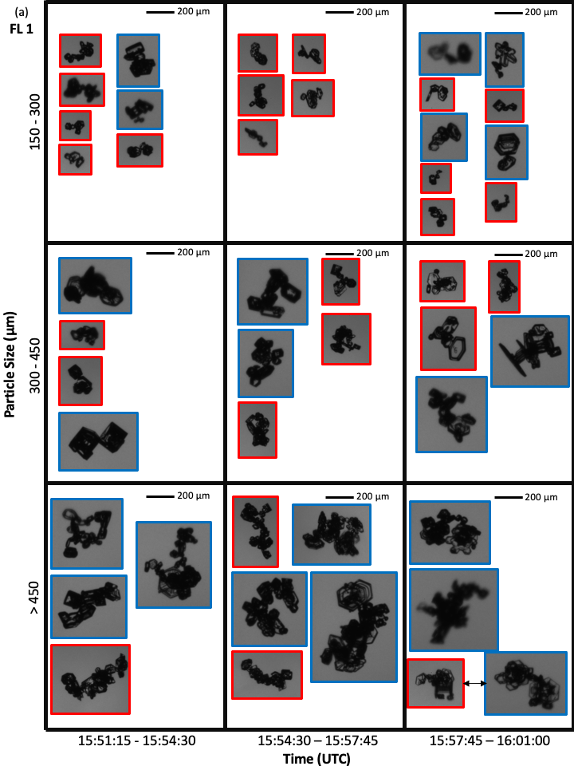
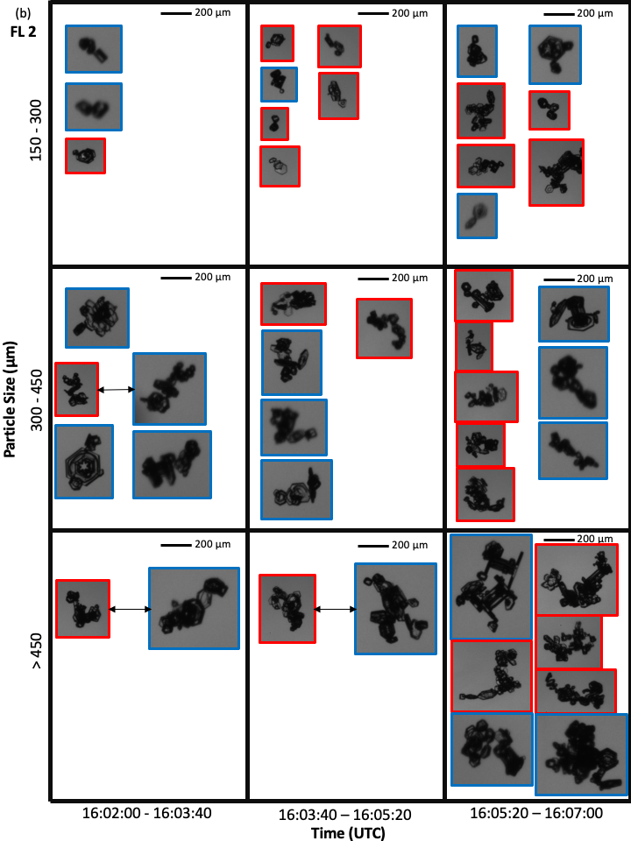

Slide 10
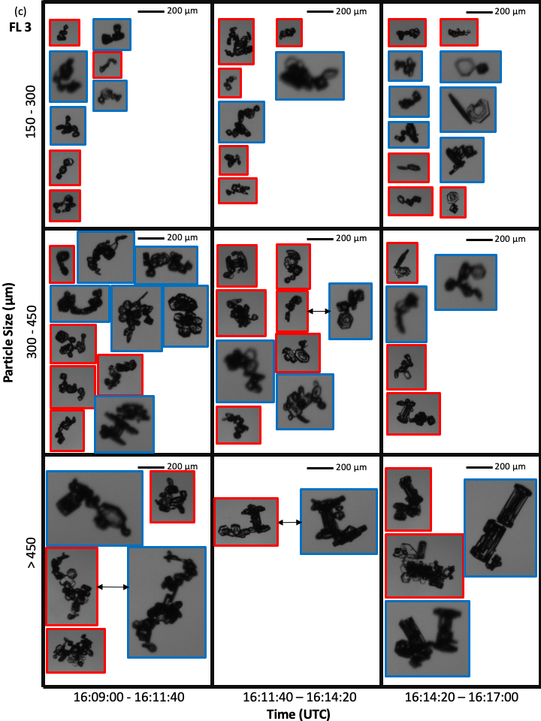
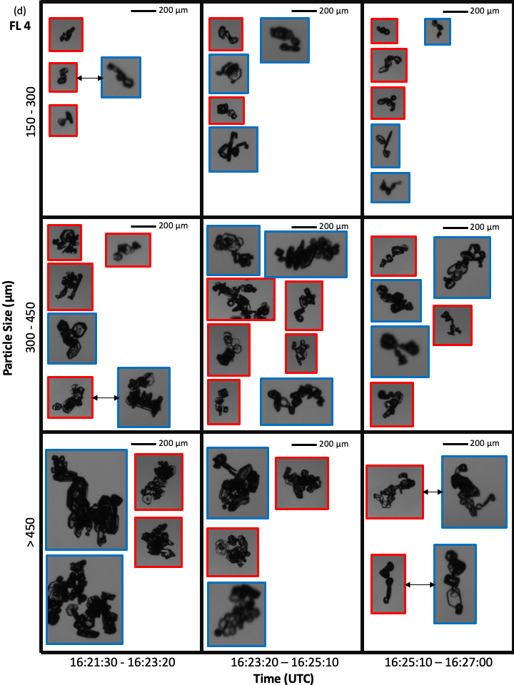

Slide 11
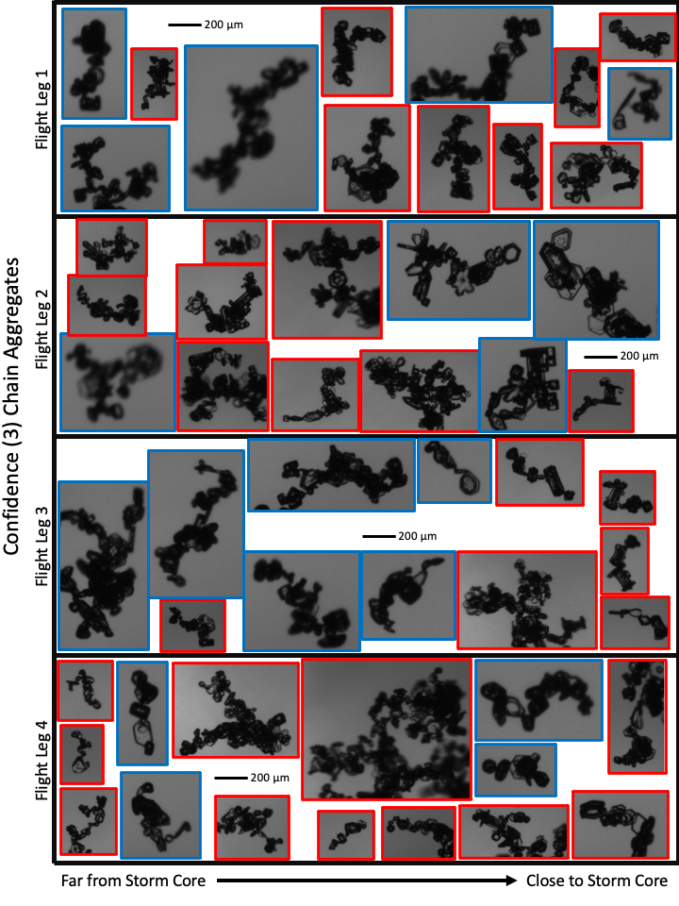

Slide 12
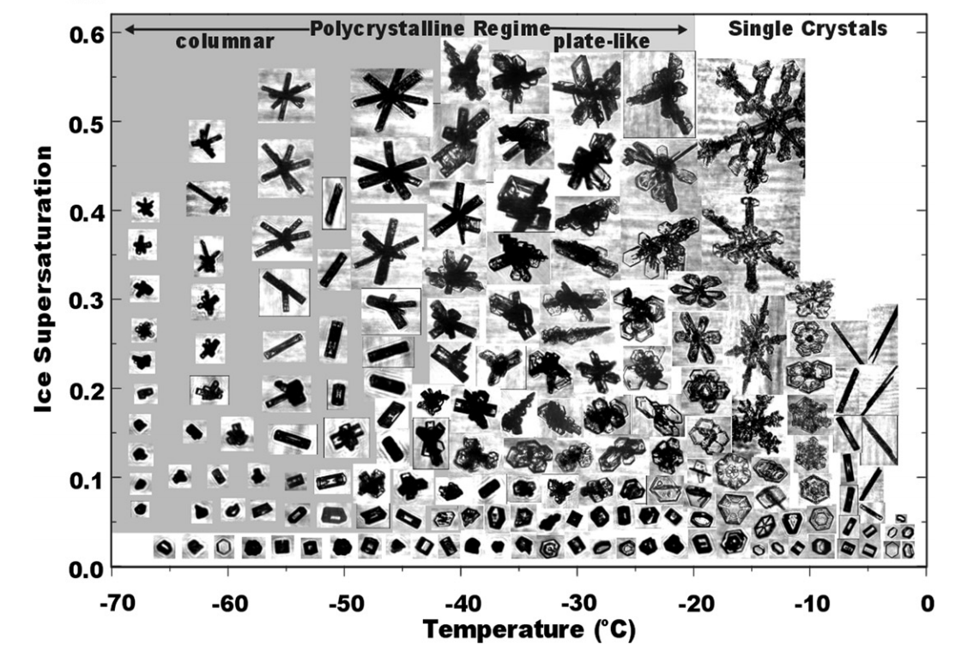

Slide 13
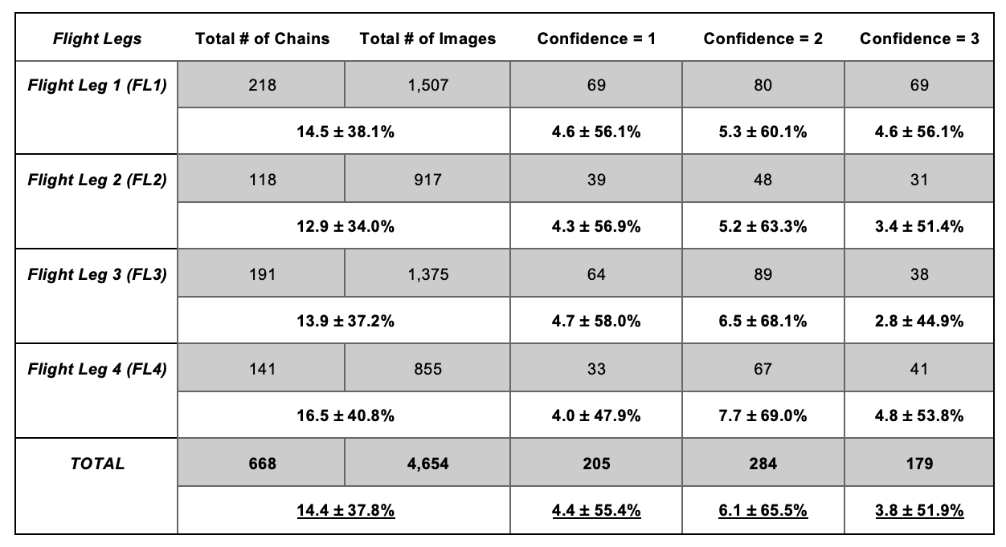

Slide 14
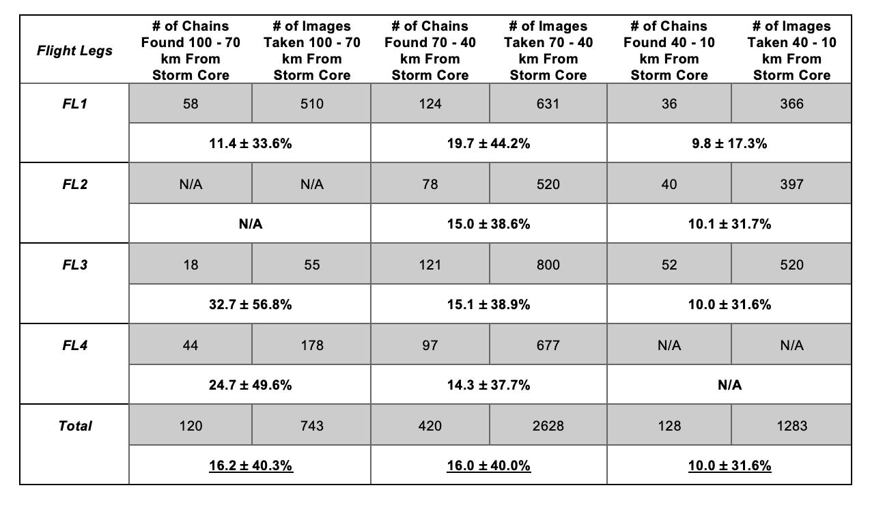

Slide 15
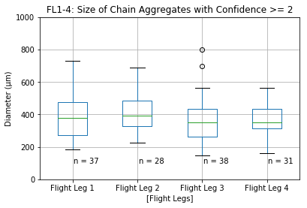
Using ‘all in’ PHIPS images

Slide 16
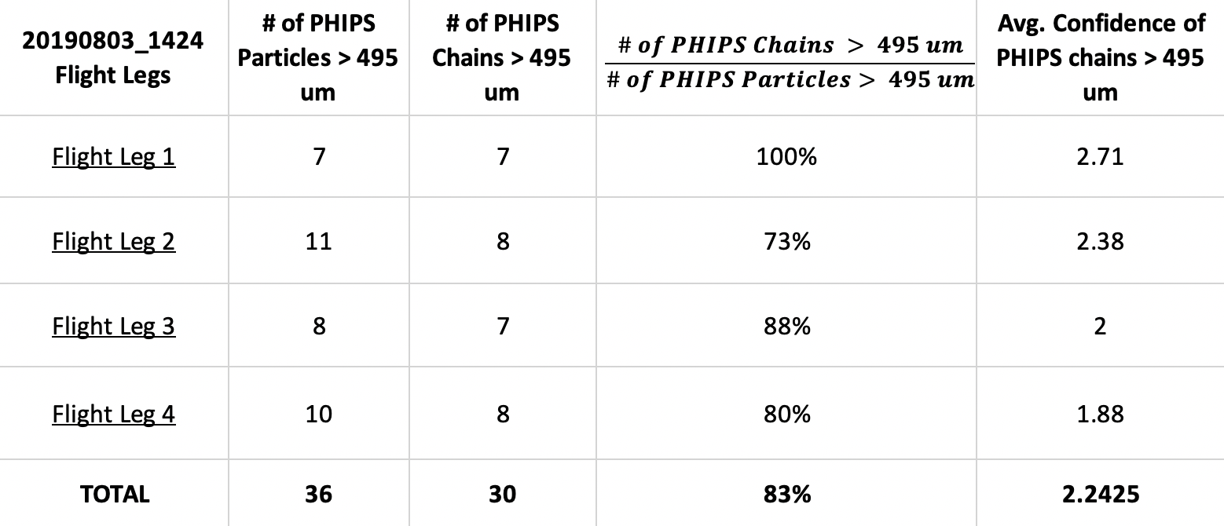
A high percentage (83%) of the PHIPS images that contained particles > 495 micro-meters were chain aggregates (with moderate-to-high confidence.
Thus, we can look at the CIP data (which has a higher sampling volume than the PHIPS) and pull the concentration of
particles > 495 micro-meters.

Slide 17
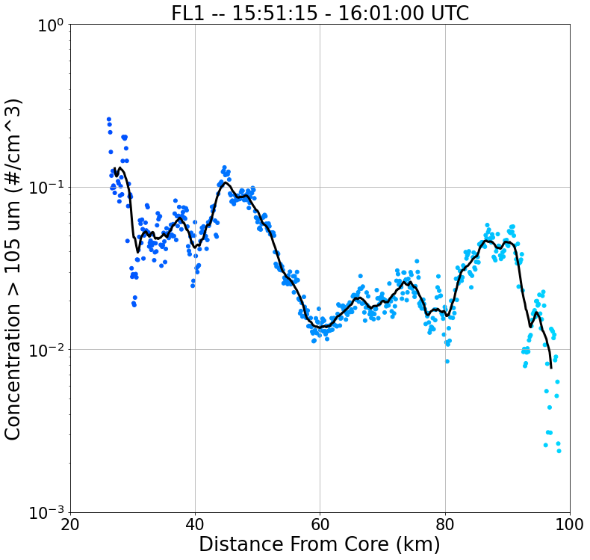
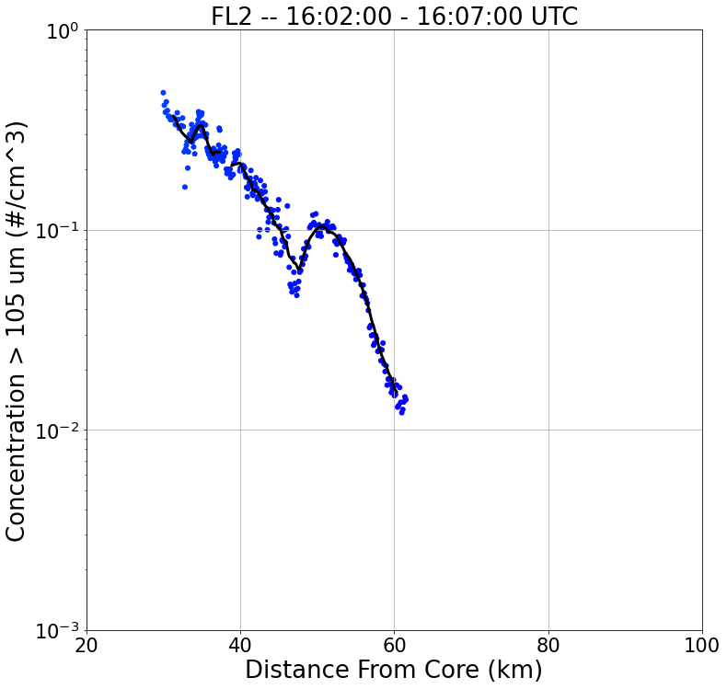
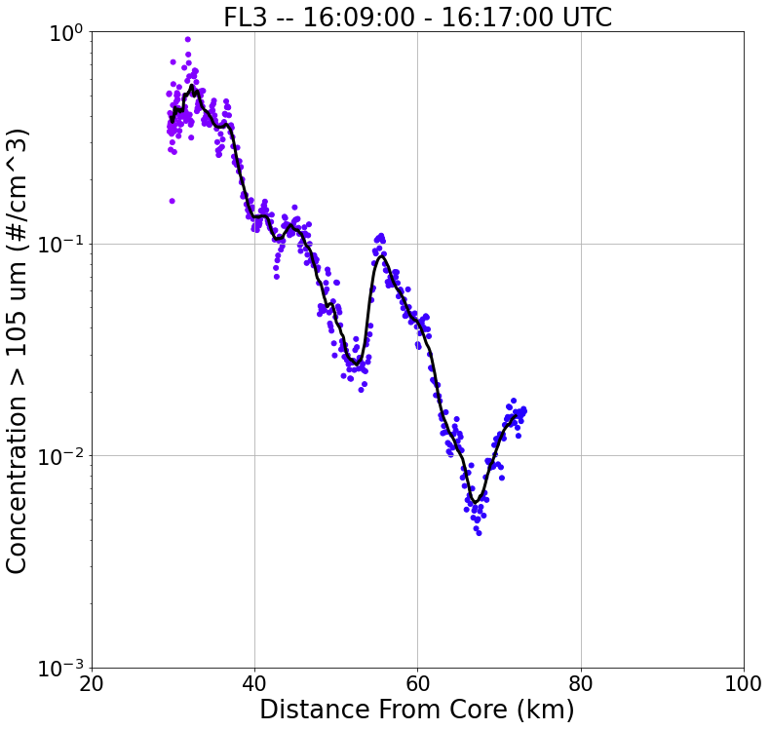
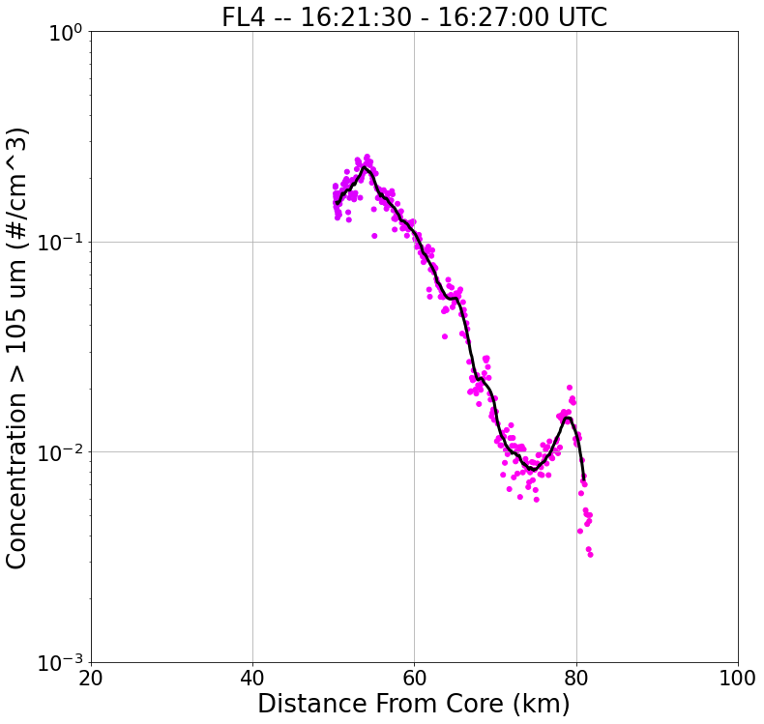
20 km
FL4
FL2
S
N
S
N
FL1
FL3
S
N
SR-Anvil Wind Direction
S
N

Slide 18
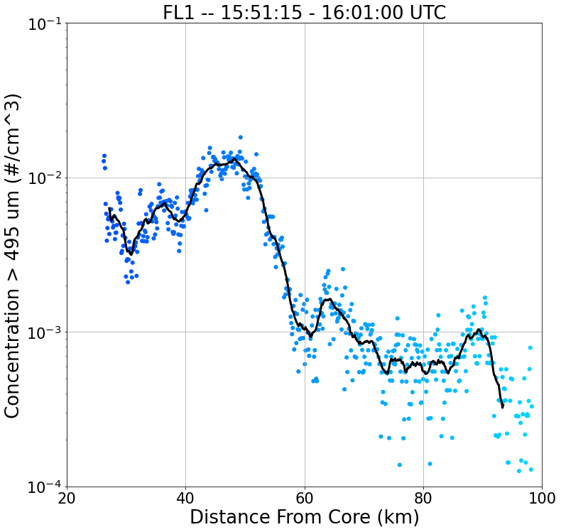
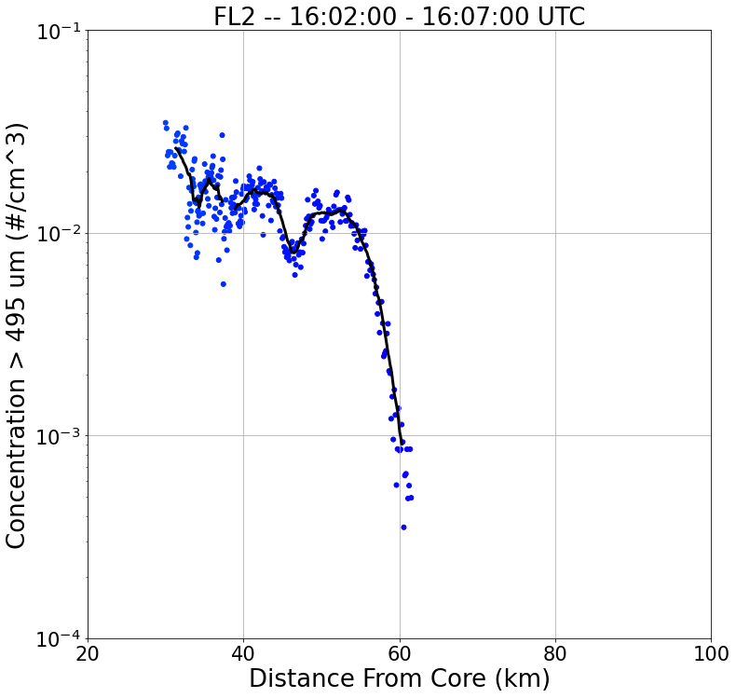
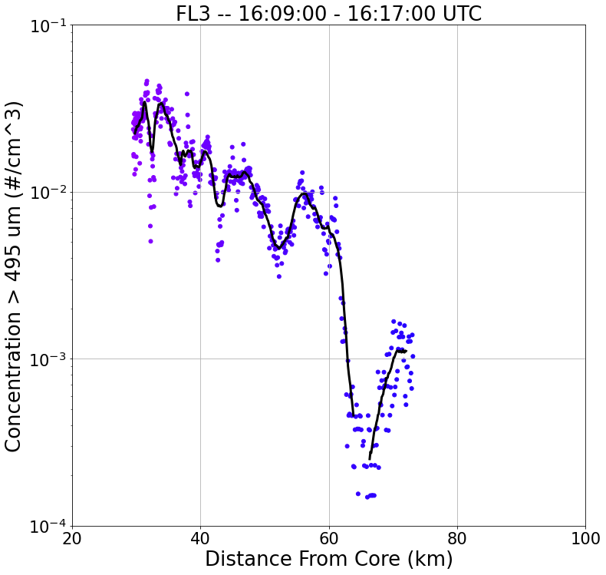
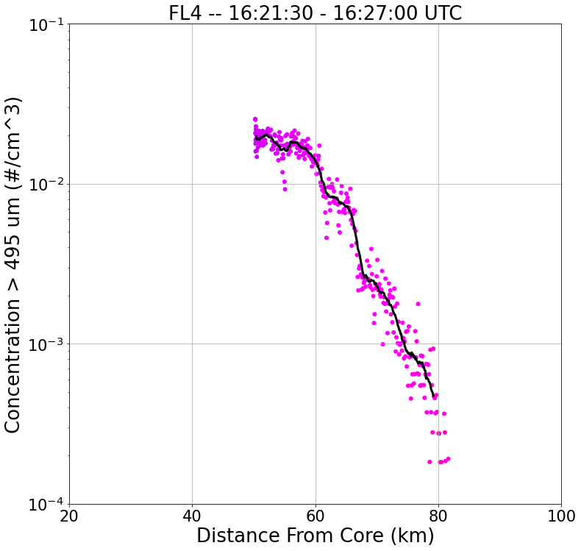
20 km
FL4
FL2
S
N
S
N
FL1
FL3
S
N
SR-Anvil Wind Direction
S
N

Slide 19
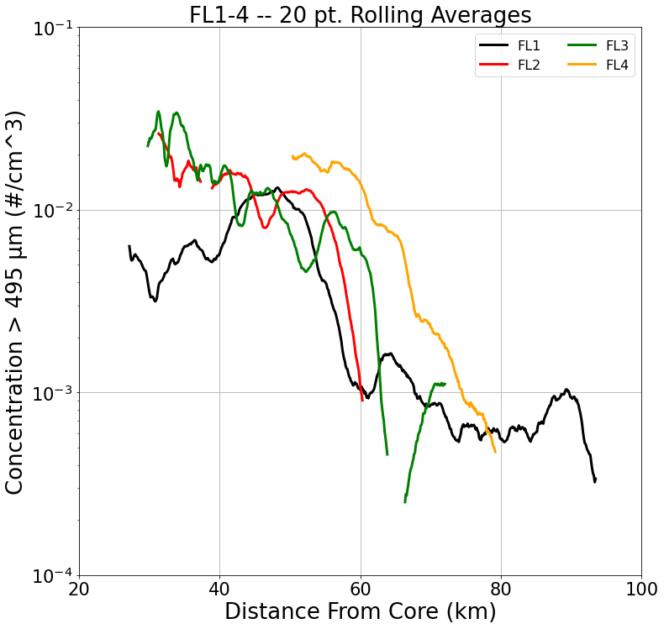

Slide 20
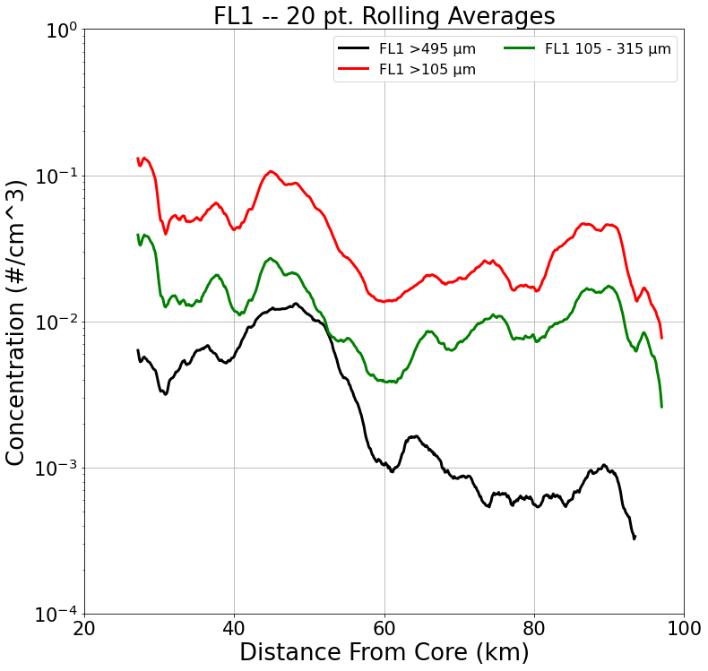
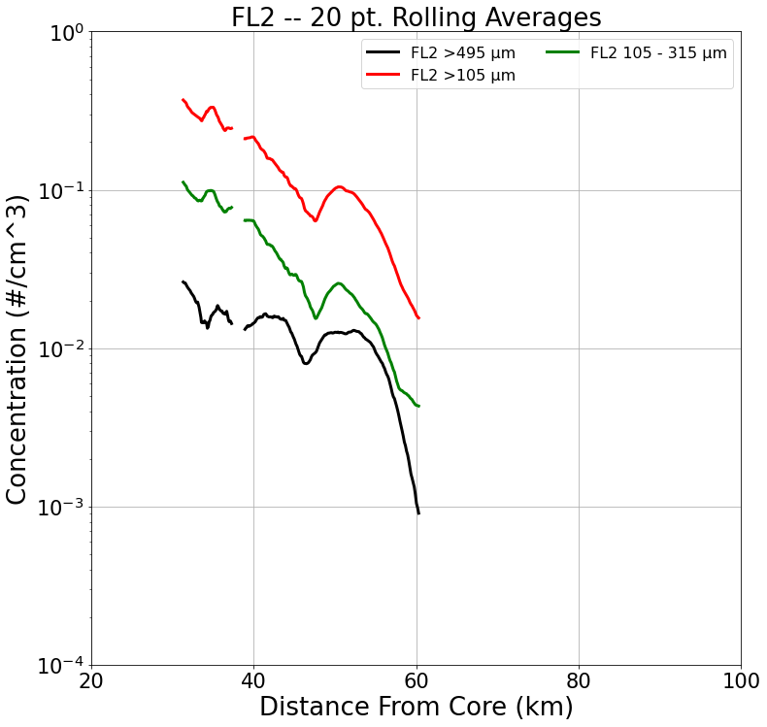
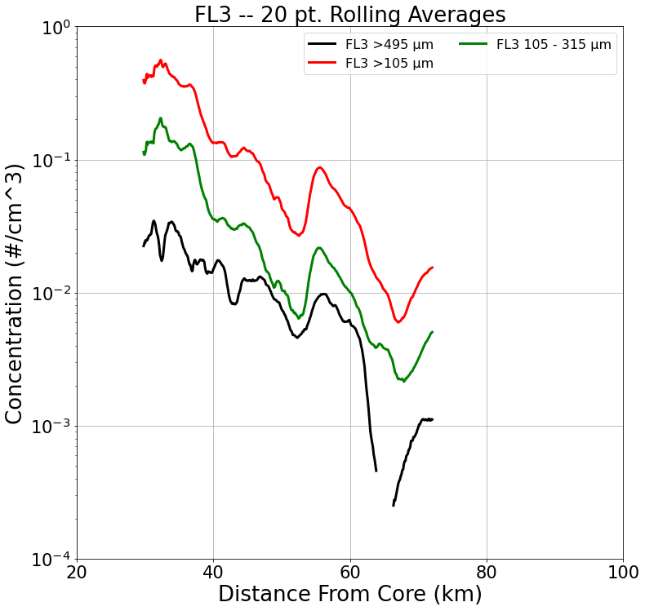
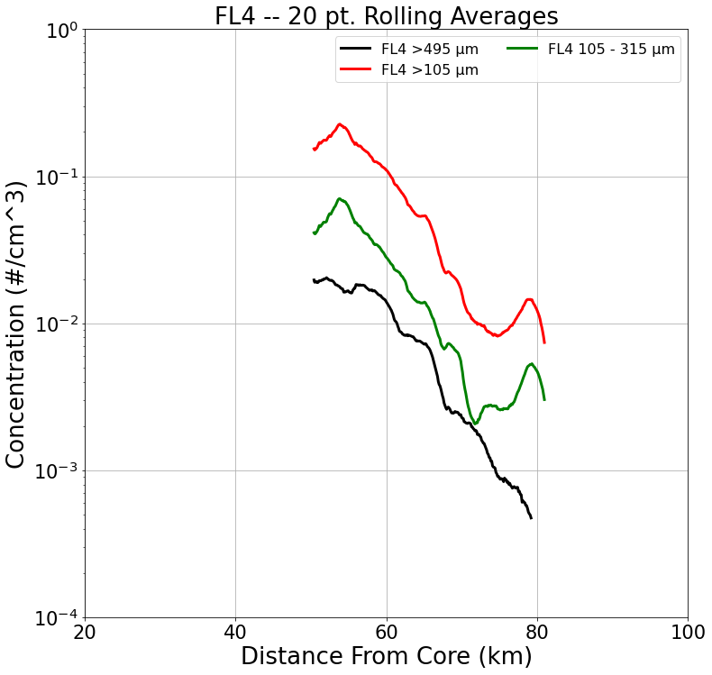
S
N
S
N
S
N
S
N

Slide 21
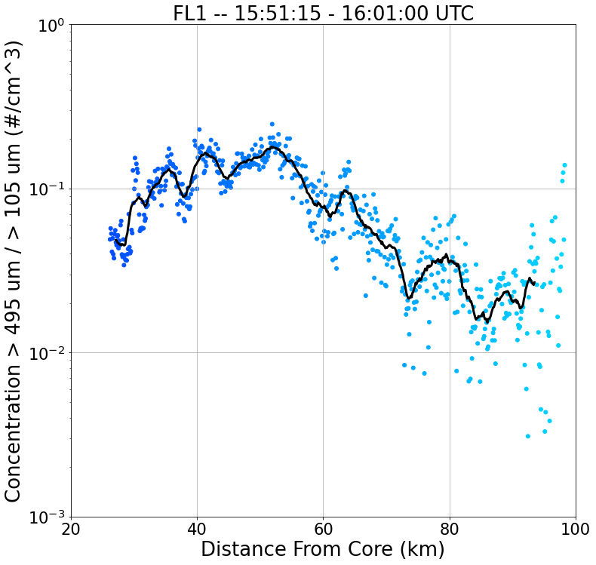
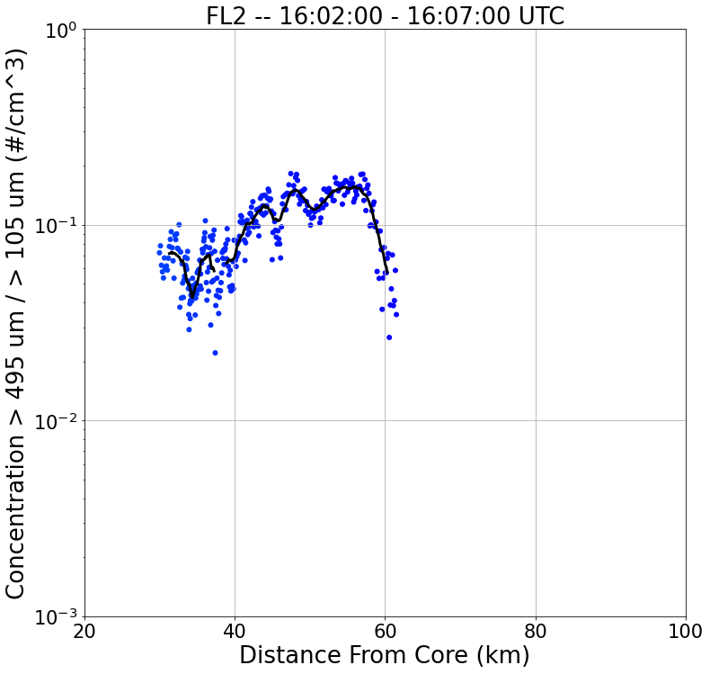
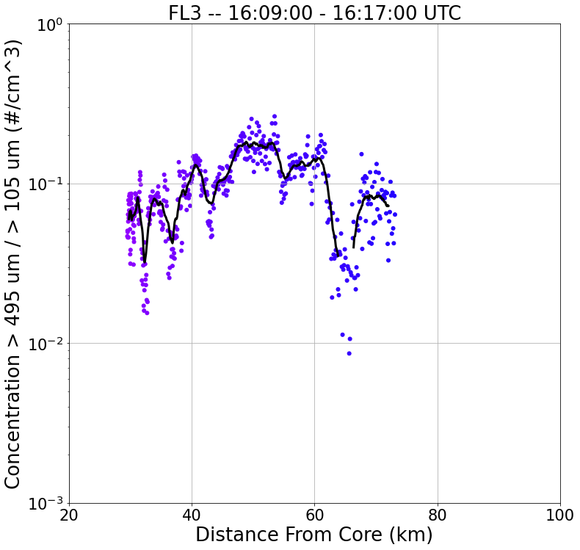
20 km
FL4
FL2
S
N
S
N
FL1
FL3
S
N
SR-Anvil Wind Direction
S
N

Slide 22
20 km
FL4
FL2
S
N
S
N
FL1
FL3
S
N
SR-Anvil Wind Direction
S
N

Slide 23
20 km
FL4
FL2
S
N
S
N
FL1
FL3
S
N
SR-Anvil Wind Direction
S
N

Slide 24
S
N
S
N
S
N
S
N

Slide 26
ELECTRIC FIELD DATA

Slide 27
Flight Legs | Time [UTC] | Ex - Range [kV/m] | Ex - Mean [kV/m] | Ey - Range [kV/m] | Ey - Mean [kV/m] | Ez - Range [kV/m] | Ez - Mean [kV/m]
FL1 | 15:51:15 - 16:01:00 | [-4.01, 0.17] | -0.89 | [-0.16, 8.04] | 0.93 | [-22.37, 1.50] | -0.87
FL2 | 16:02:00 - 16:07:00 | [-5.63, 1.52] | -1.96 | [-4.93, 6.42] | 0.78 | [-11.22, 5.53] | -1.76
FL3 | 16:09:00 - 16:17:00 | [-6.59, -0.21] | -2.95 | [-3.43, 6.67] | 1.05 | [-4.70, 10.80] | 1.15
FL4 | 16:21:30 - 16:27:00 | [-4.86, -0.40] | -2.36 | [-5.86, 4.28] | -0.11 | [-0.58, 6.15] | 0.68

Slide 28
20 km
FL4
FL2
S
N
S
N
FL1
FL3
S
N
SR-Anvil Wind Direction
S
N

Slide 29
(a)
FL1 – 15:51:15 – 16:01:00 UTC
(b)
FL2 – 16:02:00 – 16:07:00 UTC
(c)
FL3 – 16:09:00 – 16:17:00 UTC
(d)
FL4 – 16:21:30 – 16:27:00 UTC

Slide 30
(a) – FL1: 15:51:15 - 16:01:00 UTC
KMLB: 15:56:16 UTC

Slide 31
(a)
(b)
(c)

Slide 32
Flight Leg 1 (FL1) 15:51:15 – 16:01:00

Slide 33
10
20
30
40
50
60
70
80
90
100
110
Distance (km)
Aircraft Flight Track & Direction
Flight Legs | Time Span (hh:mm:ss) UTC | Time Span (SFM) | Average Altitude (m) | Average Temperature (degrees C)
Flight Leg 1 | 15:50:00-16:01:00 | 57000-57659 | 10032 (+/- 10) | -33.65 (+/- 1)

Slide 34
Flight Leg 1: 15:50:00 – 16:01:00 UTC
10
20
30
40
50
60
70
80
90
Distance (km)
Aircraft Flight Track & Direction

Slide 35
Flight Leg 1 (FL1) 15:51:15 – 16:01:00
B
A

Slide 36
16
14
12
10
Altitude (km)
8
6
4
2
A
B

Slide 37
Flight Leg 1 (FL1) 15:51:15 – 16:01:00 KMLB Vol Scan: 15:50:30 10 km CAPPI
B
A

Slide 38
16
14
12
10
Altitude (km)
8
6
4
2
A
B

Slide 39
16
14
12
10
Altitude (km)
8
6
4
2
A
B

Slide 40
Flight Leg 1 (FL1) 15:51:15 – 16:01:00 KMLB Vol Scan: 15:56:16 10 km CAPPI
B
A

Slide 41
16
14
12
10
Altitude (km)
8
6
4
2
A
B

Slide 42
16
14
12
10
Altitude (km)
8
6
4
2
A
B

Slide 43
Flight Leg 1 (FL1) 15:51:15 – 16:01:00 KMLB Vol Scan: 16:02:01 10 km CAPPI
B
A

Slide 44
16
14
12
10
Altitude (km)
8
6
4
2
A
B

Slide 45
16
14
12
10
Altitude (km)
8
6
4
2
A
B

Slide 46
Flight Leg 2 16:02:00 – 16:07:00 UTC

Slide 47
Flight Leg 2: 16:02:00 – 16:07:00 UTC
10
20
30
40
50
60
Distance (km)
Aircraft Flight Track & Direction

Slide 48
Flight Leg 3 (FL3) 16:09:00 – 16:17:00
Aircraft sampling farther
away from storm core but in the
same relative sampling locations as
Flight Leg 1.

Slide 49
10
20
30
40
50
60
70
Distance (km)
Aircraft Flight Track & Direction
Flight Legs | Time Span (hh:mm:ss) UTC | Time Span (SFM) | Average Altitude (m) | Average Temperature (degrees C)
Flight Leg 3 | 16:09:00-16:17:00 | 58140-58619 | 10032 (+/- 10) | -32.62 (+/- 1.5)

Slide 50
Flight Leg 3: 16:09:00 – 16:17:00 UTC
10
20
30
40
50
60
70
Distance (km)
Aircraft Flight Track & Direction

Slide 51
Flight Leg 4 16:21:30 – 16:27:00 UTC

Slide 52
Flight Leg 4: 16:21:30 – 16:27:00 UTC
10
20
30
40
50
60
70
80
Distance (km)
Aircraft Flight Track & Direction

Slide 53
Flight Leg 4: 16:21:30 – 16:27:00 UTC
10
20
30
40
50
60
70
80
Distance (km)
Aircraft Flight Track & Direction

Slide 54
B
A

Slide 55
16
14
12
10
Altitude (km)
8
6
4
2
A
B

Slide 56
Flight Leg 4 (FL4) 16:21:30 – 16:27:00 KMLB Vol Scan: 16:19:25 10 km CAPPI
B
A

Slide 57
16
14
12
10
Altitude (km)
8
6
4
2
A
B

Slide 58
16
14
12
10
Altitude (km)
8
6
4
2
A
B

Slide 59
Flight Leg 4 (FL4) 16:21:30 – 16:27:00 KMLB Vol Scan: 16:23:55 10 km CAPPI
B
A

Slide 60
16
14
12
10
Altitude (km)
8
6
4
2
A
B

Slide 61
16
14
12
10
Altitude (km)
8
6
4
2
A
B

Slide 62
Flight Leg 4 (FL4) 16:21:30 – 16:27:00 KMLB Vol Scan: 16:28:16 10 km CAPPI
B
A

Slide 63
16
14
12
10
Altitude (km)
8
6
4
2
A
B

Slide 64
16
14
12
10
Altitude (km)
8
6
4
2

Slide 65
Aircraft Flight Track
(Contamination)
N
S

Slide 66
Aircraft Flight Track
(Contamination)
S
N

Slide 67
Aircraft Flight Track
(Contamination)
N
S

Slide 68
Aircraft Flight Track
(Contamination)
S
N

Slide 72
(a) - - 15:40:00 – 15:50:00 UTC
(b) - - 15:50:00 – 16:00:00 UTC

Slide 73
16:01:43 UTC Lightning Event (KSCLMA)

