Slide 1
Committee Meeting
5 April 2022
Christian Nairy

Slide 2
Updates
Participated in the 2022 IMPACTS field campaign
Current writing and preparing for defense (this summer)

Slide 3
Latest data and Results

Slide 4
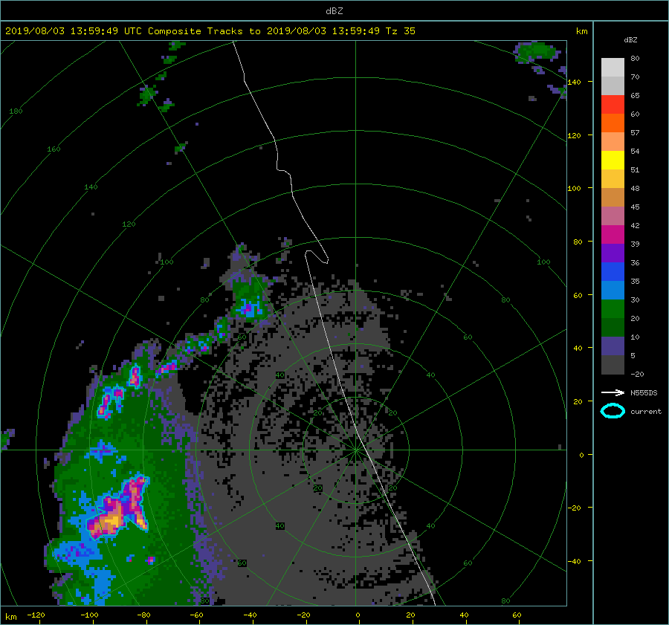

Slide 5
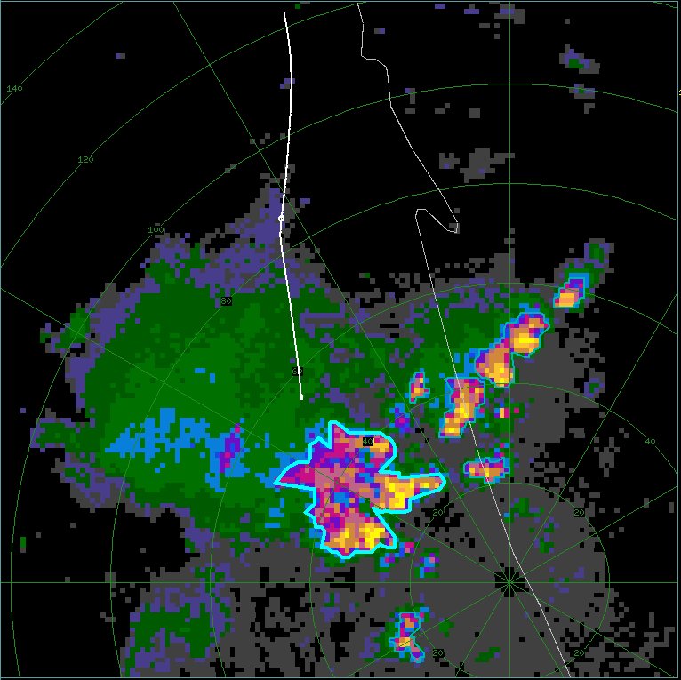
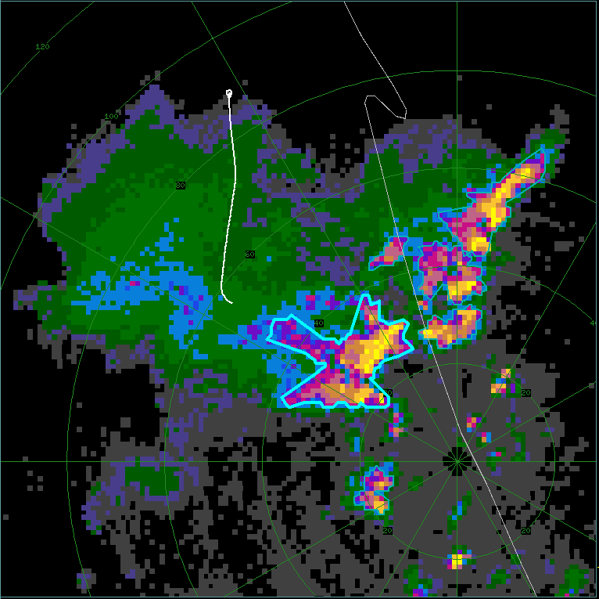
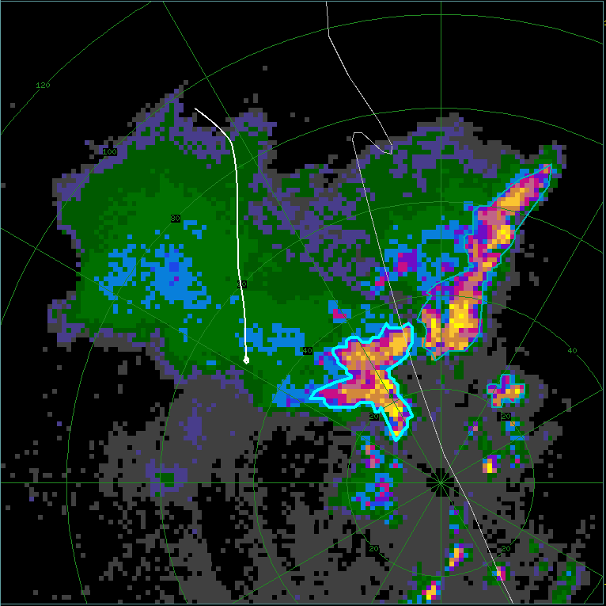
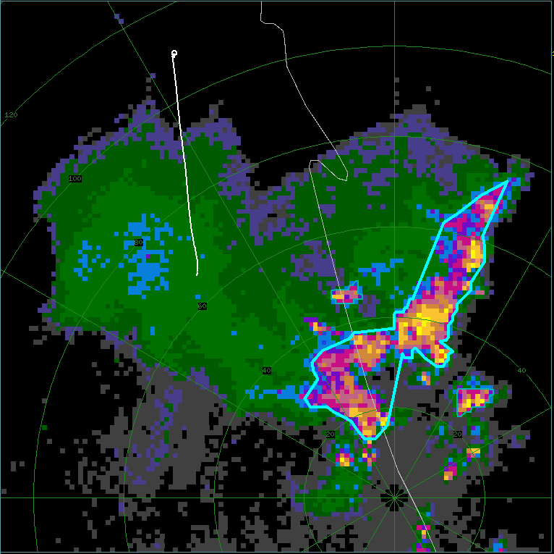
(a) – FL1: 15:51:15 - 16:01:00 UTC
(b) – FL2: 16:02:00 - 16:07:00 UTC
Omit FL5
KMLB: 15:56:16 UTC
KMLB: 16:07:52 UTC
(c) – FL3: 16:09:00 - 16:17:00 UTC
(d) – FL4: 16:21:30 - 16:27:00 UTC
KMLB: 16:19:25 UTC
KMLB: 16:28:16 UTC

Slide 6
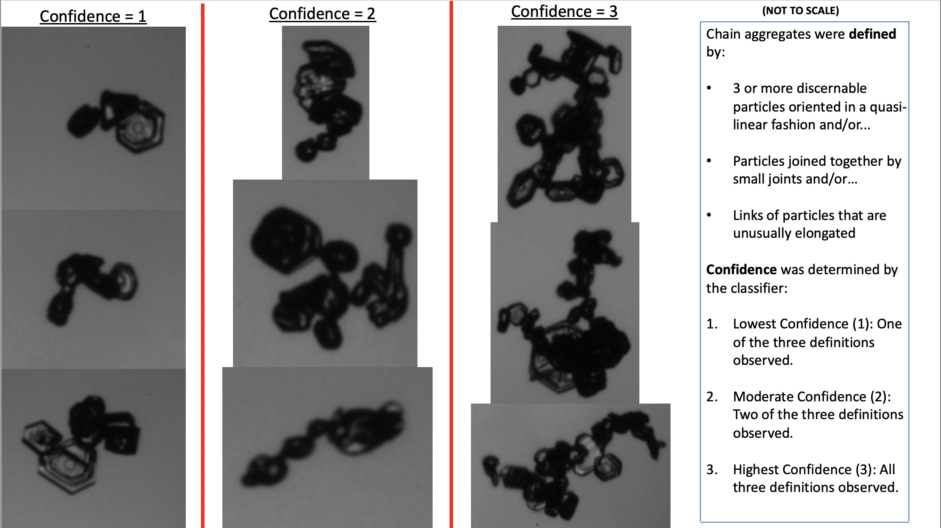

Slide 7
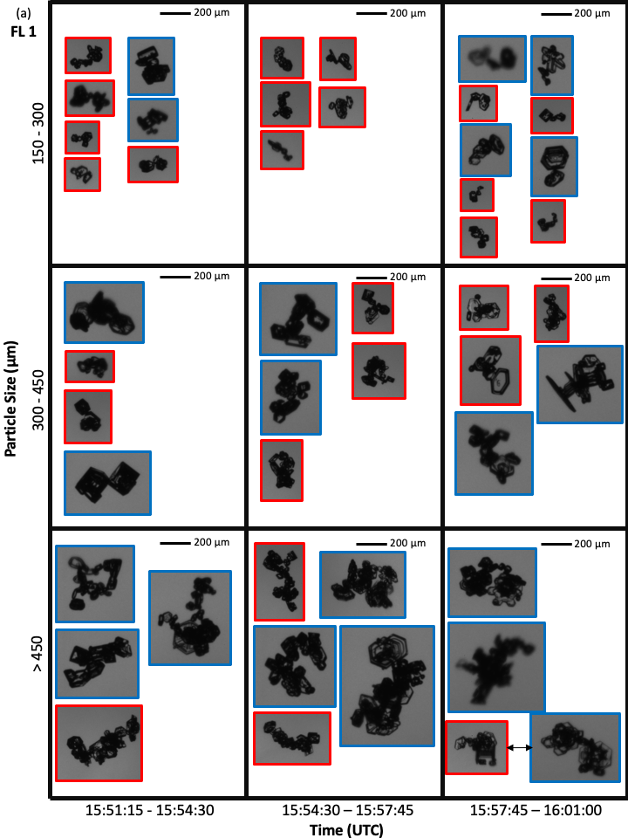
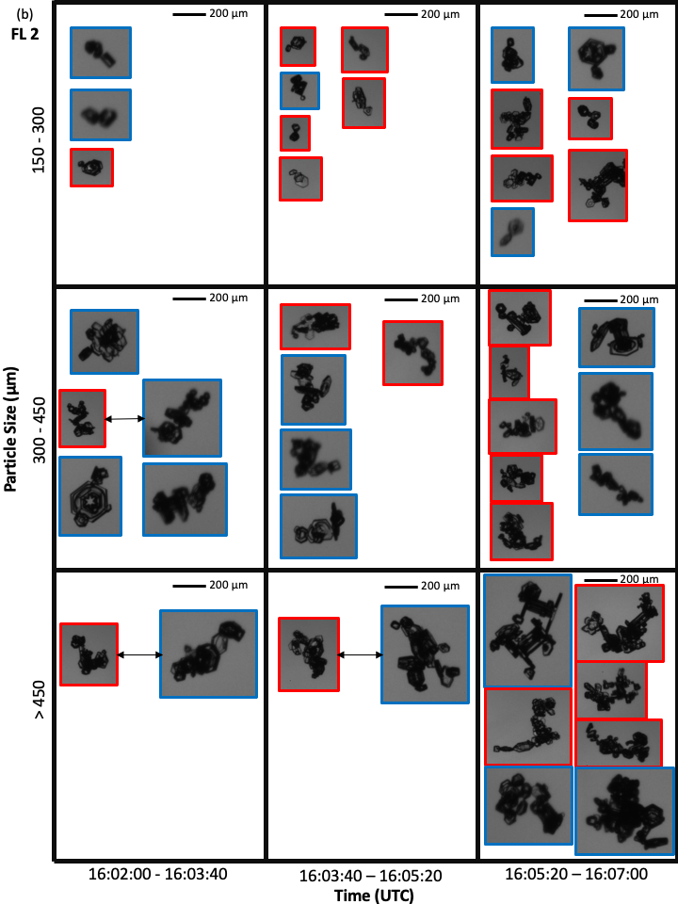

Slide 8
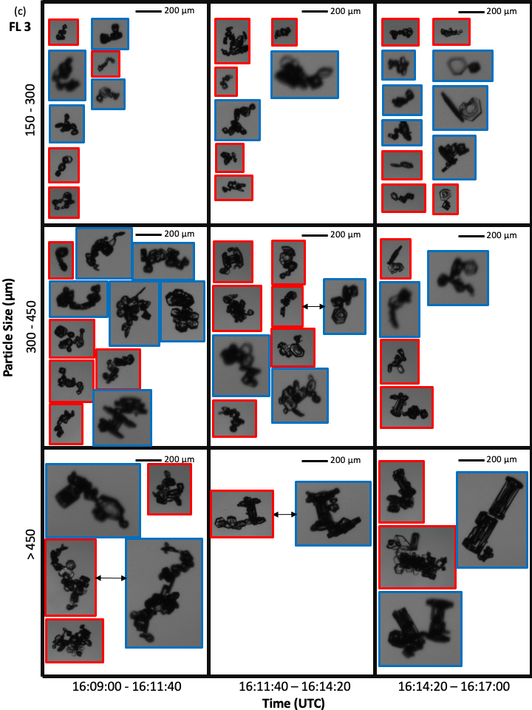
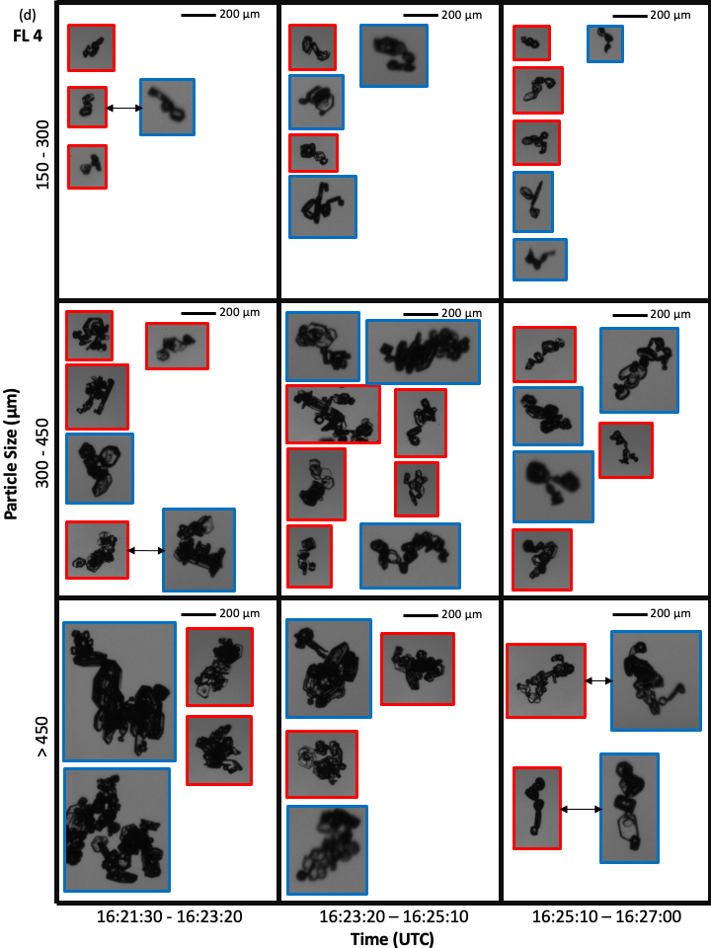

Slide 9
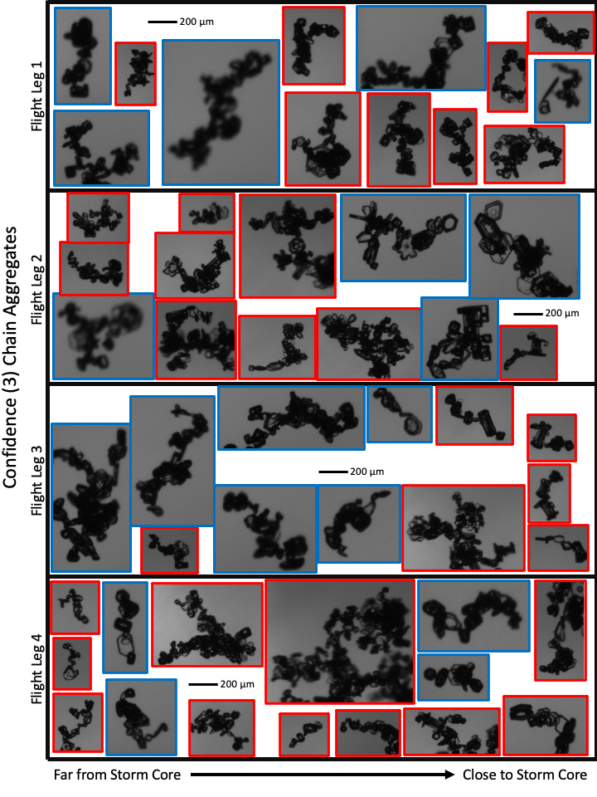

Slide 10
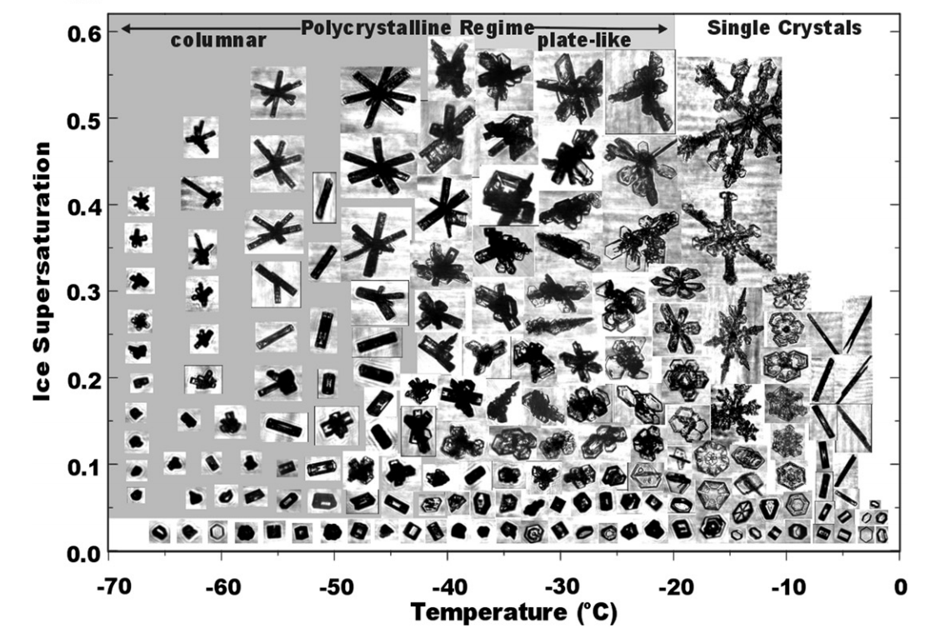

Slide 11
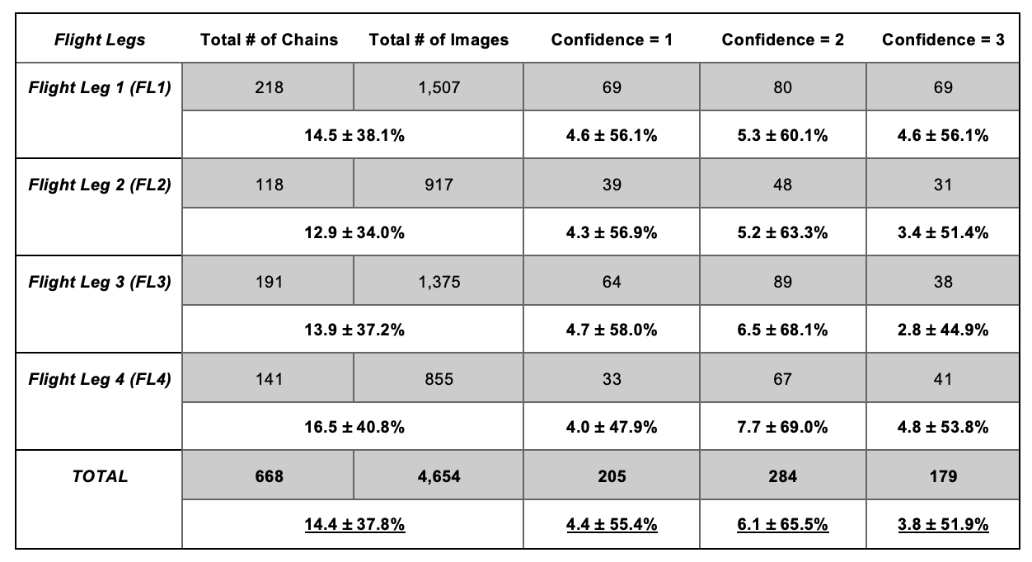

Slide 12
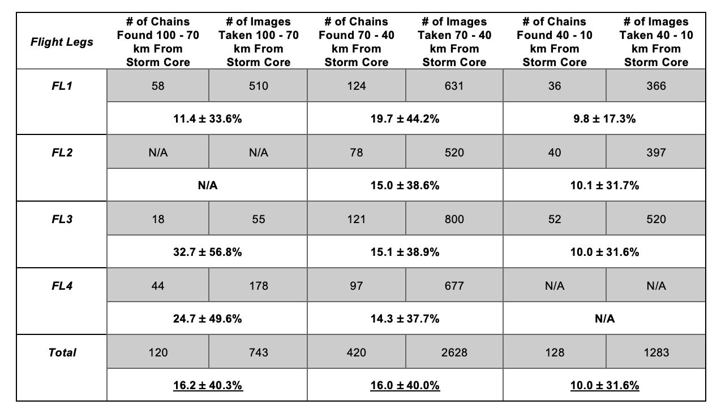

Slide 13
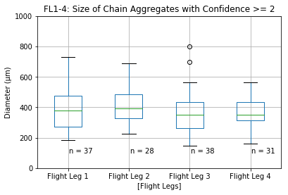
Using ‘all in’ PHIPS images

Slide 14
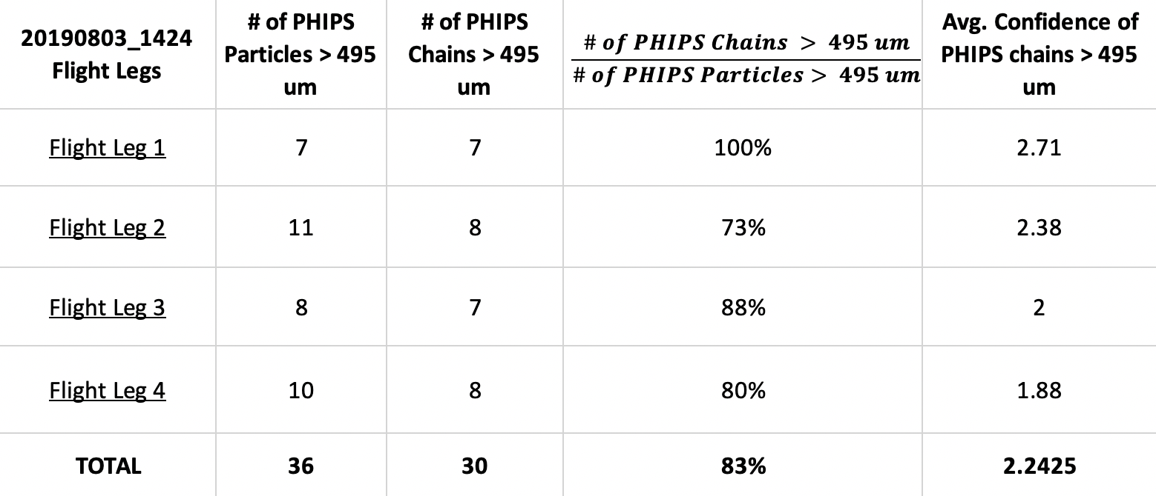
A high percentage (83%) of the PHIPS images that contained particles > 495 micro-meters were chain aggregates (with moderate-to-high confidence.
Thus, we can look at the CIP data (which has a higher sampling volume than the PHIPS) and pull the concentration of particles > 495 micro-meters.
Chain aggregates = CIP particle concentrations > 495 um; non-chain aggregates = CIP particle concentrations between 105 – 315 um; Particle buffer zone = CIP particle concentrations between 315 – 495 um.

Slide 15
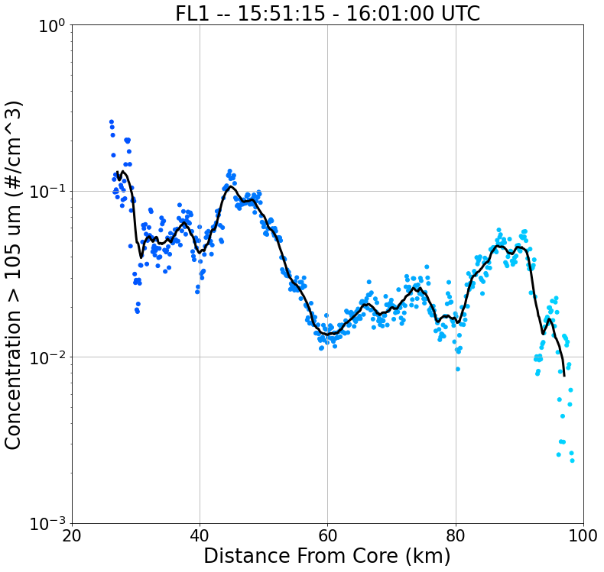
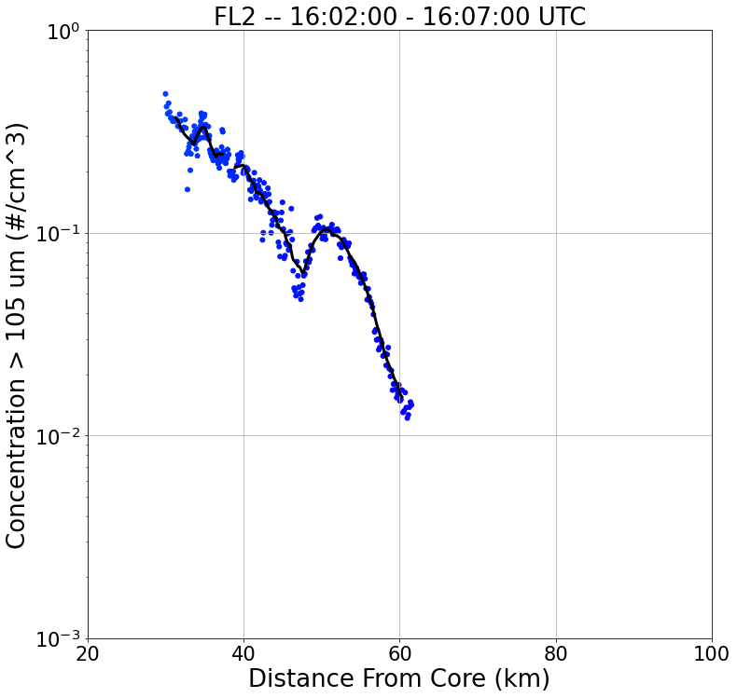
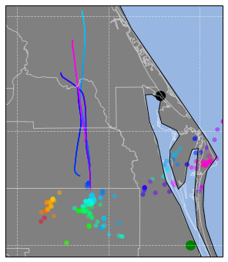
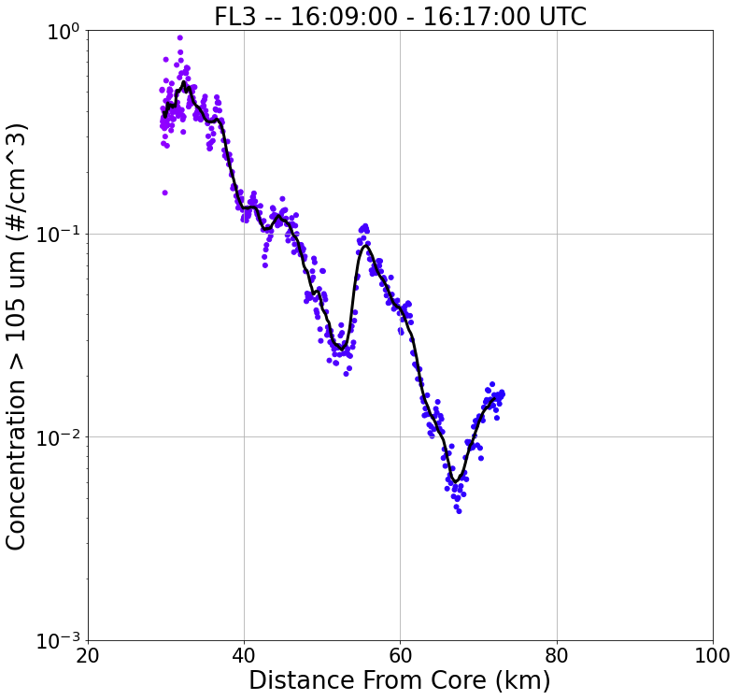
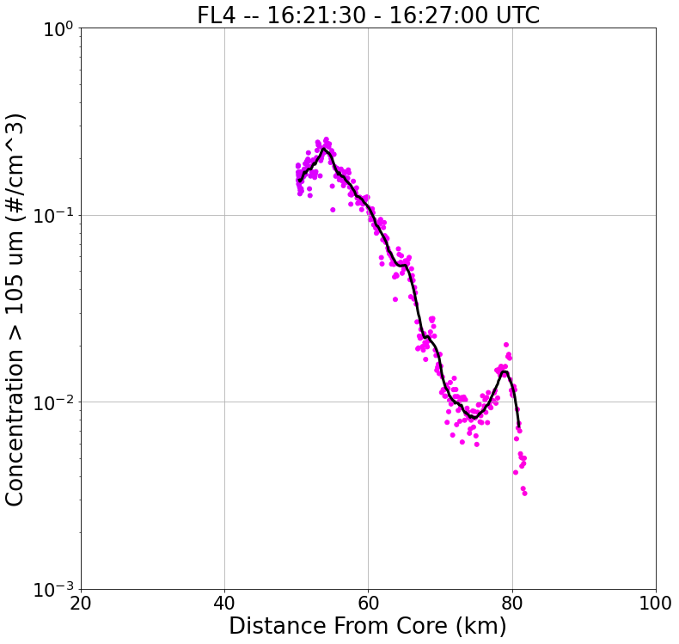
20 km
FL4
FL2
S
N
S
N
FL1
FL3
S
N
SR-Anvil Wind Direction
S
N

Slide 16
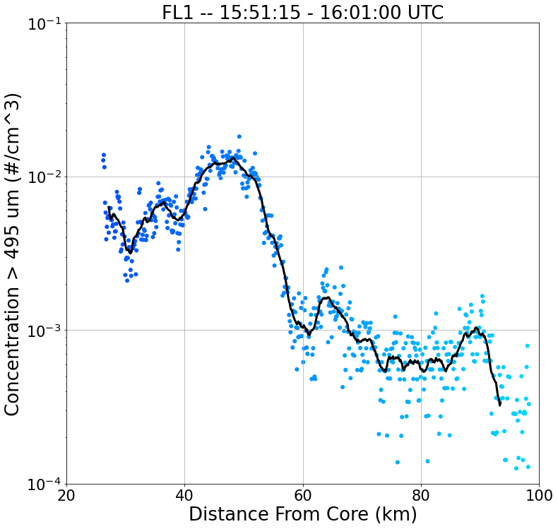
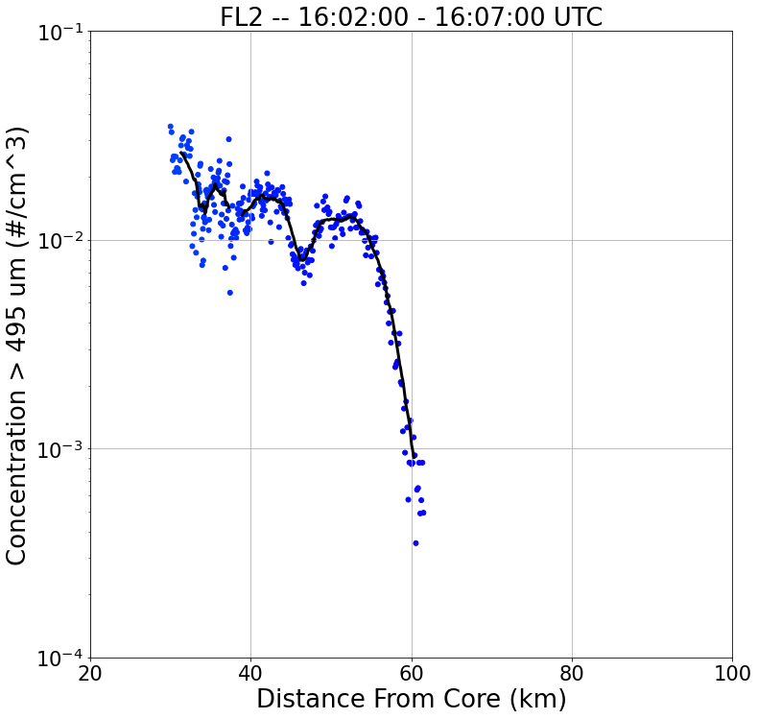
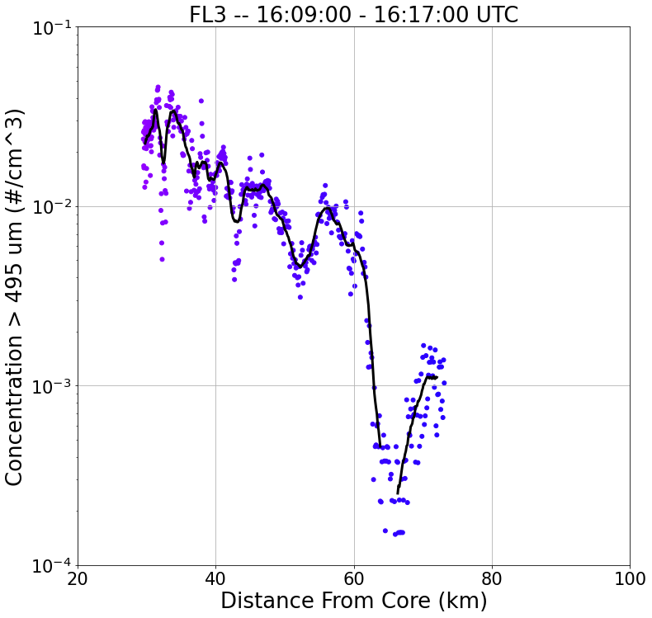
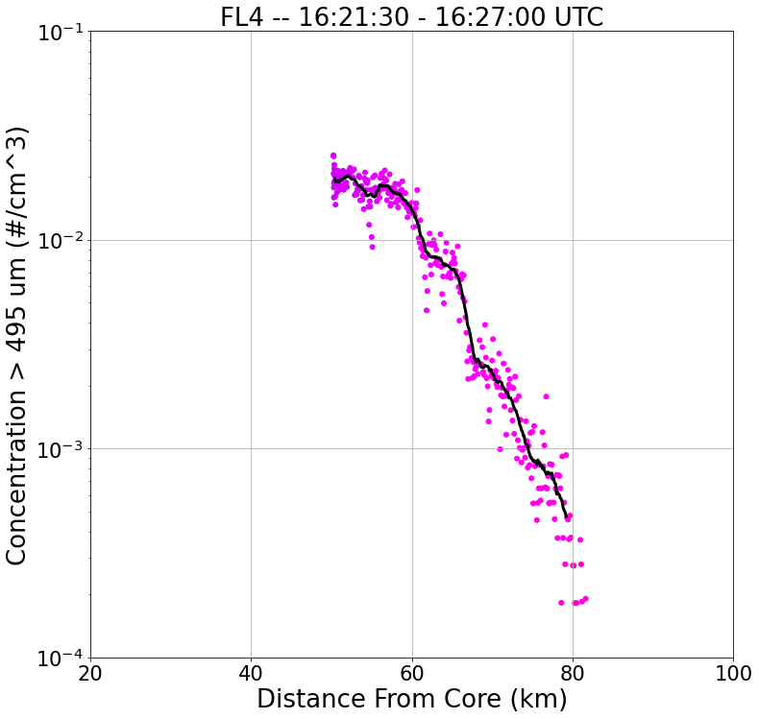
20 km
FL4
FL2
S
N
S
N
FL1
FL3
S
N
SR-Anvil Wind Direction
S
N

Slide 17
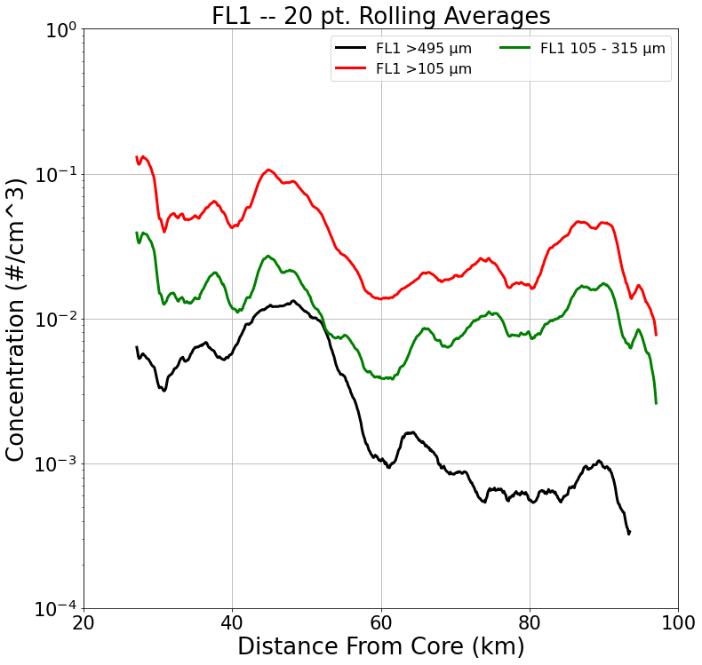
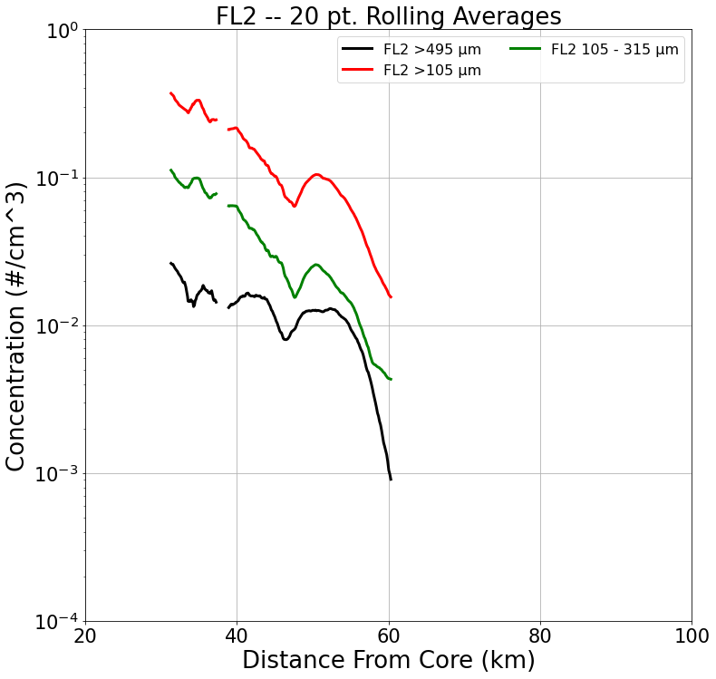
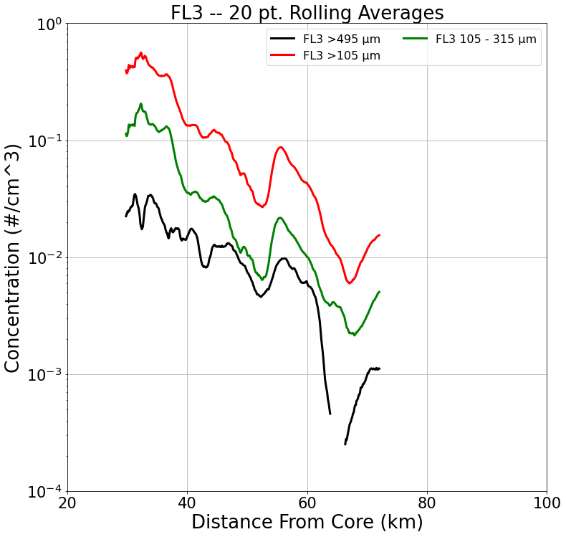
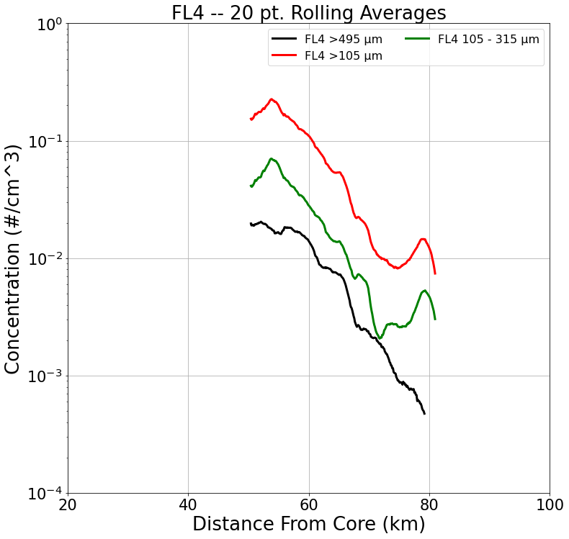
Convergence between the non-chain and chain Aggregate concentration (heading away from storm core
S
N
S
N
Direction of Flight
S
N
S
N

Slide 18
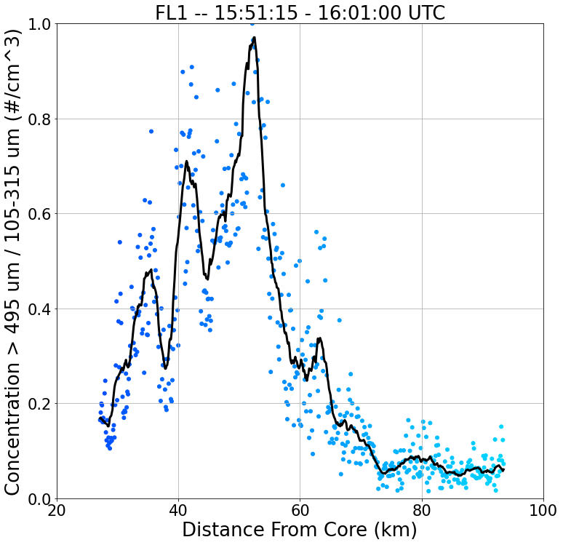
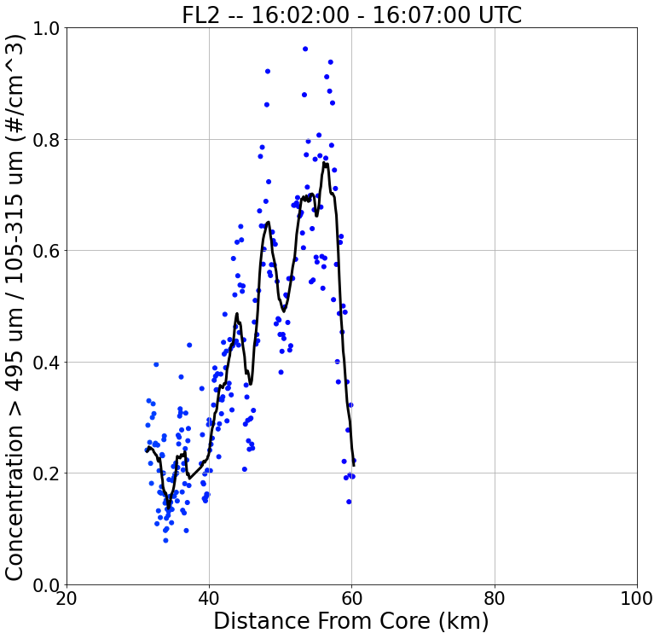
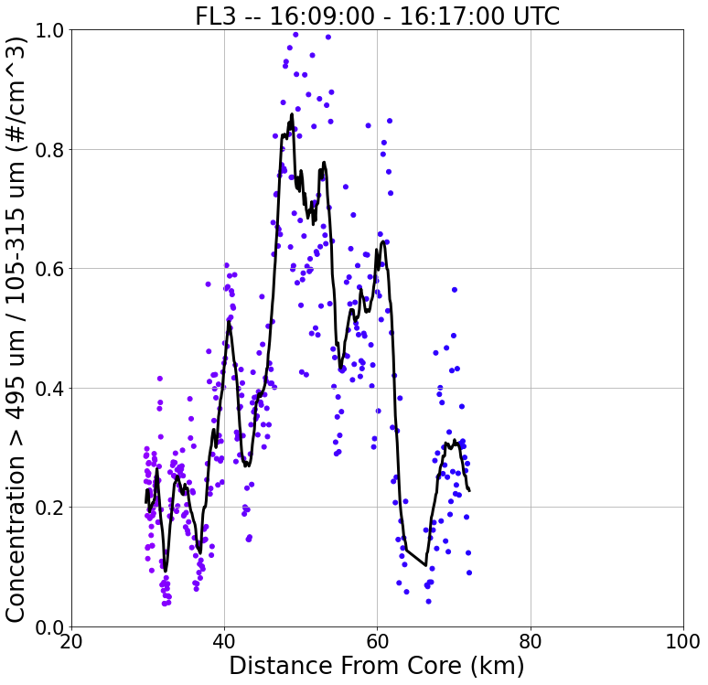
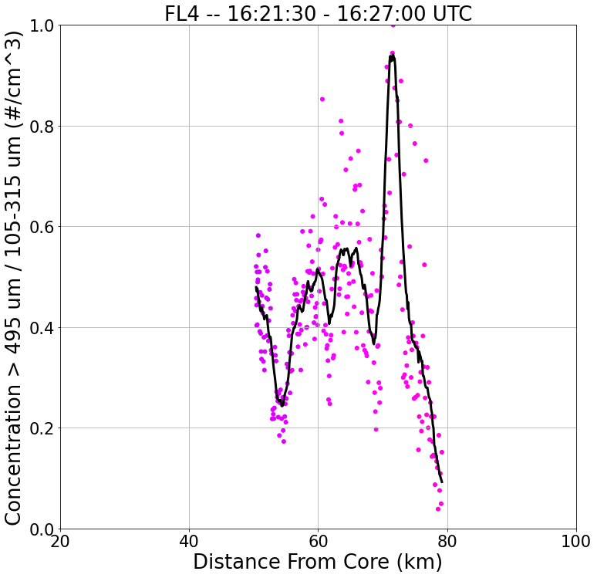
20 km
FL4
FL2
S
N
S
N
FL1
FL3
S
N
SR-Anvil Wind Direction
S
N

Slide 19
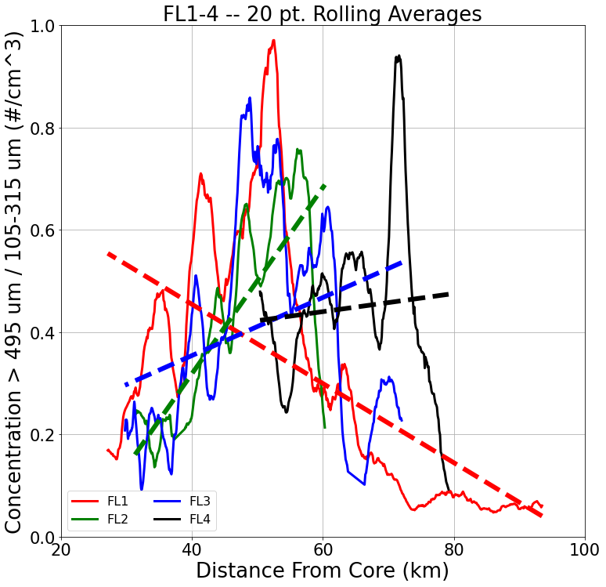
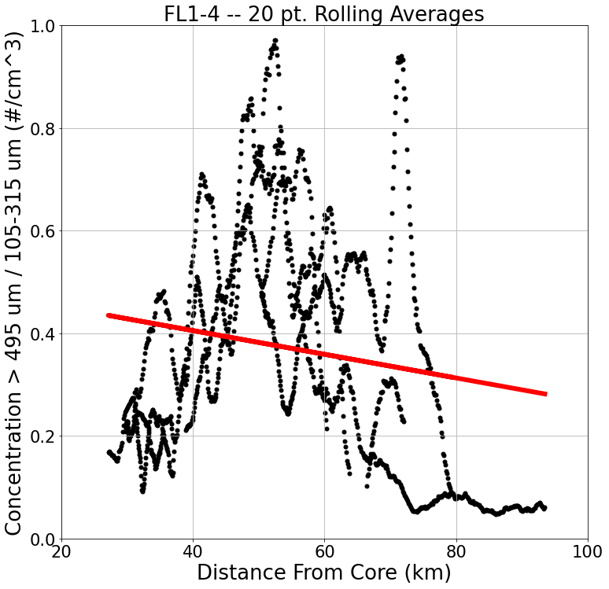

Slide 20
Summary/Discussion
While the general trend for chain and non-chain aggregate concentrations decrease with distance from core, when taking the ratio of the two parameters, there is an increase in the ratio heading away from the core (to a certain distance – varies per flight leg).
Also, the peaks in the ratio are never when the aircraft was closest to the core.
Periodicities in the data are observed.
Meaning, when the ratio value increases, either:
(1) There is a net increase in chains relative to the non-chains and/or …
(2) More of the non-chains are falling out, sublimating, and/or climbing within the cirrus anvil away from where the aircraft was sampling from and/or …
(3) The smaller particles are taking part in the chain aggregation process allowing for less smaller particles and more larger particles.
Or are the fluctuations in the particle sizes the product of storm convective growth and decay?

Slide 21
Flight Leg 1 (FL1) 15:51:15 – 16:01:00 KMLB Vol Scan: 16:02:01 10 km CAPPI
B
A

Slide 22
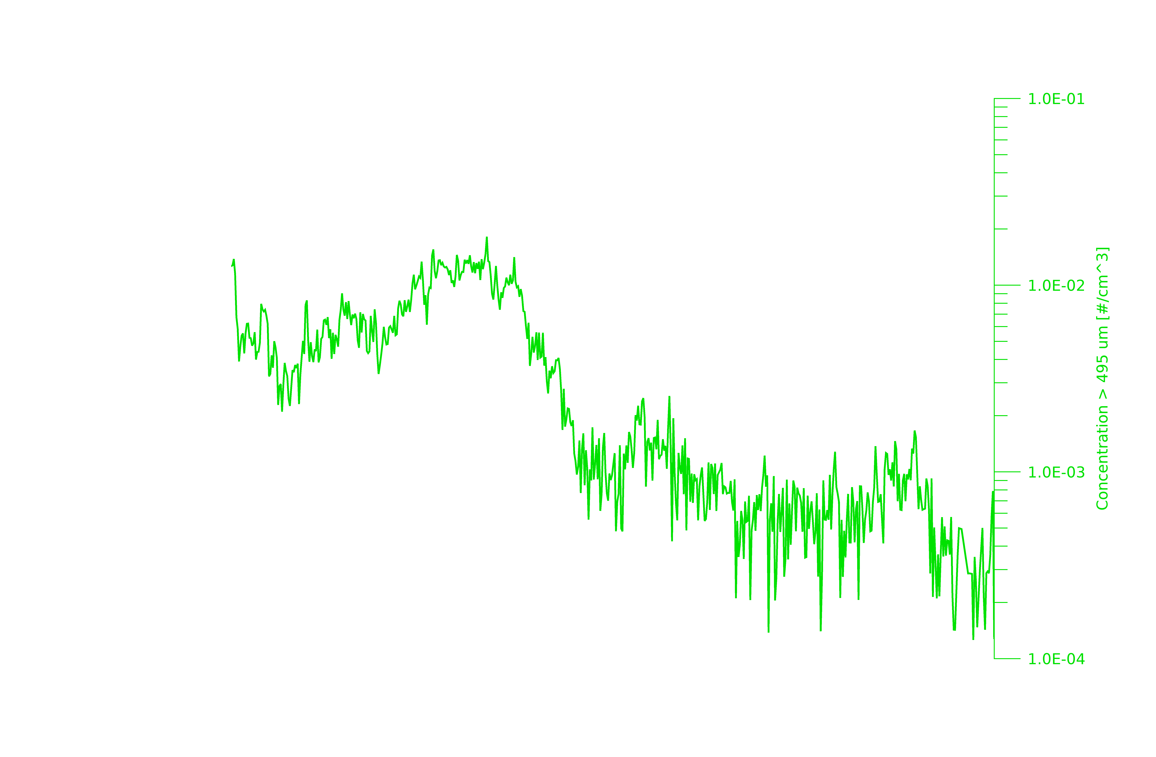
16
14
12
10
Altitude (km)
8
6
4
2
A
B

Slide 23
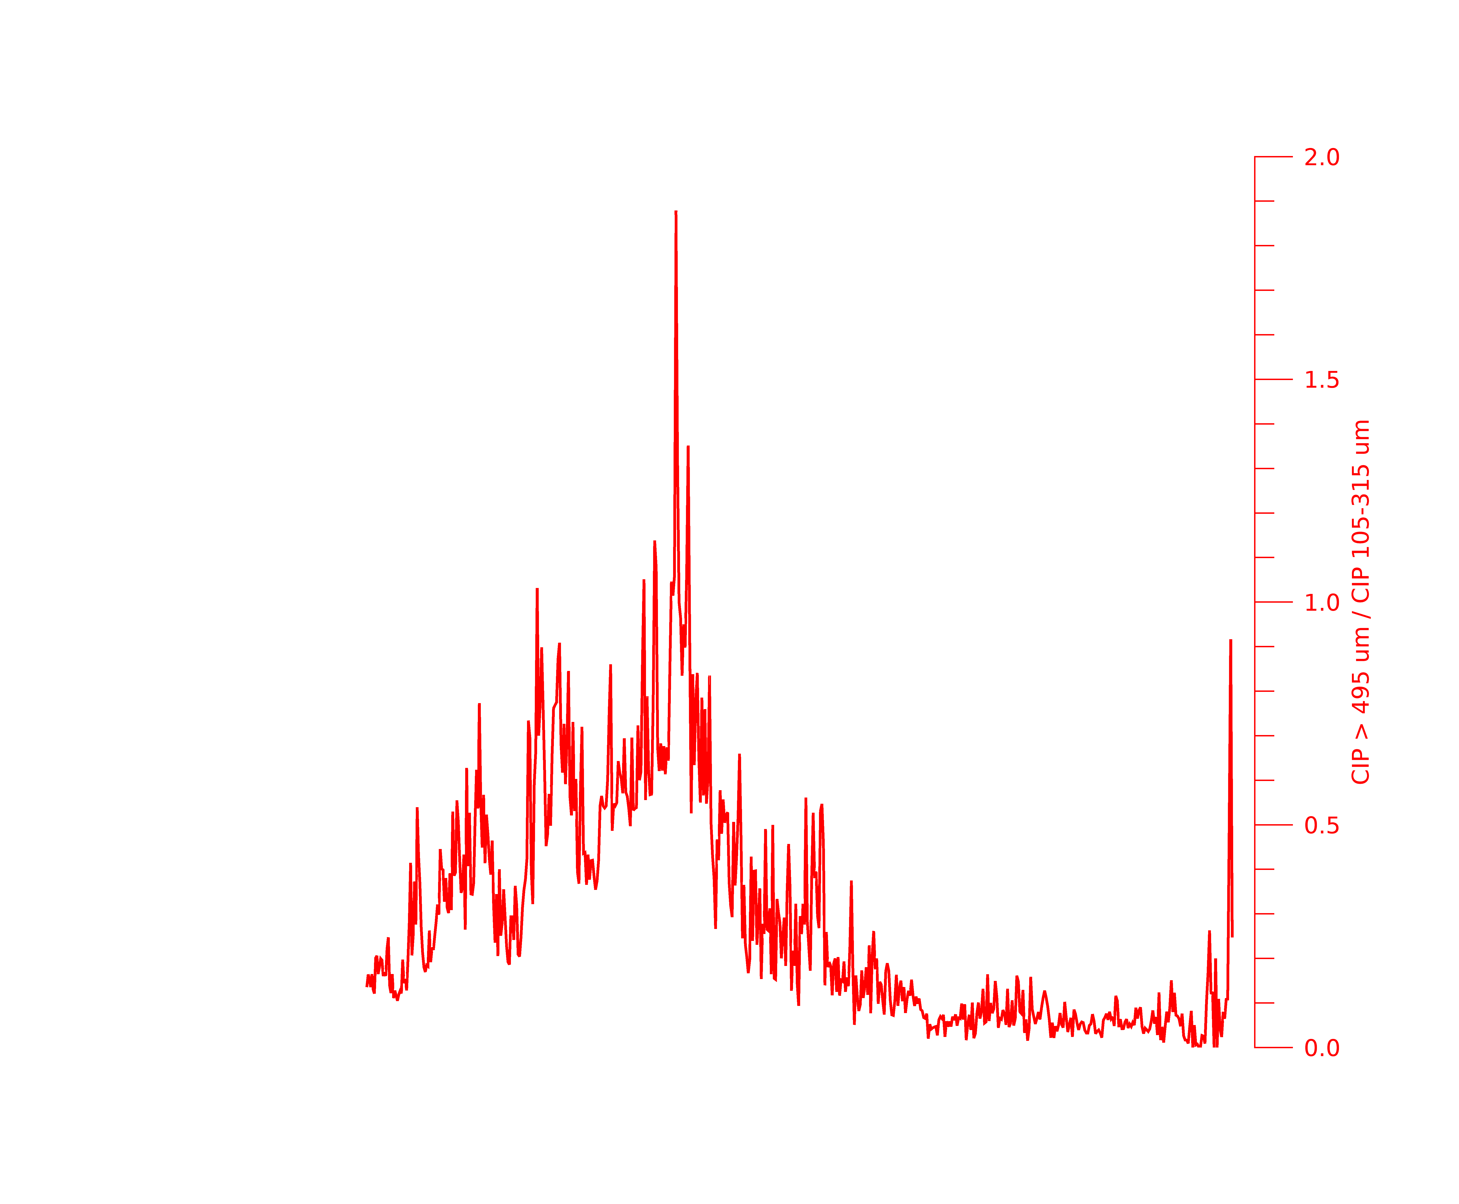
16
14
12
10
Altitude (km)
8
6
4
2
A
B

Slide 24
Flight Leg 4 (FL4) 16:21:30 – 16:27:00 KMLB Vol Scan: 16:23:55 10 km CAPPI
B
A

Slide 25
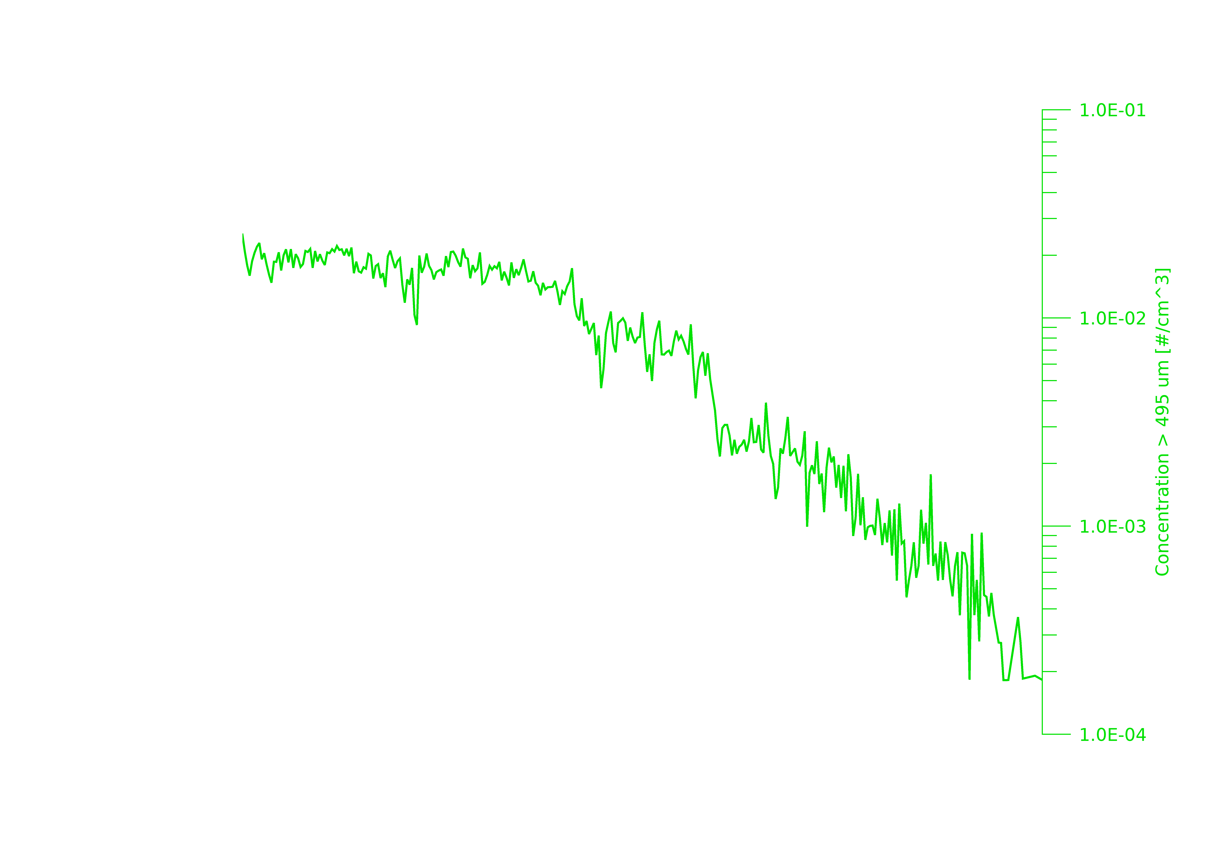
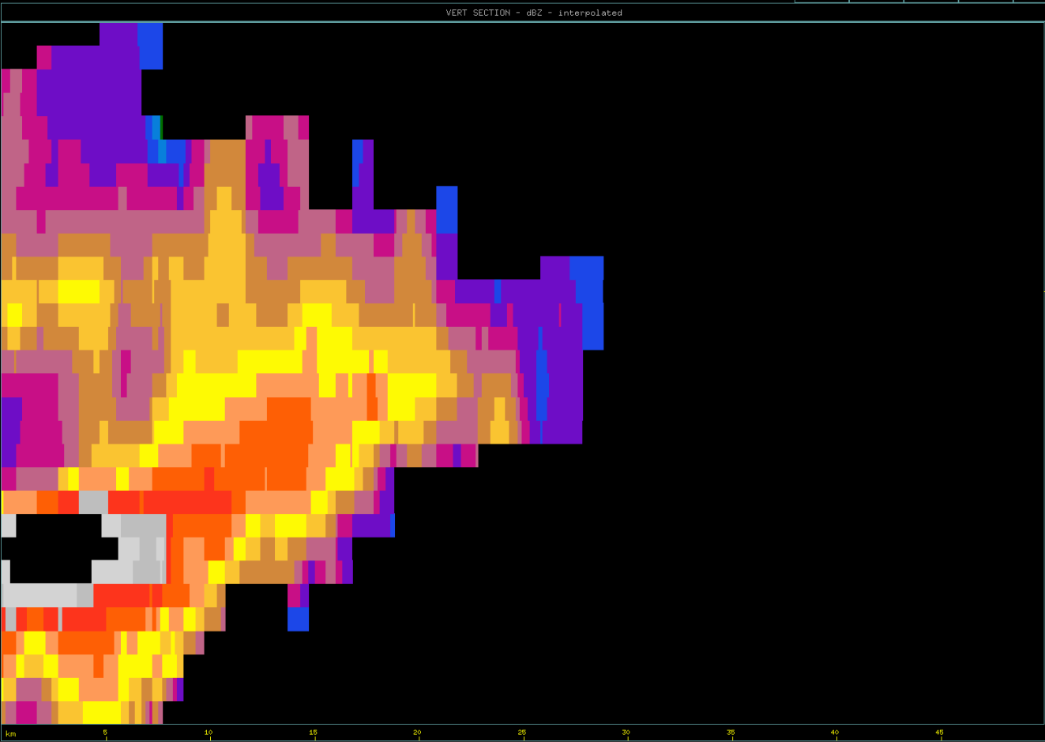
16
14
Approx. Aircraft Position @ 16:23:55 UTC
12
10
Altitude (km)
8
6
4
2
A
B

Slide 26
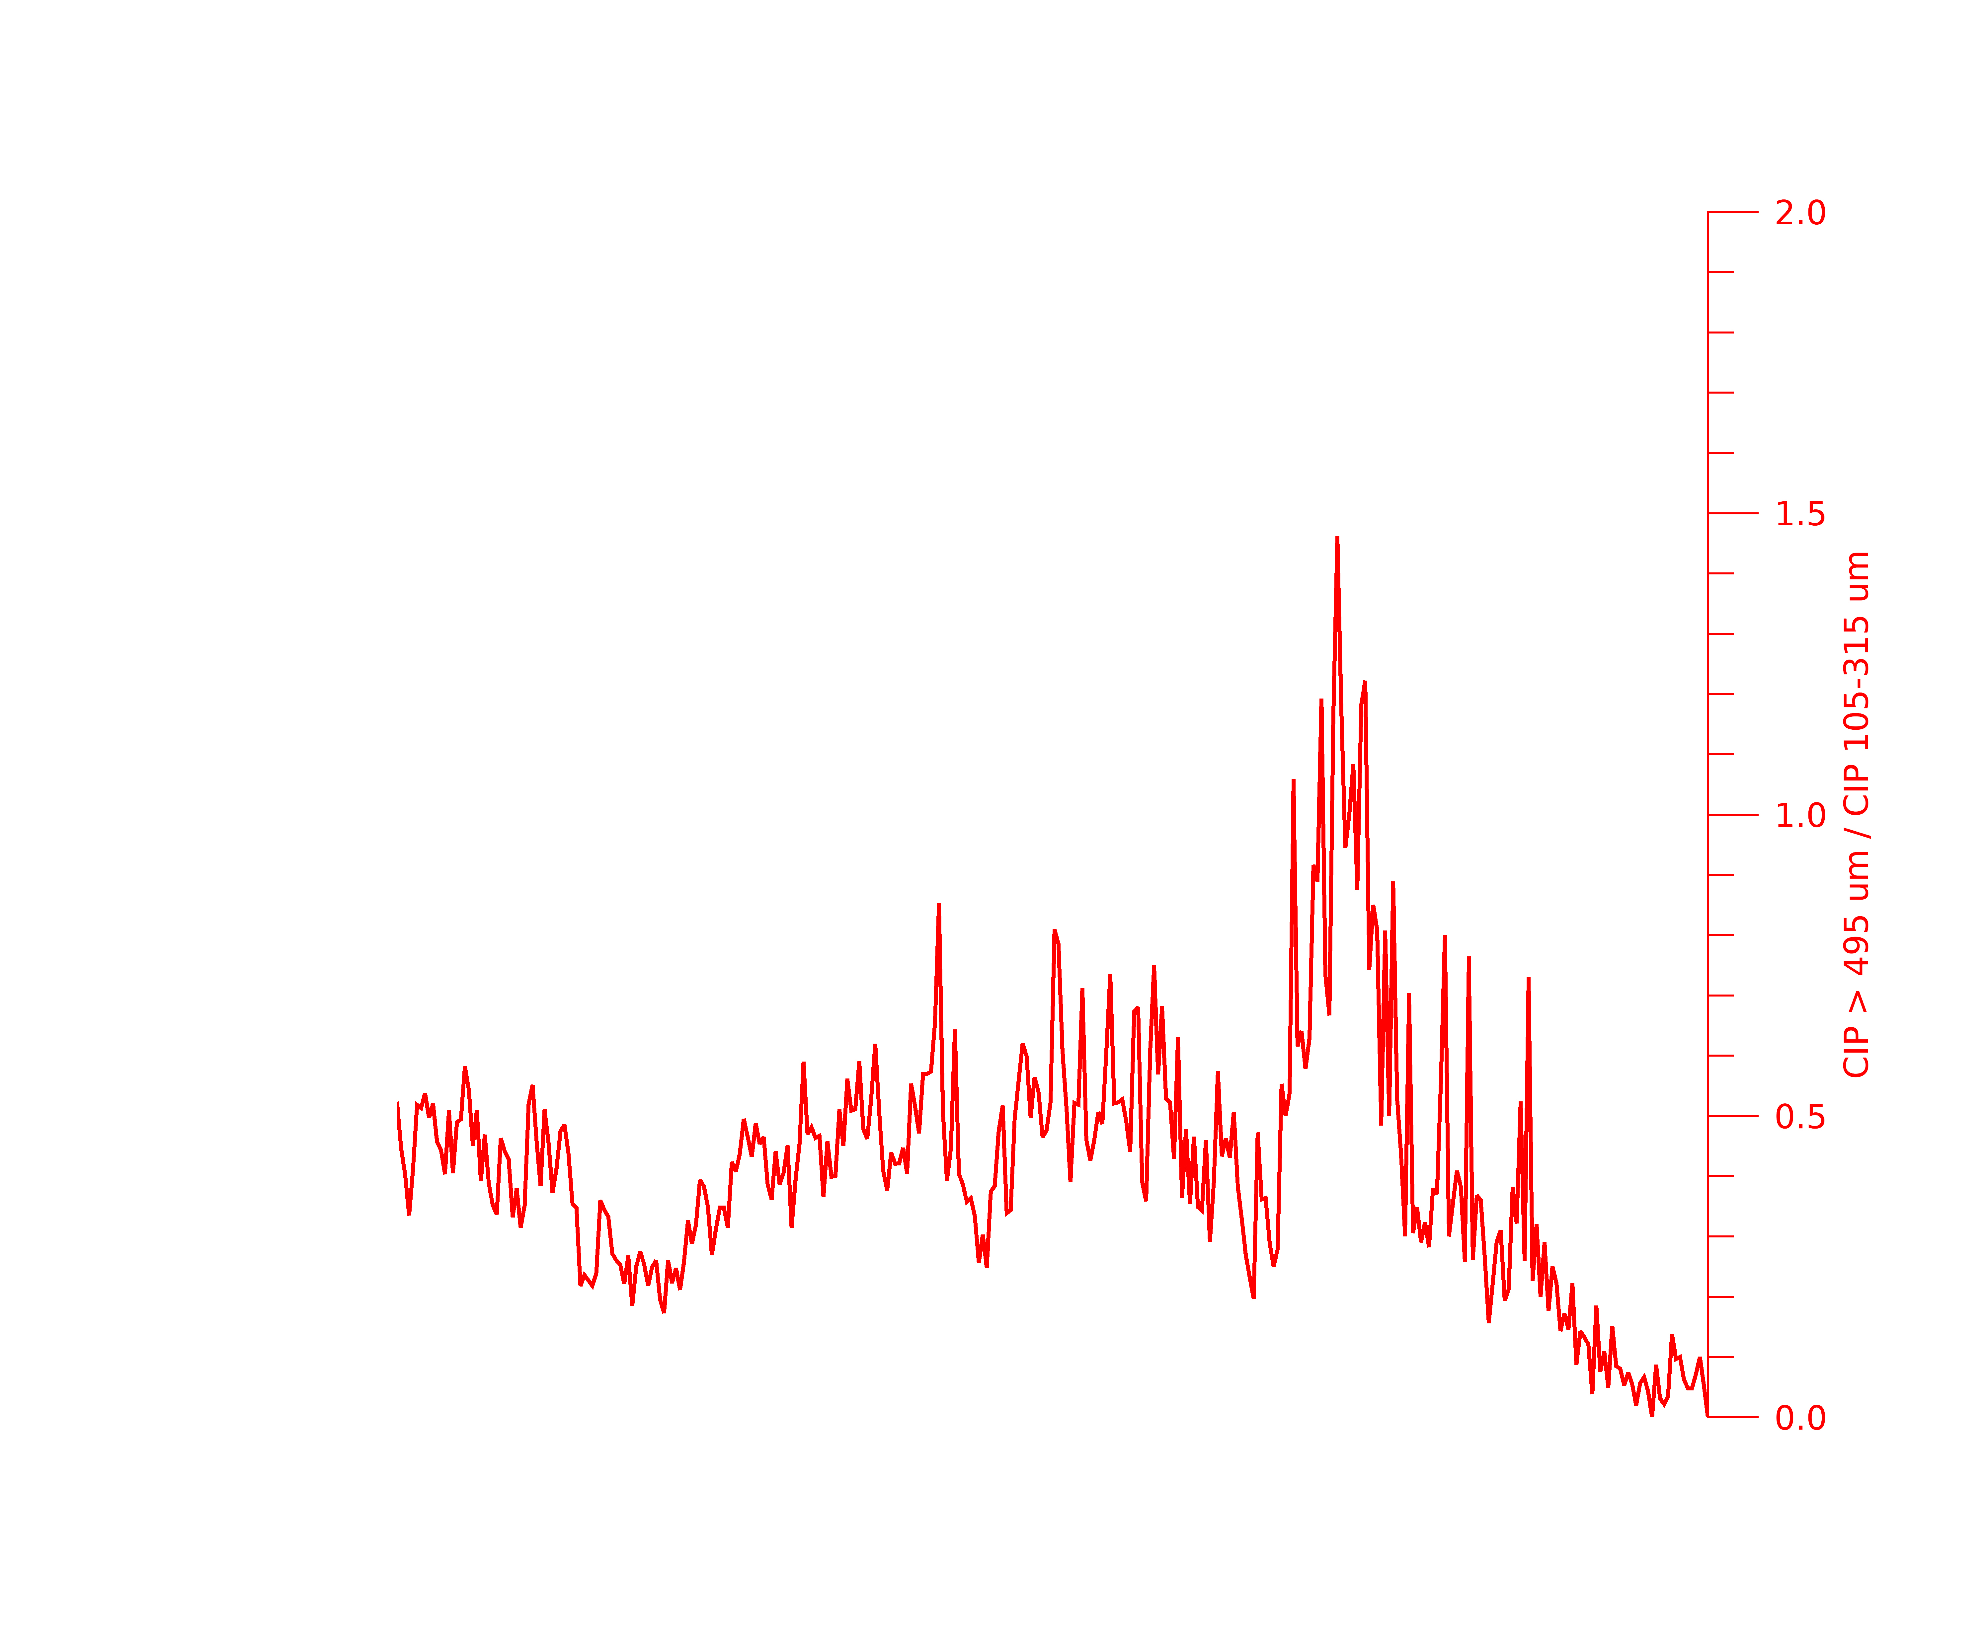
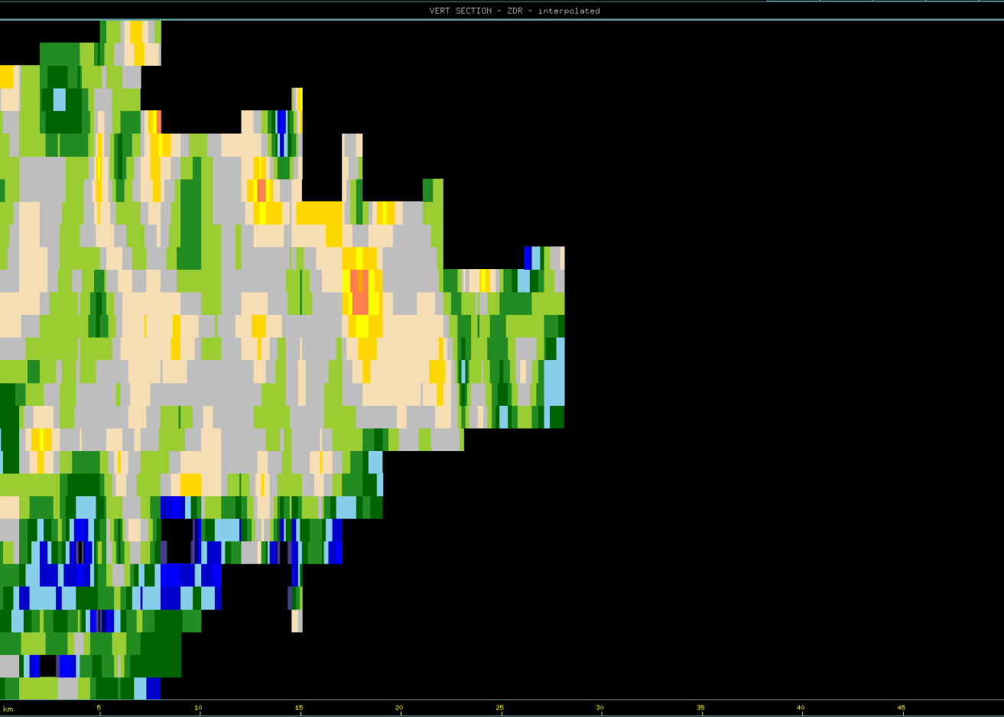
16
14
Approx. Aircraft Position @ 16:23:55 UTC
12
10
Altitude (km)
8
6
4
2
A
B

Slide 27
ELECTRIC FIELD DATA & KSCLMA ANALYSIS

Slide 28
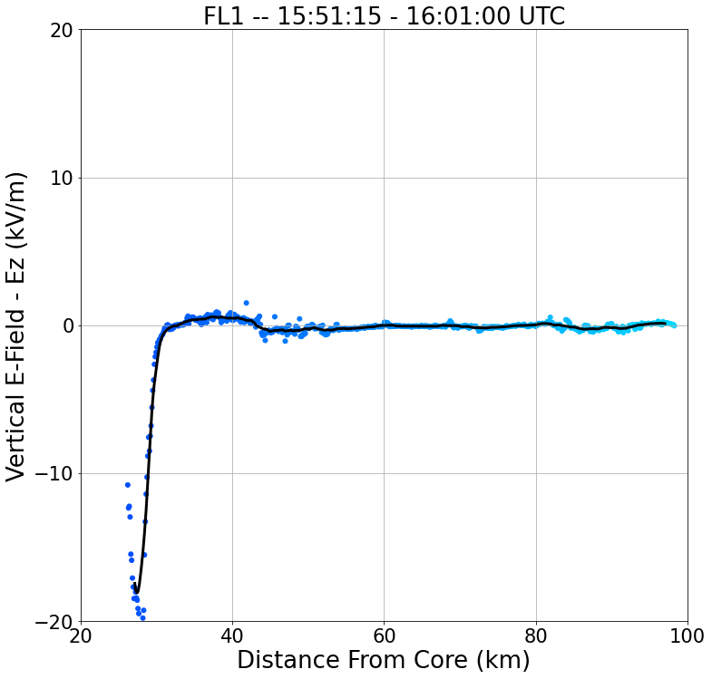
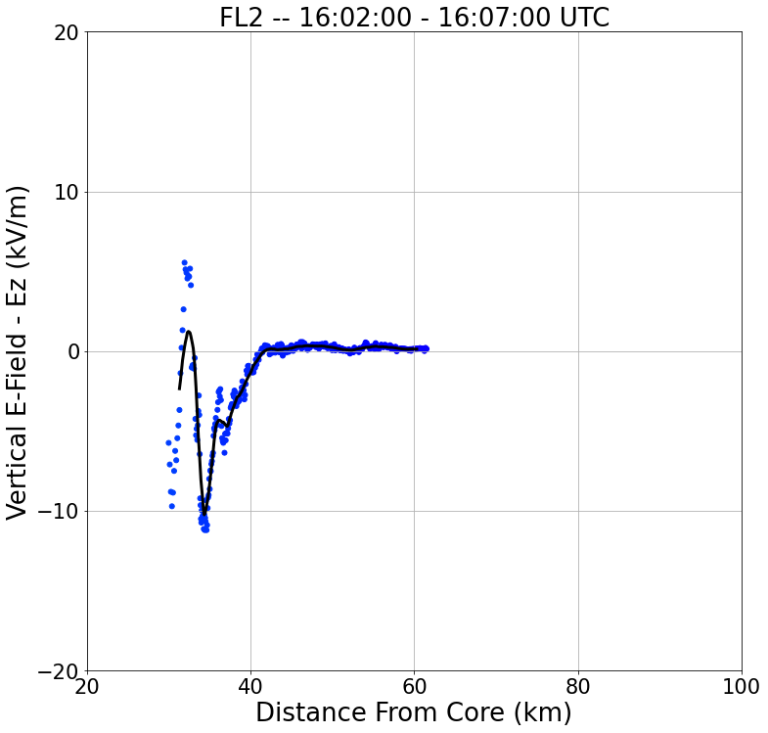
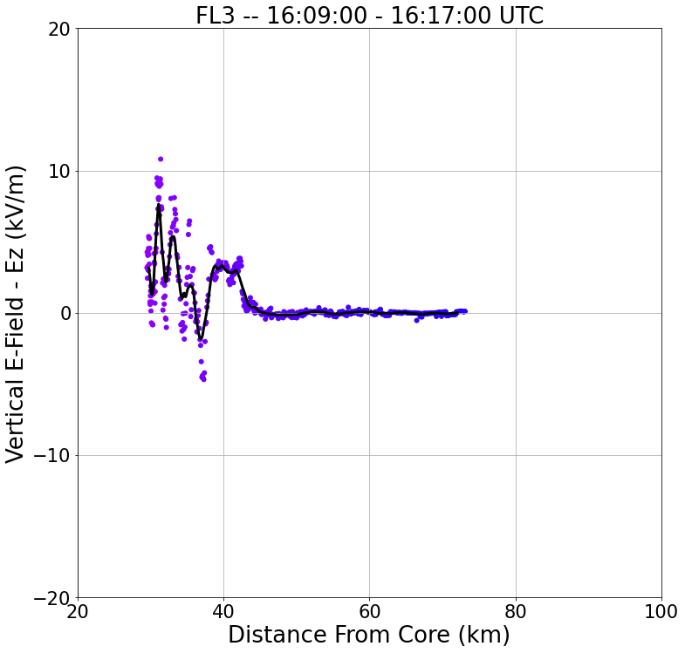
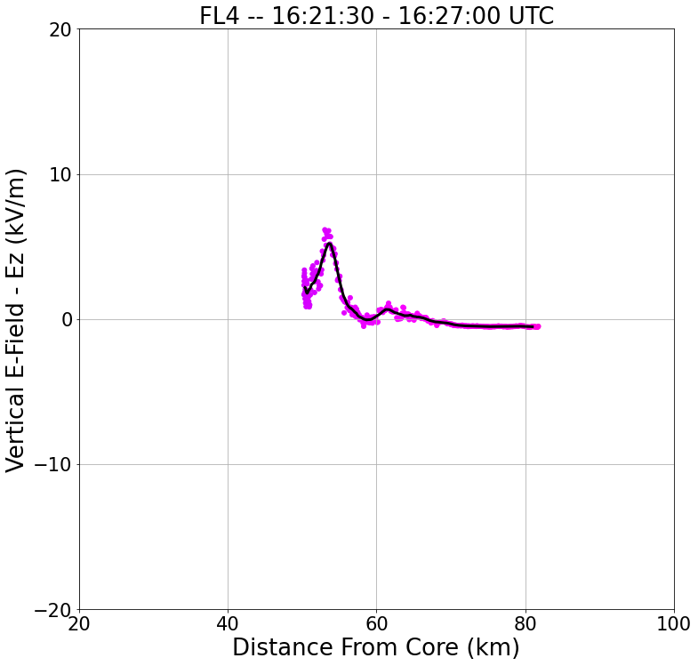
20 km
FL4
FL2
S
N
S
N
FL1
FL3
S
N
SR-Anvil Wind Direction
S
N

Slide 29
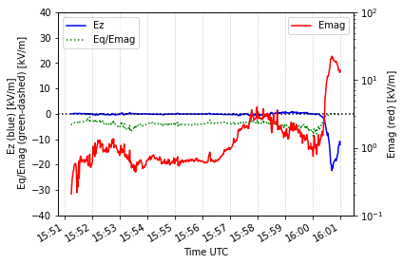
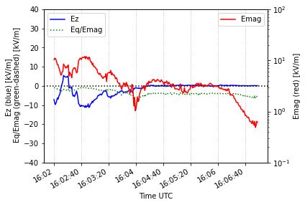
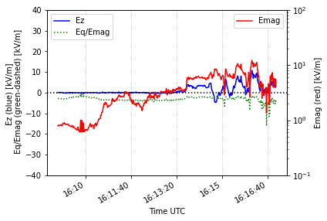
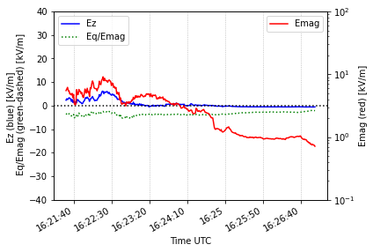
(a)
FL1 – 15:51:15 – 16:01:00 UTC
(b)
FL2 – 16:02:00 – 16:07:00 UTC
(c)
FL3 – 16:09:00 – 16:17:00 UTC
(d)
FL4 – 16:21:30 – 16:27:00 UTC

Slide 30
Flight Legs | Time [UTC] | Ex - Range [kV/m] | Ex - Mean [kV/m] | Ey - Range [kV/m] | Ey - Mean [kV/m] | Ez - Range [kV/m] | Ez - Mean [kV/m]
FL1 | 15:51:15 - 16:01:00 | [-4.01, 0.17] | -0.89 | [-0.16, 8.04] | 0.93 | [-22.37, 1.50] | -0.87
FL2 | 16:02:00 - 16:07:00 | [-5.63, 1.52] | -1.96 | [-4.93, 6.42] | 0.78 | [-11.22, 5.53] | -1.76
FL3 | 16:09:00 - 16:17:00 | [-6.59, -0.21] | -2.95 | [-3.43, 6.67] | 1.05 | [-4.70, 10.80] | 1.15
FL4 | 16:21:30 - 16:27:00 | [-4.86, -0.40] | -2.36 | [-5.86, 4.28] | -0.11 | [-0.58, 6.15] | 0.68

Slide 31
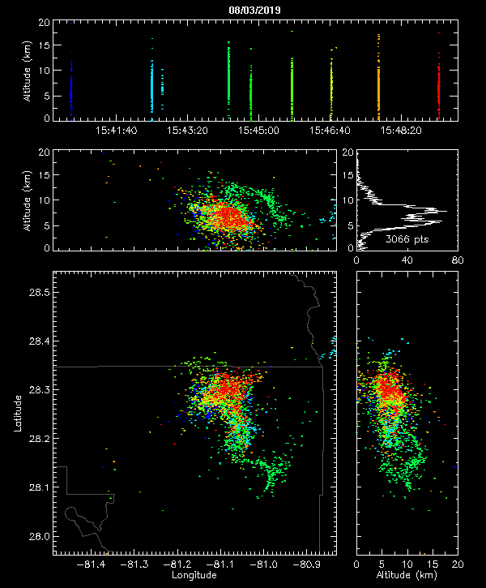

Slide 32
Lightning Strike @ 16:01:43 UTC
NOTE: According to NLDN data
This was the last lightning strike
associated with our storm of
Interest.
Upper + Charge Region
Lower - Charge Region

Slide 33
Summary/Discussion
The largest sources of electric fields are when the aircraft is in close proximity to the storm core.
Near the storm core the vertical electric field values are mainly on the order of 10⁰ kV/m for each FL.
Although, there is a strong E_{z} signal during the end of FL1 where E_{z} reached -22.37 kV/m, which is an order of magnitude higher than what is typically observed.
The temporal span (electric build-up) of this peak is on the order of seconds, and detection of electric discharges are on the order of micro – seconds, thus it is believed that this peak in electric field is due to the aircraft entering in a ‘high’ electric charge region and not by lightning.
Based on the KSCLMA data, is it possible that the upper positive region is the culprit for fluctuations in E_{z}?
The electric field magnitude (E_{mag}) for all flight legs peaked on the order of 10¹ kV/m.
Cloud chamber experiments only utilized a horizontal electric field.
The E_{mag} values are the same order of magnitude to what was used in cloud chamber experiments performed by Saunders and Wahab (1975).
However, in the cloud chamber experiments, chain aggregates were only generated while using an electric field greater than or equal to 60 kV/m.
Is the E-Field threshold smaller than previously tested?
Evidence from previous research coupled with these results -> can propose that yes it may?

Slide 34
Conclusion and Comments
Cloud chamber experiments suggest that chain aggregates are optimally formed when electric fields are > 60 kV/m at temps ~ -8 to -12 C using unrealistic (high) ice crystal concentrations.
In typical T–storms, these values would suggest the chains to be formed near the mix-layer region
PHIPS observations show chain aggregates spread out across the anvil region.
Particles of different habits
Lack of riming
CIP concentration data suggest that in the cirrus anvil:
(1) There is a net increase in chains relative to the non-chains and/or …
(2) More of the non-chains are falling out, sublimating, and/or climbing within the cirrus anvil away from where the aircraft was sampling from and/or …
(3) The smaller particles are taking part in the chain aggregation process allowing for less smaller particles and more larger particles.
The fluctuations in the particle sizes cloud be the product of storm convective growth and decay.
Further radar analysis needed.
The E_{mag} values are the same order of magnitude to what was used in cloud chamber experiments performed by Saunders and Wahab (1975).
Similar values to other field projects where chain aggregates were also observed.
E-Field thresholds for chain aggregation in the cirrus anvil may be less than 60 kV/m.

Slide 35
Request
The scanning capabilities of the S-band NWS radar is extremely limited (especially during the 3 August 2019 flight).
Lack of radar data > 100 km away
low resolution
Not concurrent with aircraft measurements
The MCR (CPR-HD) thrives where the NWS radars do not.
With the scanning capabilities of the MCR (CPR-HD), the data will be extremely beneficial when comparing to the in-situ microphysical data.
The MCR (CPR-HD) data will be used to see if chain aggregation is occurring within the convection – induced, cirrus anvil region.
Due to FL4 being more oriented to the SR-anvil wind direction and occurring when there is only one CLEAR main source of convection, it is proposed to obtain the MCR (CPR-HD) data or flight leg 4 [16:21:30 – 16:27:00 UTC] for further radar analysis.

Slide 36
Extra Slides

Slide 37
Flight Leg 1 (FL1) 15:51:15 – 16:01:00 KMLB Vol Scan: 15:50:30 10 km CAPPI
B
A

Slide 38
16
14
12
10
Altitude (km)
8
6
4
2
A
B

Slide 39
16
14
12
10
Altitude (km)
8
6
4
2
A
B

Slide 40
Flight Leg 1 (FL1) 15:51:15 – 16:01:00 KMLB Vol Scan: 15:56:16 10 km CAPPI
B
A

Slide 41
16
14
12
10
Altitude (km)
8
6
4
2
A
B

Slide 42
16
14
12
10
Altitude (km)
8
6
4
2
A
B

Slide 43
Flight Leg 1 (FL1) 15:51:15 – 16:01:00 KMLB Vol Scan: 16:02:01 10 km CAPPI
B
A

Slide 44
16
14
12
10
Altitude (km)
8
6
4
2
A
B

Slide 45
16
14
12
10
Altitude (km)
8
6
4
2
A
B

Slide 46
Flight Leg 4 (FL4) 16:21:30 – 16:27:00 KMLB Vol Scan: 16:19:25 10 km CAPPI
B
A

Slide 47
16
14
12
10
Altitude (km)
8
6
4
2
A
B

Slide 48
16
14
12
10
Altitude (km)
8
6
4
2
A
B

Slide 49
Flight Leg 4 (FL4) 16:21:30 – 16:27:00 KMLB Vol Scan: 16:23:55 10 km CAPPI
B
A

Slide 50
16
14
12
10
Altitude (km)
8
6
4
2
A
B

Slide 51
16
14
12
10
Altitude (km)
8
6
4
2
A
B

Slide 52
Flight Leg 4 (FL4) 16:21:30 – 16:27:00 KMLB Vol Scan: 16:28:16 10 km CAPPI
B
A

Slide 53
16
14
12
10
Altitude (km)
8
6
4
2
A
B

Slide 54
16
14
12
10
Altitude (km)
8
6
4
2

