Slide 1
Observations of Chain Aggregates in Florida Cirrus Cloud Anvils
Christian Nairy
08/13/2021

Slide 2
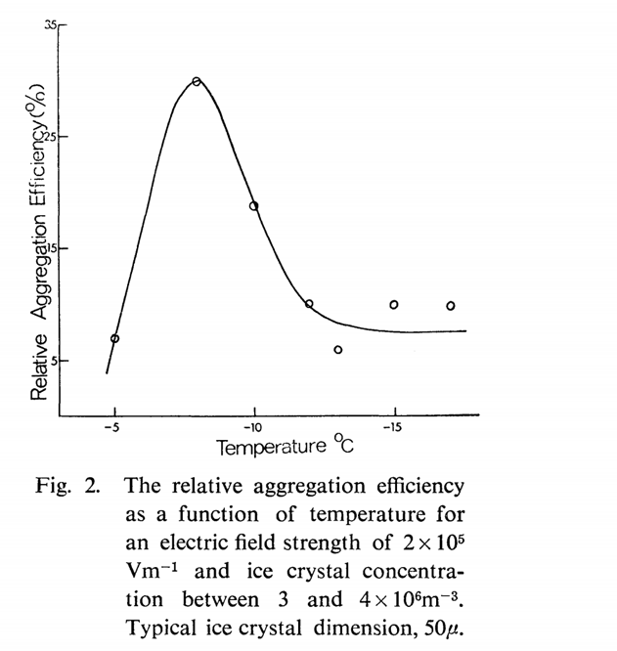
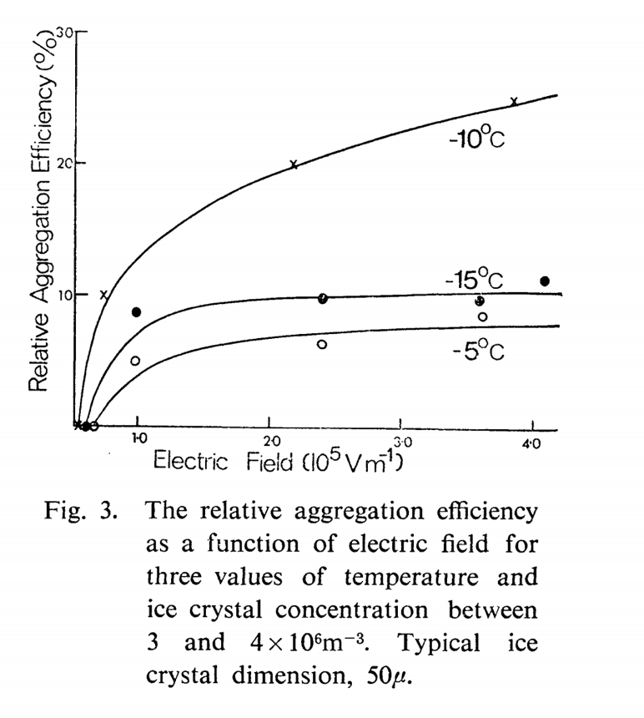
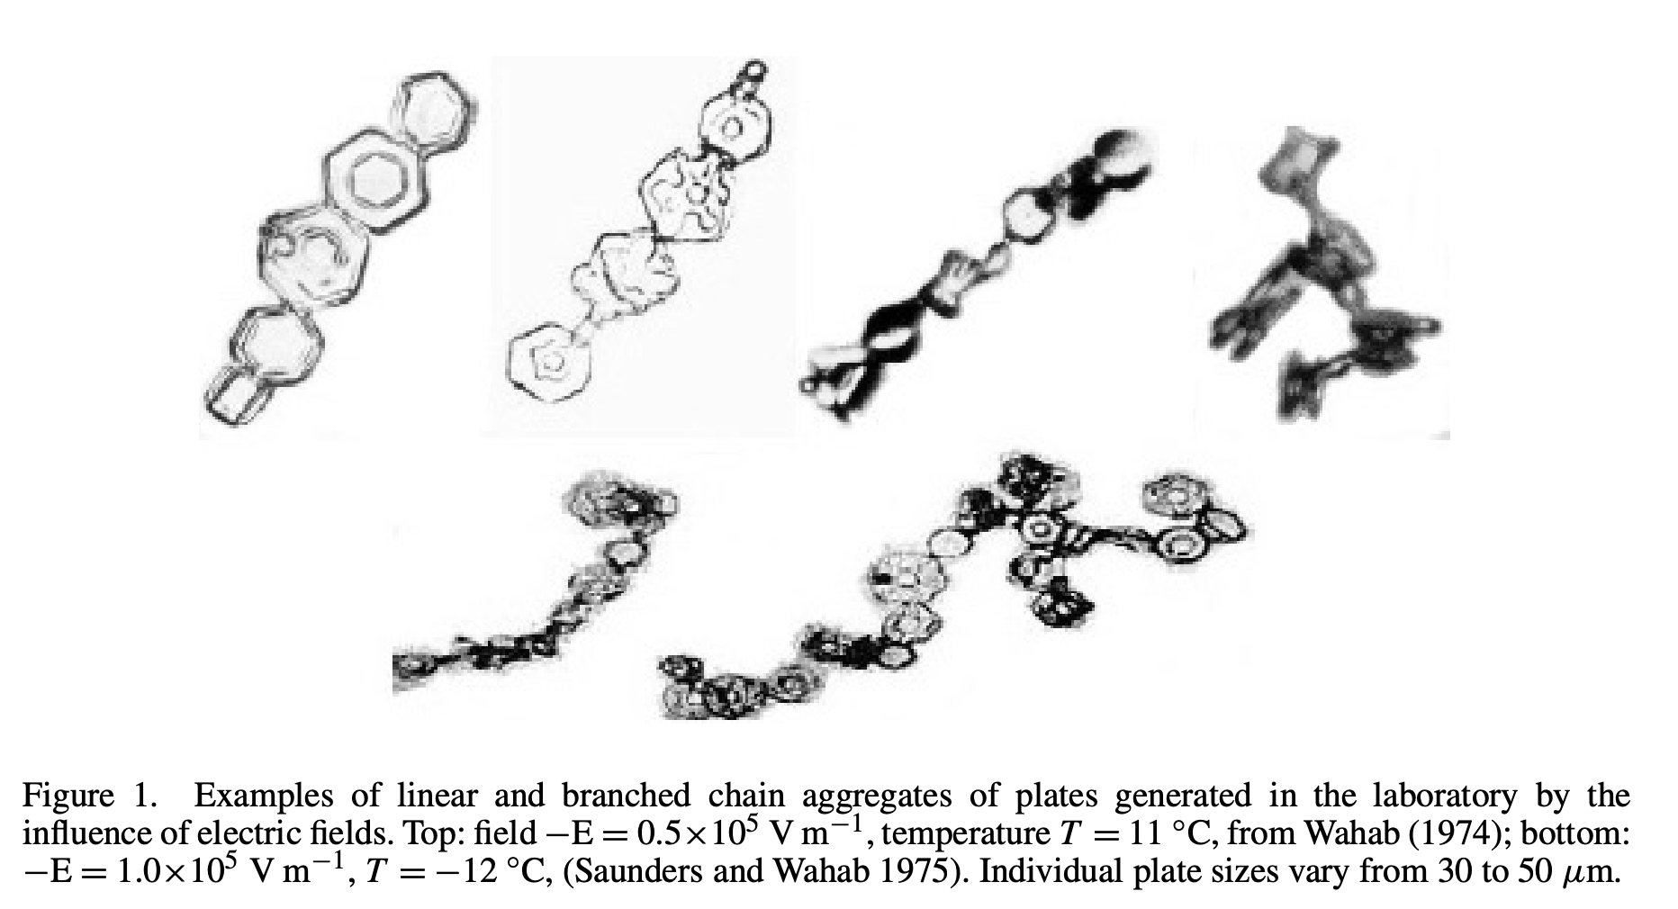
Introduction
Evidence since the 1960’s has shown that electric fields have an influence on aggregation.
Previous Cloud Chamber Experiments:
Crowther and Saunders (1973): Tested aggregation and fragmentation of ice crystals in the presence of electric fields (10⁵ V m⁻¹).
Observed aggregates not in clumps, but in an elongated, quasi-linear, chain-like orientation occasionally containing 10 or more ice crystal elements.
Saunders and Wahab (1975): Tested aggregation and fragmentation of ice crystals in the presence of electric fields (10⁵ V m⁻¹) using high, but more realistic ice crystal concentrations (than previous cloud chamber work).
Notes:
Crowther and Saunders: Utilizing electric field strengths on the order of 10⁵ V m⁻¹, high ice crystal concentrations (10⁷ m⁻³), and varying temperatures (0°C to -20°C),

Slide 3
Introduction Connolly et al. 2005
Island forced convection over the Tiwi Islands.
Aerosol inflow tends to be from continental Australia and so it is classed as continental.
Ice-crystal chains were found in the highest frequencies near the anvil base (continental).
Sedimentation and/or other mechanisms.
No direct measurements of electric fields were made.
Possible that the aggregates originated higher above the mixed-phase updraught region?
Distinct lack of riming on the crystal aggregate chains observed in the outflow (Tiwi Island convection)
Gives some evidence to support the idea that the majority of the chains in the dataset formed in fully glaciated regions below approximately −37°C.
Notes:
formed in fully glaciated regions below approximately −37 ◦C (i.e. the ‘threshold’ freezing temperature for large supercooled drops by homogeneous nucleation of ice, see Jeffery and Austin (1997)).

Slide 4
Objective
Question of interest:
Is chain aggregation occurring in the cirrus anvil region of Florida thunderstorms?
Utilize the CapeEx19 dataset and characterize the observed chain aggregates in cirrus anvil region.
Microphysical properties and crystal elements.
In-situ electric field and environmental properties/measurements (where the chains were sampled).
Compare data to the Saunders and Wahab (1975) criteria. Is the cirrus anvil environment conducive for chain aggregation?
Notes:
Second bullet: Since there is no set definition of what a chain aggregate is. Our own will be used. Since chain aggregates don’t always seem apparent, a confidence scale was generated.
Close with: How can we try to answer this main question? We will use the various instrumentation on the aircraft

Slide 5
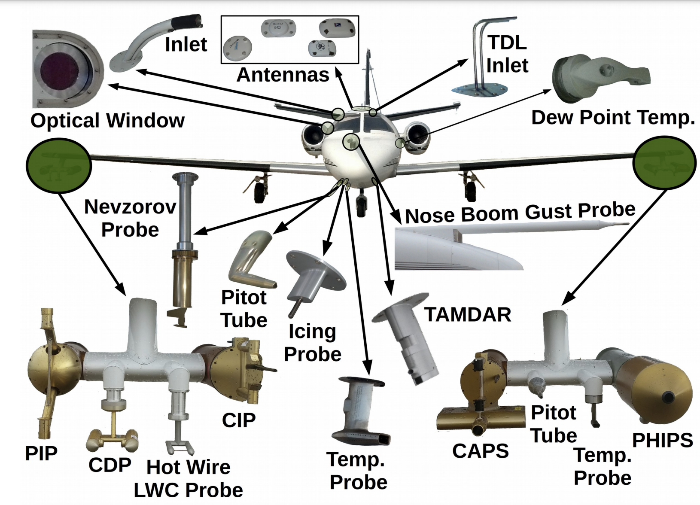
Methodology
CapeEx19 Field Campaign
Location: Cape Canaveral, Florida
Time Frame: Late July 2019 – Early August 2019
Field Campaign Objectives:
Continue improvements to both cirrus cloud modeling and radar interpretation by utilizing aircraft observations to enhance our understanding of Florida convection.
Understanding the various processes that result in chain aggregate formation.
Not pictured:
6-Rotating Vane
Electric Field Mills

Slide 6
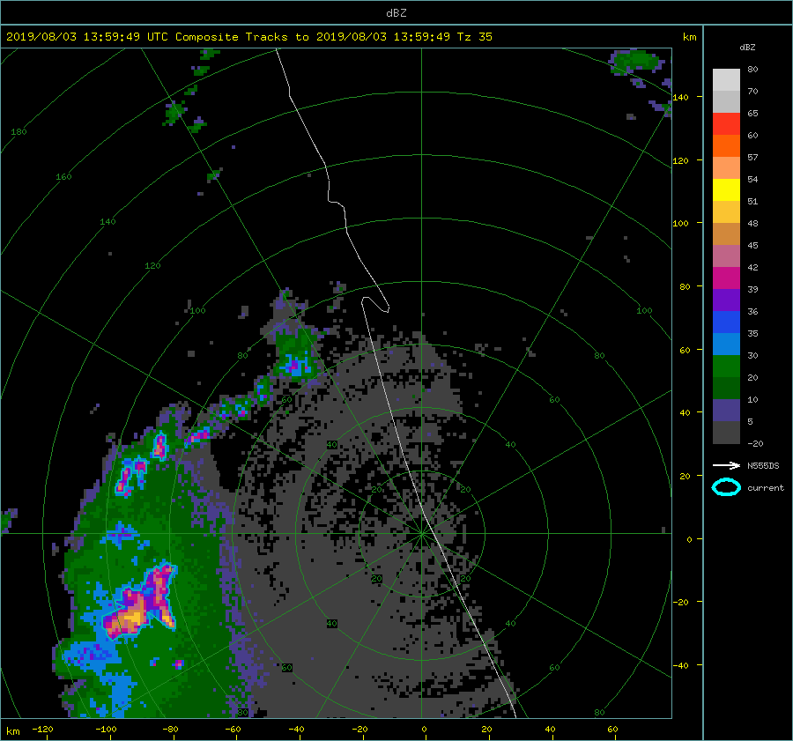
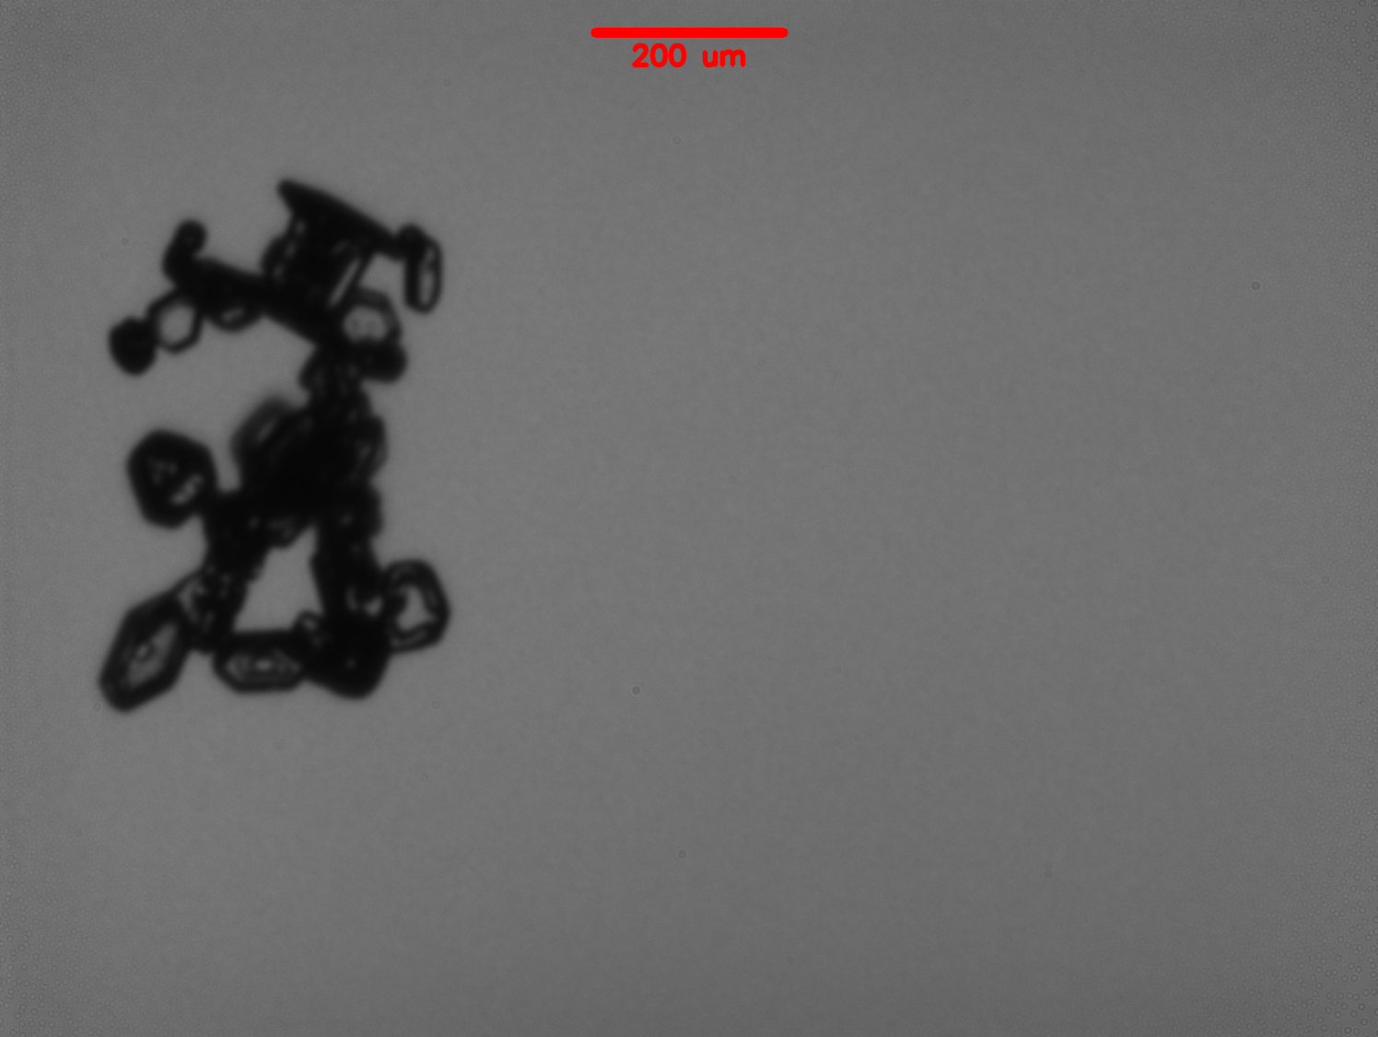
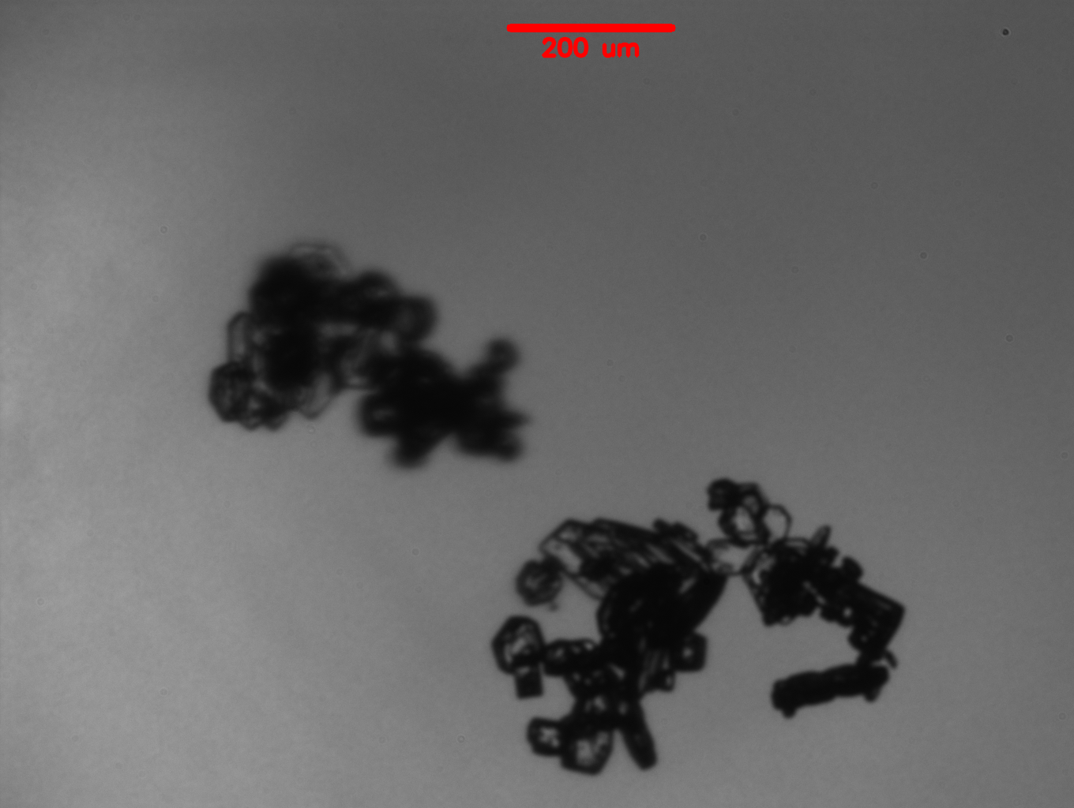
Methodology
3 August 2019 flight (20190803a) during the CapeEx19 field Campaign
Sea-breeze induced convection over western Florida. Later enhanced by convergence zone west of Cape Canaveral, Florida.
14:24:00 – 17:26:00 UTC
North Dakota Citation II Research Aircraft sampled through the cirrus anvil regions (9.5 – 11.5 km above ground level).
Chain Aggregates observed
15:54:16 UTC
16:10:56 UTC
Notes:
-40 to -30 C range

Slide 7
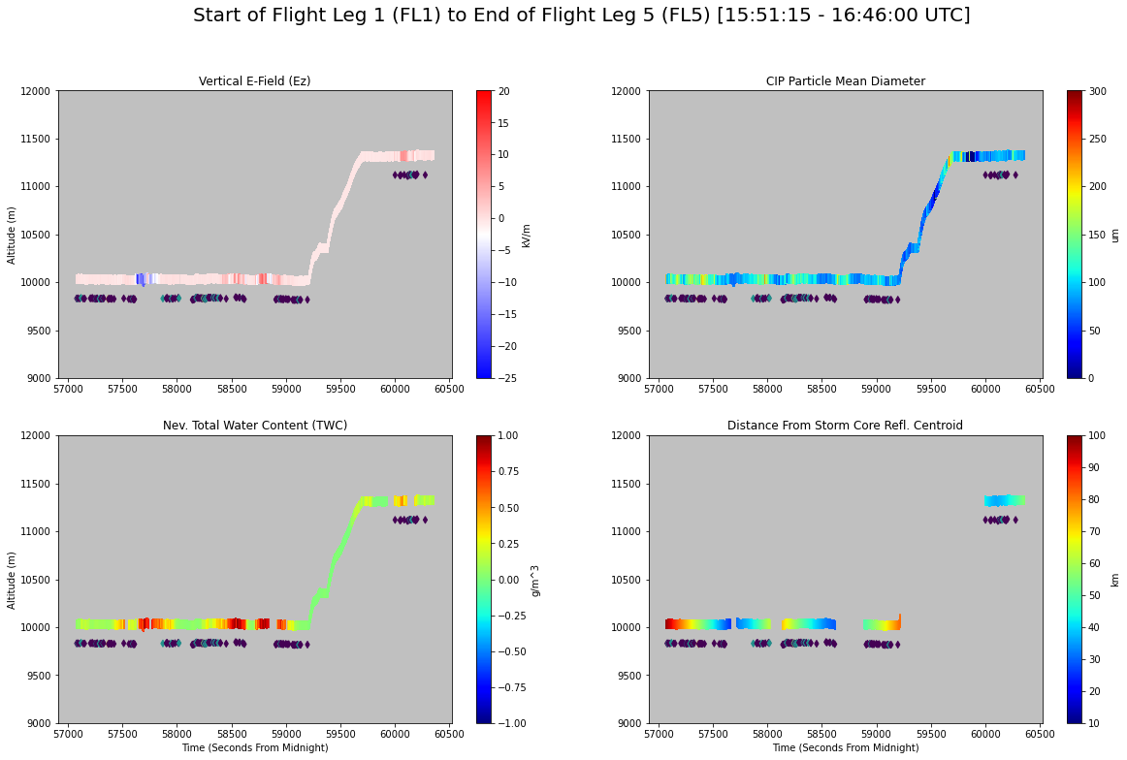
FL5
FL5
FL1
FL2
FL3
FL4
FL1
FL2
FL3
FL4
FL5
FL5
FL1
FL2
FL3
FL4
FL1
FL2
FL3
FL4

Slide 8
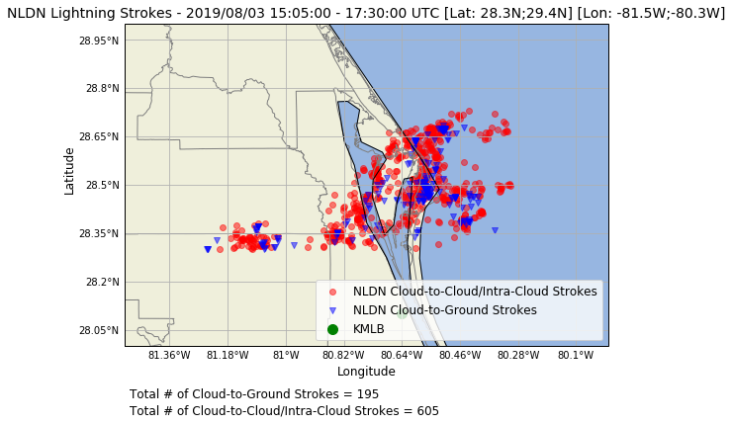
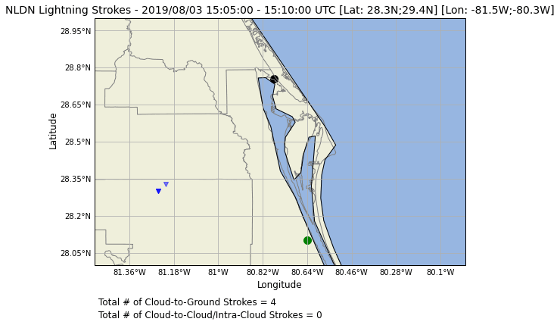
NLDN Data
How Electrically Active was the Sampled Storm?

Slide 9
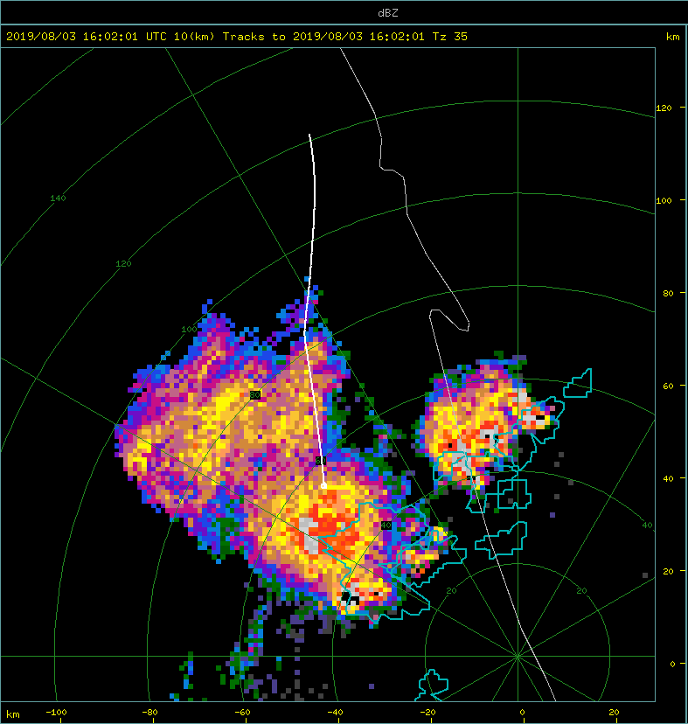
According to the Nev. TWC probe, the aircraft was above the 0.005 g/cm^3 threshold = in cloud.
Flight Leg 1:
15:51:15 – 16:01:00 UTC
Radar Scan: 16:02:01 UTC
10 km CAPPI
KMLB
Location of CPR-HD and Ka-band radar (KASPR).
Aircraft current position at
16:01:00 UTC.
Blue circles indicating convective cores. (35 dBZ threshold).
Notes:
Add arrow for the aircraft and convective core.
Take out the scale and blow it up larger.

Slide 10
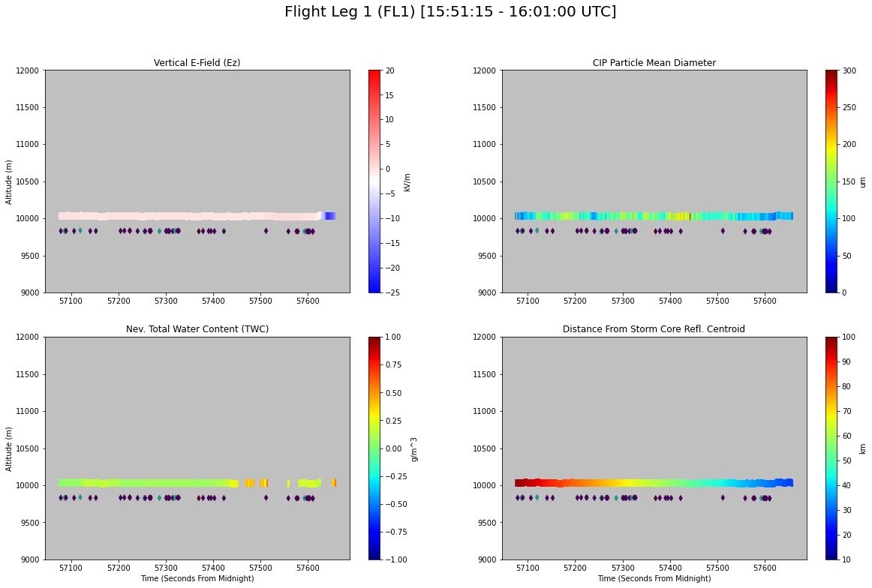
Temperature Range (°C):
-34.35 to -32.73
Average Temperature (°C):
-33.65
--------------
CIP Mean Particle Diameter Range (μm):
69.65 to 369.14
Mean CIP Mean Particle Diameter (μm):
142.8
--------------
TWC Range (g/m^3):
0.0145 to 0.6336
Mean TWC (g/m^3):
0.147
--------------
Vert. E-Field Range (kV/m):
-20.74 to 0.80
Mean Vert. E-Field (kV/m):
-0.90
--------------

Slide 11
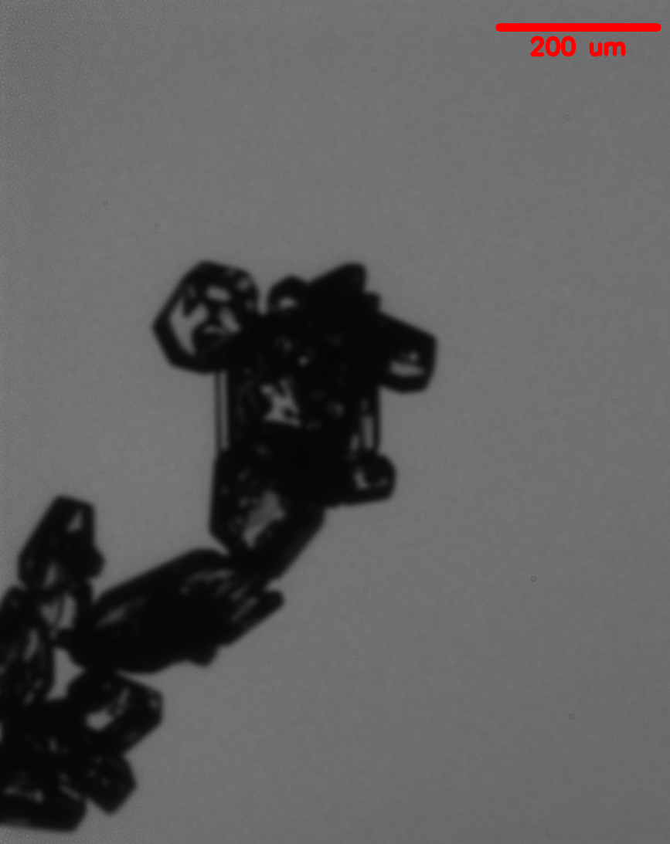
100-70 km from Storm Core
40-10 km from Storm Core
15:51:18 UTC
16:00:10 UTC
15:54:17 UTC
16:00:02 UTC
70-40 km from Storm Core
15:56:31 UTC
15:58:31 UTC
15:55:01 UTC
15:56:09 UTC
15:59:59 UTC

Slide 12
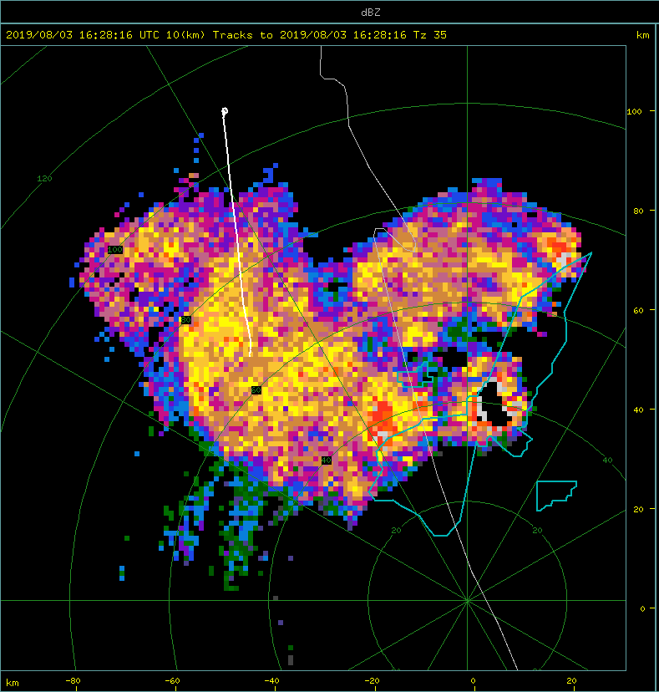
GoPro images and TWC probe indicate that the aircraft was still in cloud.
Flight Leg 4:
16:21:30 – 16:27:00 UTC
Radar Scan: 16:28:16 UTC
10 km CAPPI
KMLB
Aircraft current position at time-stamp above.
Location of CPR-HD and Ka-band radar (KASPR).
KASPR scan range (Azimuth 210;
30 km range)
[Plot next slide].

Slide 13
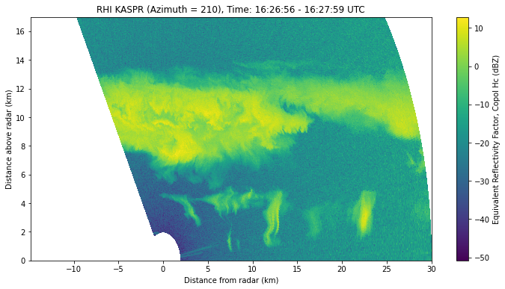
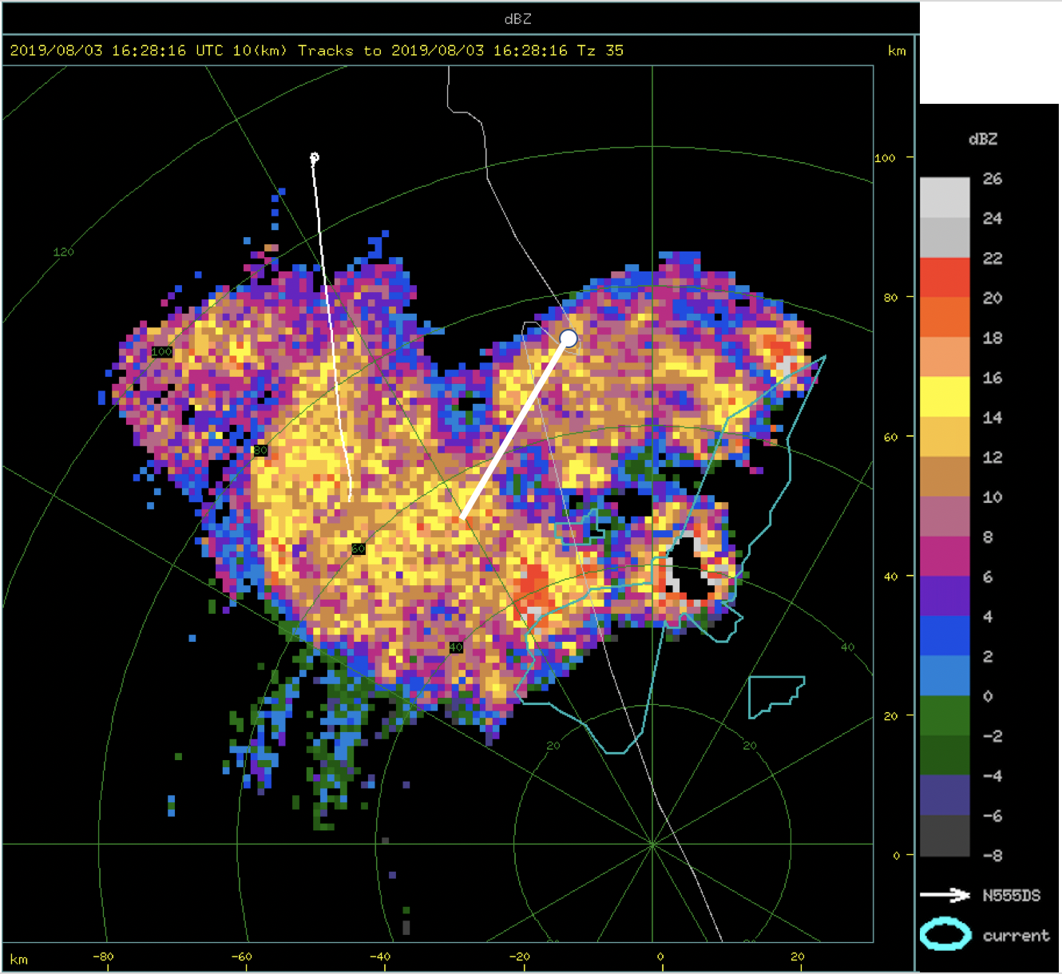
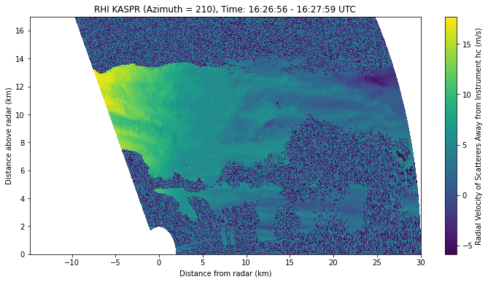
: Aircraft Sampling Altitude
Flight Leg 4

Slide 14
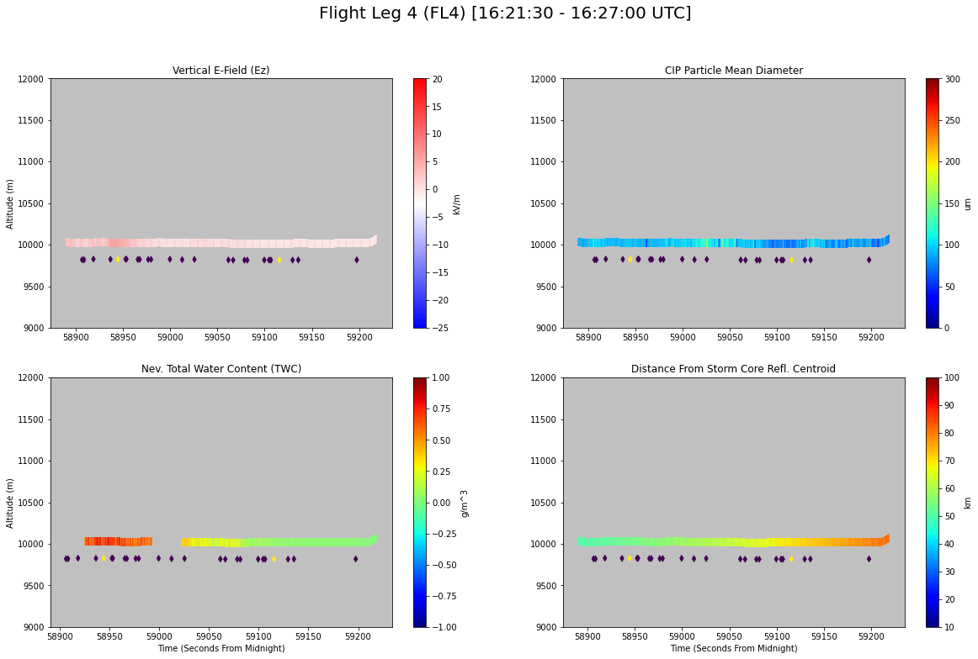
Temperature Range (°C):
-30.28 to -29.31
Average Temperature (°C):
-29.79
--------------
CIP Mean Particle Diameter Range (μm):
51.12 to 178.22
Mean CIP Mean Particle Diameter (μm):
101.55
--------------
TWC Range (g/m^3):
0.0165 to 0.872
Mean TWC (g/m^3):
0.2587
--------------
Vert. E-Field Range (kV/m):
-0.55 to 5.97
Mean Vert. E-Field (kV/m):
0.93
--------------

Slide 15
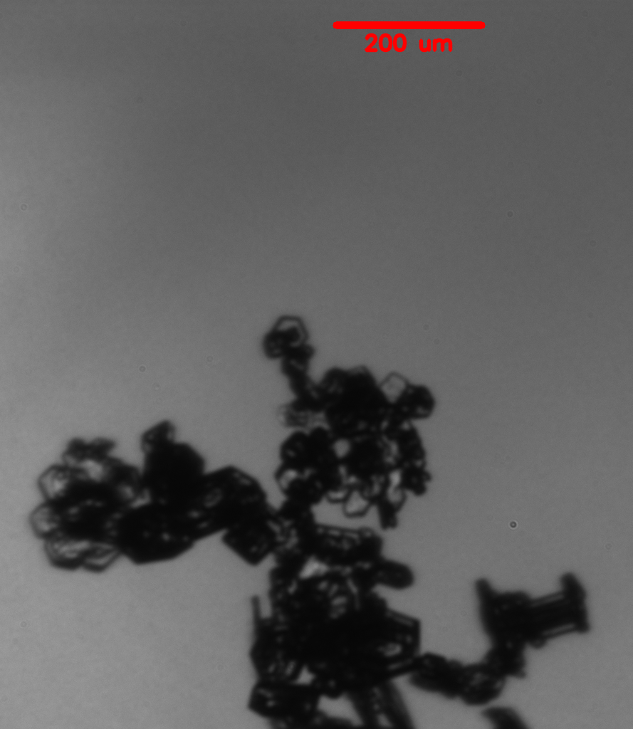
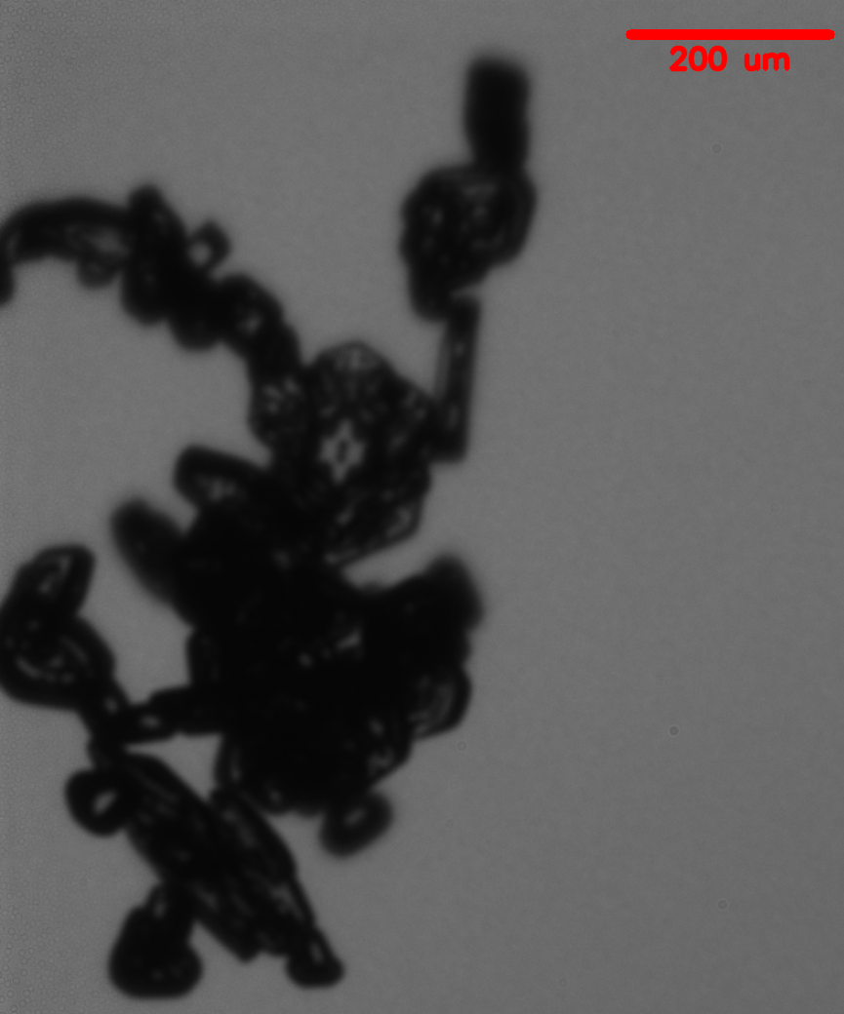
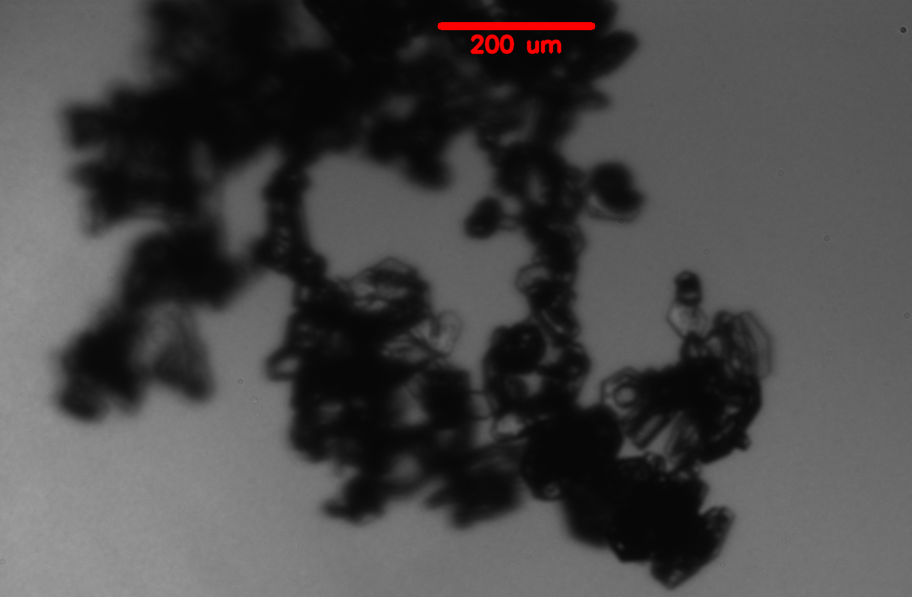
70-40 km from Storm Core
100-70 km from Storm Core
16:21:47 UTC
16:26:38 UTC
16:22:15 UTC
16:25:36 UTC
16:24:22 UTC
16:25:16 UTC
16:22:34 UTC

Slide 16
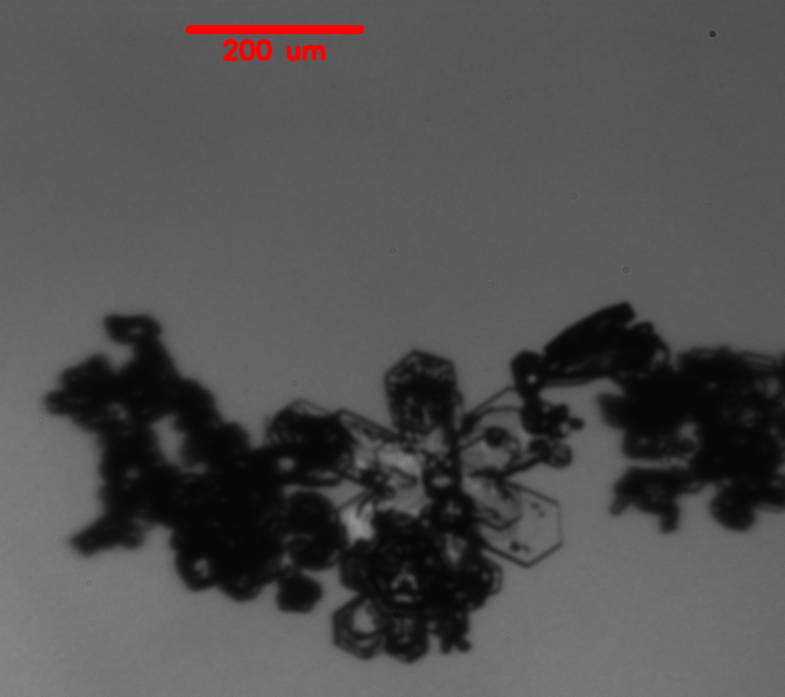
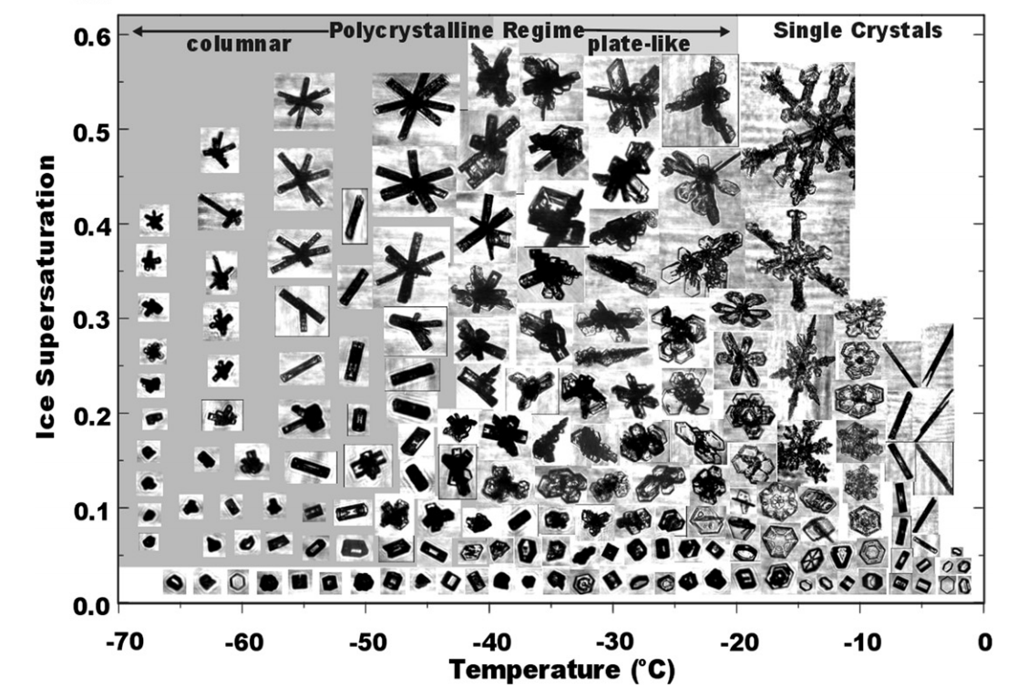
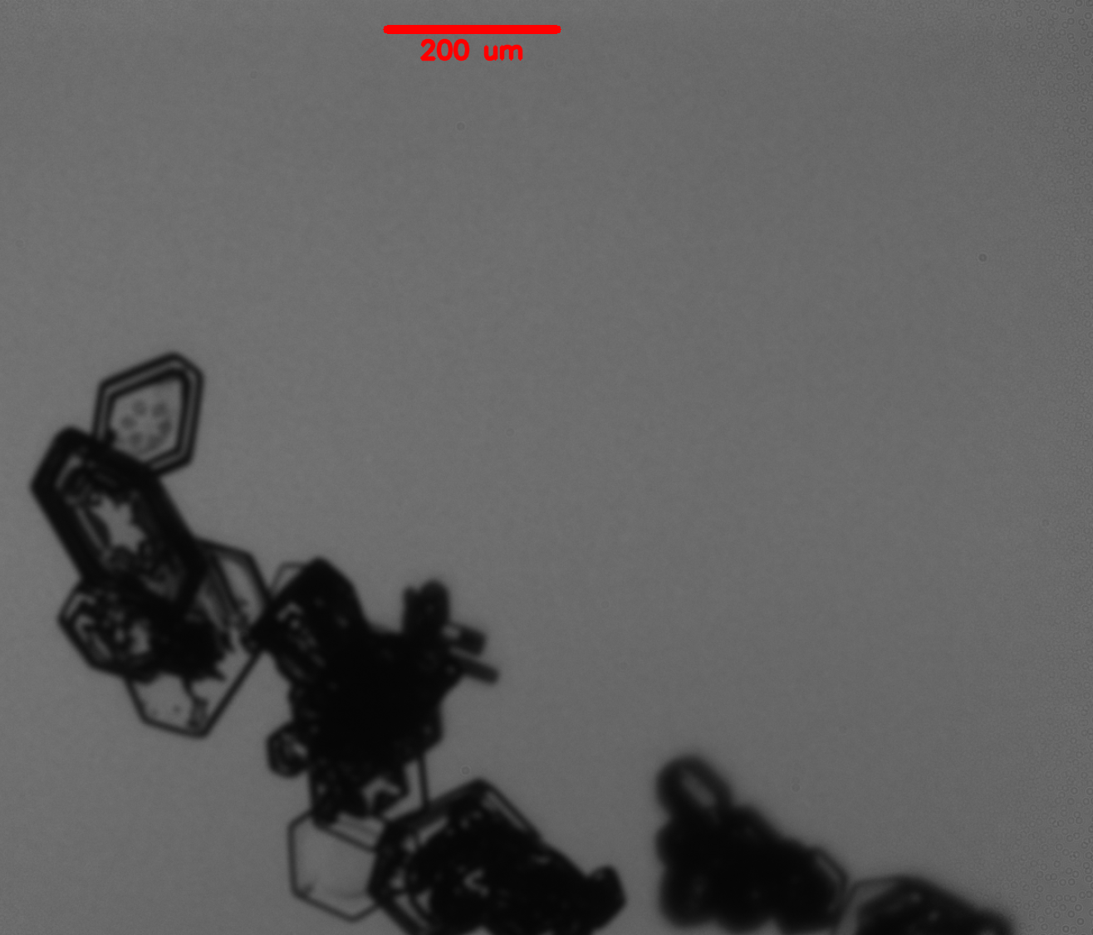
Observed Crystal Elements of the Chain Aggregates
16:16:44 UTC
16:25:16 UTC
16:16:12 UTC
15:54:17 UTC
15:51:18 UTC
Bailey & Hallett 2009

Slide 17
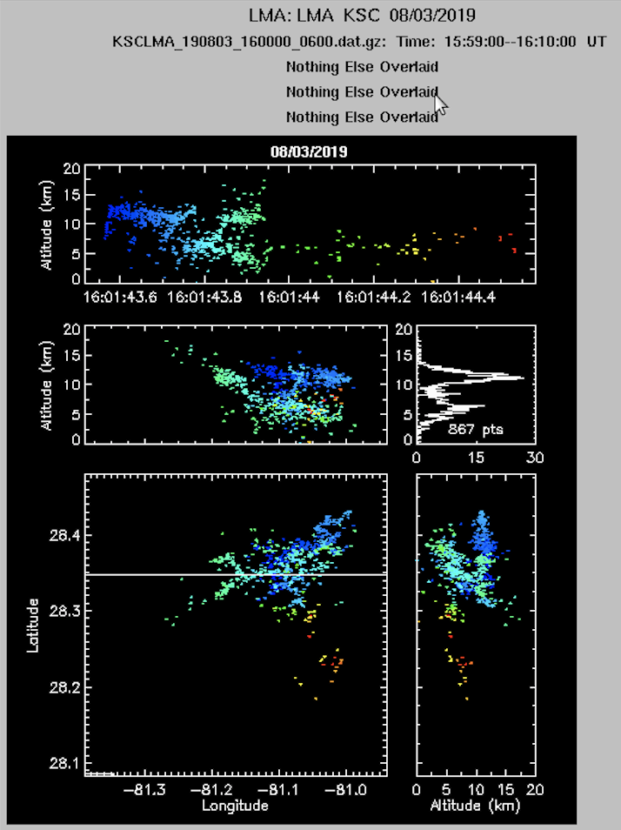
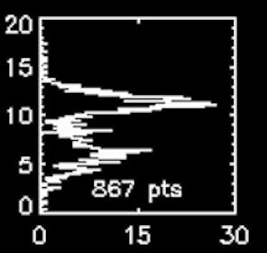
Kennedy Space Center Lightning Mapping Array
Intra/inner-cloud lightning strike that occurred at ~ 16:01:43 UTC within 5 km from aircraft (right after FL1 and right before FL2).
Upper-positive charge region?
~11 km AGL
lower-negative charge region?
~6 km AGL

Slide 18
Conclusions
During FL1-5 the E-field does not meet the threshold of 50 kV/m (as depicted by Saunders and Wahab 1975).
Though E-fields did reach up to –Ez = 21 kV/m (during FL1)
Lack of riming on the chain aggregates are also observed (similar to observations by Connolly et al 2005).
Some chain aggregates show signs of sublimation.
Possible by entrainment near the outer edges of the thunderstorm?
Some chains are comprised of just plates. Others are a mixture of crystal elements from different temperature regimes (~ -50°C to 0°C).
Due to internal mixing via turbulent eddies? Shear zones from the updraft and downdrafts?
Possible optimization of chain aggregation near the upper positive charge region (~10 km AGL)?
Notes:
This work is inconclusive in terms of answering the question can chain aggregation occur in the cirrus anvil. However, this study does find that the chain aggregation process is more complex outside of cloud chamber work, and the evidence of un-rimed chains and chains of multiple crystal habits from different temperature regions suggest that chain aggregation may be occurring well above the mixed layer (where sintering is more abundant and where cloud electric fields are high).

Slide 19
Future Work
In order to conclude that chain aggregation is occurring in the cirrus anvil region…
An analysis of other flights during the CapeEx19 Campaign (Fall AGU2021 Meeting).
More cloud chamber work using more realistic ice concentrations, colder temperatures (> -15°C), and lower applied electric fields (5-30 kV/m).
A deeper understanding into the adhesion properties of ice particles in the presence of electric fields at colder temperatures.
To conclude that chain aggregation is occurring in other regions of the storm…
More conducted flights needed to sample different heights within a storm.
Storm core penetration? -> safety restraints?

Slide 20
References
Bailey, M. P., and J. Hallett, 2009: A Comprehensive Habit Diagram for Atmospheric Ice Crystals: Confirmation from the Laboratory, AIRS II, and Other Field Studies. Journal of the Atmospheric Sciences, 66, 2888–2899, https://doi.org/10.1175/2009JAS2883.1
Connolly, P. J., C. P. R. Saunders, M. W. Gallagher, K. N. Bower, M. J. Flynn, T. W. Choularton, J. Whiteway, and R. P. Lawson, 2005: Aircraft Observations of the Influence of Electric Fields on the Aggregation of Ice Crystals. Quarterly Journal of the Royal Meteorological Society, 131, 1695–1712, https://doi.org/10.1256/qj.03.217
Saunders, C. P. R., and N. M. A. Wahab, 1975: The Influence of Electric Fields on the Aggregation of Ice Crystals. Journal of the Meteorological Society of Japan, 53, 121–126, https://doi.org/10.2151/jmsj1965.53.2_121

