Slide 1
Radar and Airborne Observations in Florida Thunderstorm Anvils
Christian Nairy, Dr. Andrew Detwiler, Dr. David Delene

Slide 2
Background
Multiple airborne field projects have been performed to obtain in-situ measurements within Florida thunderstorms^{1,2}.
Aircraft/balloon sampling of continental and maritime convection show many differences in the electrical structure³.
As well as microphysical properties.
Aircraft sampling from Florida cirrus anvils³ mostly agree with past lab experiments (Wahab 1974) where inter-cloud electric charge can alter the microphysical properties of particles.

Slide 3
Motivation
Concurrent in-situ observations of electric fields, radar, particle, microphysical, and environmental observations by aircraft through Florida cirrus anvils have yet to be obtained until the CapeEx19 Field Campaign.
Newly obtained data may provide further insight in the electrical structure and microphysical characteristics in the upper-levels of Florida Thunderstorms.

Slide 4
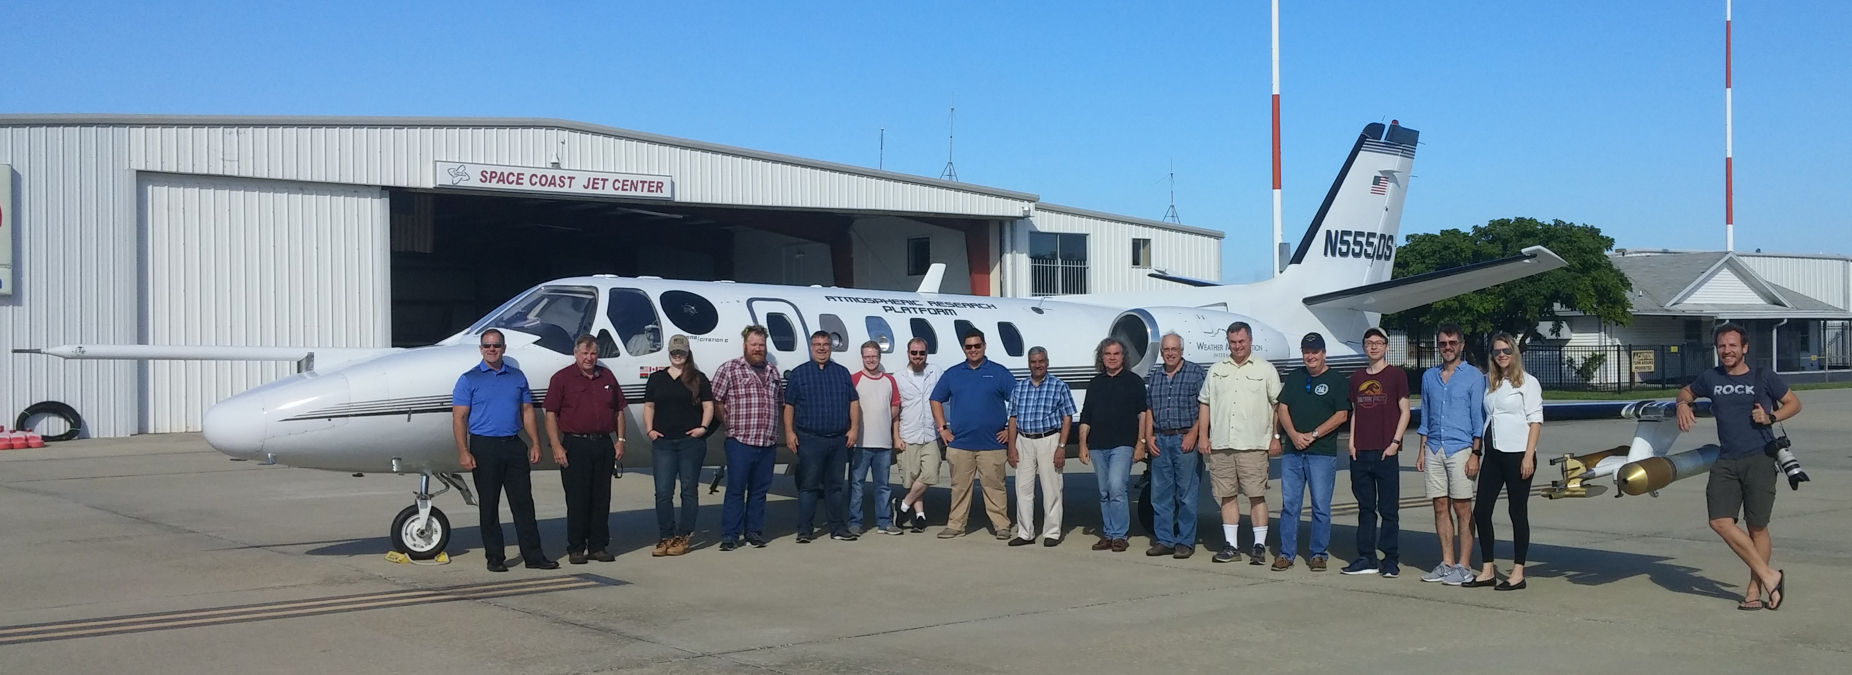
Cape Experiment (CapeEx19)
Field Campaign on behalf of the Naval Surface Warfare Center.
University of North Dakota (UND), Weather Modification International (WMI)
Location: Cape Canaveral, Florida
Objectives:
Improve Florida thunderstorm knowledge.
Improve radar using concurrent radar & aircraft observations.
Implement data collected into microphysical/cloud models.
12 Research Flights
From 2019/07/22 – 2019/08/03

Slide 5
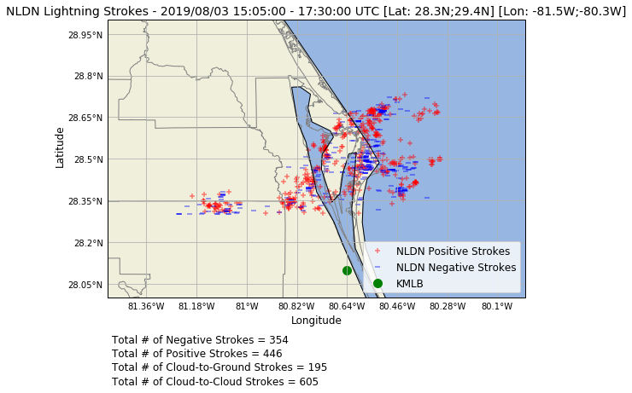
NLDN Data⁴
Add flight tracking data

Slide 6
Flight Leg 1 (FL1) 15:50:00 – 16:01:00

Slide 7
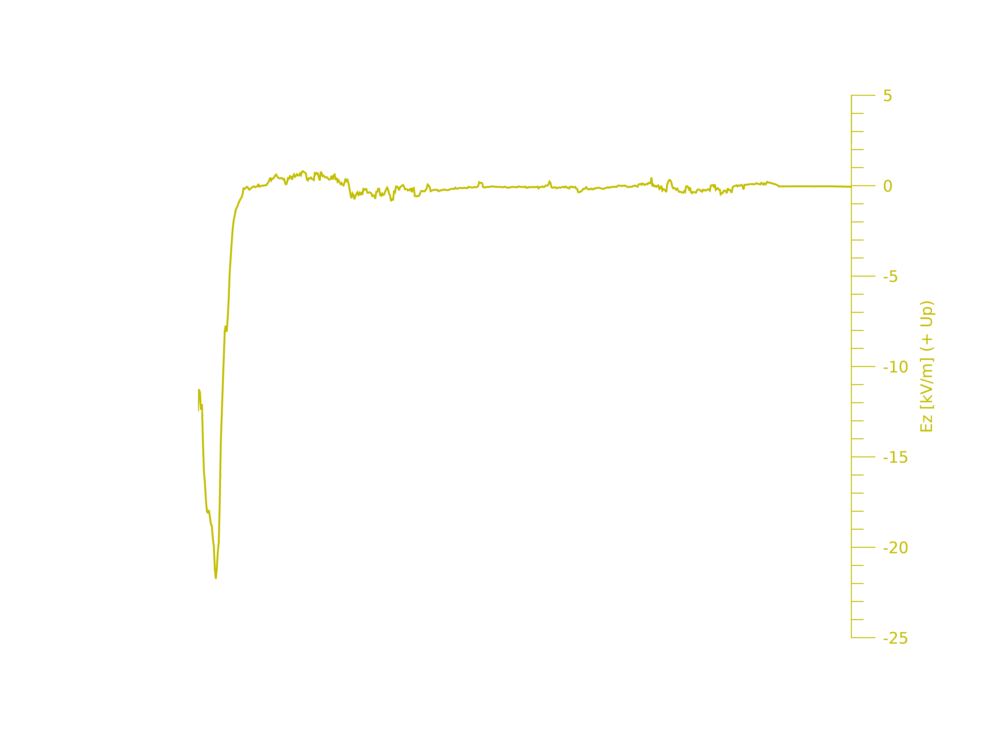
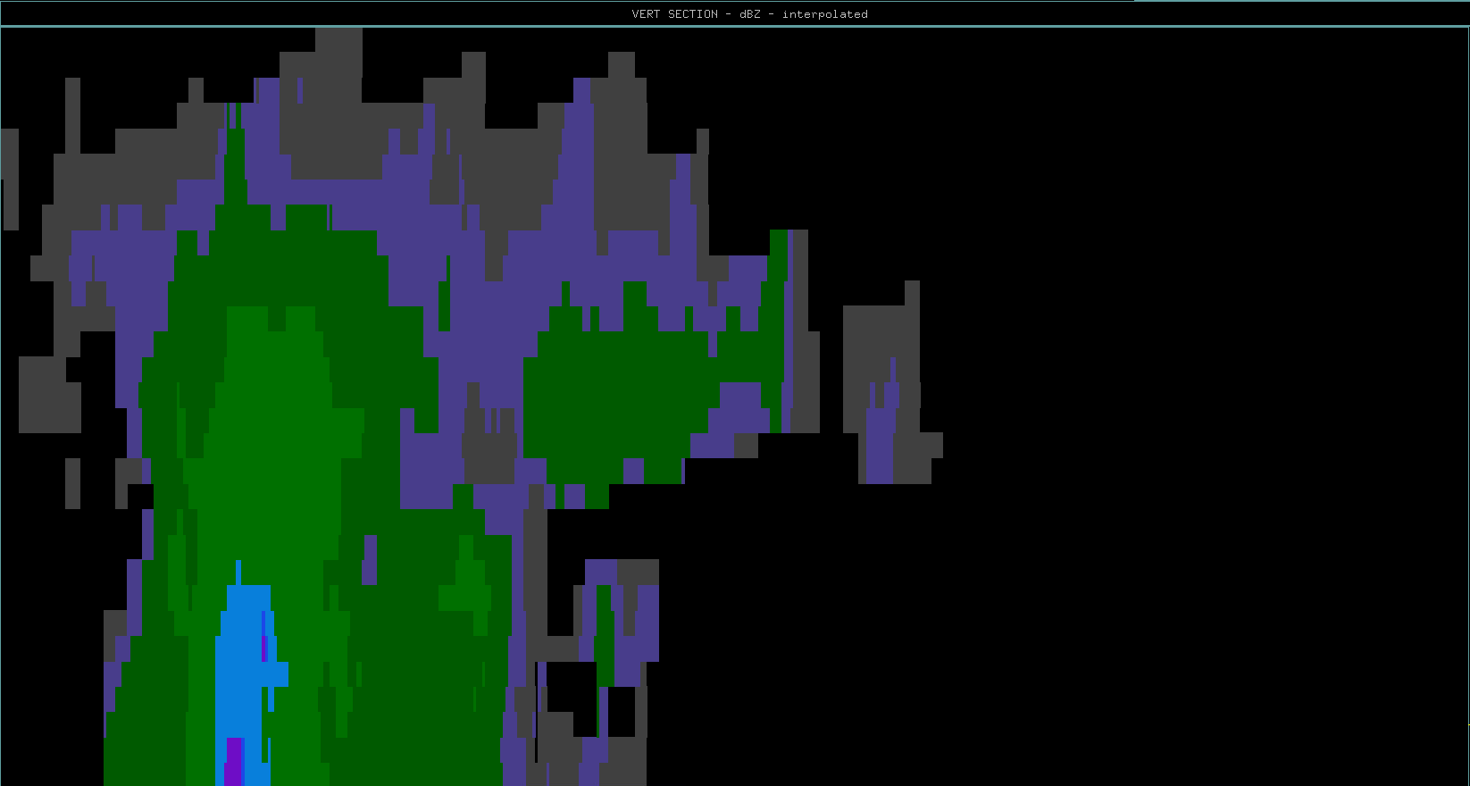
10
20
30
40
50
60
70
80
90
100
110
Distance (km)
Aircraft Flight Track & Direction
Flight Legs | Time Span (hh:mm:ss) UTC | Time Span (SFM) | Altitude Span (m) | Temperature Span (degrees C)
Flight Leg 1 | 15:50:00-16:01:00 | 57000-57659 | 10022-10041 | -34.35 to -34.35

Slide 8
Microphysical Data Flight Leg 1 15:50:00 – 16:01:00

Slide 9
Flight Leg 3 (FL3) 16:09:00 – 16:17:00
Aircraft sampling father
away from storm core but in the
same relative sampling locations as
Flight Leg 1.

Slide 10
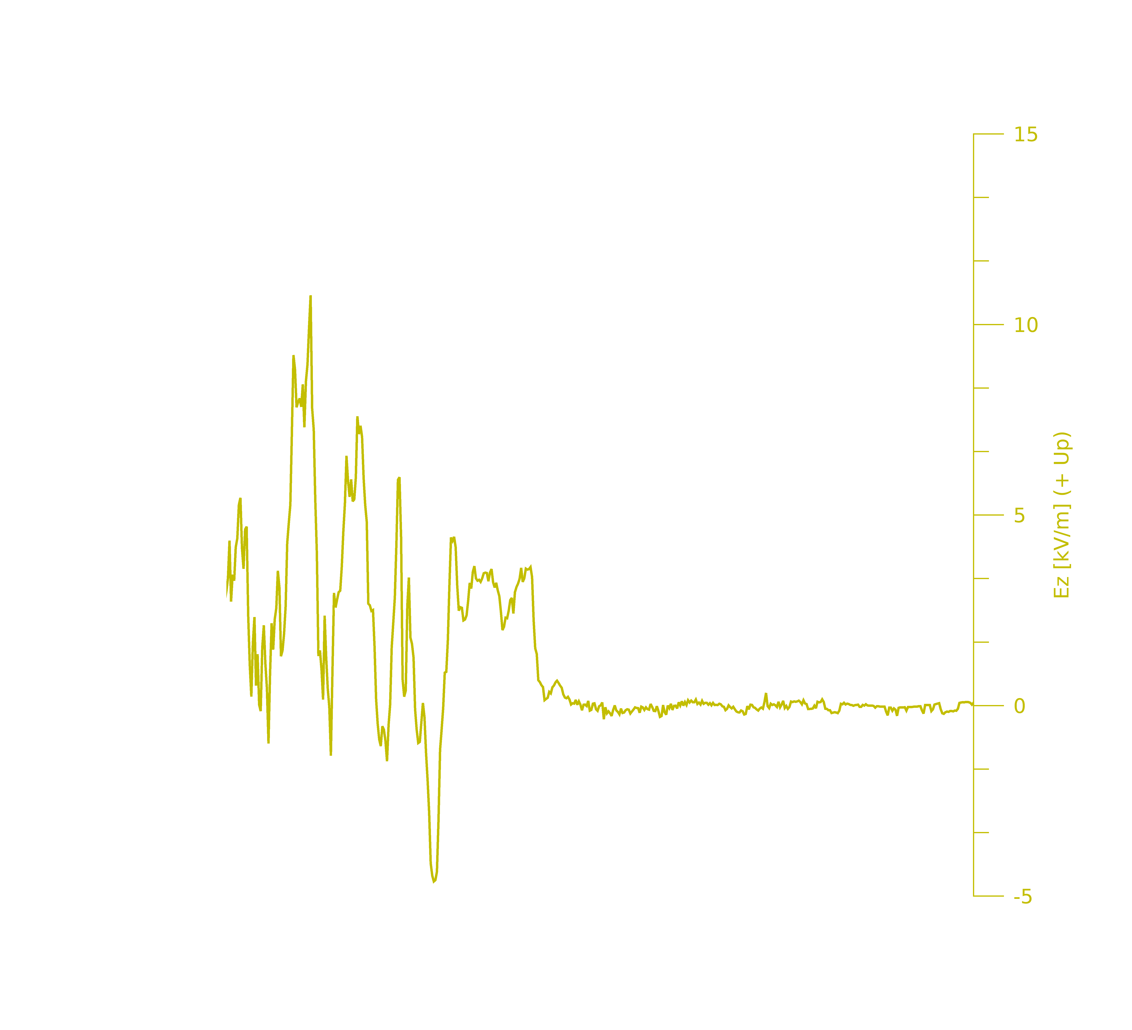
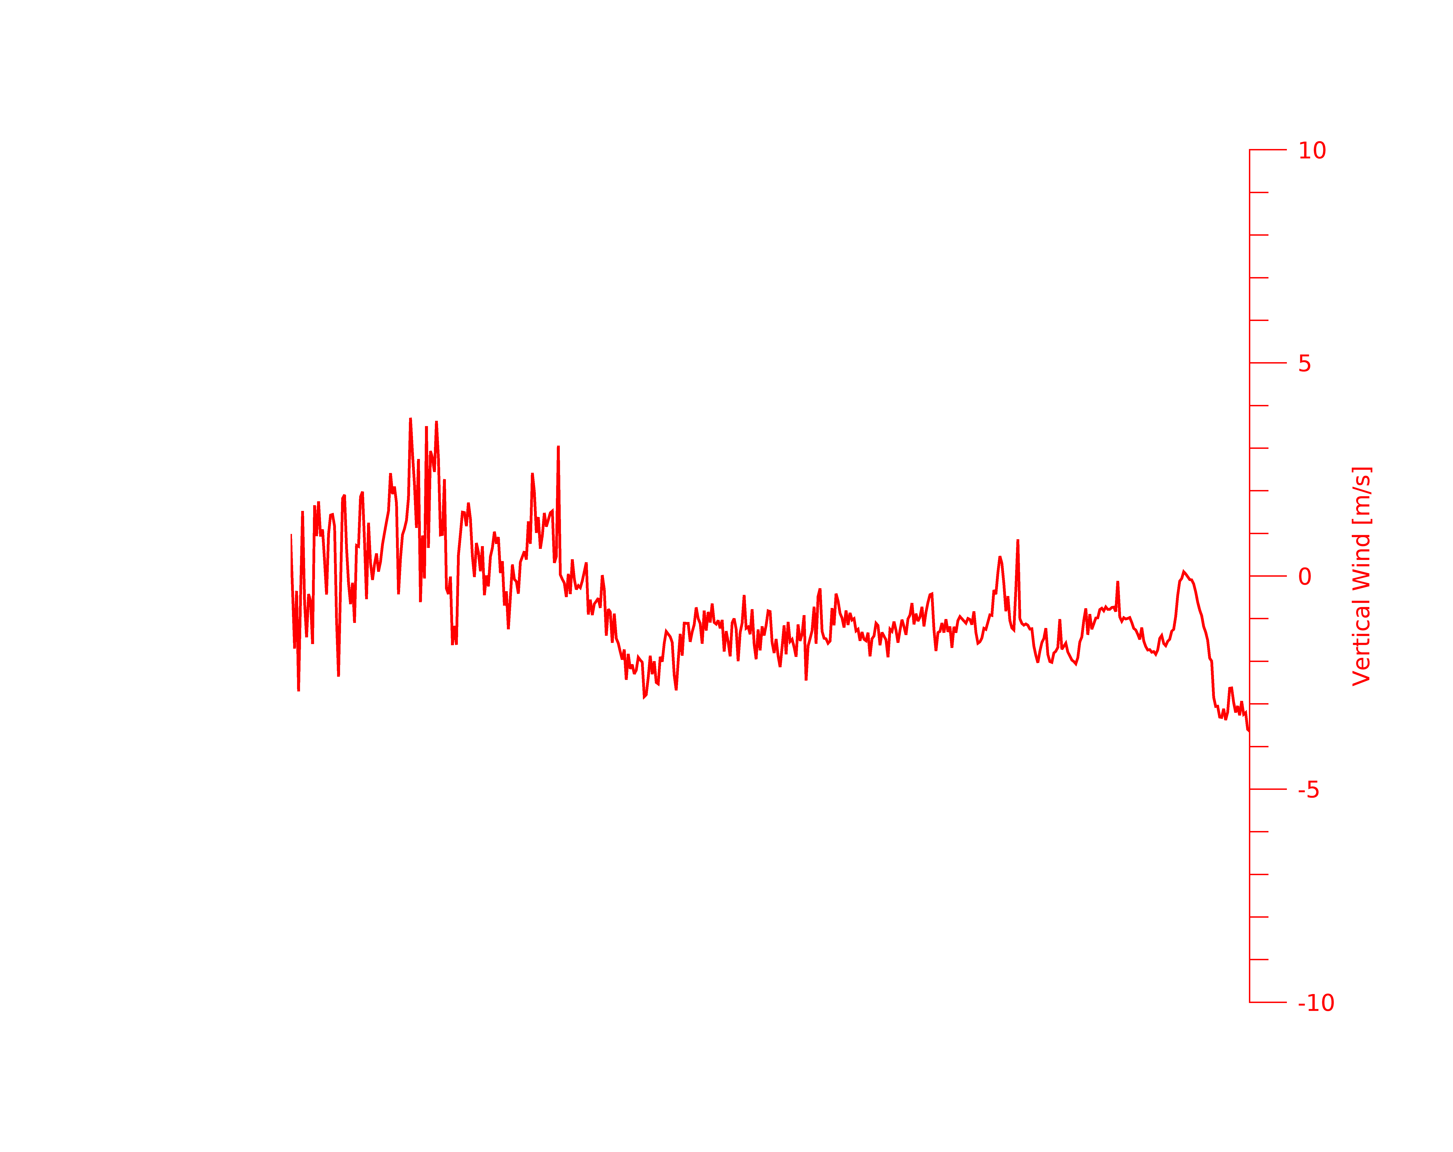
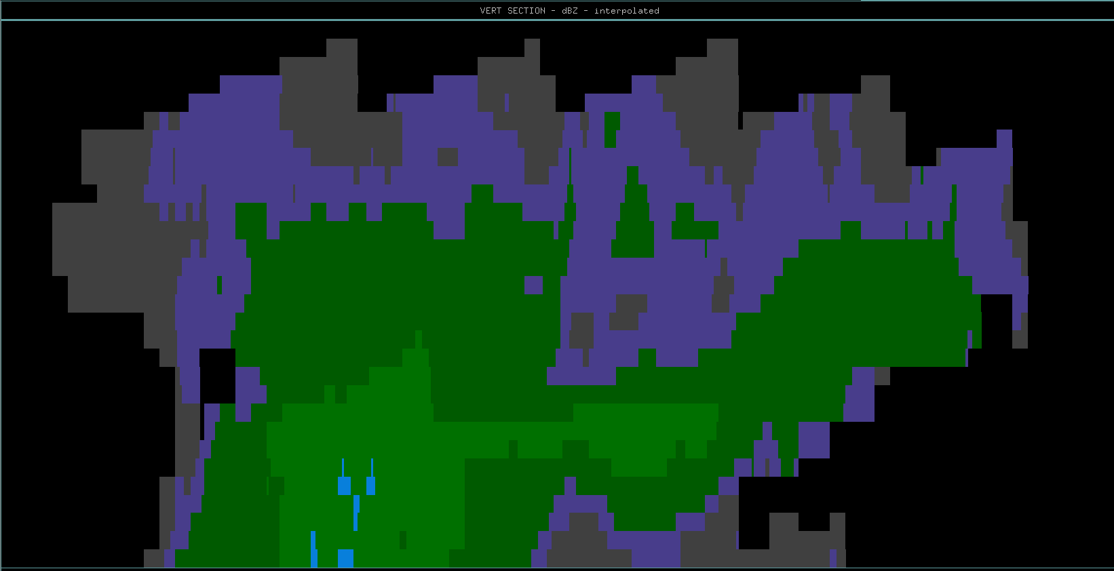
10
20
30
40
50
60
70
Distance (km)
Aircraft Flight Track & Direction
Flight Legs | Time Span (hh:mm:ss) UTC | Time Span (SFM) | Altitude Span (m) | Temperature Span (degrees C)
Flight Leg 3 | 16:09:00-16:17:00 | 58140-58619 | 10017-10046 | -30.64 to -33.88

Slide 11
Microphysical Data Flight Leg 3 16:09:00 – 16:17:00

Slide 12
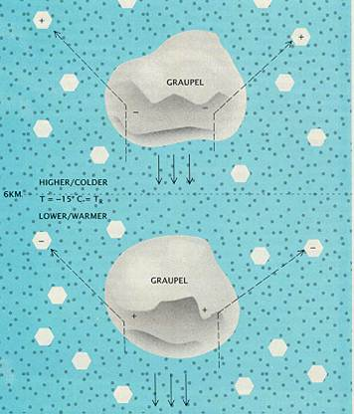
Graupel-Ice Collision Mechanism⁵

Slide 13
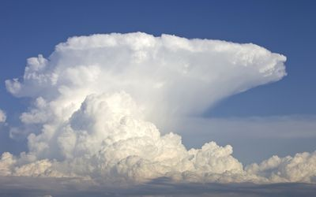
(Not the actual sampled storm –
for visual reference)
Screening Layer
U.P. Charge Region
( Graupel/Cloud Ice)
Updrafts carry some charged
graupel upwards above the -30°C
level.
-30°C
N Charge Region
( Graupel)
Downdraft
Downdraft
-15°C
FL1 PHIPS Imagery - 16:00:02 UTC
100 μm
L.P. Charge Region
( Graupel)
Updraft
Updraft

Slide 14
References
^{1 ﻿}Bringi et al. 1996 -- CaPe
² CAPEX15
³ P. J. Connonlly et al. 2005
⁴NLDN for lightning data
⁵Earle R. Williams – The electrification of thunderstorms

Slide 15
Extra Slides

Slide 16
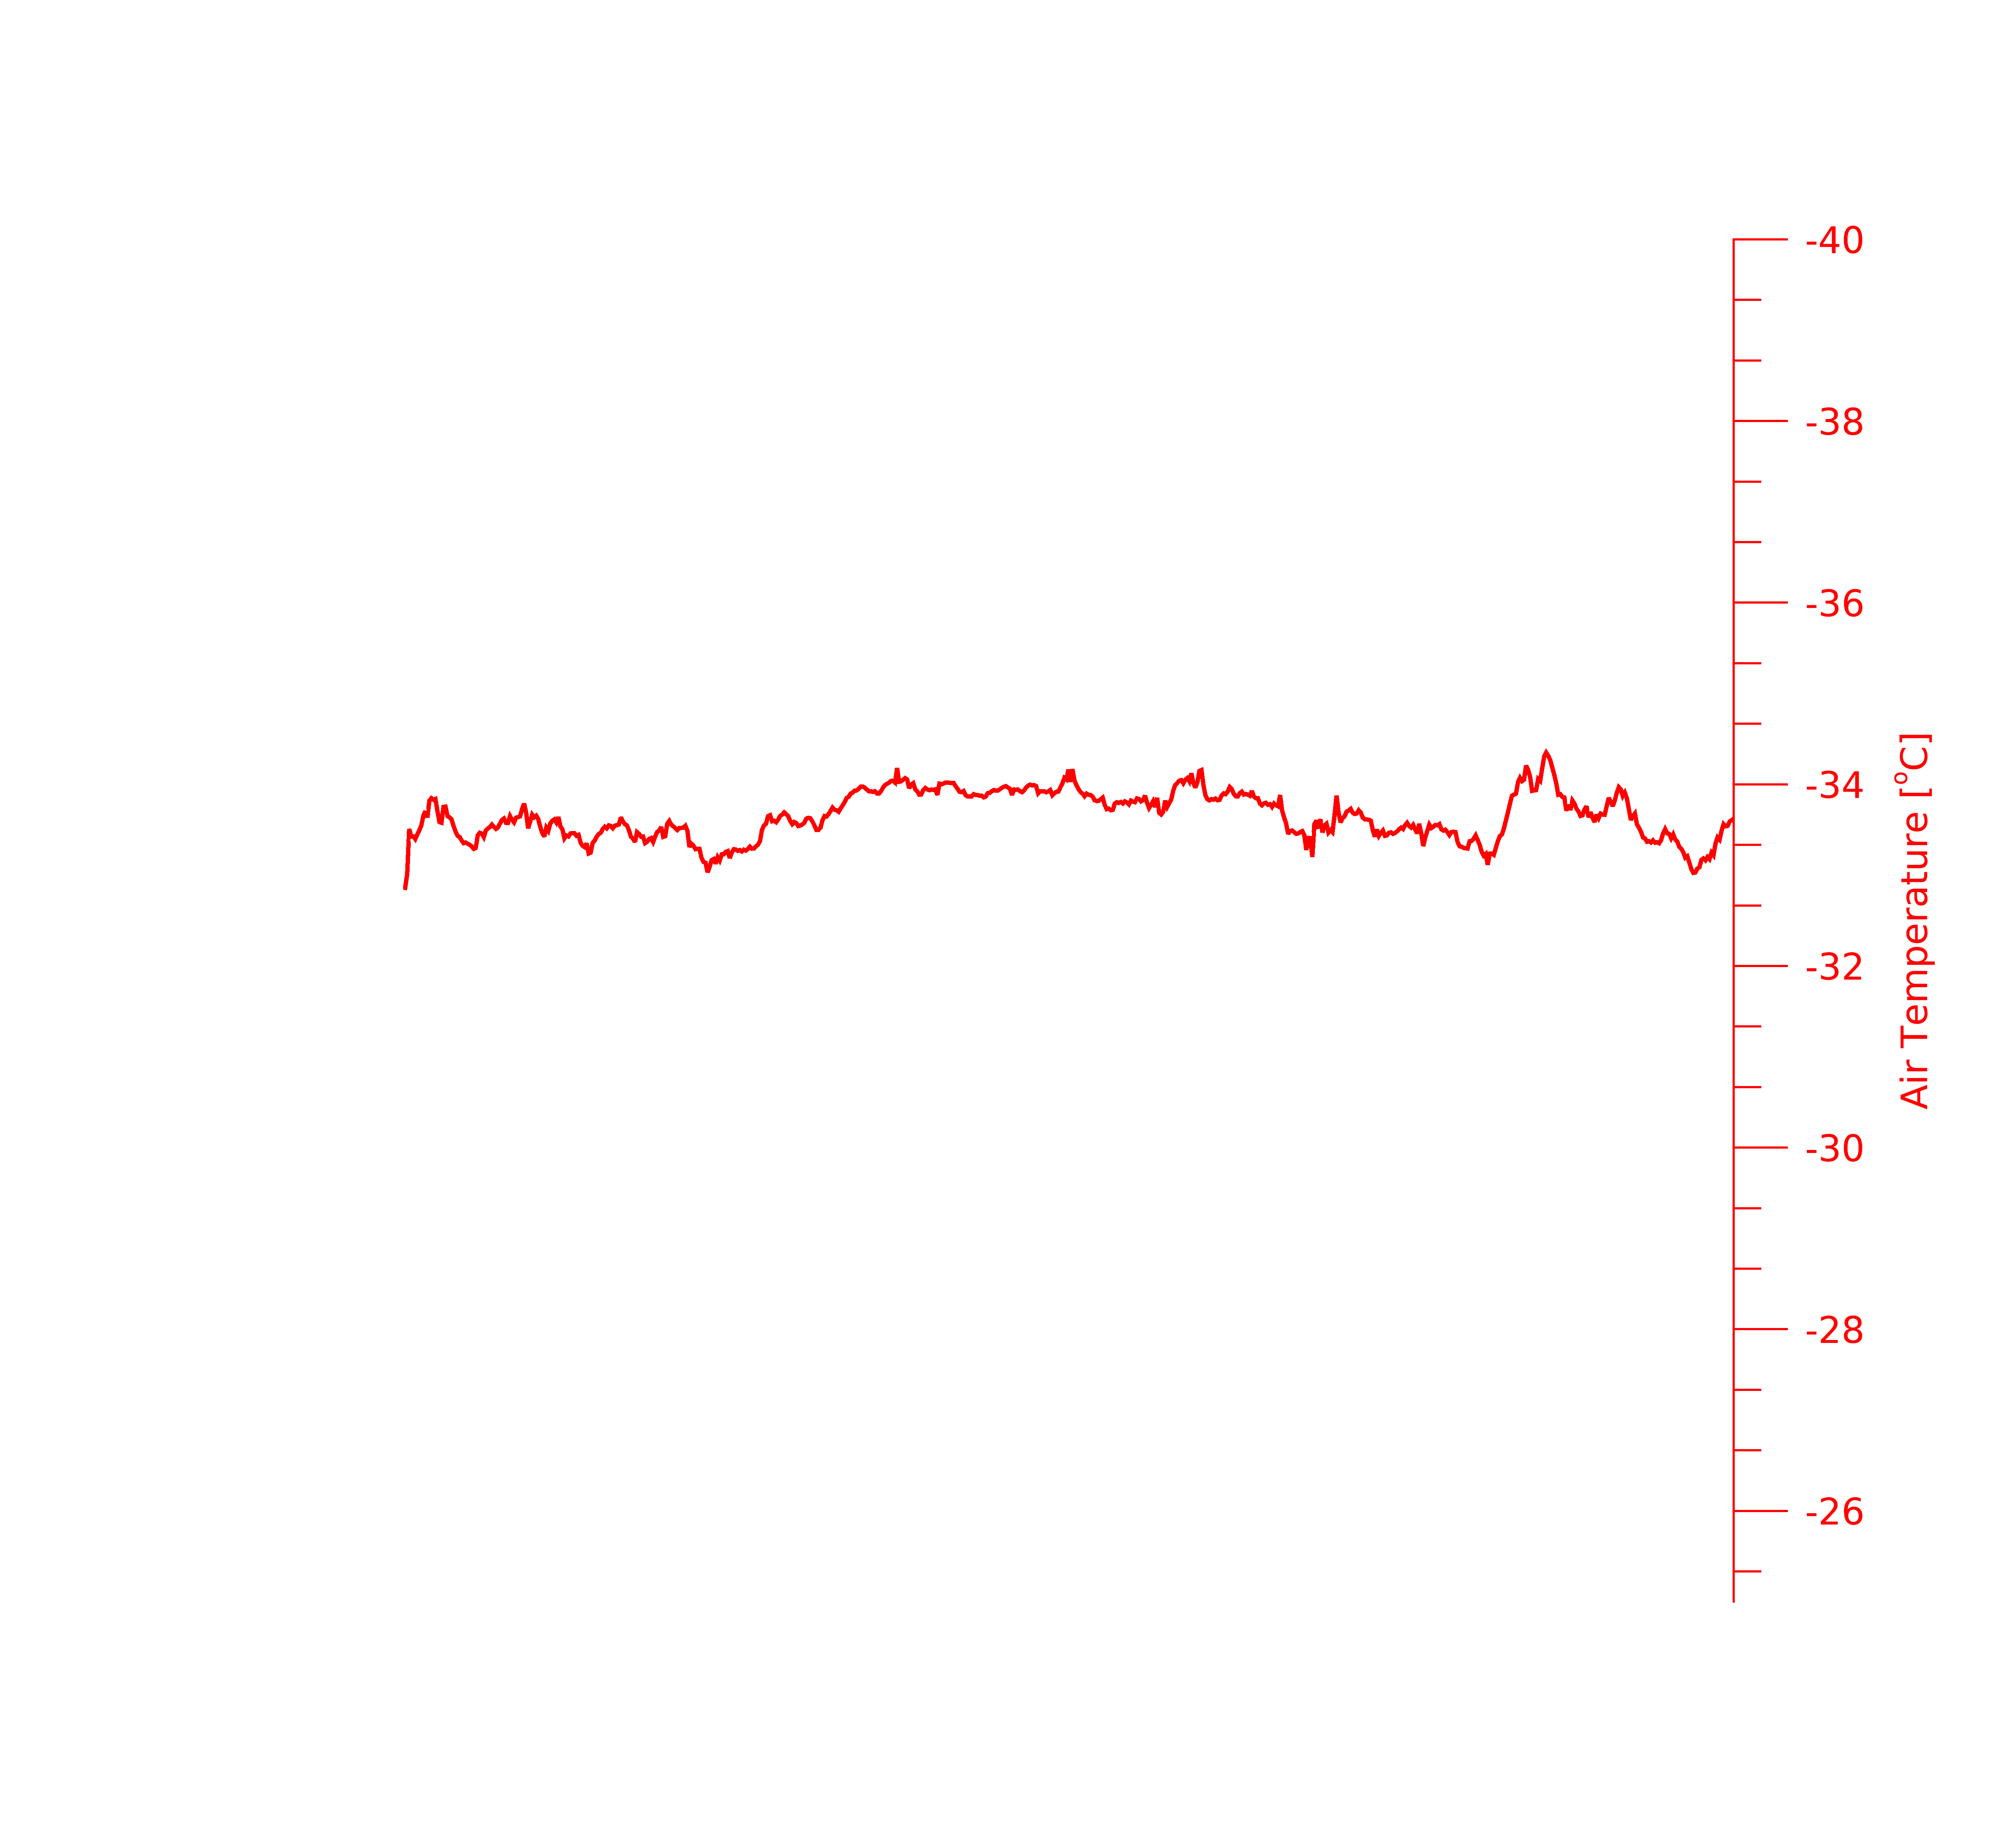
10
20
30
40
50
60
70
80
90
100
110
Distance (km)
Aircraft Flight Track & Direction

Slide 17
10
20
30
40
50
60
70
Distance (km)
Aircraft Flight Track & Direction

Slide 18
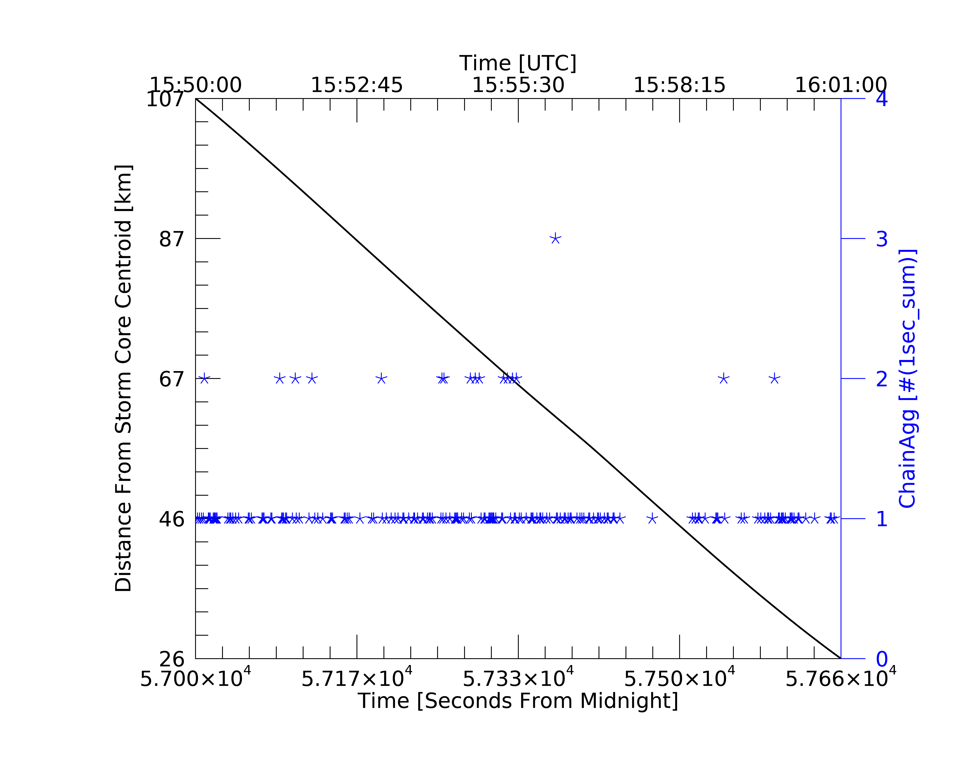
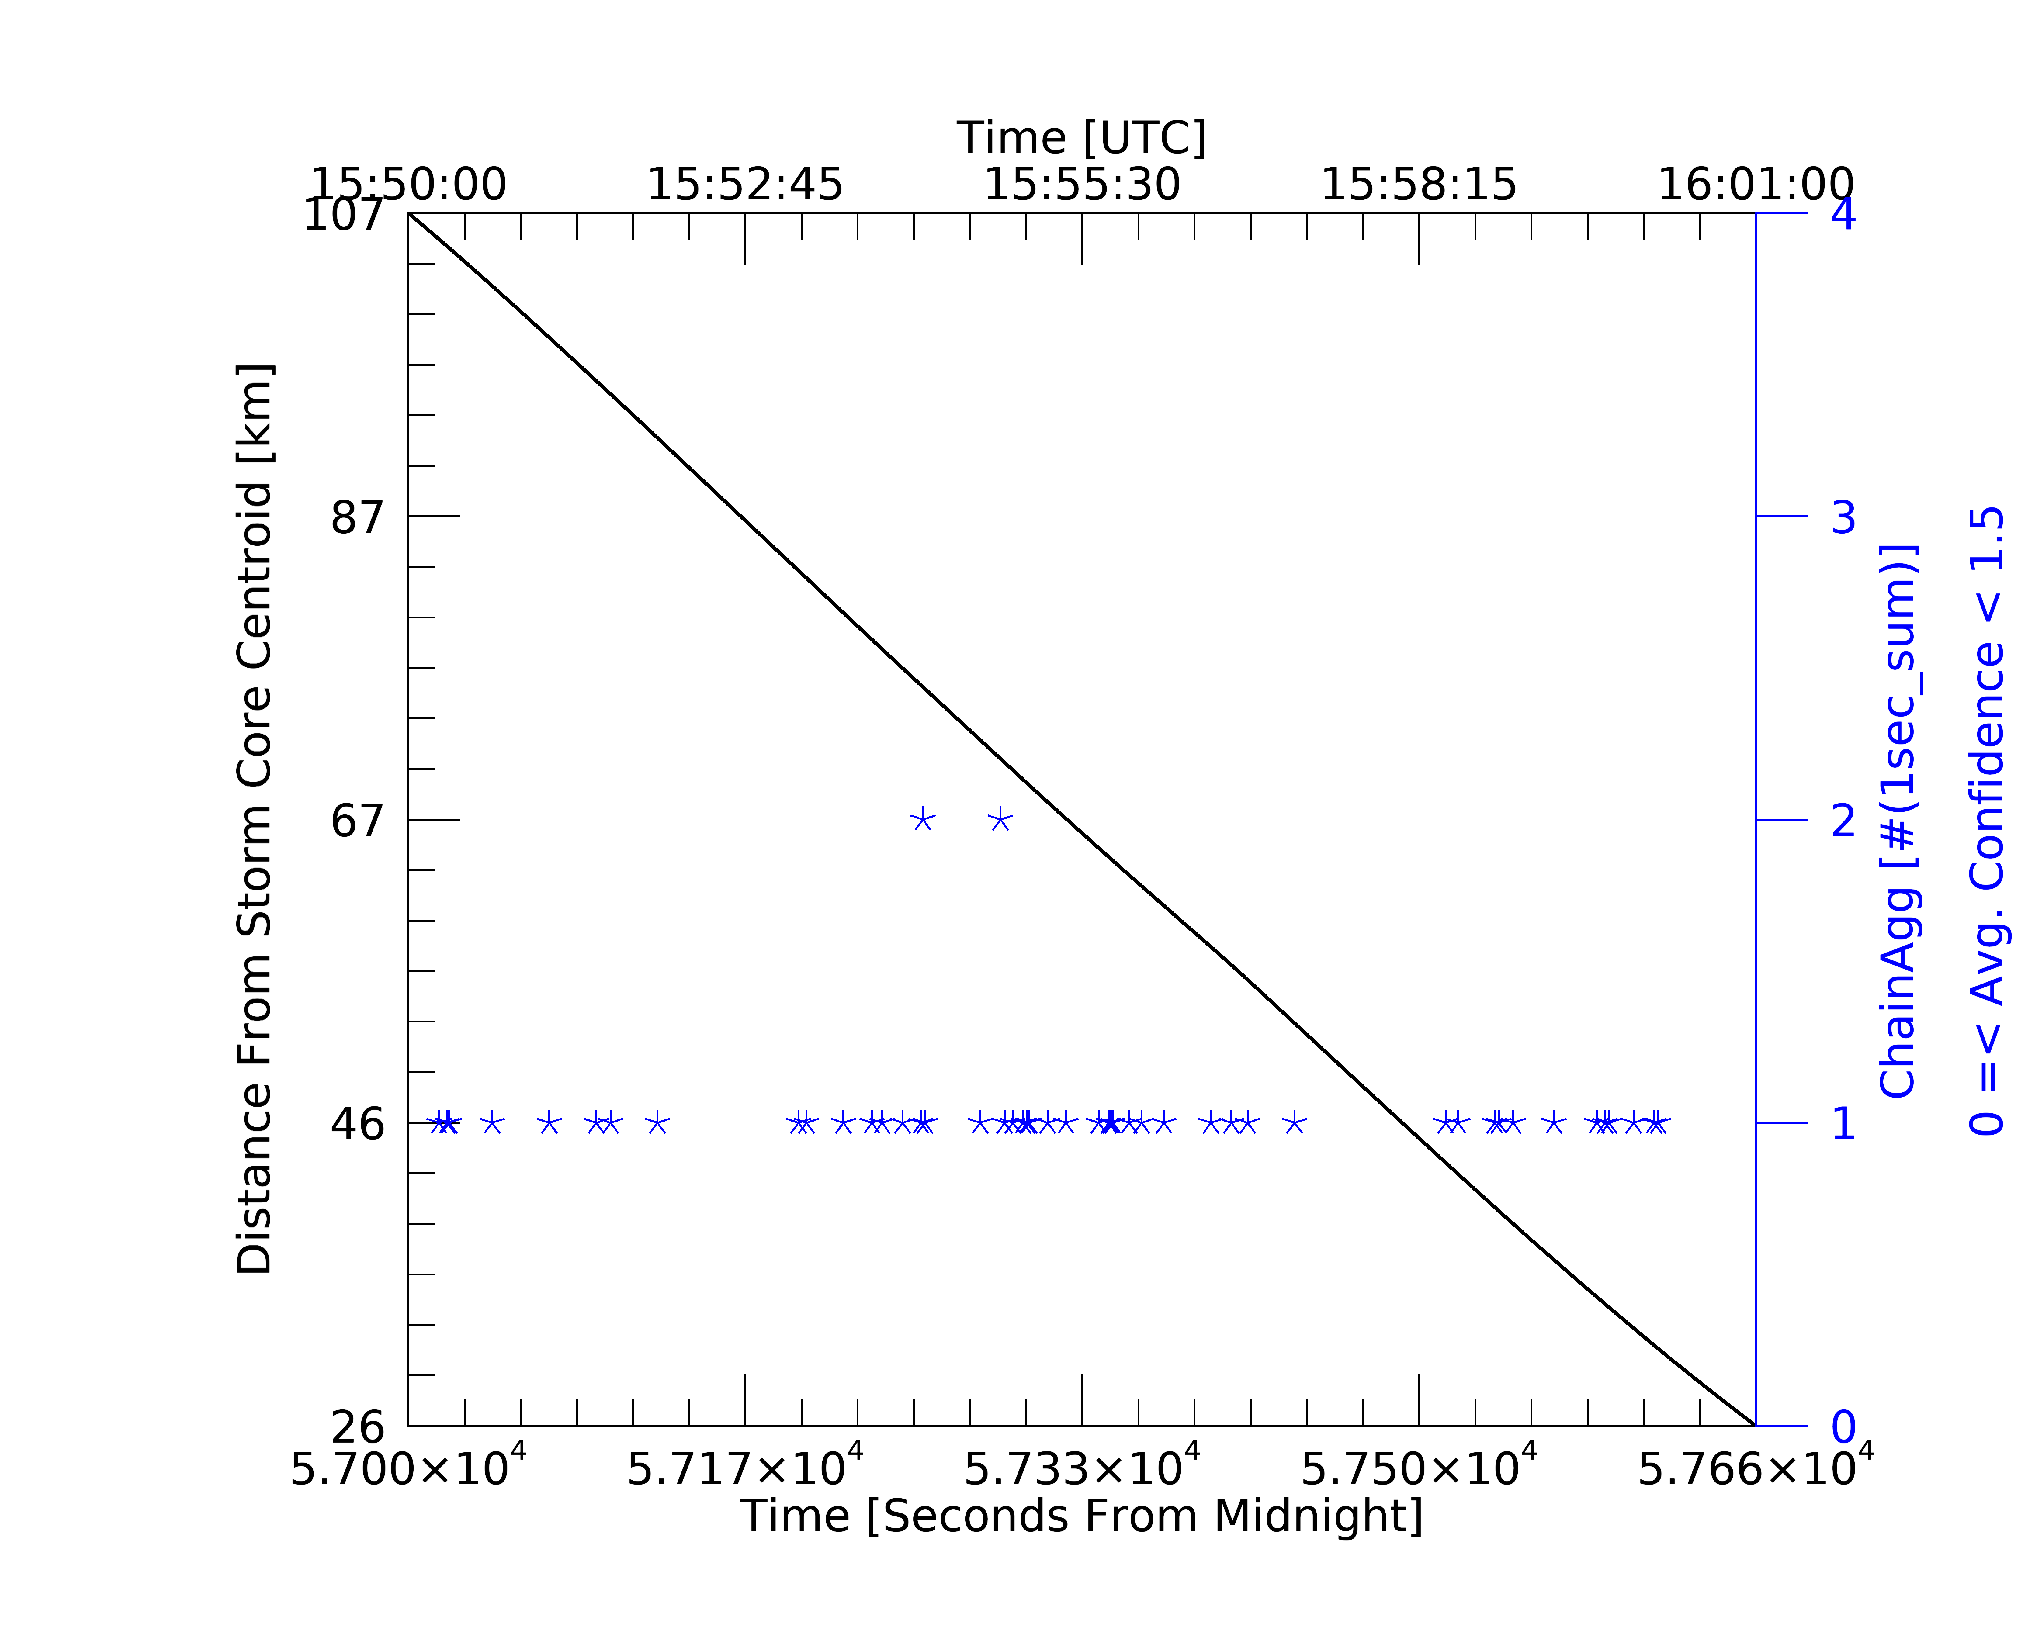
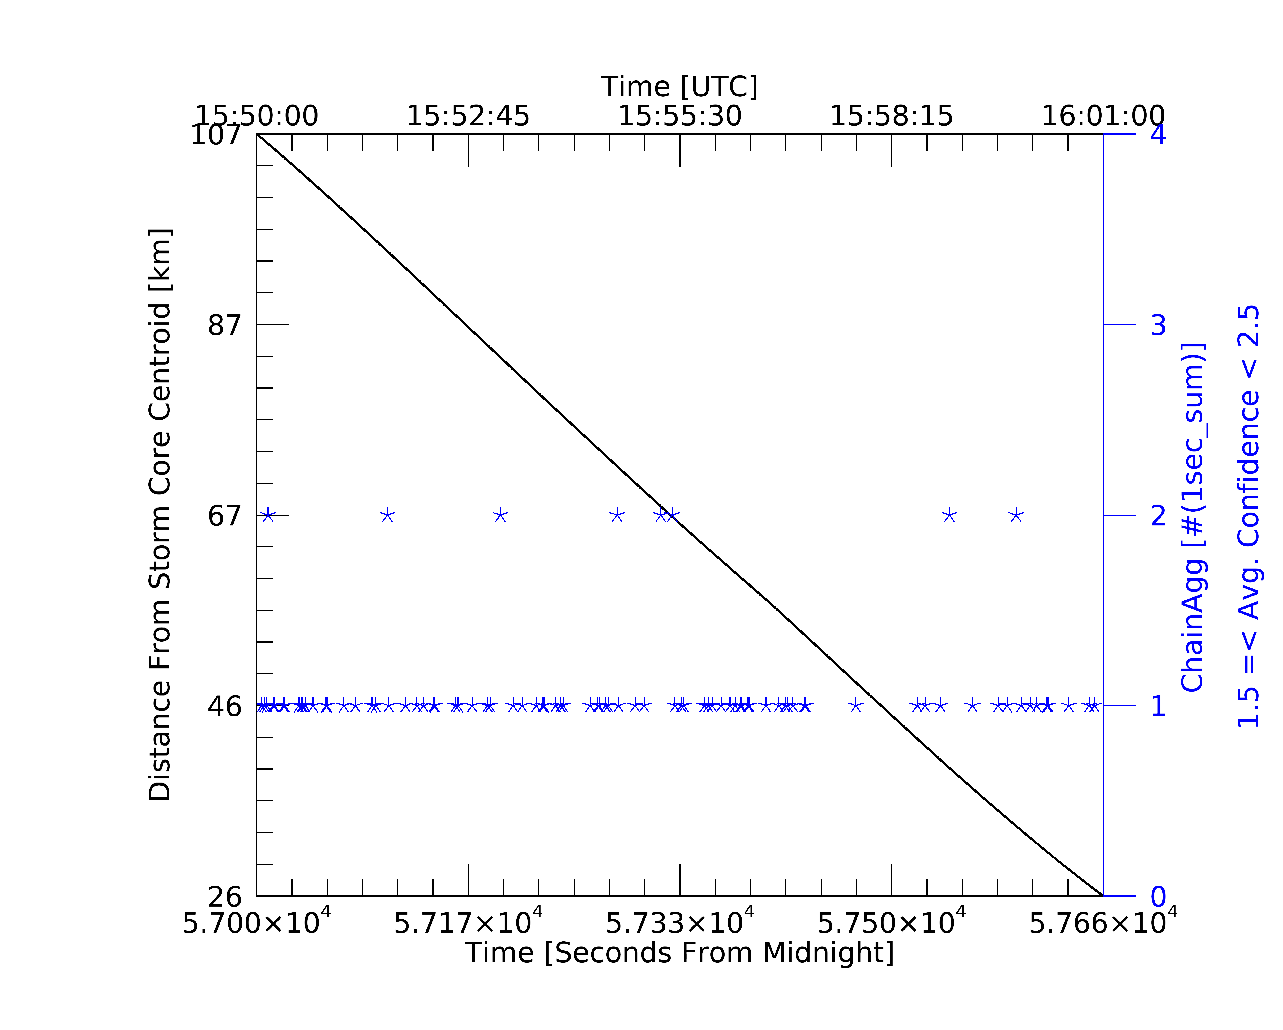
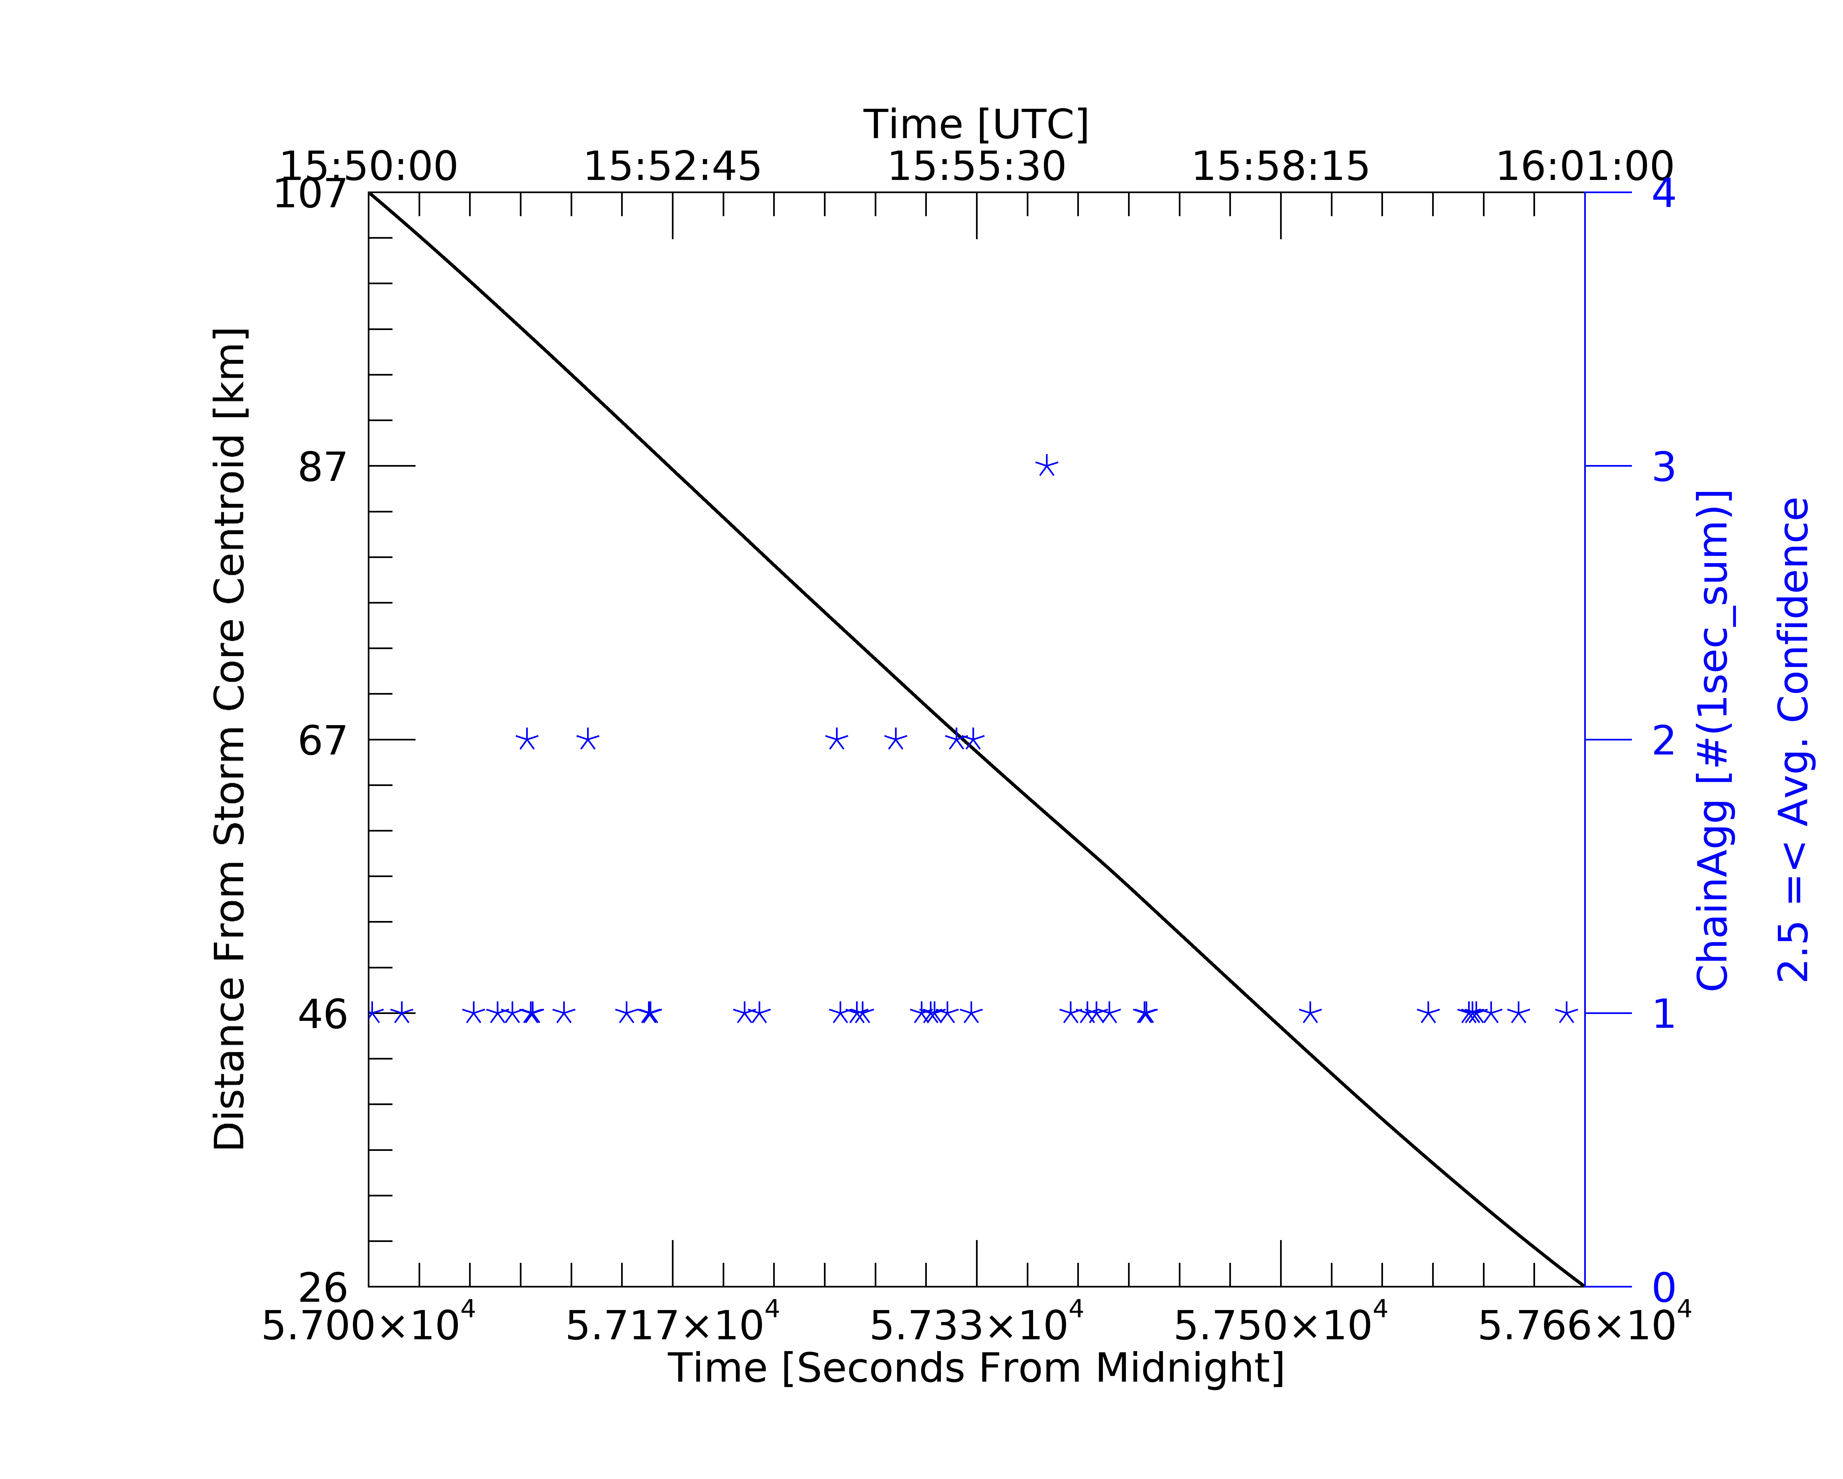
a.)
b.)
c.)
d.)

