Slide 1
Christian Nairy’s Thesis Committee Meeting
2021/06/01
Committee Members:
Dr. David Delene (Chair)
Prof. Michael Poellot
Dr. Jerome Schmidt
Dr. Paul Harasti

Slide 2
Table of Contents
Review from Last Committee Meeting.
Thesis Topic Proposal for Thesis Committee
Results on Latest Research
Current Plan

Slide 3
Review from Last Committee Meeting
Reviewed the AGU poster and oral presentations.
Presentations are on the UND Wiki page:
wiki.atmos.und.edu/doku.php?id=atmos:citation:research:agu_presentation
Completed the Thesis Plan of Study form.

Slide 4
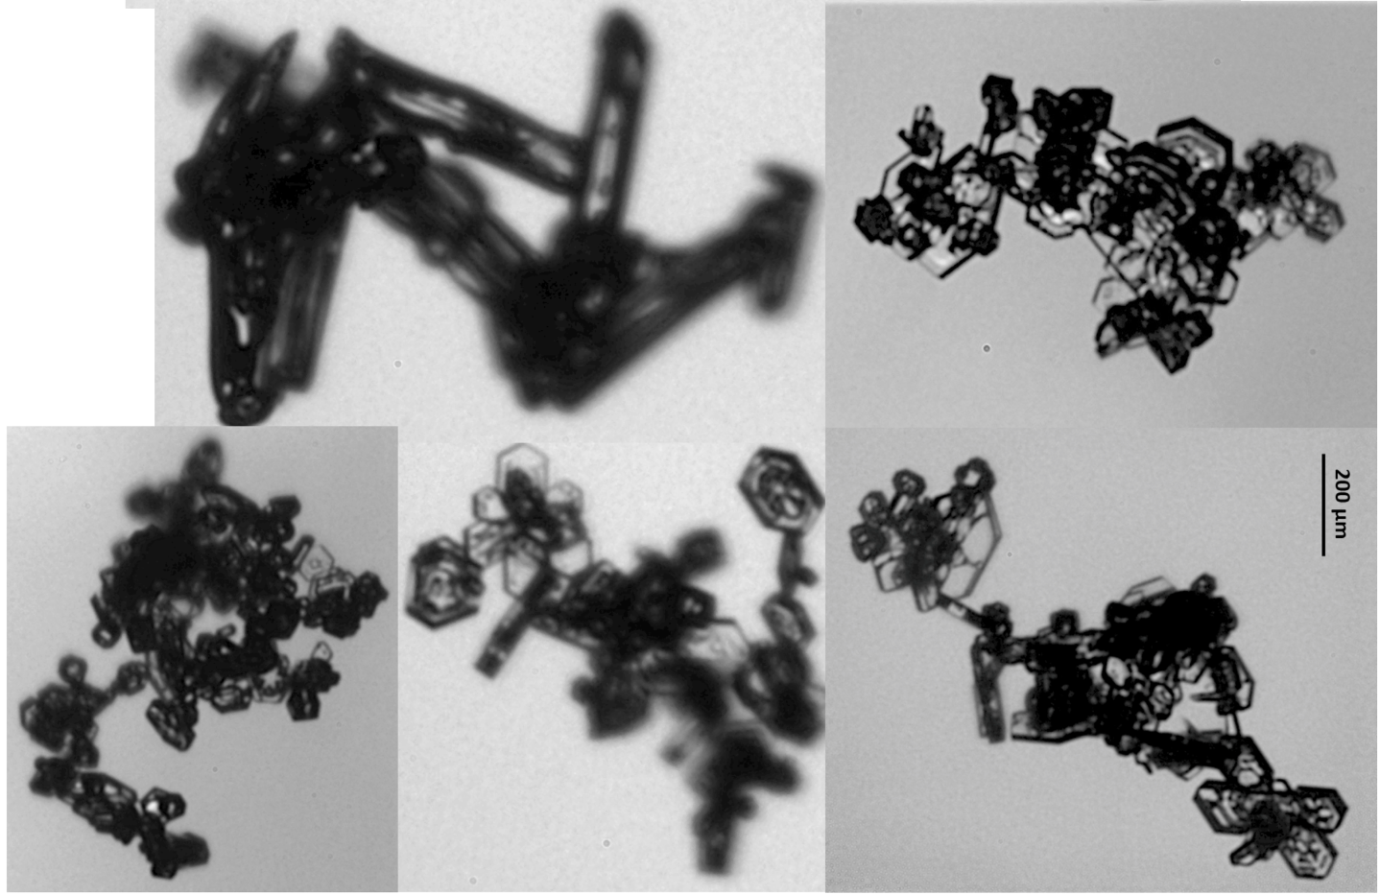
Thesis Topic Proposal
Title: Microphysical Observations of Chain Aggregates in Florida Cirrus Cloud Anvils on 3 August 2019

Slide 5
Thesis Topic Proposal - Introduction
Evidence since the 1960’s has shown that electric fields have an influence on aggregation.
Previous Cloud Chamber Experiments:
Latham and Saunders (1970): Small ice crystals collection efficiencies substantially increased in the presence of electric fields.
Crowther and Saunders (1973): Tested aggregation and fragmentation of ice crystals in the presence of electric fields (10⁵ V m⁻¹).
Observed aggregates not in clumps, but in an elongated, quasi-linear, chain-like orientation occasionally containing 10 or more ice crystal elements.
Saunders and Wahab (1975): Tested aggregation and fragmentation of ice crystals in the presence of electric fields (10⁵ V m⁻¹) but using more realistic ice crystal concentrations (than previous cloud chamber work).
Notes:
Crowther and Saunders: Utilizing electric field strengths on the order of 10⁵ V m⁻¹, high ice crystal concentrations (10⁷ m⁻³), and varying temperatures (0°C to -20°C),

Slide 6
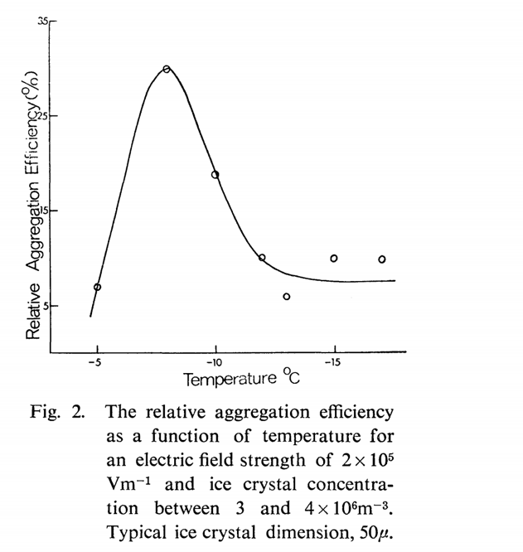
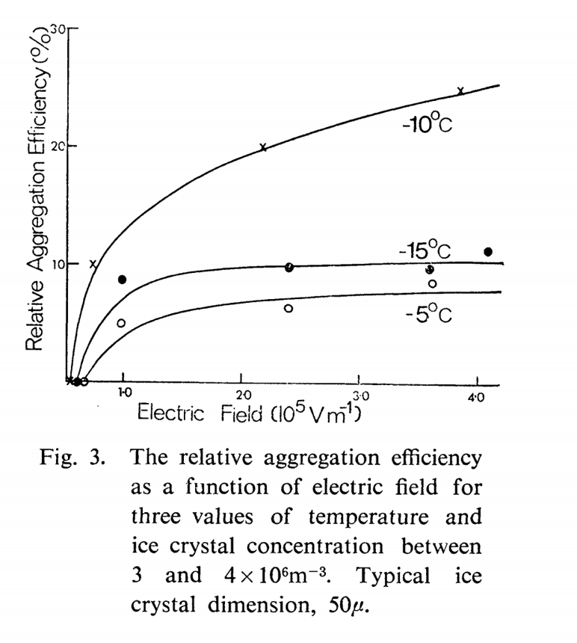
Thesis Topic Proposal - Introduction
Saunders and Wahab, 1975:
Notes:
Description of chain aggregation efficiency:
Peak efficiency @ T = -8°C @ constant E-field (Fig. 2)
﻿Figure 3 shows how the relative aggregation efficiency depends on the applied field strength for constant values of temperature.
Minimum E-Field that aggregation plays a roll on (based on their experiments) = 0.6 x 10⁵ Vm⁻¹
The aggregation of ice crystals may be increased by up to 30% in the presence of electric fields
Strengths similar to those measured in highly electrified natural clouds.
Above a threshold electric field of 0.6 * 105V m-1 the electric field is able to promote a larger number of collisions and to increase the adhesion efficiency.
At lower temperatures, the ice crystal field-free collection efficiency decreased.
Crystal interactions tended to result in separation more often than at higher temperatures with a consequent increase in the number of charged crystals at lower temperatures.
This effect would have been offset to a certain extent by the increase in electrical relaxation time at lower temperatures which may have prevented complete charge transfer in many of the short-contact time interactions.

Slide 7
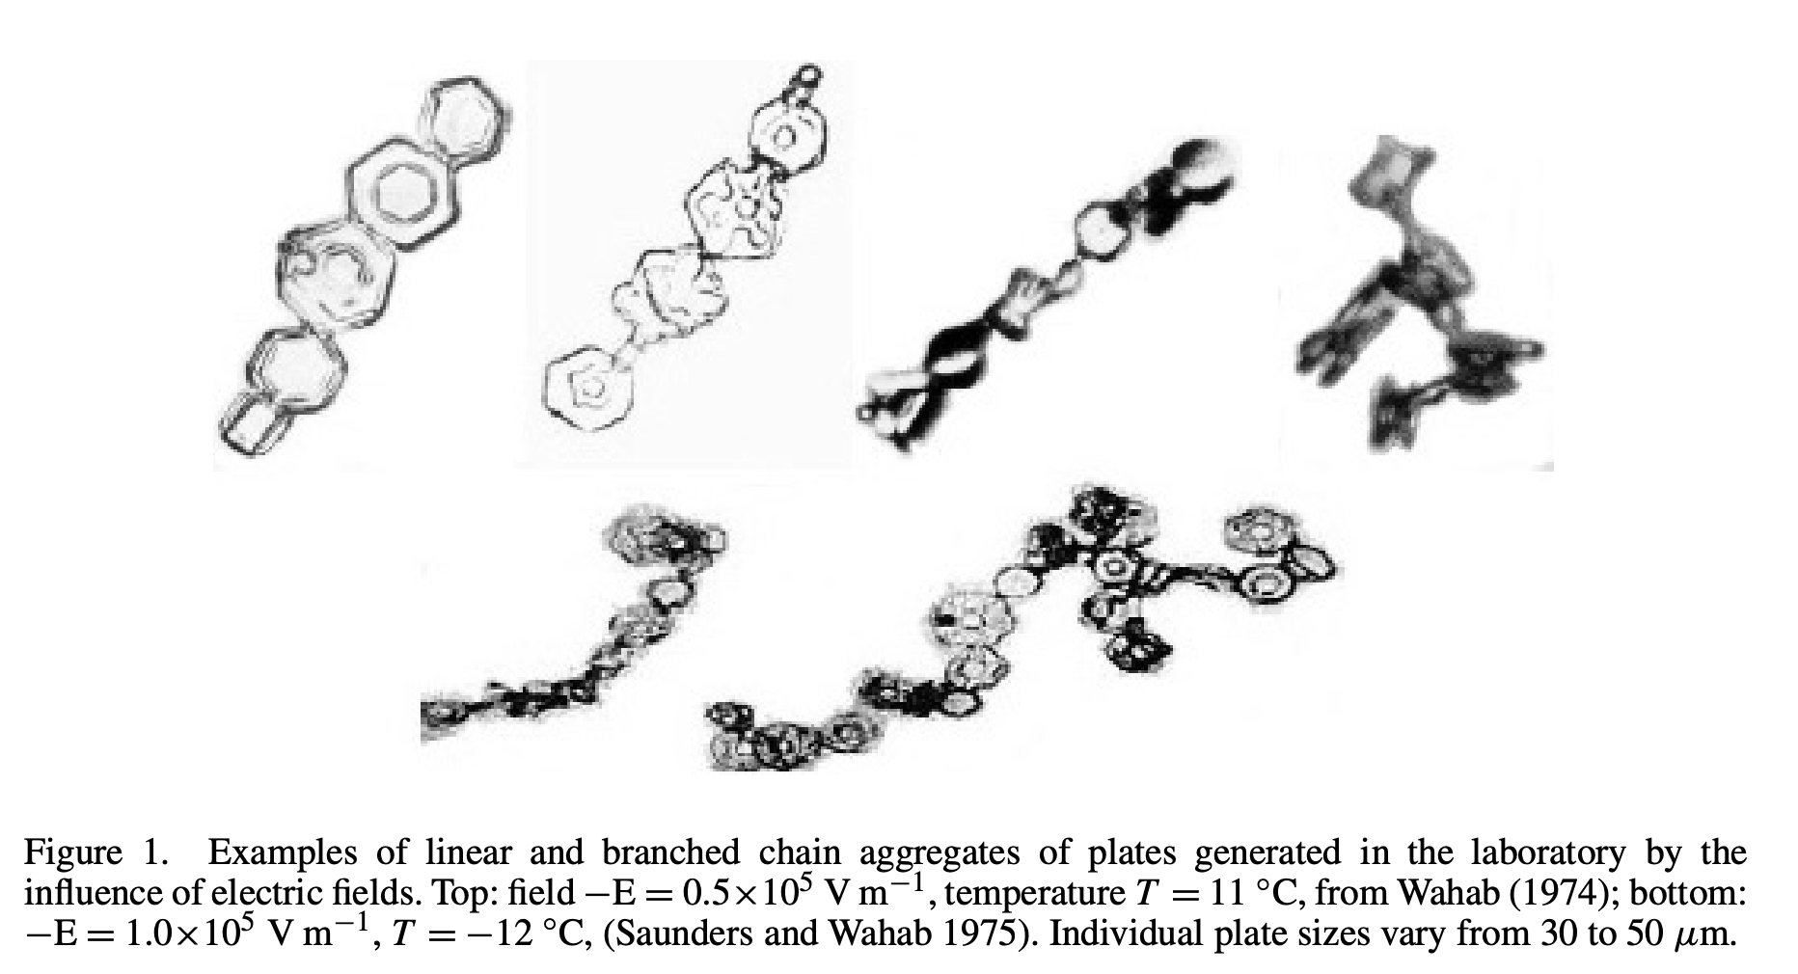
Thesis Topic Proposal – Introduction Saunders and Wahab, 1975:

Slide 8
Thesis Topic Proposal - Introduction
Recent field campaigns (aircraft in-situ sampling that observed chain aggregates):
Stith et al. 2002, 2004, 2014; Lawson et al. 2003; Whiteaway et al. 2004; Connolly et al. 2005; Garret et al. 2005; Gayet et al. 2012.
Higher concentrations of chain aggregates have been observed in cirrus anvils produced by continental convection than maritime convection.
Chain Aggregates produced from continental convection:
Found in colder temperature regimes.
Chain aggregates (rimed and unrimed) found at ~ -8°C in Florida thunderstorms during the CRYSTAL-FACE field campaign.

Slide 9
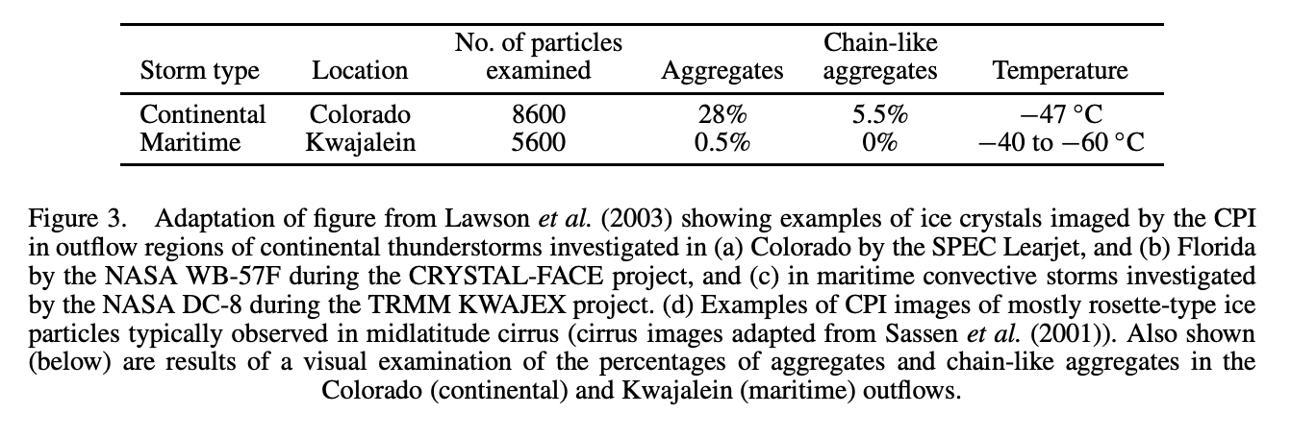
Thesis Topic Proposal – Introduction - Field Campaigns
Data presented by Connolly et al. 2005:
Comparison between continental and maritime anvils where chain aggregates were observed
Case study for the EMERALD-II field campaign.

Slide 10
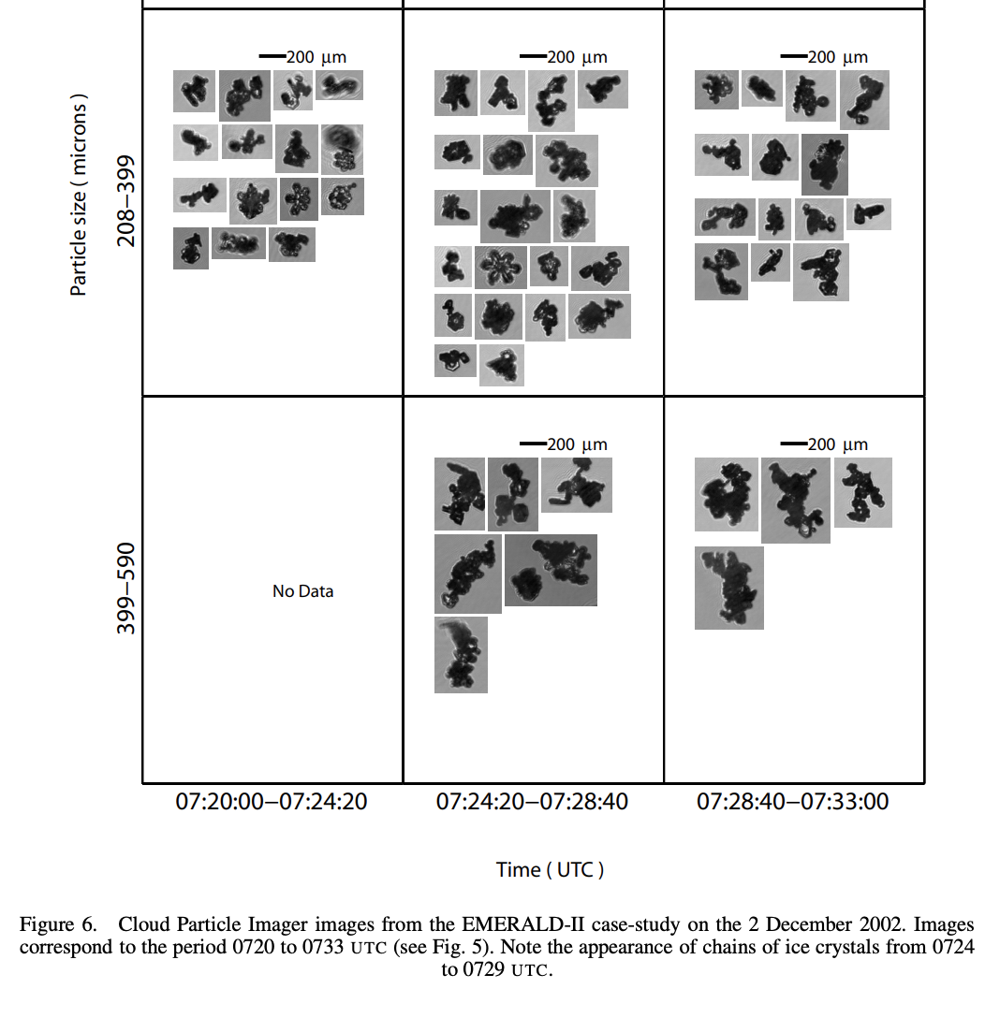
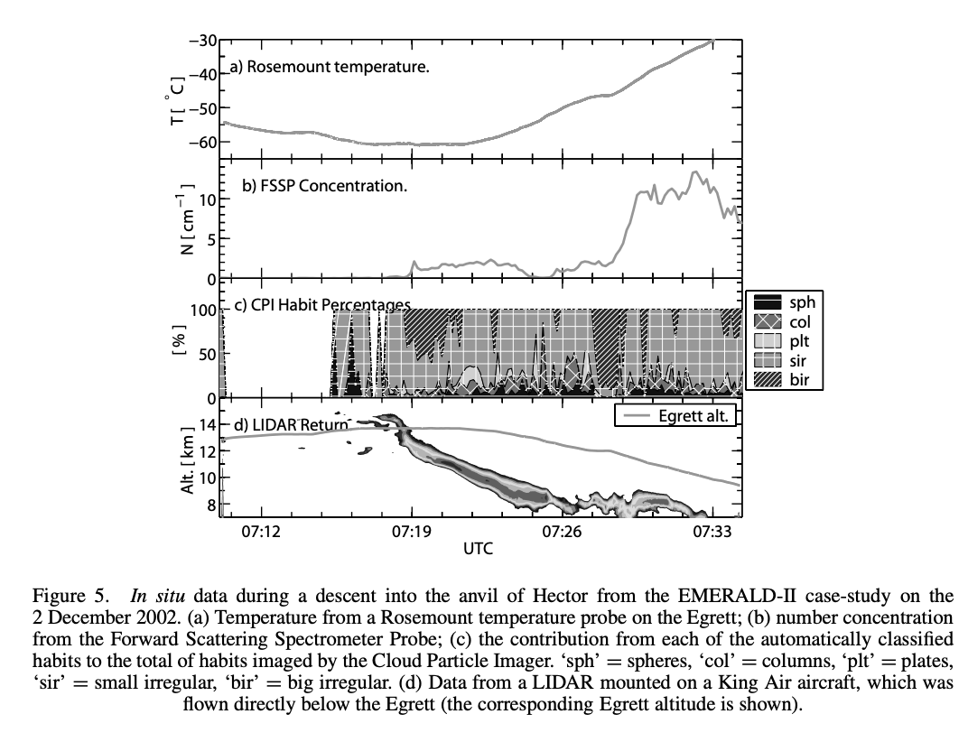
Thesis Topic Proposal – Introduction Connolly et al. 2005
Case study for the EMERALD-II Field Campaign
Island forced convection over the Tiwi Islands.
Sampled cirrus outflow from tropical multi-cell convection.
Hector is not actually strictly continental; the aerosol inflow tends to be from continental Australia and so it is classed as continental.

Slide 11
Thesis Topic Proposal – Introduction Connolly et al. 2005
Ice-crystal chains were found in the highest frequencies near the anvil base (continental).
Sedimentation and/or other mechanisms.
No direct measurements of electric fields were made.
Possible that the aggregates originated higher in the mixed-phase updraught region?
Distinct lack of riming on the crystal aggregate chains observed in the outflow (Tiwi Island convection)
Gives some evidence to support the idea that the majority of the chains in the dataset formed in fully glaciated regions below approximately −37°C.
Notes:
formed in fully glaciated regions below approximately −37 ◦C (i.e. the ‘threshold’ freezing temperature for large supercooled drops by homogeneous nucleation of ice, see Jeffery and Austin (1997)).

Slide 12
Thesis Topic Proposal – Introduction
Due to the minimal amount of in-situ observations in thunderstorms, the processes involved in chain aggregate formation are not well understood.
To further our understanding of the chain aggregation process, the recent CapeEx19 field campaign provides an additional dataset where chain aggregation was observed via in-situ sampling.
During the CapeEx19 field campaign, the North Dakota Citation II Research Aircraft obtain in-situ observations in tropical-continental cirrus anvils initiated by sea-breeze convection over Florida.

Slide 13
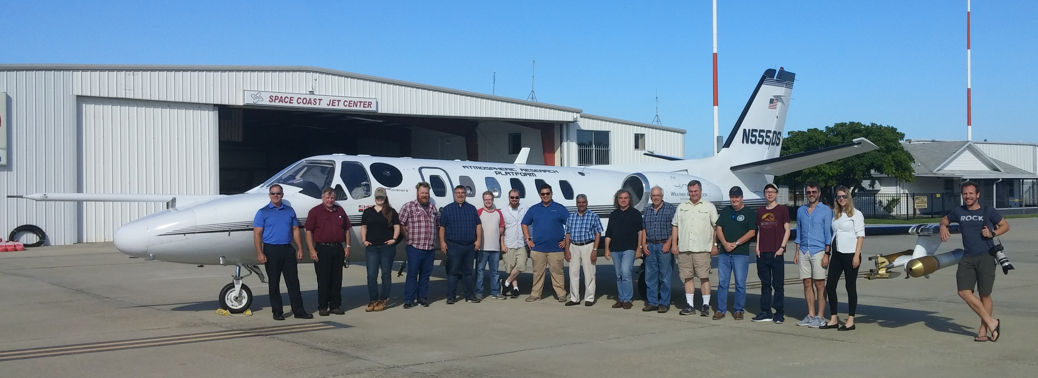
Thesis Topic Proposal - Methodology
CapeEx19 Field Campaign
Location: Cape Canaveral, Florida
Time Frame: Late July 2019 – Early August 2019
Field Campaign Objectives:
Continue improvements to both cirrus cloud modeling and radar interpretation by utilizing aircraft observations to enhance our understanding of Florida convection.
Understanding the various processes that result in chain aggregate formation.

Slide 14
Thesis Topic Proposal - Methodology
North Dakota Citation II Research Aircraft

Slide 15
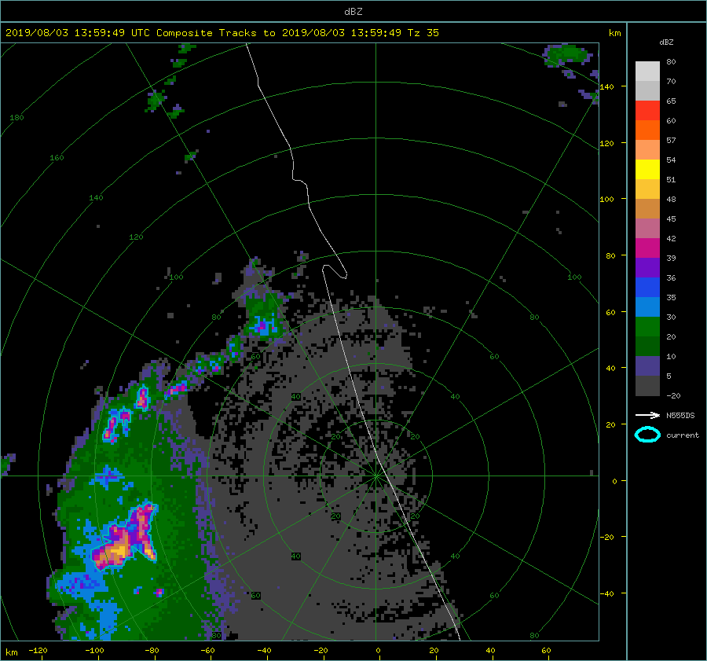
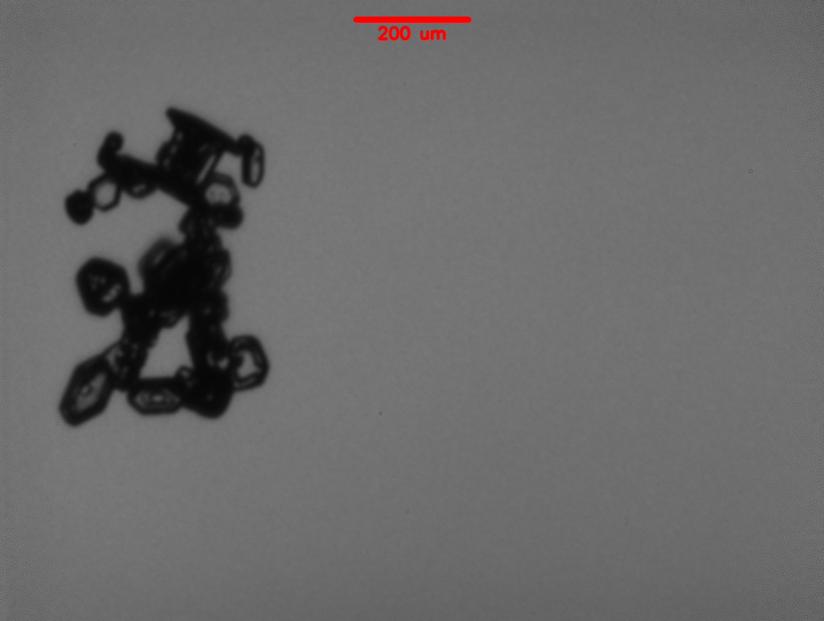
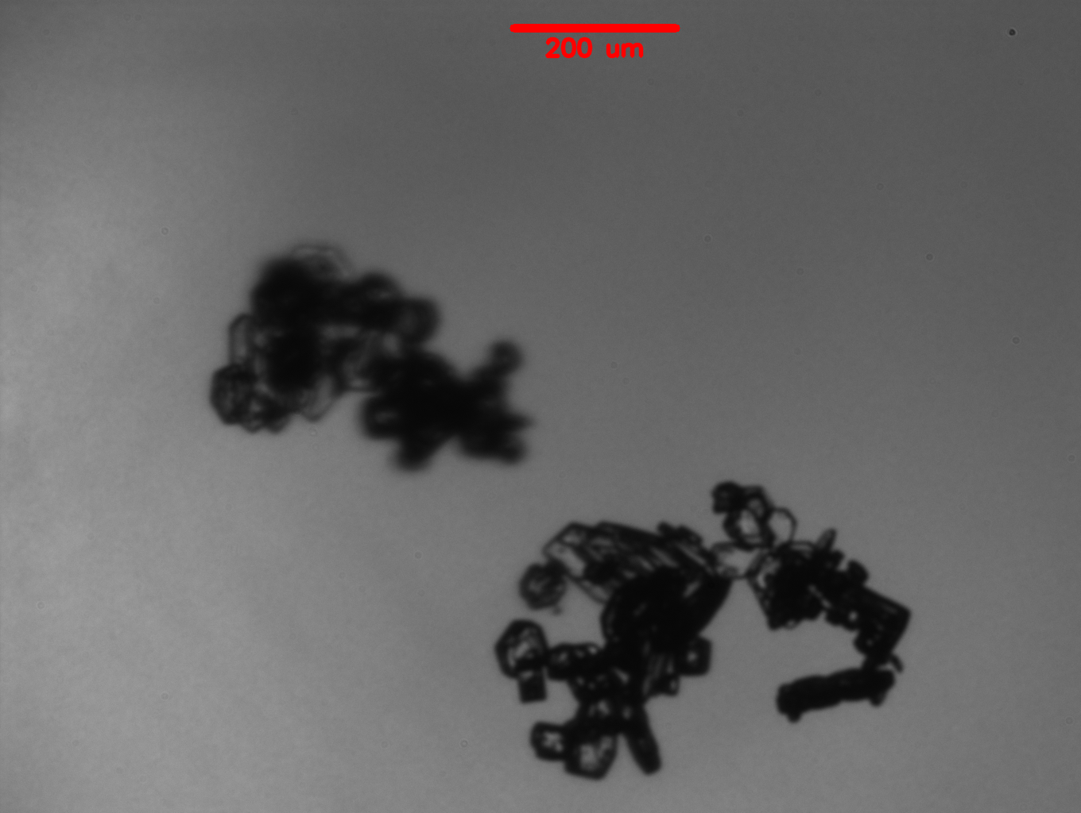
Thesis Topic Proposal – Methodology
Case study on the 3 August 2019 flight (20190803a) during the CapeEx19 field Campaign
Sea-breeze induced convection over western Florida. Later enhanced by convergence zone west of Cape Canaveral, Florida.
14:24:00 – 17:26:00 UTC
North Dakota Citation II Research Aircraft sampled through the cirrus anvil regions (9.5 – 11.5 km above ground level).
Chain Aggregates observed
15:54:16 UTC
16:10:56 UTC
Notes:
-40 to -30 C range

Slide 16
Thesis Topic Proposal – Methodology
Question: Is chain aggregation occurring in the cirrus anvil region of Florida thunderstorms?
Utilize CapeEx19 dataset and characterize the observed chain aggregates in cirrus anvil region.
Microphysical properties
Environmental properties (where the particles were sampled).
Properties based on distance from convective cores.
Compare data to the Saunders and Wahab (1975) criteria. Is the cirrus anvil environment conducive for chain aggregation?
Comparisons from previous field campaigns and other flights during the CapeEx19 field campaign to provide context as to what is typical/atypical from the case study.
Notes:
Second bullet: Since there is no set definition of what a chain aggregate is. Our own will be used. Since chain aggregates don’t always seem apparent, a confidence scale was generated.
Close with: How can we try to answer this main question? We will use the various instrumentation on the aircraft

Slide 17
Thesis Topic Proposal – Methodology Key Instrumentation/Datasets
- On Aircraft
Particle Habit Imaging Polar Scattering (PHIPS) Probe
Depiction of the individual chain aggregate size, orientation, and the individual number of elements.
Characterizing the different or similar individual crystal-type habits that make up the chain aggregate in its entirety.
Depict if the chain aggregate experienced any riming and during its existence up until the time of sampling.
Analyze the various phase changes the chain aggregate may have possibly experienced up until the time of sampling (in combination with the environmental probes).
Nezorov Probe
Utilize for inner-cloud threshold, LWC, and TWC.
Cloud Imaging Probe (CIP)
Provide information regarding the number concentrations of particles and the size distribution of those particles sampled during flight.
Utilize to see if inner-cloud particle concentrations meet the criteria necessary for chain aggregation based in Saunders & Wahab, 1975
(6) Rotating-Vane Electric Field Mills
Utilize to distinguish if the electric field is sufficient for chain aggregation in the cirrus anvil region based in Saunders & Wahab, 1975
Notes:
PHIPS: High definition particle imager.

Slide 18
Thesis Topic Proposal – Methodology Key Instrumentation/Datasets
- On Aircraft
Melbourne, FL National Weather Service WSR-88D Radar (KMLB)
S-band radar data.
Cloud Precipitation Radar – Hydrometeor Detection (CPR-HD)
C-band radar data.
National Lightning Detection Network (NLDN)
Provide insight into the electrical activity of the sampled storm(s).
Kennedy Space Center Lightning Mapping Array (KSCLMA)
Provide insight to inner-cloud electric charge regions & intensity.

Slide 19
Thesis Topic Proposal – Objective
Provide a quantification of aggregation in the cirrus anvil region for the formation of chain-like aggregates.
Is chain aggregation occurring in the cirrus anvil or not?
Notes:
Using in-situ microphysical data, the electric field, National Lightning Detection Network (NLDN), Lightning Mapping Array (LMA) data and radar data, distinguish if the known prerequisites for chain aggregation is sufficient in the cirrus anvil region.

Slide 20
Thesis Topic Proposal – Expected Results
Answer our main objective (previous slide)
Allow for better interpretation of radar data.
Provide microphysical data and characteristics about chain aggregates observed in Florida cirrus anvils which may inevitably enable models to predict their occurrence.
Implementation of chain aggregates in models will improve the accuracy of the radiative impacts of cirrus anvils.
Chain aggregation in models will lead to more accurate and efficient supersonic projectile travel.
Hypersonic collisions with relatively large and irregular ice crystals may cause cratering on supersonic vehicle’s nose cones, which can alter the vehicle’s aerodynamics (Meng and Ludema 1995, Barnes Jr. 1982).
Notes:
Third bullet: Especially in the cirrus anvil regions
Fifth bullet: Since chain aggregates have larger mass and different optical properties compared to individual ice crystals

Slide 21
Questions/Comments on Topic Proposal?

Slide 22
Brief Results
20190803a Flight Legs (FL)
Lightning Activity - NLDN
PHIPS Images
Observed Chain Aggregates & Levels of Confidence
PHIPS Data
Maximum Diameter of Observed Chain Aggregates (FL1-5)
Chain Aggregates vs. Distance from Storm Core (Reflectivity Centroid)
CIP Particle Concentrations
Electric Field Measurements

Slide 23
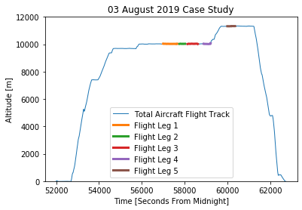
In order to provide consistency when analyzing the data, individual flight legs are defined during the 3 August 2019 flight where the aircraft was sampling without sharp maneuvers, heading toward, away, and parallel to the convective thunderstorm cores.

Slide 24
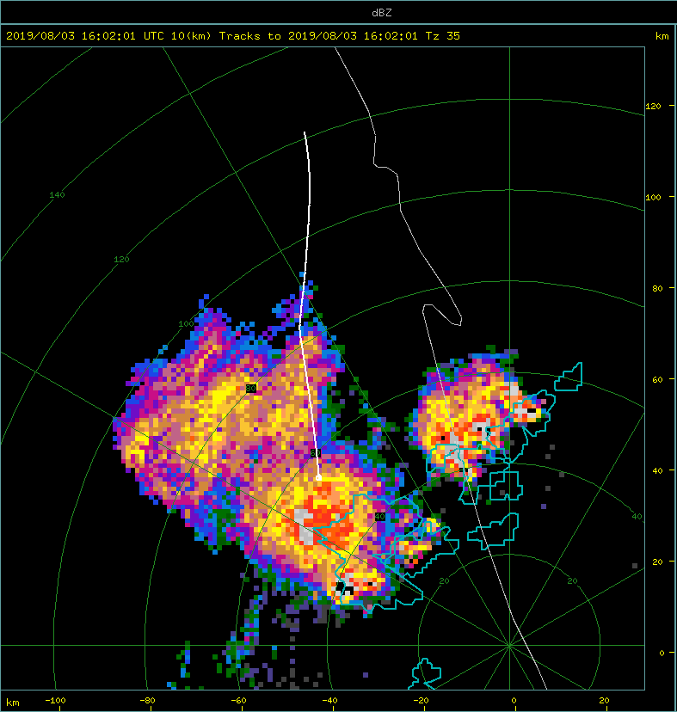
According to the Nev. TWC probe, the aircraft was above the 0.005 g/cm^3 threshold = in cloud
Flight Leg 1:
15:51:15 – 16:01:00 UTC
Radar Scan: 16:02:01 UTC
10 km CAPPI
Aircraft current position at time-stamp above.
Blue circles indicating convective cores. (35 dBZ threshold)
Notes:
Add arrow for the aircraft and convective core.
Take out the scale and blow it up larger.

Slide 25
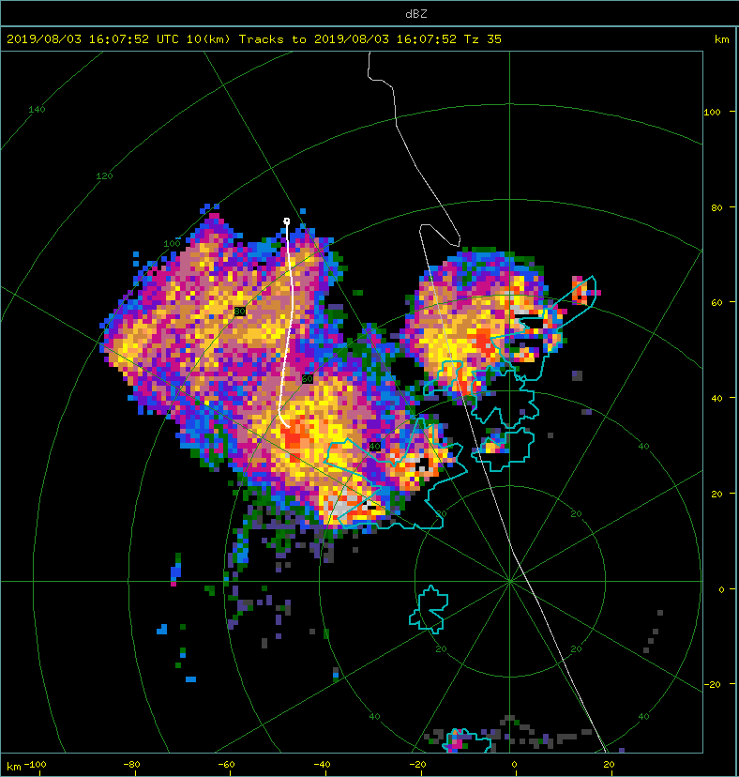
Flight Leg 2:
16:02:00 – 16:07:00 UTC
Radar Scan: 16:07:52 UTC
10 km CAPPI
Aircraft current position at time-stamp above.

Slide 26
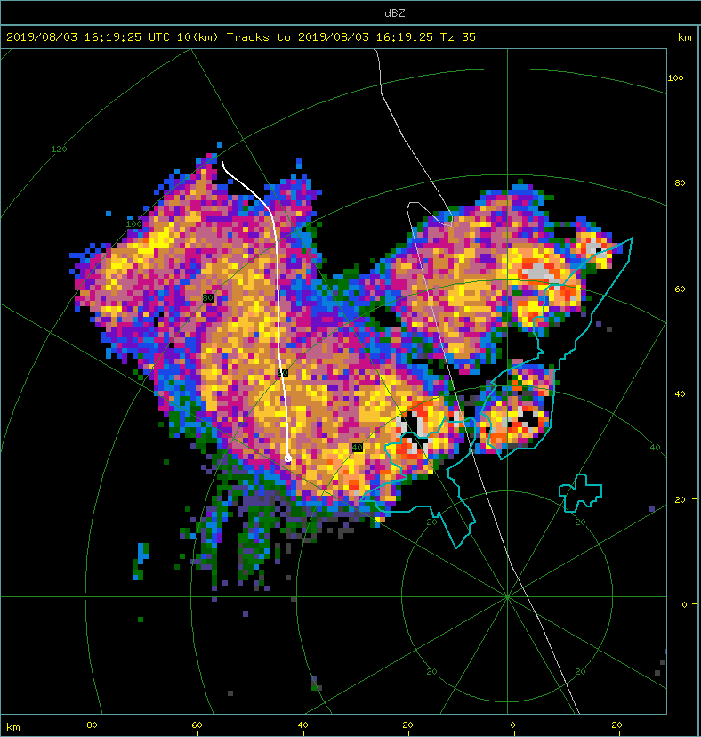
Flight Leg 3:
16:09:00 – 16:17:00 UTC
Radar Scan: 16:19:25 UTC
10 km CAPPI
Aircraft current position at time-stamp above.

Slide 27
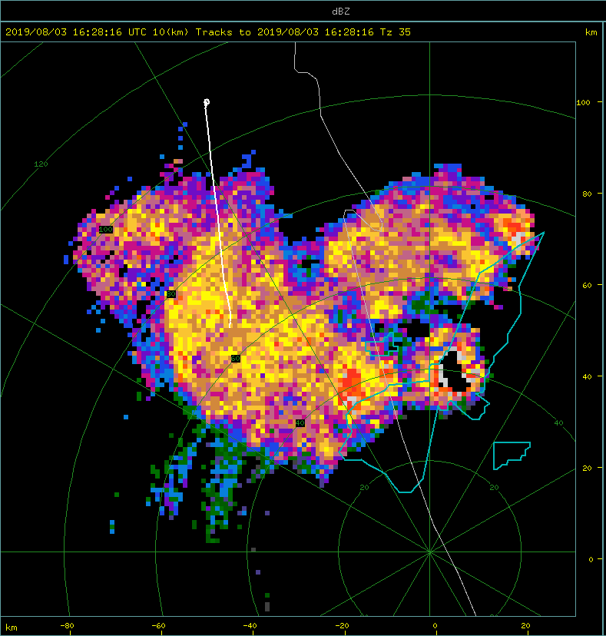
GoPro images and TWC probe indicate that the aircraft was still in cloud
Flight Leg 4:
16:21:30 – 16:27:00 UTC
Radar Scan: 16:28:16 UTC
10 km CAPPI
Aircraft current position at time-stamp above.

Slide 28
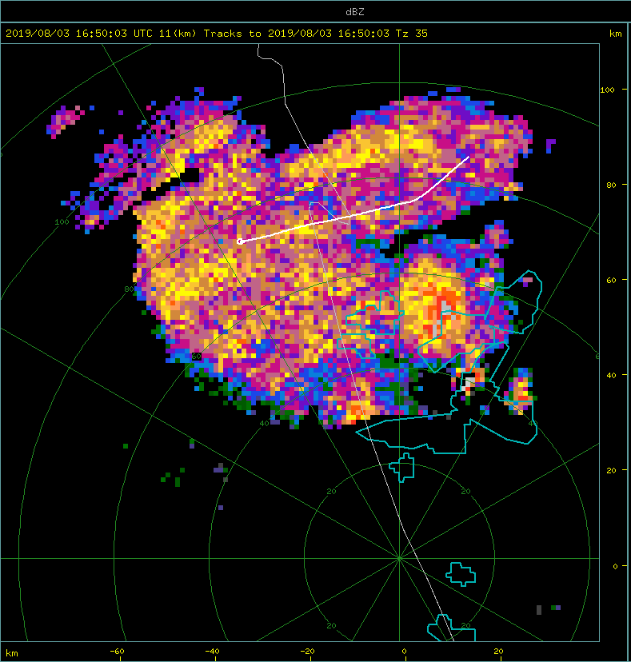
Flight Leg 5:
16:40:00 – 16:46:00 UTC
Radar Scan: 16:50:03 UTC
11 km CAPPI
Aircraft current position at time-stamp above.

Slide 29
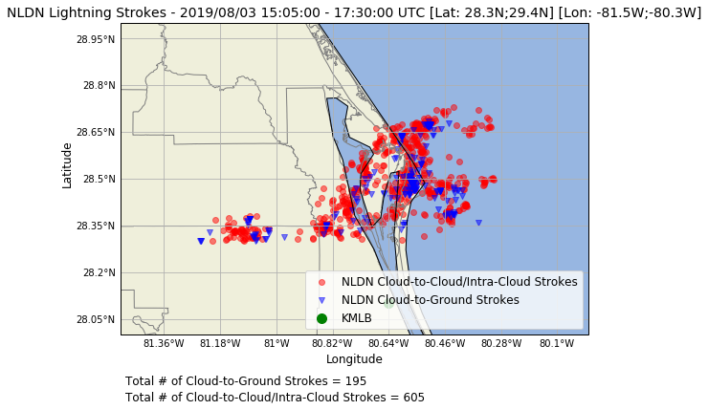
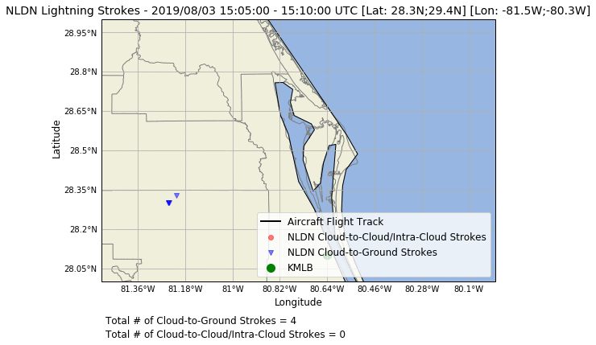
NLDN Data

Slide 30
Confidence = 1
Confidence = 2
Confidence = 3
30
﻿Chain aggregates were defined by:
3 or more particles oriented in a linear fashion and/or...
Multiple particles joined by small joints and/or…
Elongated
Confidence was determined by the classifier:
Lowest Confidence (1): One of the three definitions observed.
Moderate Confidence (2): Two of the three definitions observed.
Highest Confidence (3): All three definitions observed.
(NOT TO SCALE)
Notes:
Will need to improve this slide to provide more insight (chains per minute).
Maybe split the slides up to show examples of different chains with different confidence. Before this slide
Another y-axis = #/minute
******# of chains per PHIPS image

Slide 31
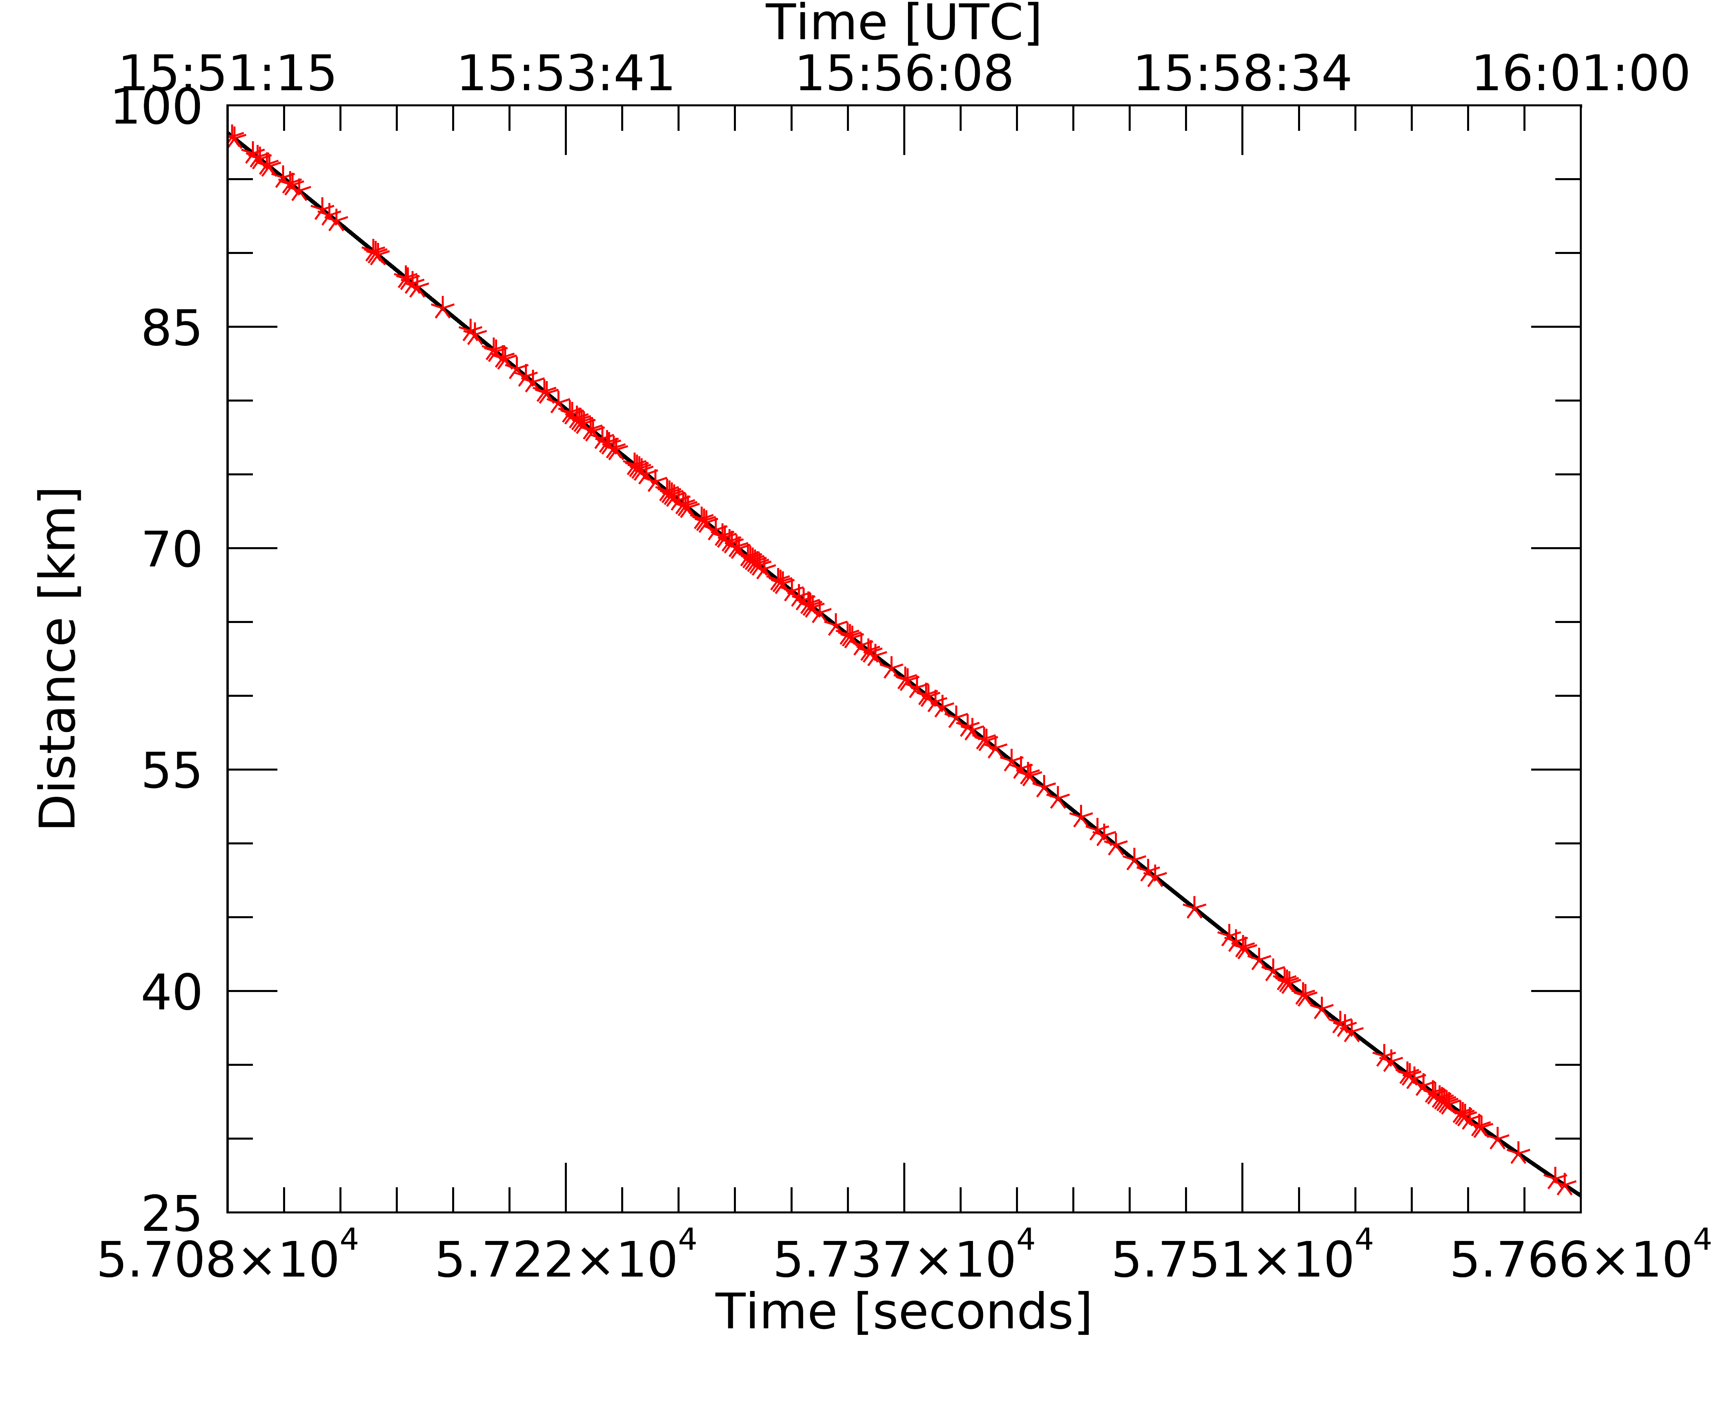
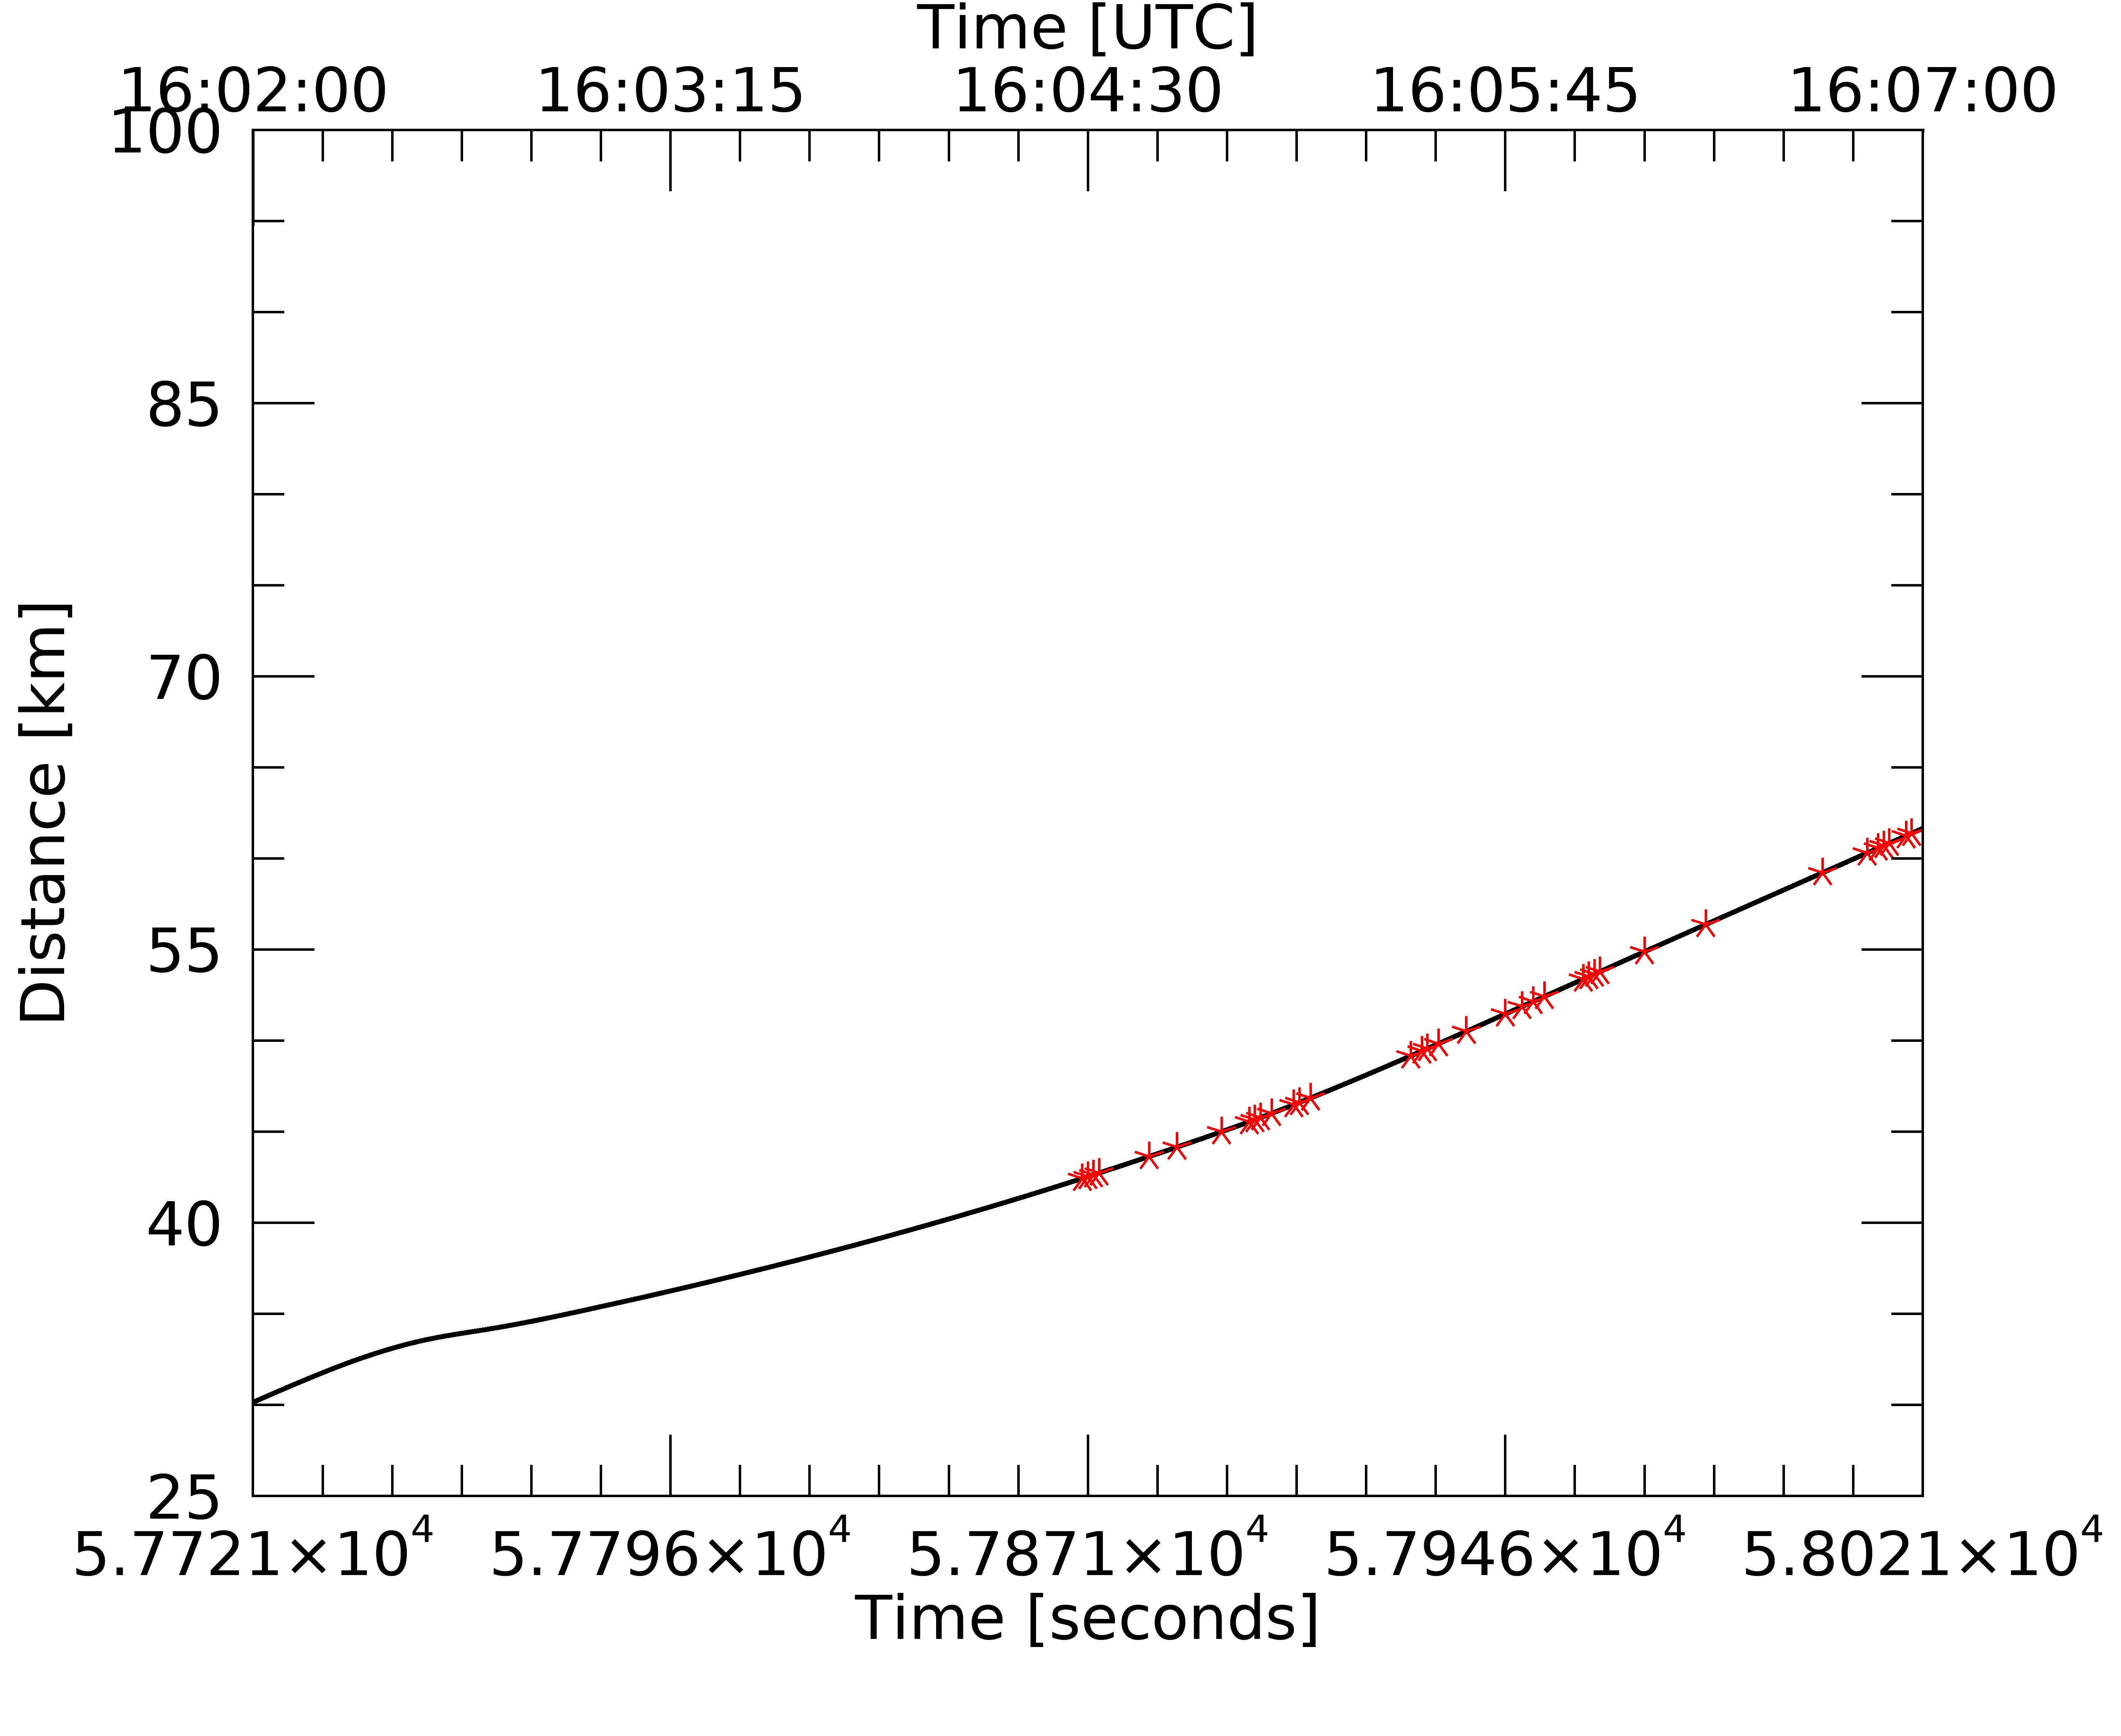
FL1
Distance From Storm Core
FL2
1st 1/3 of FL1
# of Chains = 68
# of PHIPS Images = 435
15.6%
mean distance = 84.0 km
median distance = 82.9 km
2nd 1/3 of FL1
# of Chains = 73
# of PHIPS Images = 398
18.3%
mean distance = 63.7 km
median distance = 64.7 km
3rd 1/3 of FL1
# of Chains = 44
# of PHIPS Images = 389
11.3%
mean distance = 36.5 km
median distance = 34.8 km
1st 1/3 of FL2
# of Chains = 0
*# of PHIPS Images = 1*
0%
mean distance = N/A
median distance = N/A
2nd 1/3 of FL2
# of Chains = 17
# of PHIPS Images = 103
16.5%
mean distance = 44.7 km
median distance = 45.2 km
3rd 1/3 of FL2
# of Chains = 24
# of PHIPS Images = 252
9.5%
mean distance = 54.8 km
median distance = 53.5 km

Slide 32
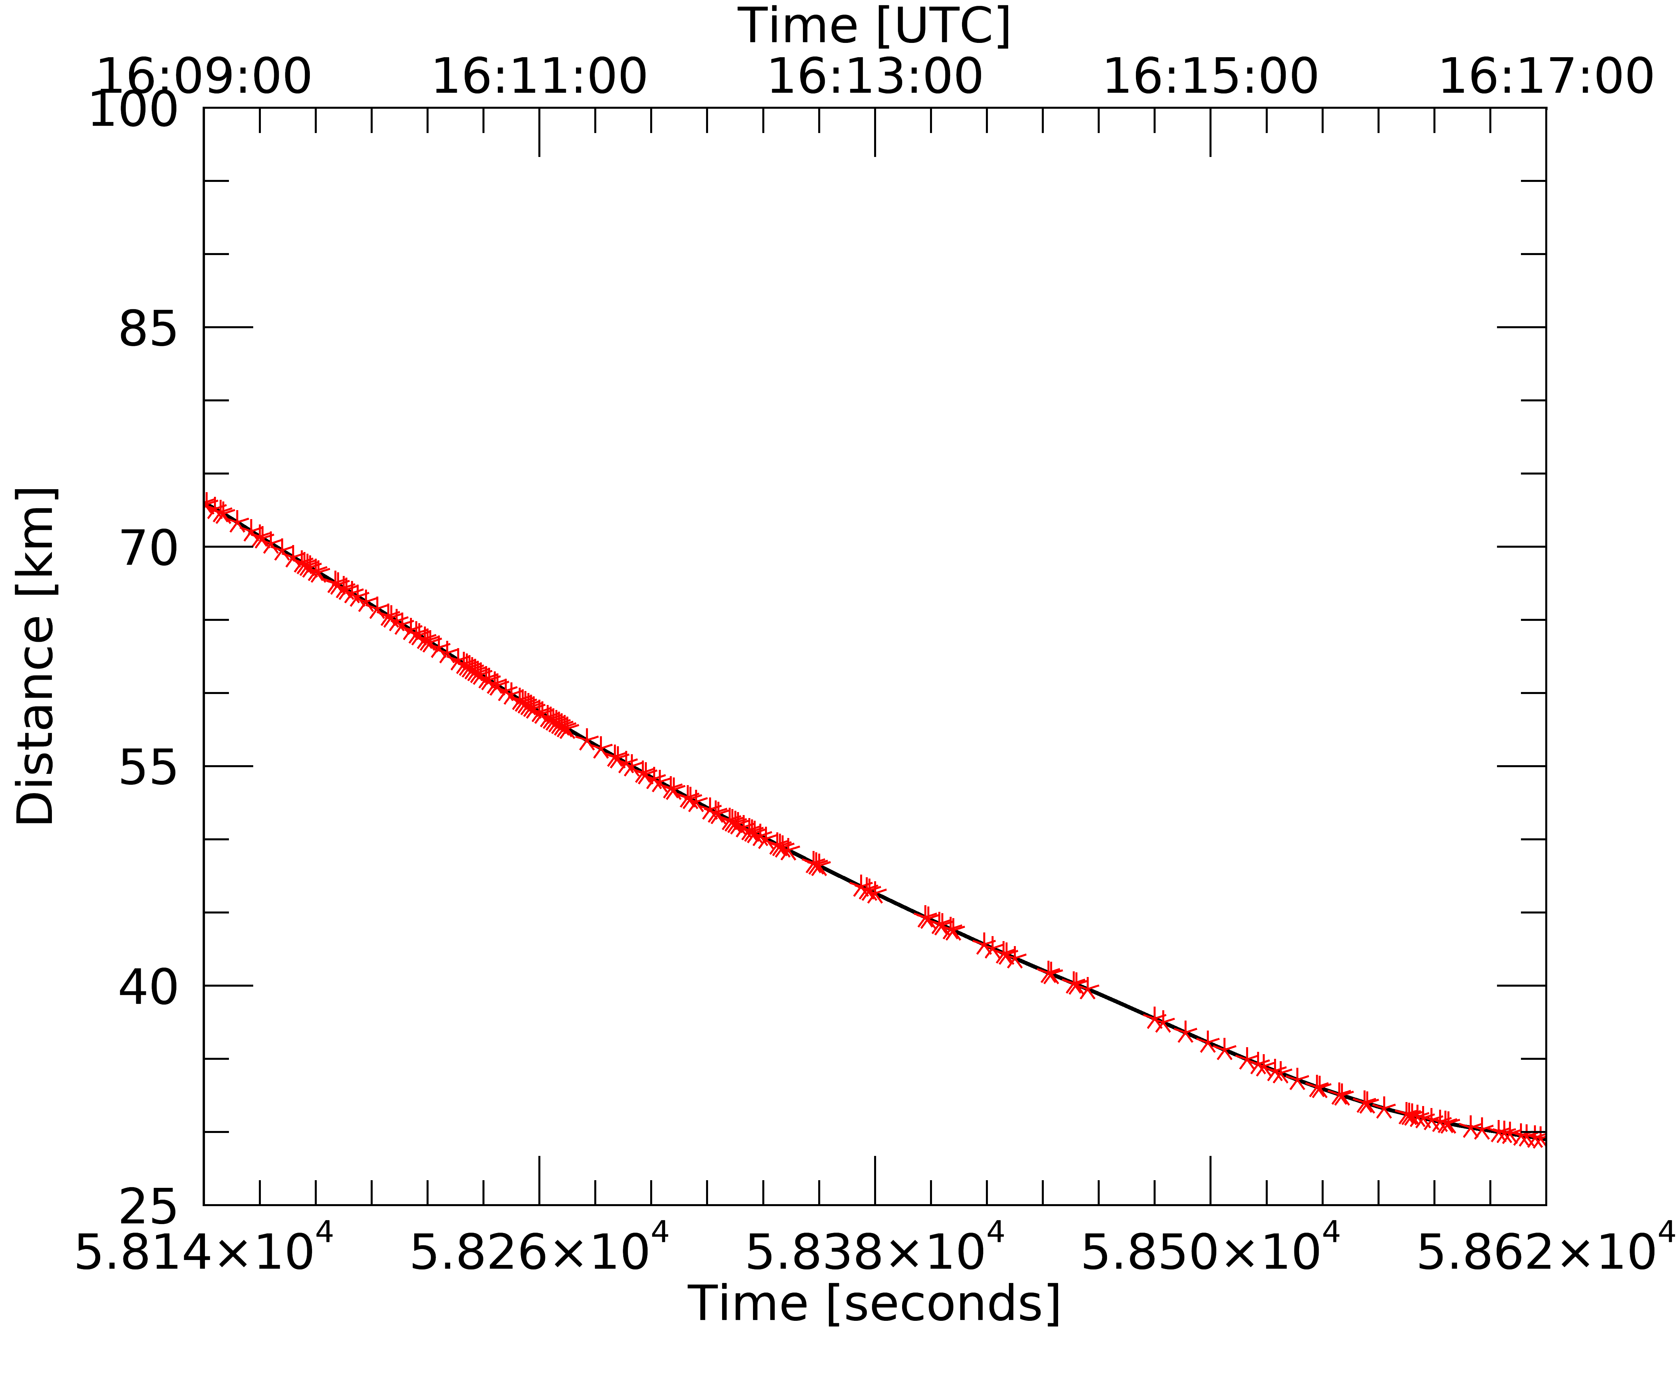
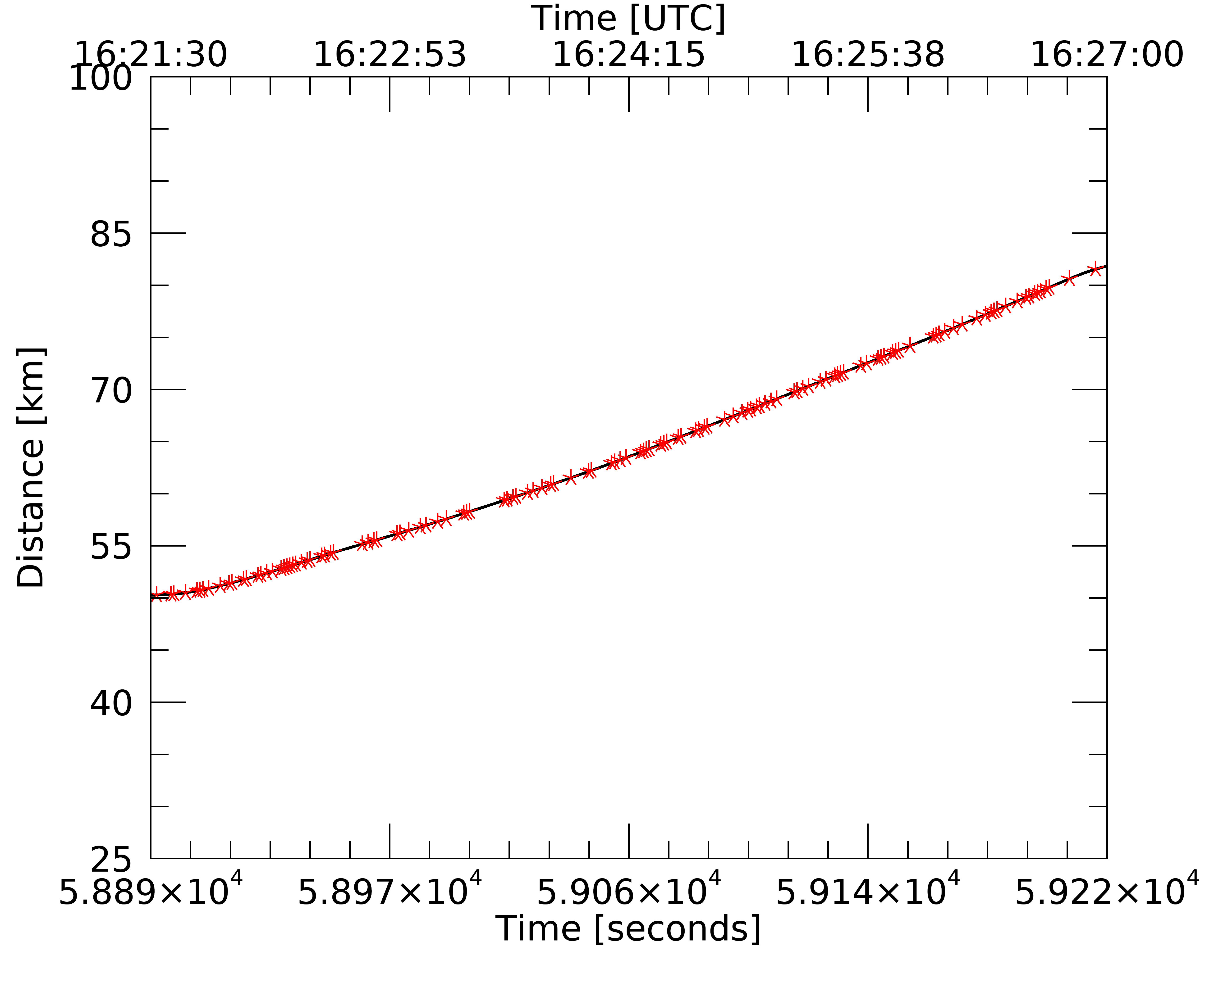
FL3
Distance From Storm Core
FL4
1st 1/3 of FL3
# of Chains = 95
# of PHIPS Images = 421
22.5%
mean distance = 63.2 km
median distance = 62.4 km
2nd 1/3 of FL3
# of Chains = 53
# of PHIPS Images = 484
10.9%
mean distance = 47.7 km
median distance = 49.2 km
3rd 1/3 of FL3
# of Chains = 46
# of PHIPS Images = 592
7.7%
mean distance = 32.3 km
median distance = 31.4 km
1st 1/3 of FL4
# of Chains = 49
# of PHIPS Images = 191
25.6%
mean distance = 53.5 km
median distance = 53.1 km
2nd 1/3 of FL4
# of Chains = 47
# of PHIPS Images = 291
16.1%
mean distance = 64.1 km
median distance = 64.2 km
3rd 1/3 of FL4
# of Chains = 47
# of PHIPS Images = 332
14.1%
mean distance = 75.1 km
median distance = 75.2 km

Slide 33
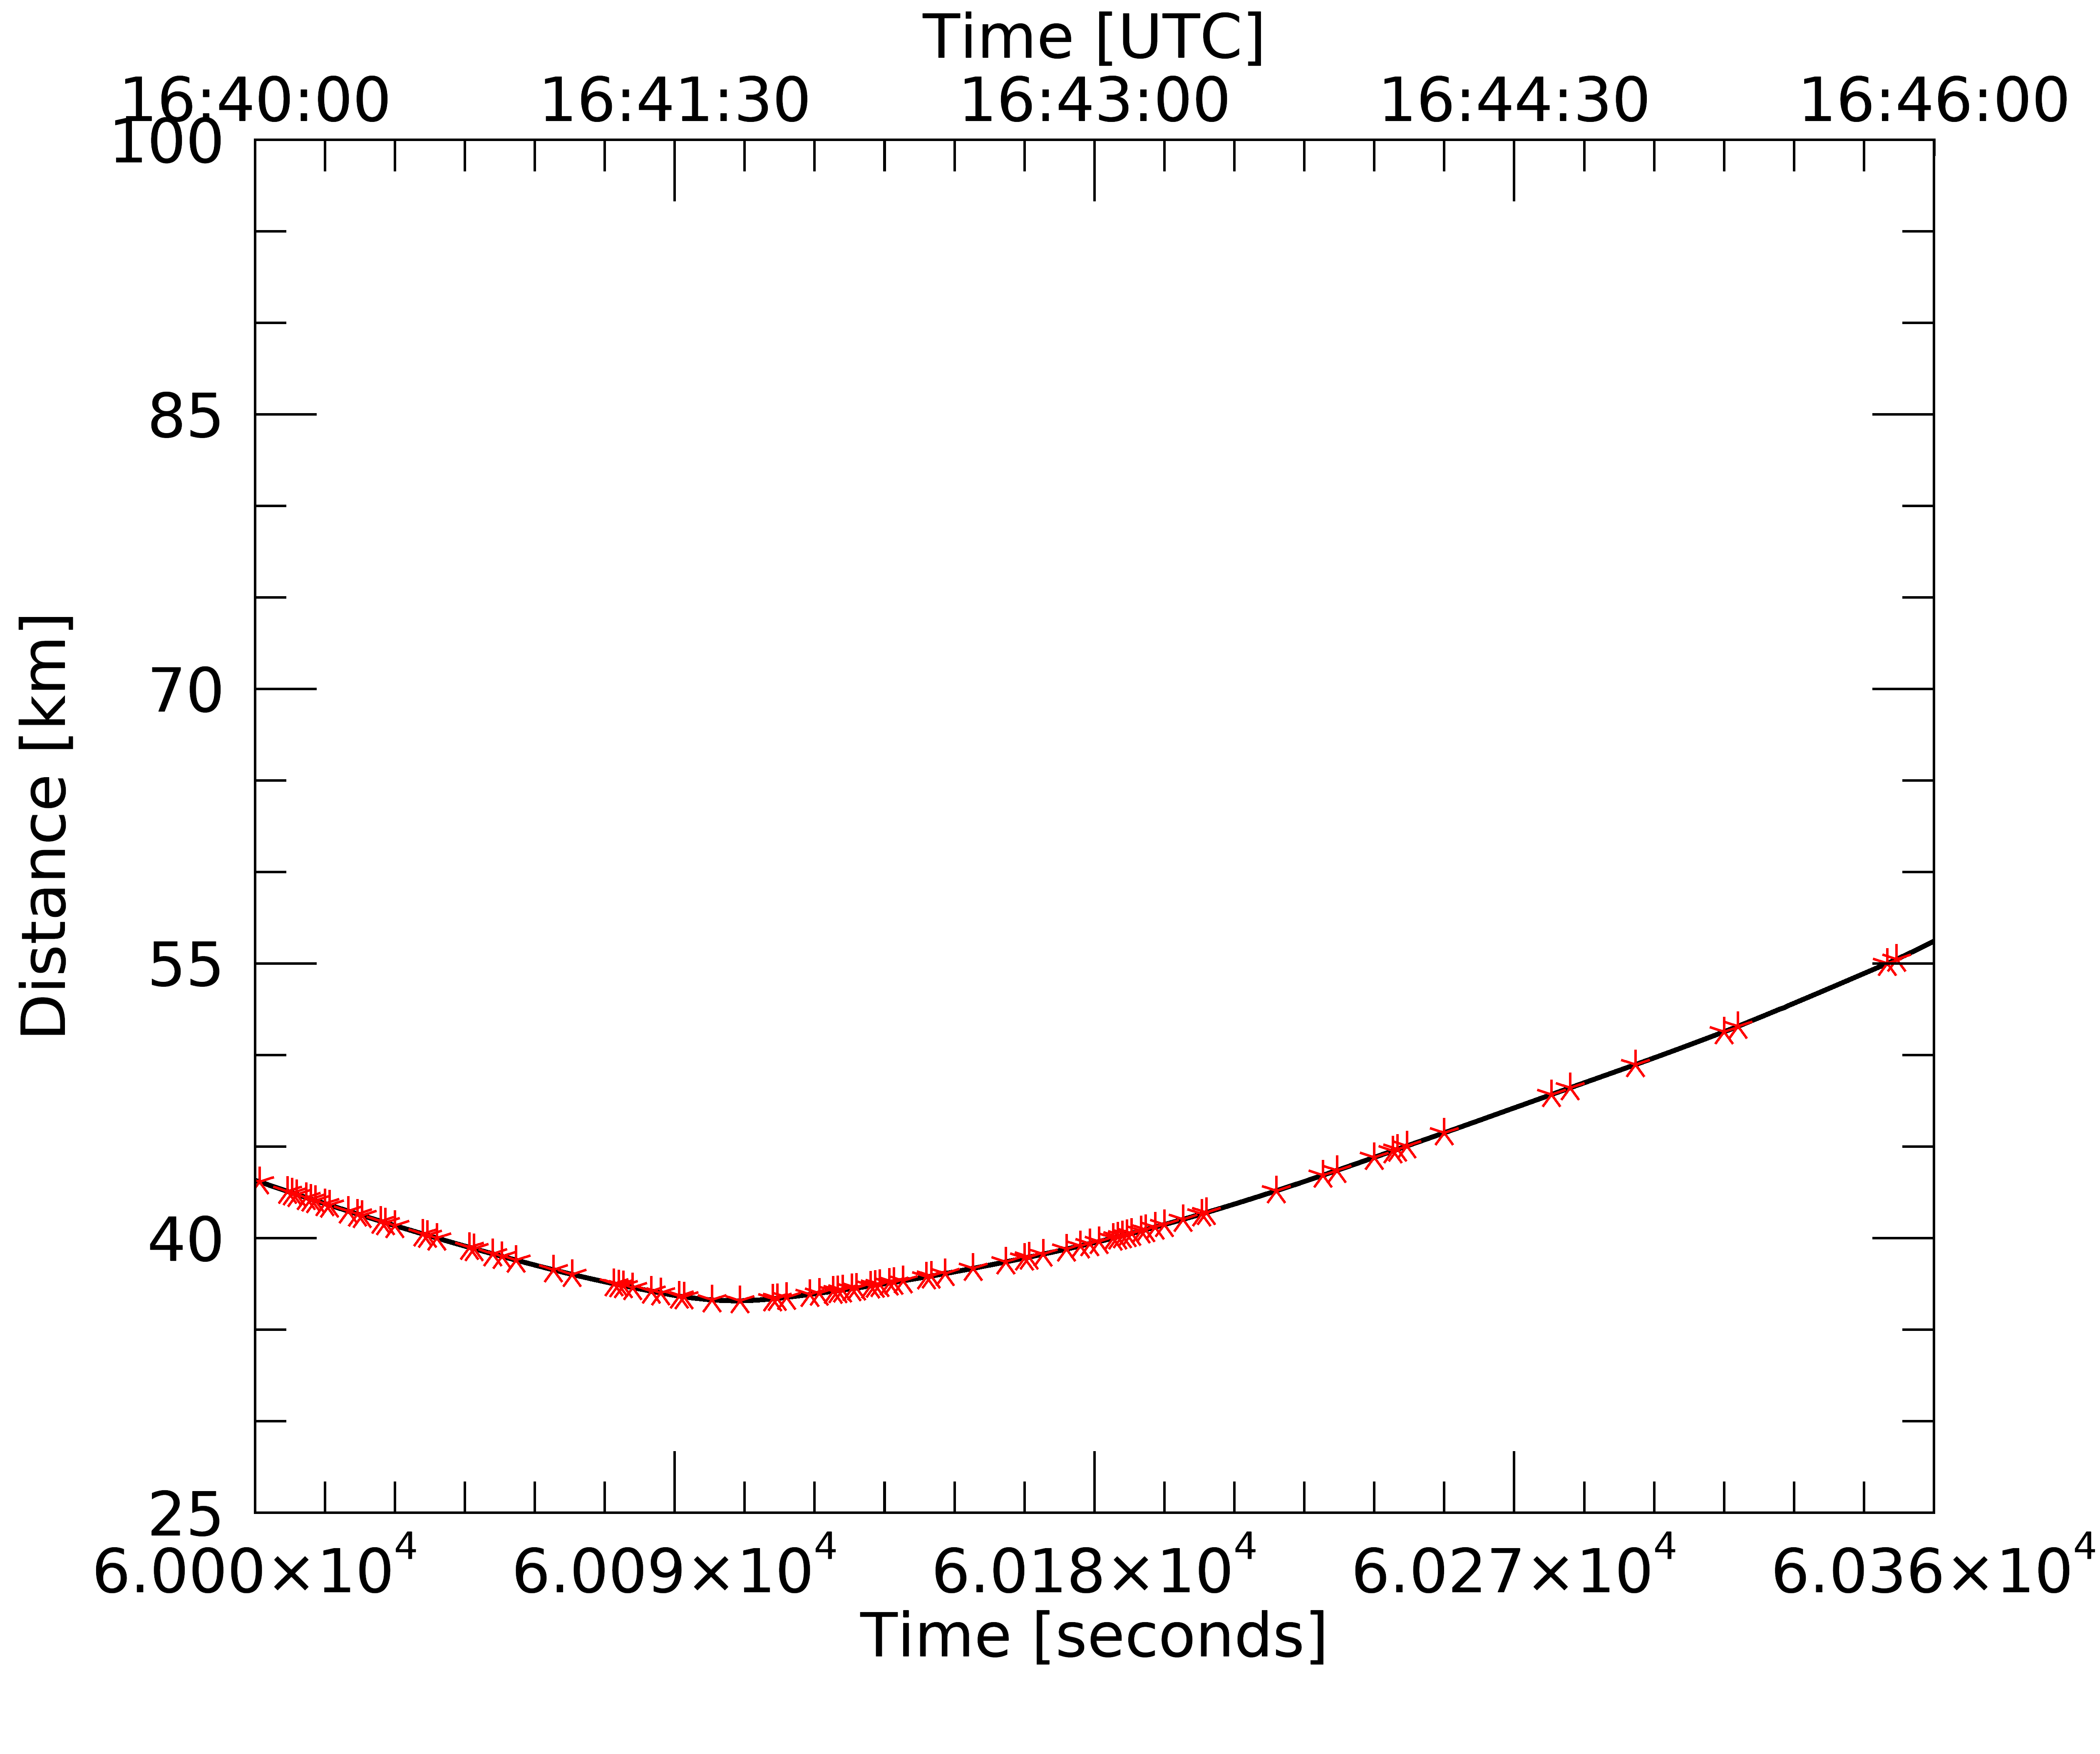
Distance From Storm Core
FL5
NOTE:
In FL5 the Citation was flying at an average altitude of 11,321 m, while in FL1-4 the Citation was flying a the 10,014 – 10,053 m range.
Also, in FL5 the Citation was flying nearly parallel to the storm core, while in FL1-4 the Citation was heading towards or away from the storm core.
1st 1/3 of FL5
# of Chains = 41
# of PHIPS Images = 161
25.4%
mean distance = 39.4 km
median distance = 39.4 km
2nd 1/3 of FL5
# of Chains = 46
# of PHIPS Images = 202
22.7%
mean distance = 39.2 km
median distance = 39.1 km
3rd 1/3 of FL5
# of Chains = 12
# of PHIPS Images = 119
10.0%
mean distance = 48.6 km
median distance = 48.0 km

Slide 34
Discussion
Distance from storm core range: 70 – 100 km
141 Chain Aggregates / 876 PHIPS Images = 16.1%
Distance from storm core range: 40 – 70 km
378 Chain Aggregates / 2,348 PHIPS Images = 16.1%
Distance from storm core range: 10 – 40 km
141 Chain Aggregates / 1,208 PHIPS Images = 11.7%
No clear correlation between the amount of chain aggregates with respect to distance from storm core.
*Altitude Range: 10 – 11 km AGL

Slide 35
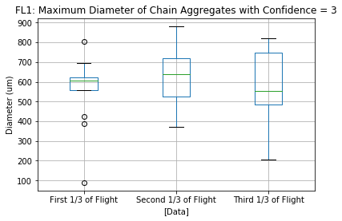
PHIPS: Maximum Diameter of Chains in FL1 Intervals
Aircraft Heading Toward Storm Core (N to S)
Aircraft Heading Toward Storm Core (N to S)
Notes:
Might be some misclassified chain aggregates in the dataset. Some very small high confidence chains… Or could be the fact that some of the chains were cut off in the composite images.

Slide 36
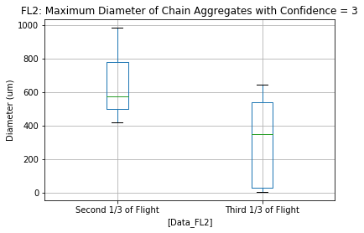
PHIPS: Maximum Diameter of Chains in FL2 Intervals
*No PHIPS Images taken in the first 1/3 of flight in FL2
Aircraft Heading Away From Storm Core (S to N)
Aircraft Heading Away From Storm Core (S to N)

Slide 37
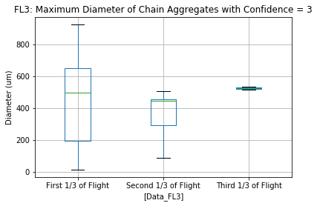
PHIPS: Maximum Diameter of Chains in FL3 Intervals
Aircraft Heading Toward Storm Core (N to S)
Aircraft Heading Toward Storm Core (N to S)

Slide 38
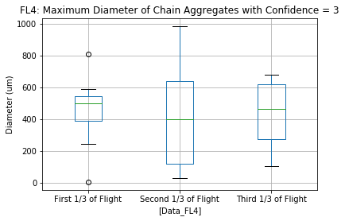
PHIPS: Maximum Diameter of Chains in FL4 Intervals
Aircraft Heading Away From Storm Core (S to N)
Aircraft Heading Away From Storm Core (S to N)

Slide 39
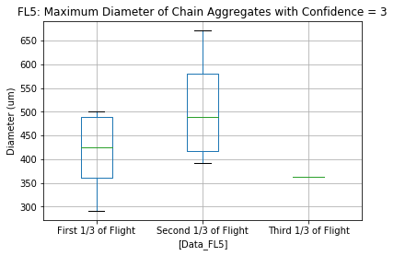
PHIPS: Maximum Diameter of Chains in FL5 Intervals
Aircraft Parallel to Storm Core (E to W)
Aircraft Parallel to Storm Core (E to W)
Notes:
Analysis on chain aggregate size with respect to storm core still ongoing.

Slide 40
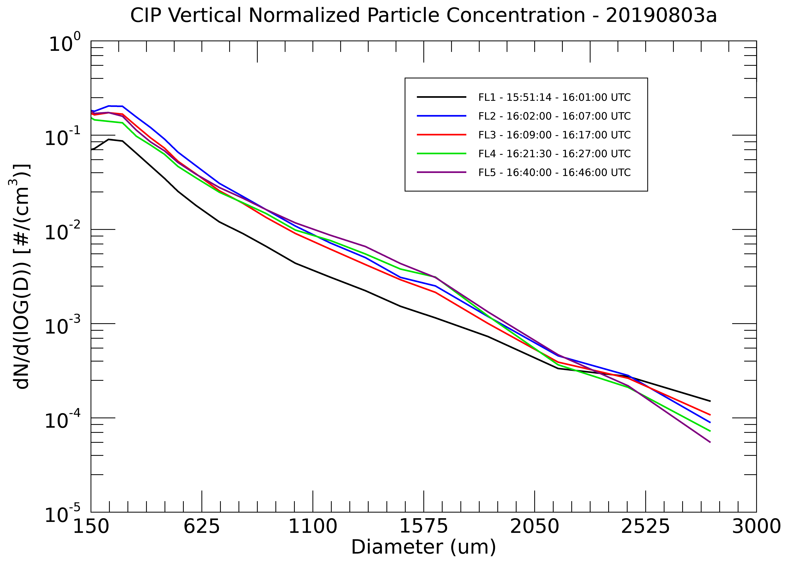
Notes:
Need to dive into the particle concentrations in more depth.

Slide 41
Electric Field Data FL1-5
During the Flight Legs, the Ex, Ey, and Ez do not meet the minimum E-field criteria as tested (60 kV/m) by Saunders and Wahab, 1975
Further evidence for higher rates of chain aggregation closer to the mixed-phase region of the storm?
*Aircraft never was directly over the storm core*.
Notes:
Need to look into the particle concentration value in more depth.
With that information, will be able to compare to cloud chamber work and show if (quantitatively) chain aggregation can be or not be possible in the cirrus anvil region.

Slide 42
Current Plan
Send out semi-final form of topic proposal to all committee members to review and make comments.
Submit for graduate school approval by the end of June.
Starting June 7th, I will be starting the NRIEP (NRL internship in Monterey, CA).
10-week duration (First 5 weeks are remote, last 5 weeks in person).
Driving to Monterey, CA on July 7th -> arriving late July 9th or early July 10th
Internship ends August 13th
Resume my thesis work.
Start writing my thesis.
All done with classes.
Taking two hours every morning (increasing the duration every week) to solely focus on writing.
Concurrently taking time to finalize my results and making publish worthy figures.
During (or before) writing, I’ll be creating a thesis defense PowerPoint.
Graduation planned for December 2021.

Slide 43
References
Barnes Jr., A. A., 1982: The Sub-visible Cirrus Background. Air Force Geophysics Laboratory. Date Accessed: 04-15-2021. https://apps.dtic.mil/dtic/tr/fulltext/u2/a117389.pdf
Connolly, P. J., C. P. R. Saunders, M. W. Gallagher, K. N. Bower, M. J. Flynn, T. W. Choularton, J. Whiteway, and R. P. Lawson, 2005: Aircraft Observations of the Influence of Electric Fields on the Aggregation of Ice Crystals. Quarterly Journal of the Royal Meteorological Society, 131, 1695–1712, https://doi.org/10.1256/qj.03.217.
Crowther, A. G. and C. P. R. Saunders, 1973: On the Aggregation and Fragmentation of Freely-Falling Ice Crystals in an Electric Field. J. Met. Soc. Japan, 51, 490-493.
Garrett, T. J., and Coauthors, 2005: Evolution of a Florida Cirrus Anvil. Journal of the Atmospheric Sciences, 62, 2352–2372, https://doi.org/10.1175/JAS3495.1.
Gayet, J.-F., and Coauthors, 2012: On the observation of unusual high concentration of small chain-like aggregate ice crystals and large ice water contents near the top of a deep convective cloud during the CIRCLE-2 experiment. Atmospheric Chemistry and Physics, 12, 727–744, https://doi.org/10.5194/acp-12-727-2012.
Latham, J., and C. P. R. Saunders, 1970: Experimental measurements of the collection efficiencies of ice crystals in electric fields. Quarterly Journal of the Royal Meteorological Society, 96, 257–265, https://doi.org/10.1002/qj.49709640808.
Lawson, R. P., B. A. Baker, and B. L. Pilson, In Situ Measurements of Microphysical Properties of Mid-latitude and Anvil Cirrus. Date Accessed: 04-25-2021. http://www.specinc.com/sites/default/files/pdfs/Cirrus_Anvil_paper_Rev2_.pdf
Meng, H.C. and Ludema, K.C., 1995: Wear models and predictive equations: their form and content, Wear 181-183, 443-457.
Saunders, C. P. R., and N. M. A. Wahab, 1975: The Influence of Electric Fields on the Aggregation of Ice Crystals. Journal of the Meteorological Society of Japan, 53, 121–126, https://doi.org/10.2151/jmsj1965.53.2_121
Stith, J. L., J. E. Dye, A. Bansemer, A. J. Heymsfield, C. A. Grainger, W. A. Petersen, and R. Cifelli, 2002: Microphysical Observations of Tropical Clouds. J. Appl. Meteor., 41, 97–117, https://doi.org/10.1175/1520-0450(2002)041<0097:MOOTC>2.0.CO;2.
Stith, J. L., J. A. Haggerty, A. Heymsfield, and C. A. Grainger, 2004: Microphysical Characteristics of Tropical Updrafts in Clean Conditions. Journal of Applied Meteorology and Climatology, 43, 779–794, https://doi.org/10.1175/2104.1.
Stith, J. L., and Coauthors, 2014: Ice particles in the upper anvil regions of midlatitude continental thunderstorms: the case for frozen-drop aggregates. Atmos. Chem. Phys., 14, 1973–1985, https://doi.org/10.5194/acp-14-1973-2014.
Whiteway, J., and Coauthors, 2004: Anatomy of cirrus clouds: Results from the Emerald airborne campaigns. Geophysical Research Letters, 31, https://doi.org/10.1029/2004GL021201.

