Slide 1
CapeEx19 Flight 20190803_1424 Flight Legs 1-4
TITAN Rview Vertical Cross-Section with Vertical Electric Field (Ez), Temperature (◦C), Altitude (km), and Cross-section Distance (km)

Slide 2
Flight Leg 1 15:50:00 – 16:01:00 UTC

Slide 3
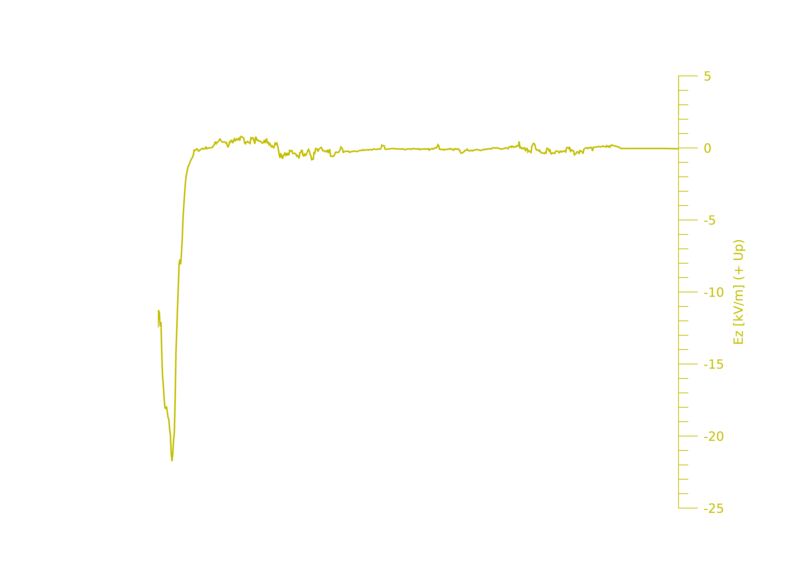
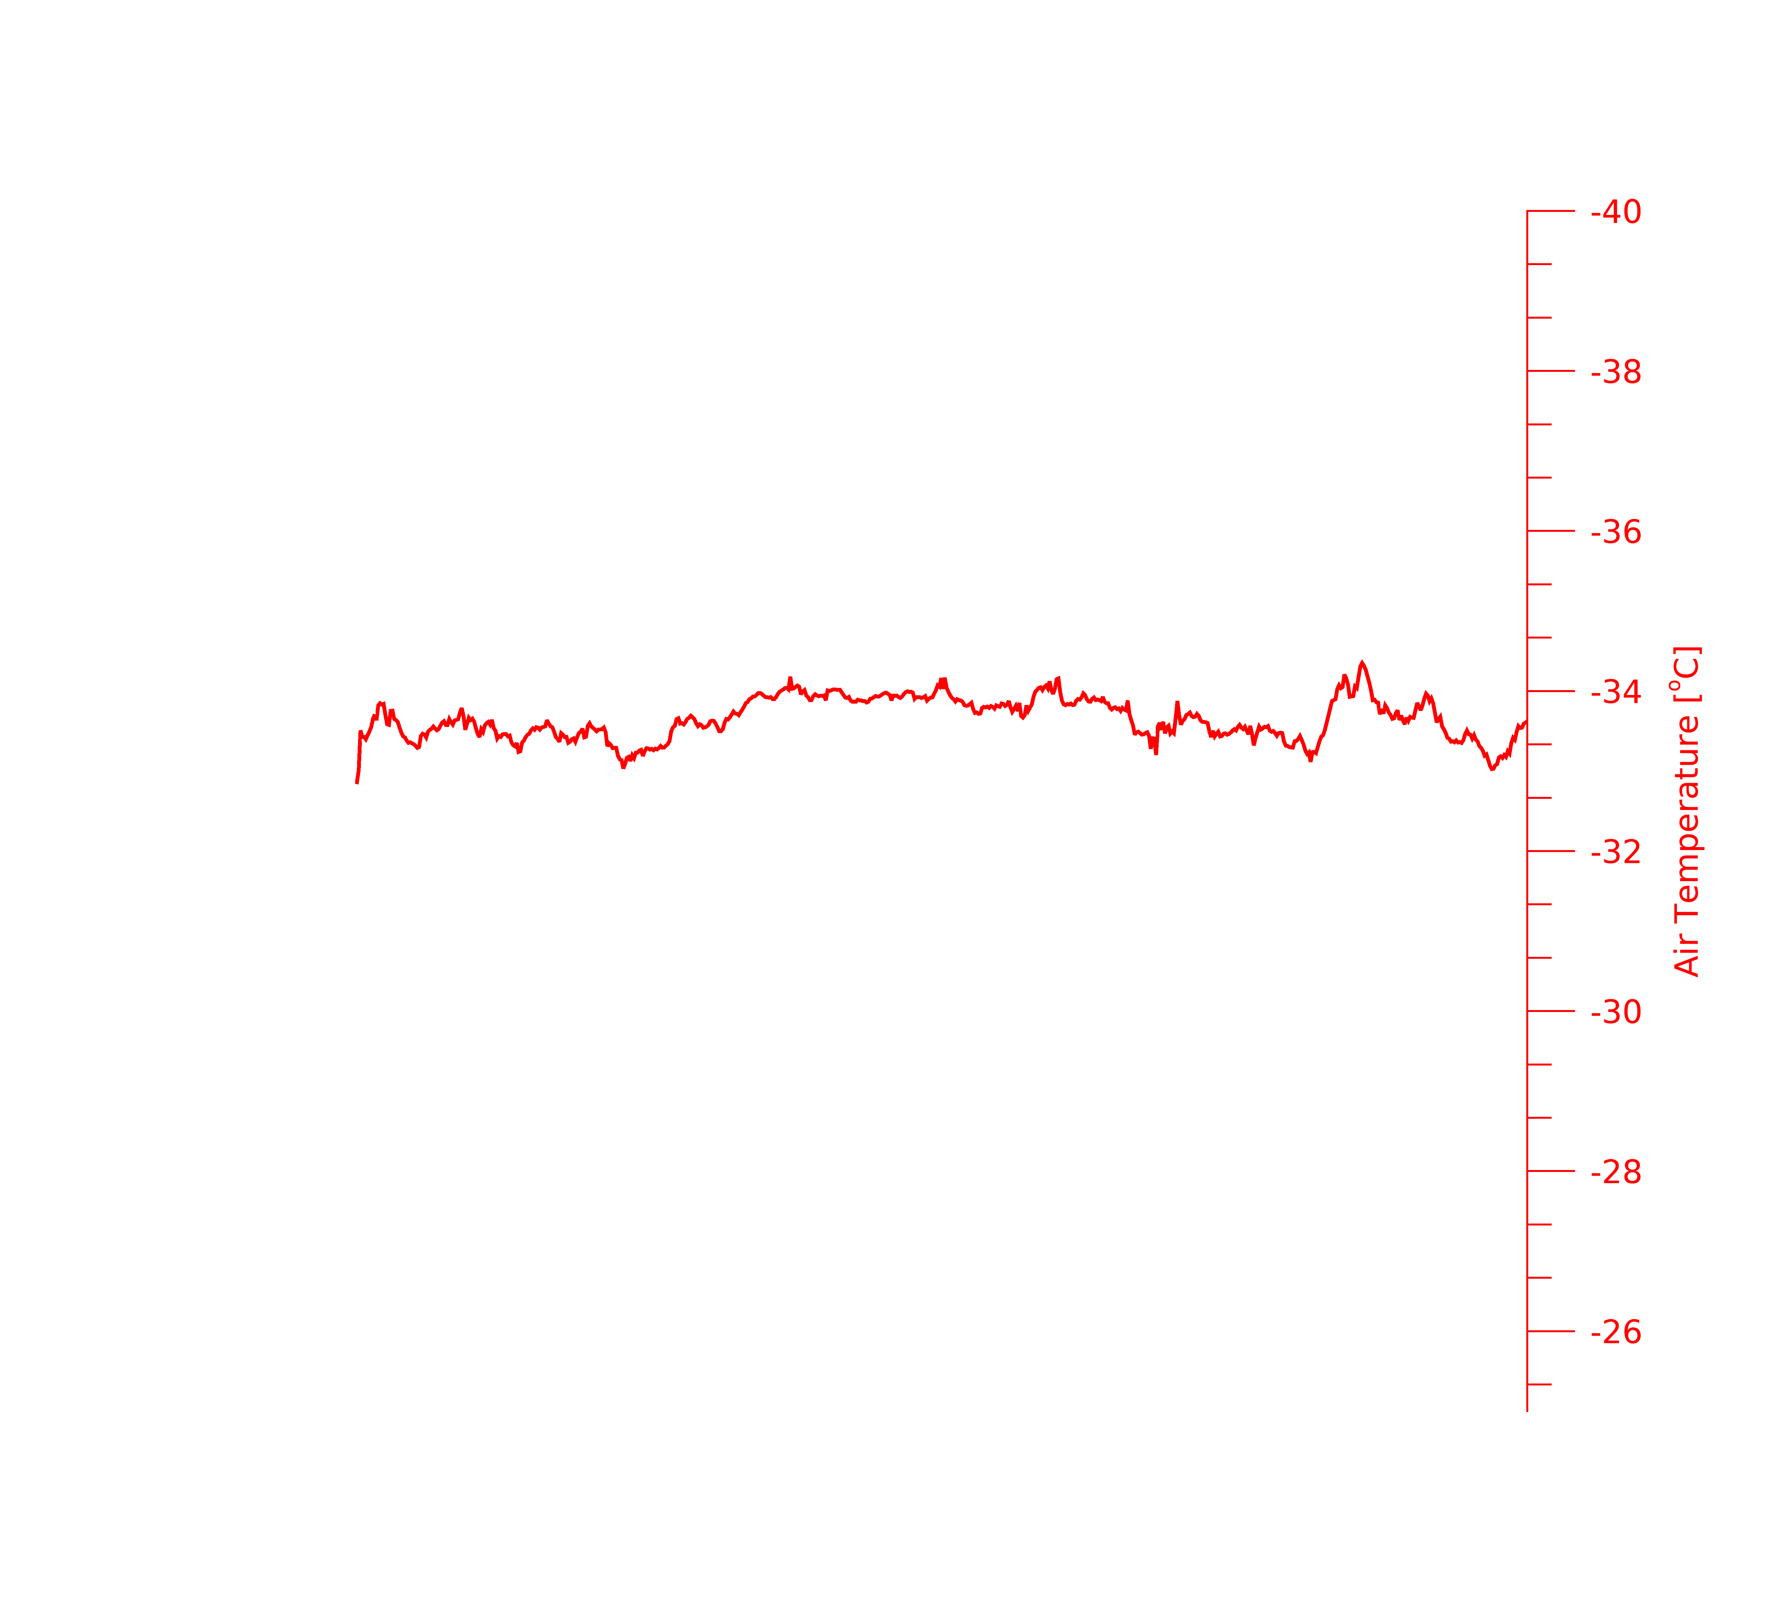
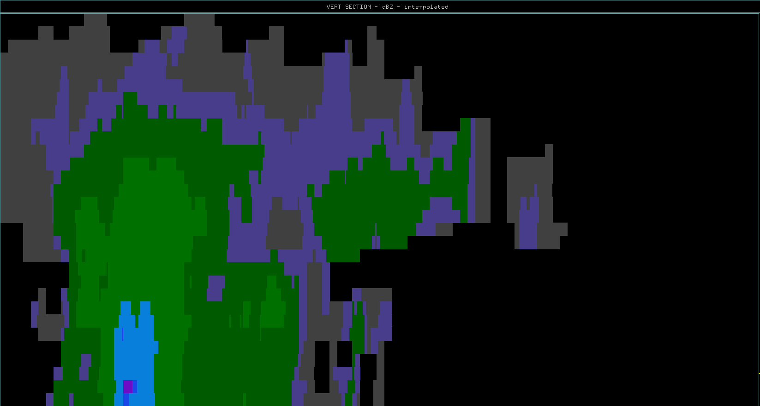
Flight Leg 1: 15:50:00 – 16:01:00 UTC
10
20
30
40
50
60
70
80
90
Distance (km)
Aircraft Flight Track & Direction

Slide 4
Flight Leg 1: 15:50:00 – 16:01:00 UTC
10
20
30
40
50
60
70
80
90
Distance (km)
Aircraft Flight Track & Direction

Slide 5
Flight Leg 1: 15:50:00 – 16:01:00 UTC
10
20
30
40
50
60
70
80
90
Distance (km)
Aircraft Flight Track & Direction

Slide 6
Flight Leg 2 16:02:00 – 16:07:00 UTC

Slide 7
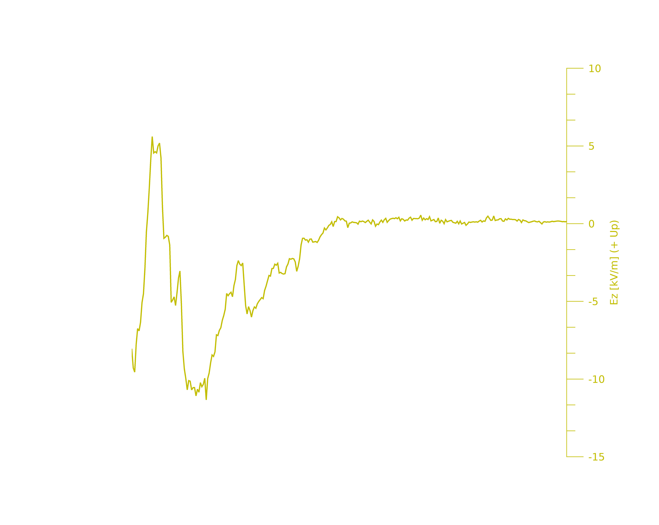
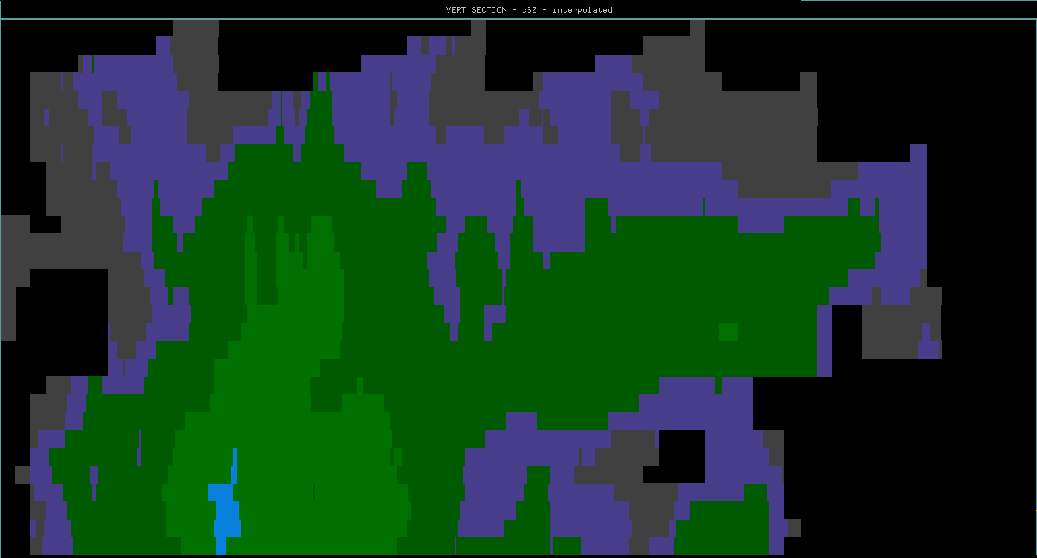
10
20
30
40
50
60
Distance (km)
Aircraft Flight Track & Direction

Slide 8
Flight Leg 2: 16:02:00 – 16:07:00 UTC
10
20
30
40
50
60
Distance (km)
Aircraft Flight Track & Direction

Slide 9
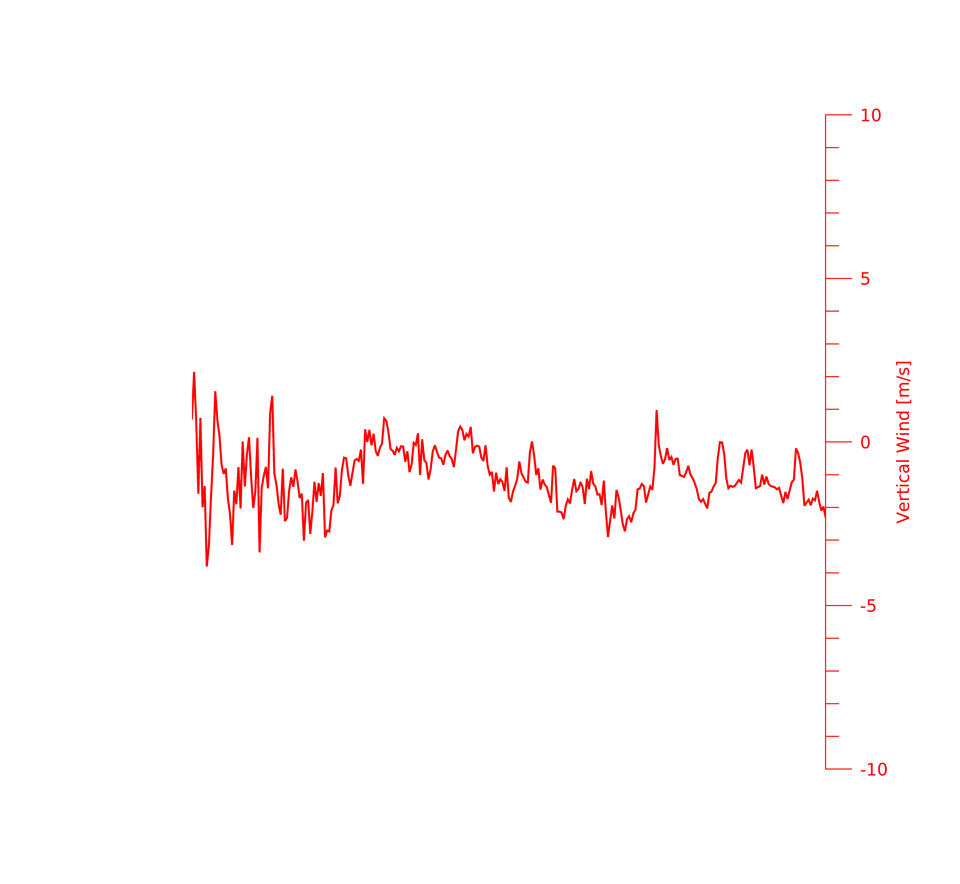
10
20
30
40
50
60
Distance (km)
Aircraft Flight Track & Direction

Slide 10
Flight Leg 3 16:09:00 – 16:17:00
Aircraft sampling father
away from storm core but in the
same relative sampling locations as
flight leg 1.

Slide 11
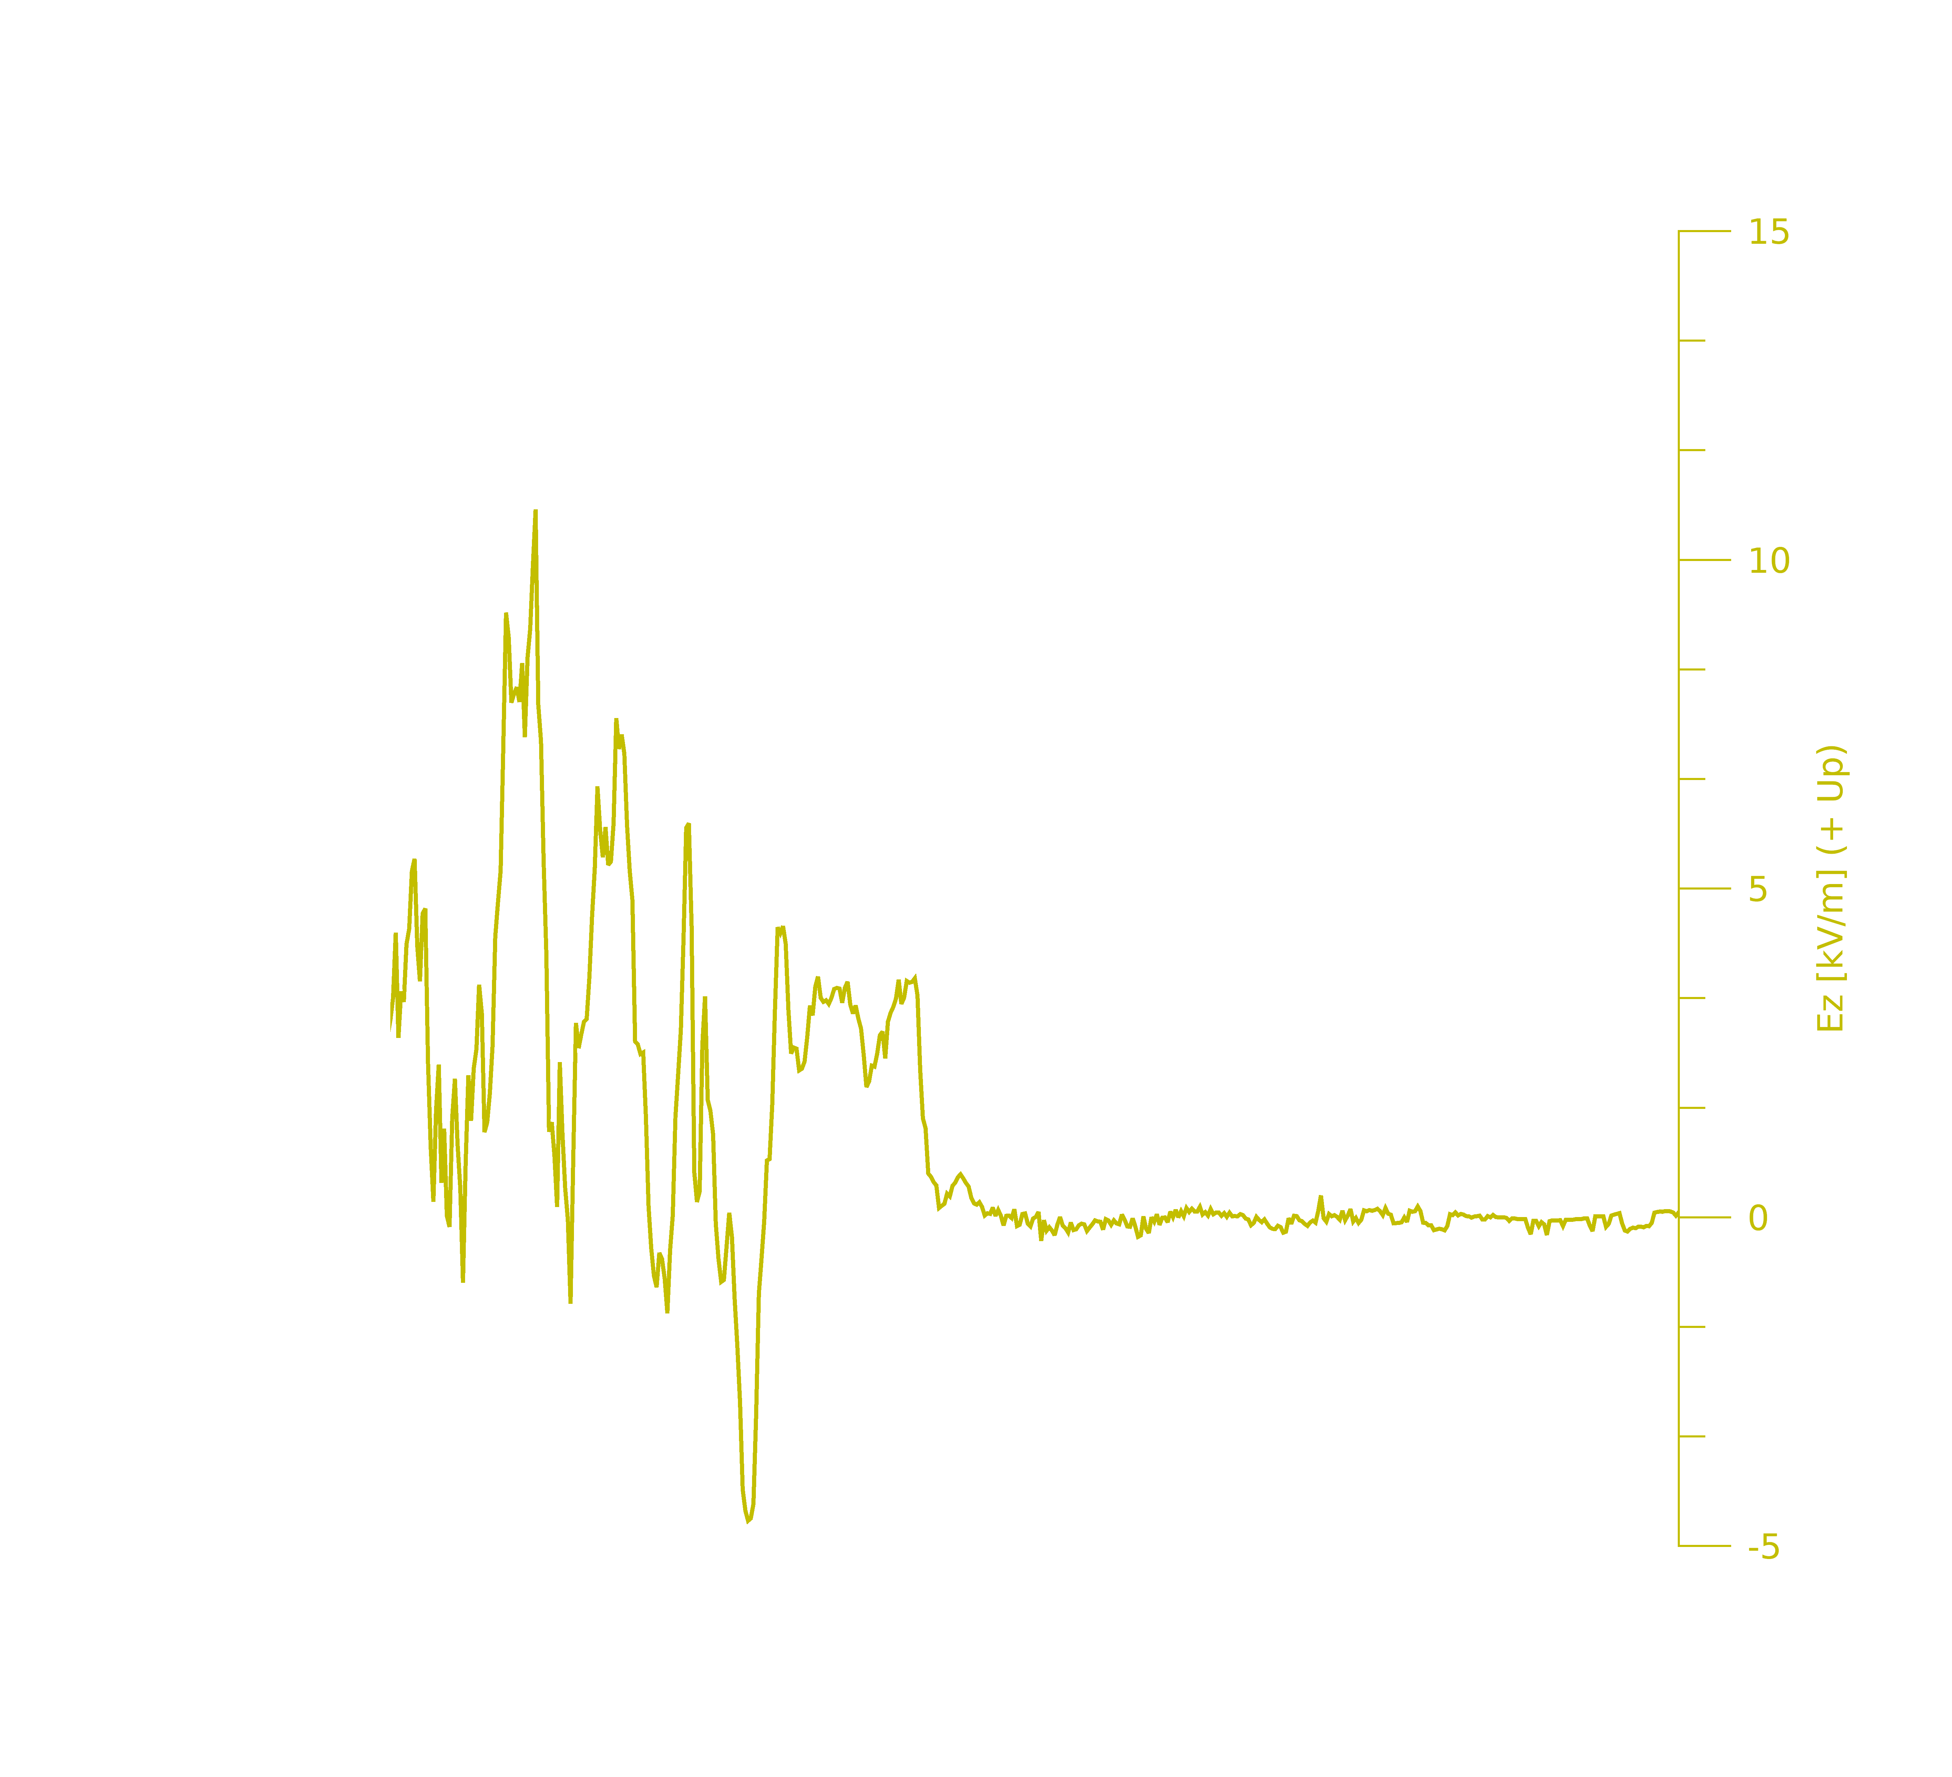
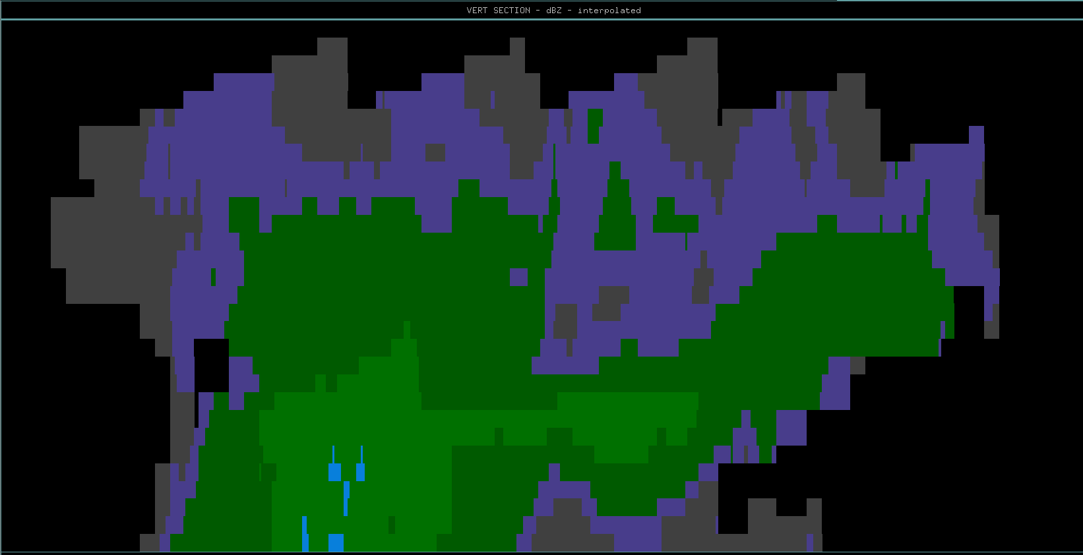
Flight Leg 3: 16:09:00 – 16:17:00 UTC
10
20
30
40
50
60
70
Distance (km)
Aircraft Flight Track & Direction

Slide 12
Flight Leg 3: 16:09:00 – 16:17:00 UTC
10
20
30
40
50
60
70
Distance (km)
Aircraft Flight Track & Direction

Slide 13
10
20
30
40
50
60
70
Distance (km)
Aircraft Flight Track & Direction

Slide 14
Flight Leg 4 16:21:30 – 16:27:00 UTC

Slide 15
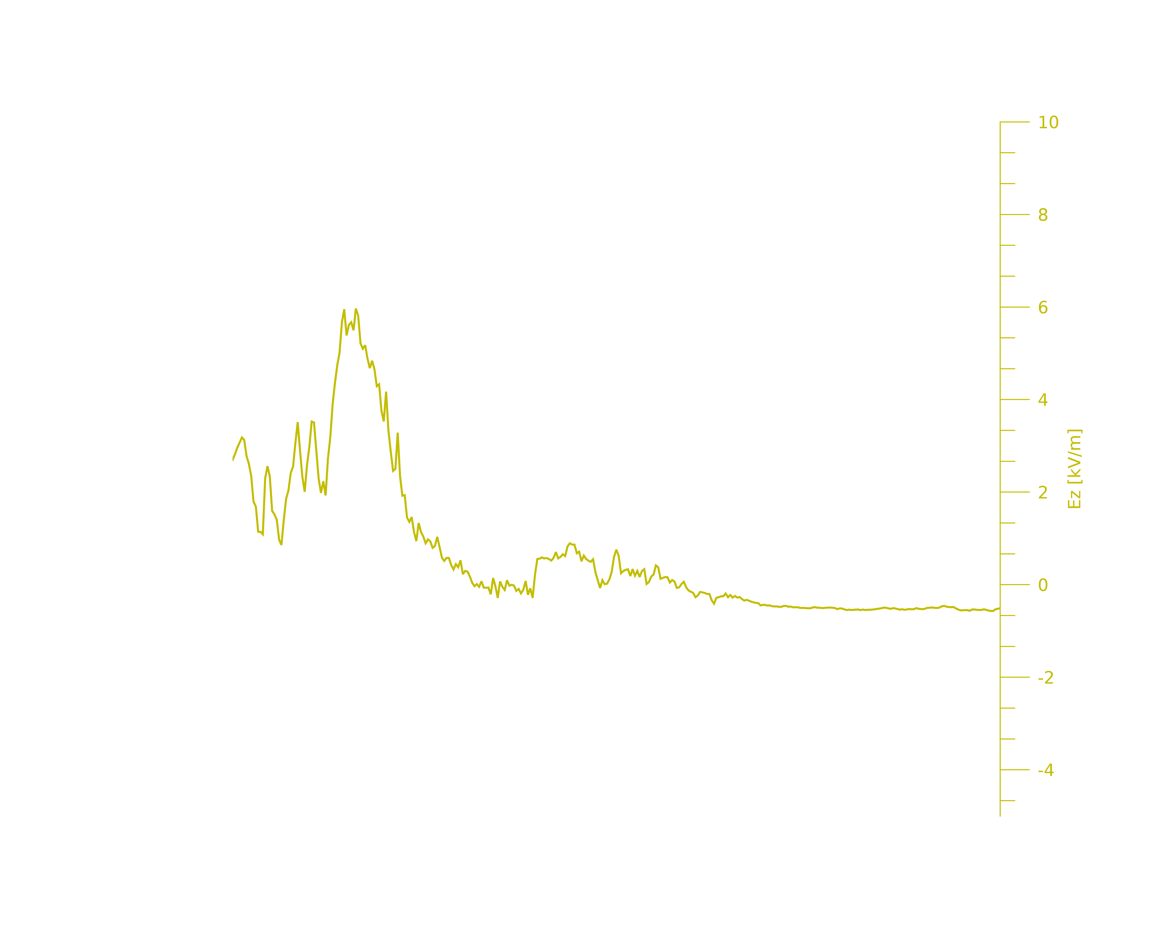
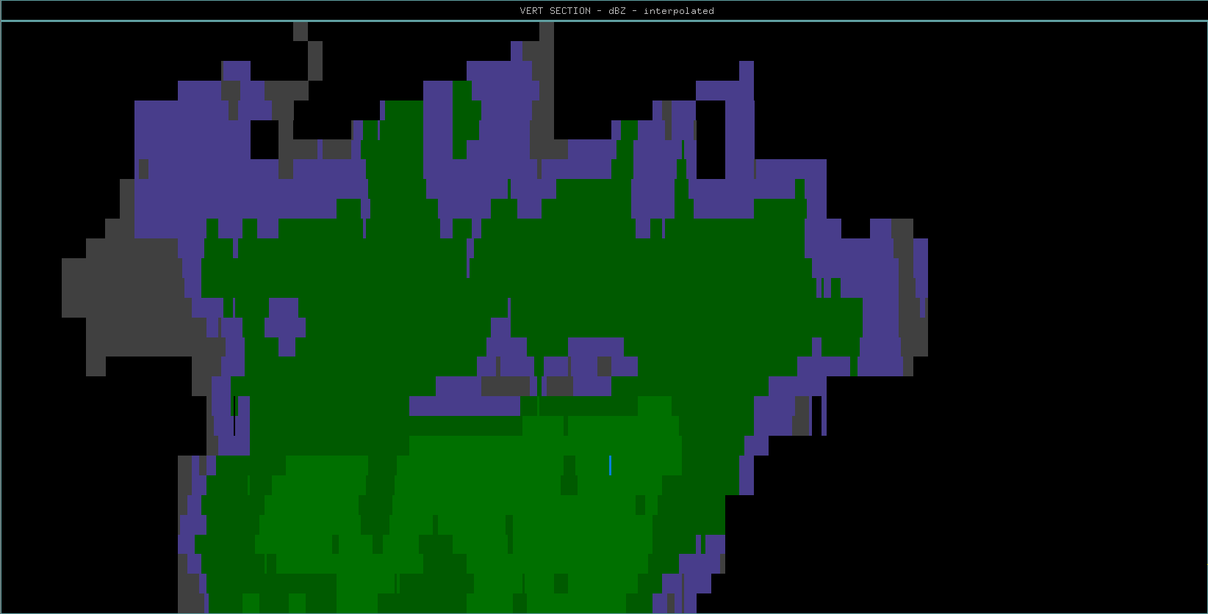
10
20
30
40
50
60
70
80
Distance (km)
Aircraft Flight Track & Direction

Slide 16
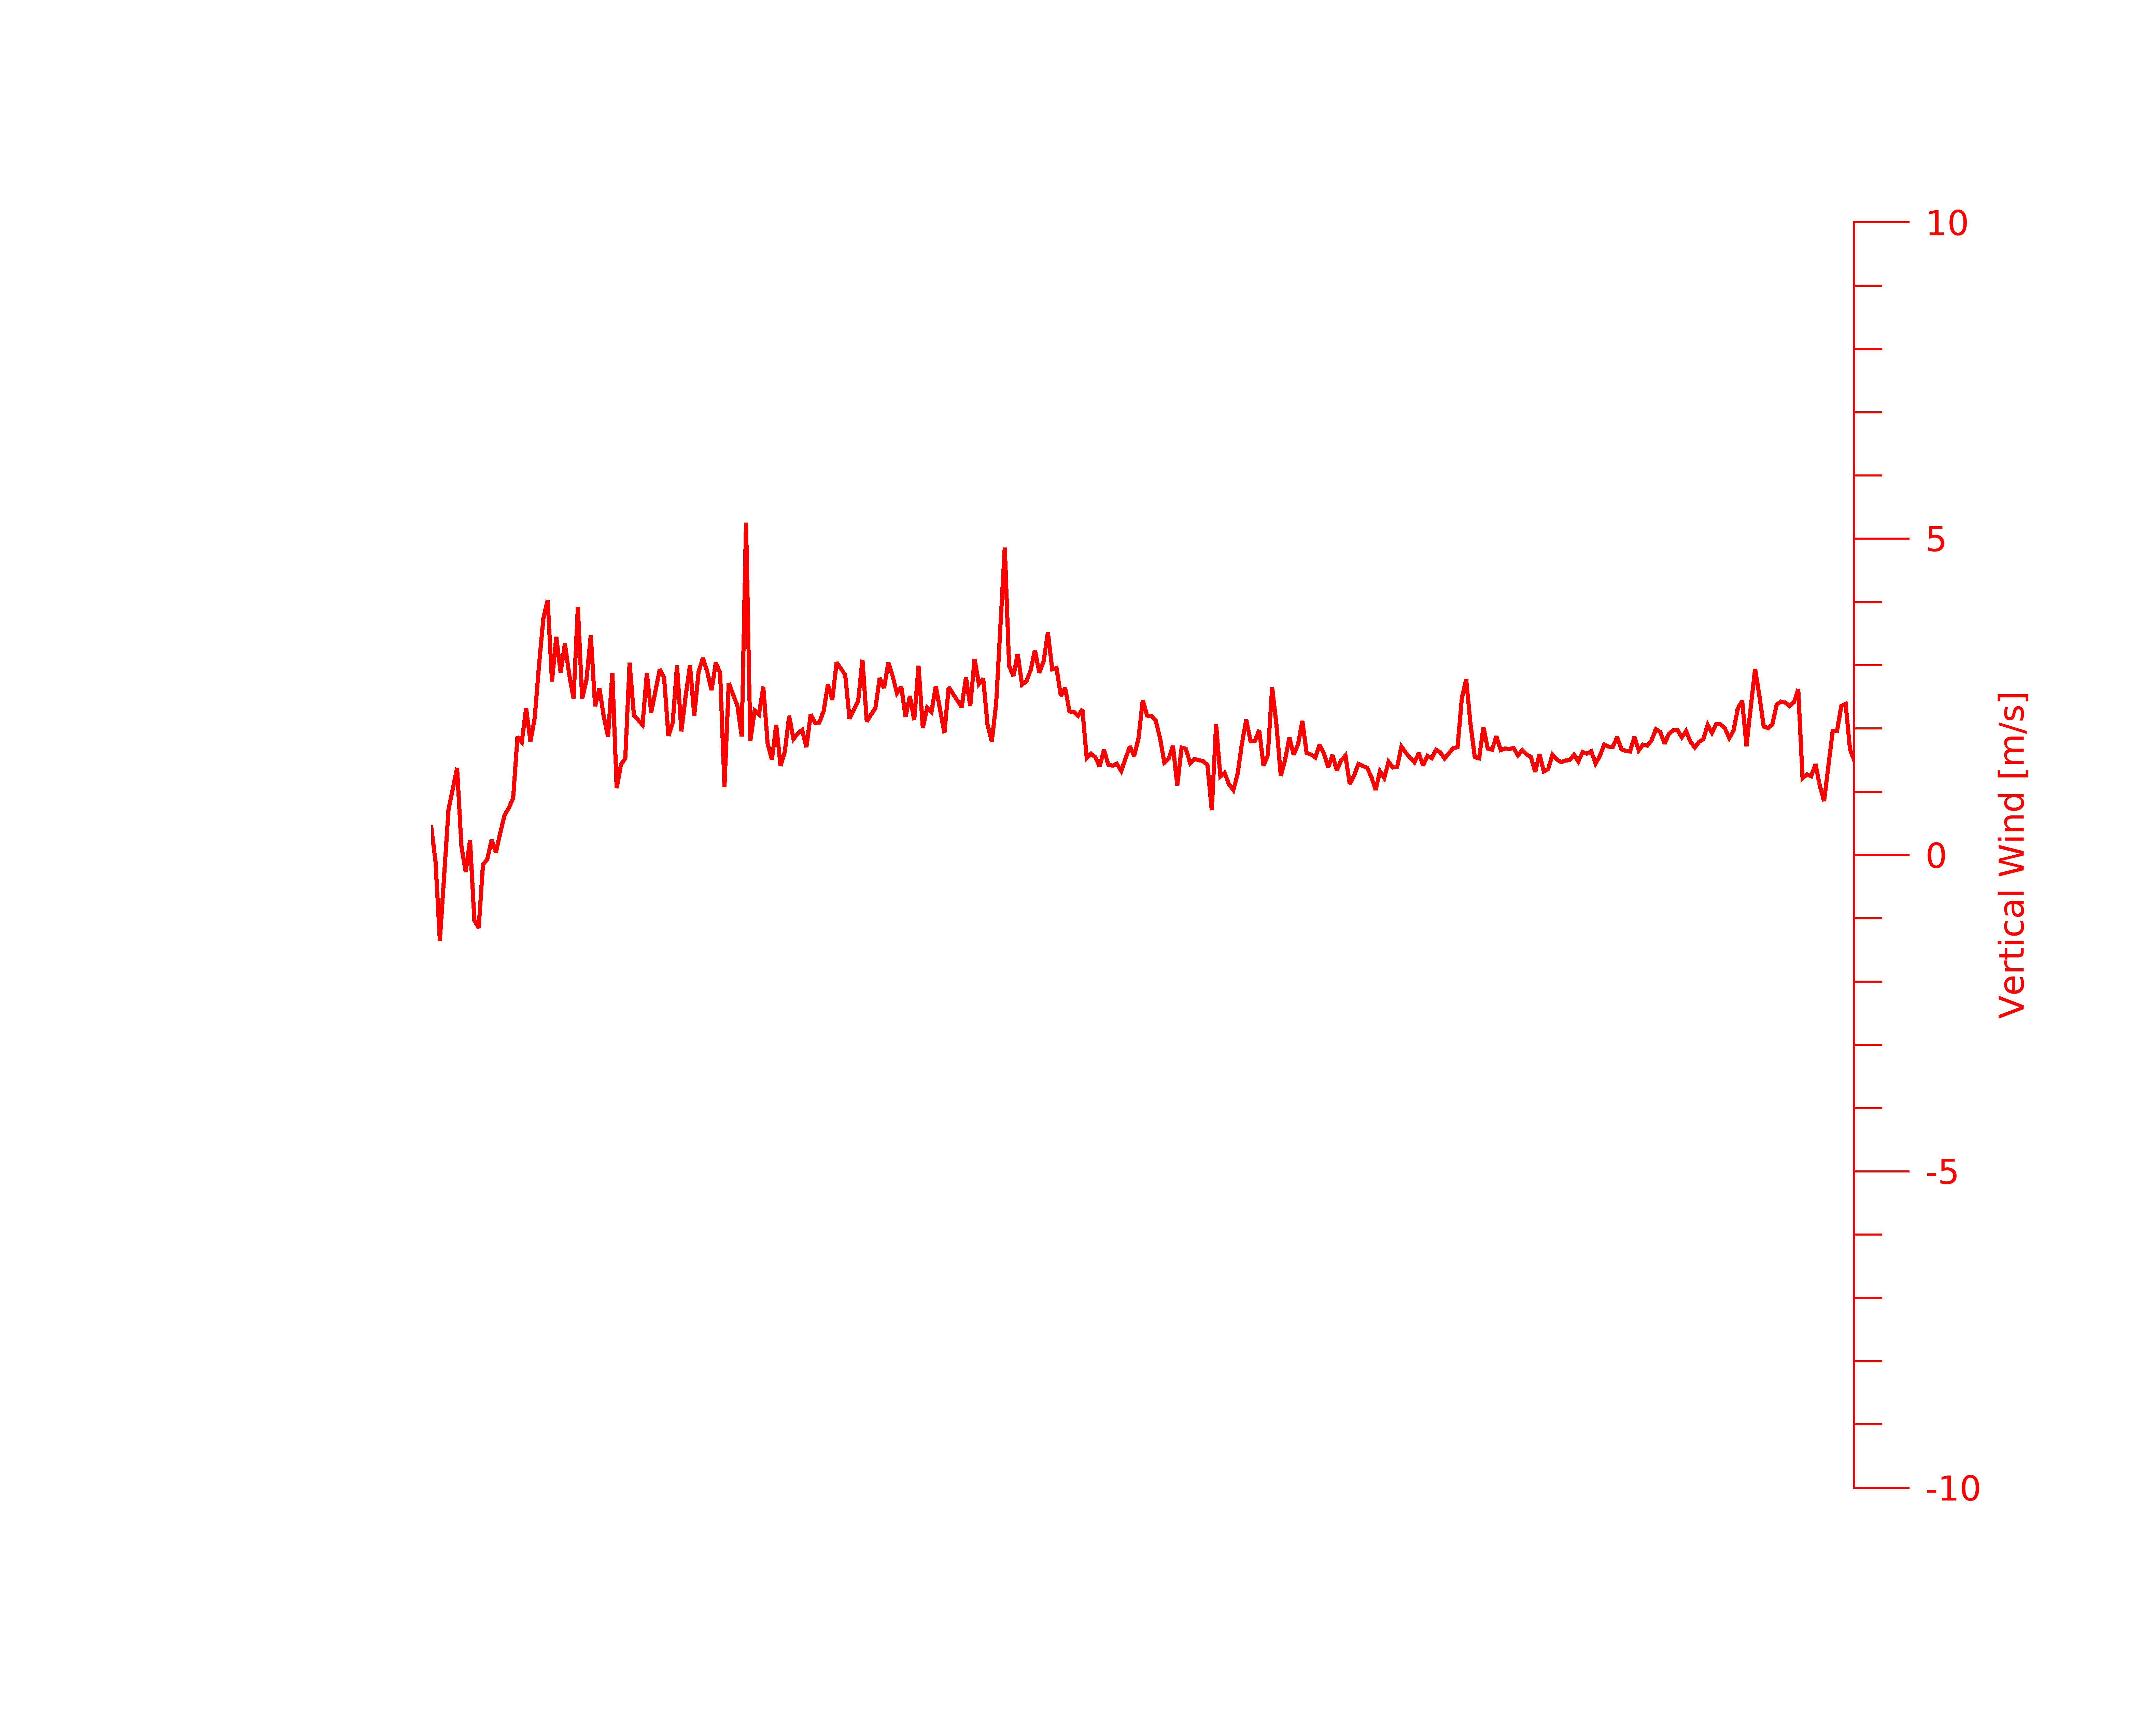
Flight Leg 4: 16:21:30 – 16:27:00 UTC
10
20
30
40
50
60
70
80
Distance (km)
Aircraft Flight Track & Direction

Slide 17
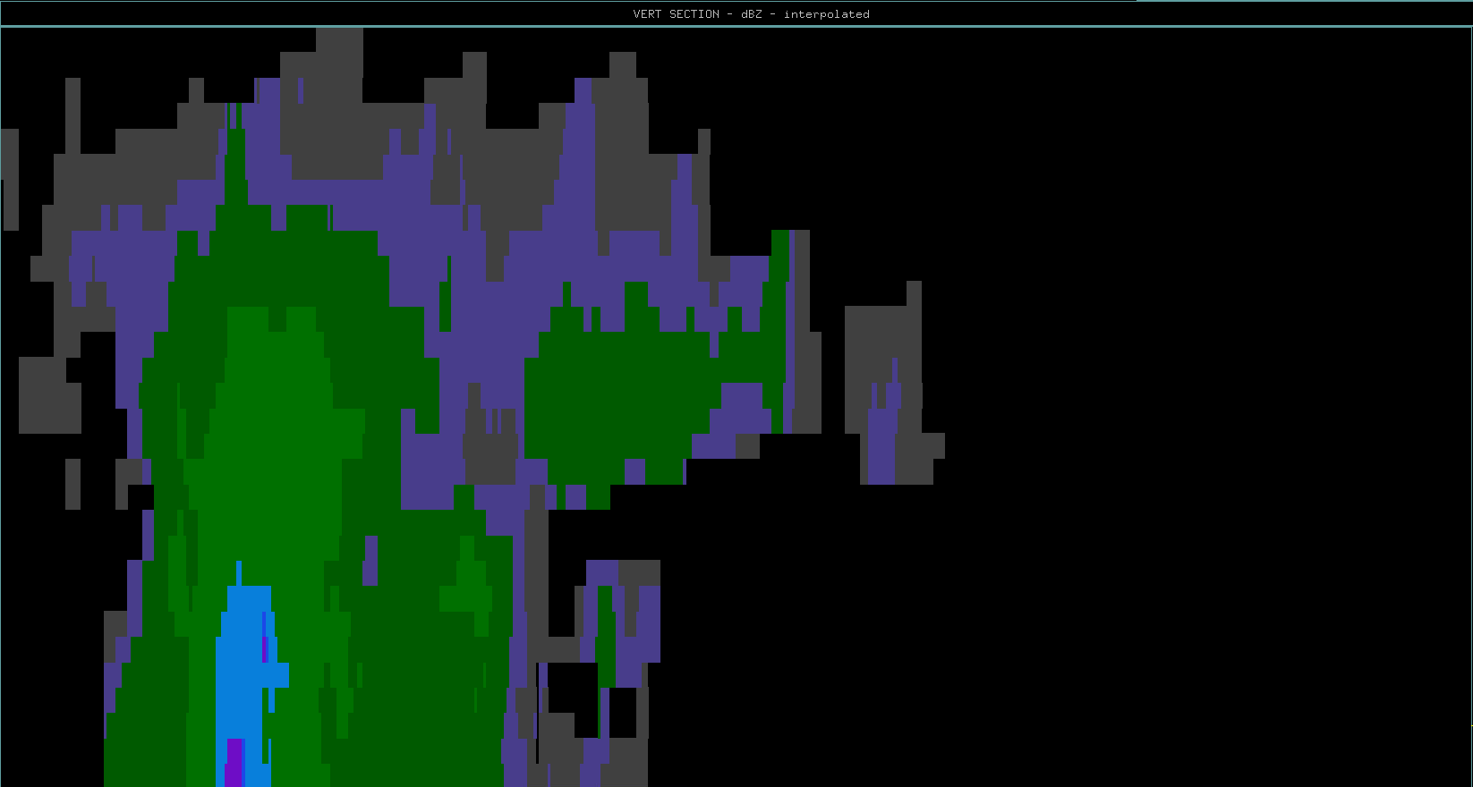
10
20
30
40
50
60
70
80
90
100
110
Distance (km)
Aircraft Flight Track & Direction

Slide 18
10
20
30
40
50
60
70
80
90
100
110
Distance (km)
Aircraft Flight Track & Direction

