Slide 1
Florida Cirrus Anvil Extent during CapeEx19 using the WRF-ARW
Numerical Weather Prediction (ATSC 530) – Final Project
Christian Nairy

Slide 2
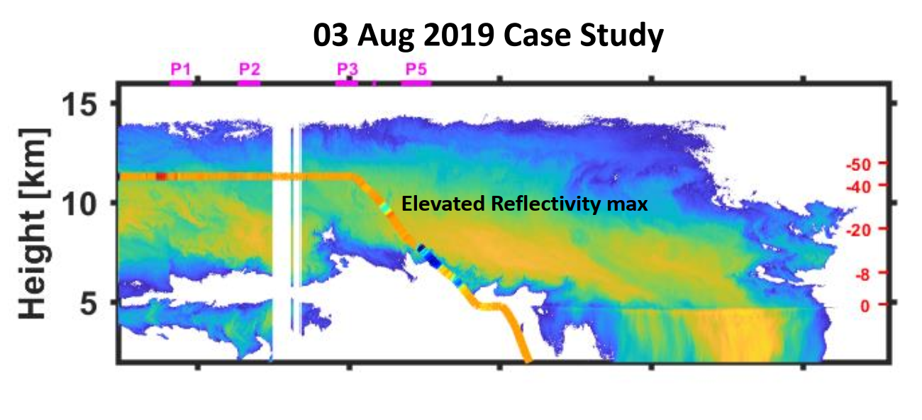
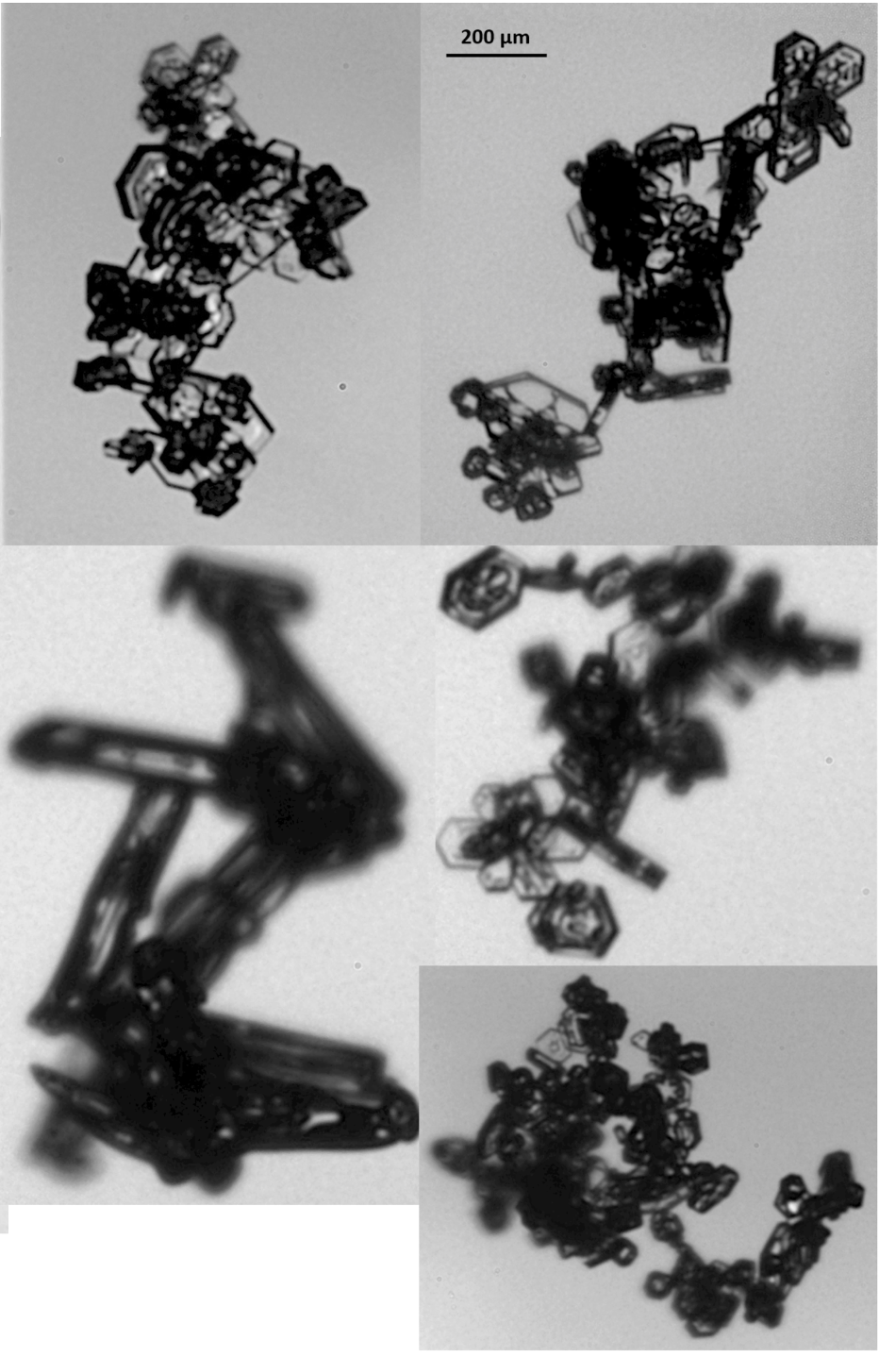
Background Information
Figure 1
Investigators for the CapeEx19 field campaign have shown that summer-time convection and convection produced cirrus anvils near Cape Canaveral, Florida was poorly represented in models.
More specifically – Cirrus anvil extent and updraft locations.
Observations of large particles (chain aggregates) were found in the FL cirrus anvil regions (Figure 1).
Have significant impact on radiation budget (Liou 1973).
Particle images from cirrus anvil
~10.5km AGL // -30°C

Slide 3
Methodology
Run the WRF_V4.0 (Skamarock et al. 2019) utilizing different microphysical parameterizations.
WDM 6-class scheme – First WRF run
Lin et al. scheme – Second WRF run
WSM 5-class scheme – Third WRF run
WDM 5-class scheme – Fourth WRF run
Run 24-hr simulation on 3 August 2019.
4 total WRF simulations.
Compare WRF output results to in-situ and radar observations from the CapeEx19 field campaign.
What Microphysical scheme worked the best in modeling the cirrus anvil extent at ~10 km AGL?

Slide 4
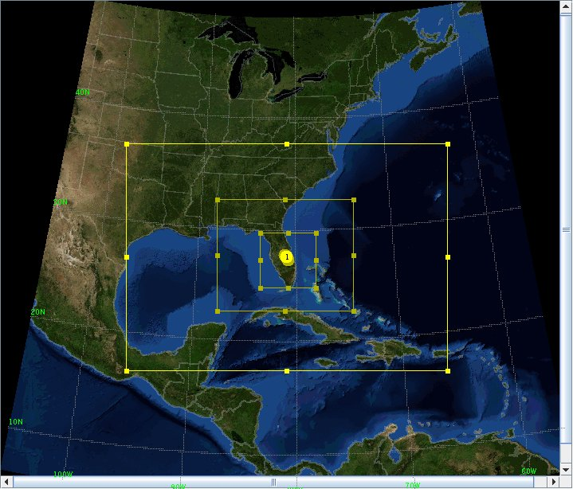
Data – WRF Model
Figure 2
Utilized the WRF-ARW Version 4.0
Input data for WRF: NCEP North American Regional Reanalysis (NARR) data
All model runs ran on a 3:1 grid ratio with 2 inner-nests (Figure 2).
Parent domain = 27 km; Outer nest = 9 km; Inner nest = 3 km
30 vertical levels.
Land-surface types - ﻿Noah land surface model scheme (Niu et al., 2011)
The shortwave (Dudhia scheme [Hong, 2004]) and longwave radiation scheme (Rapid Radiative Transfer Model ﻿[Mlawer et al. 1997]) are used.
Domain for all WRF simulations

Slide 5
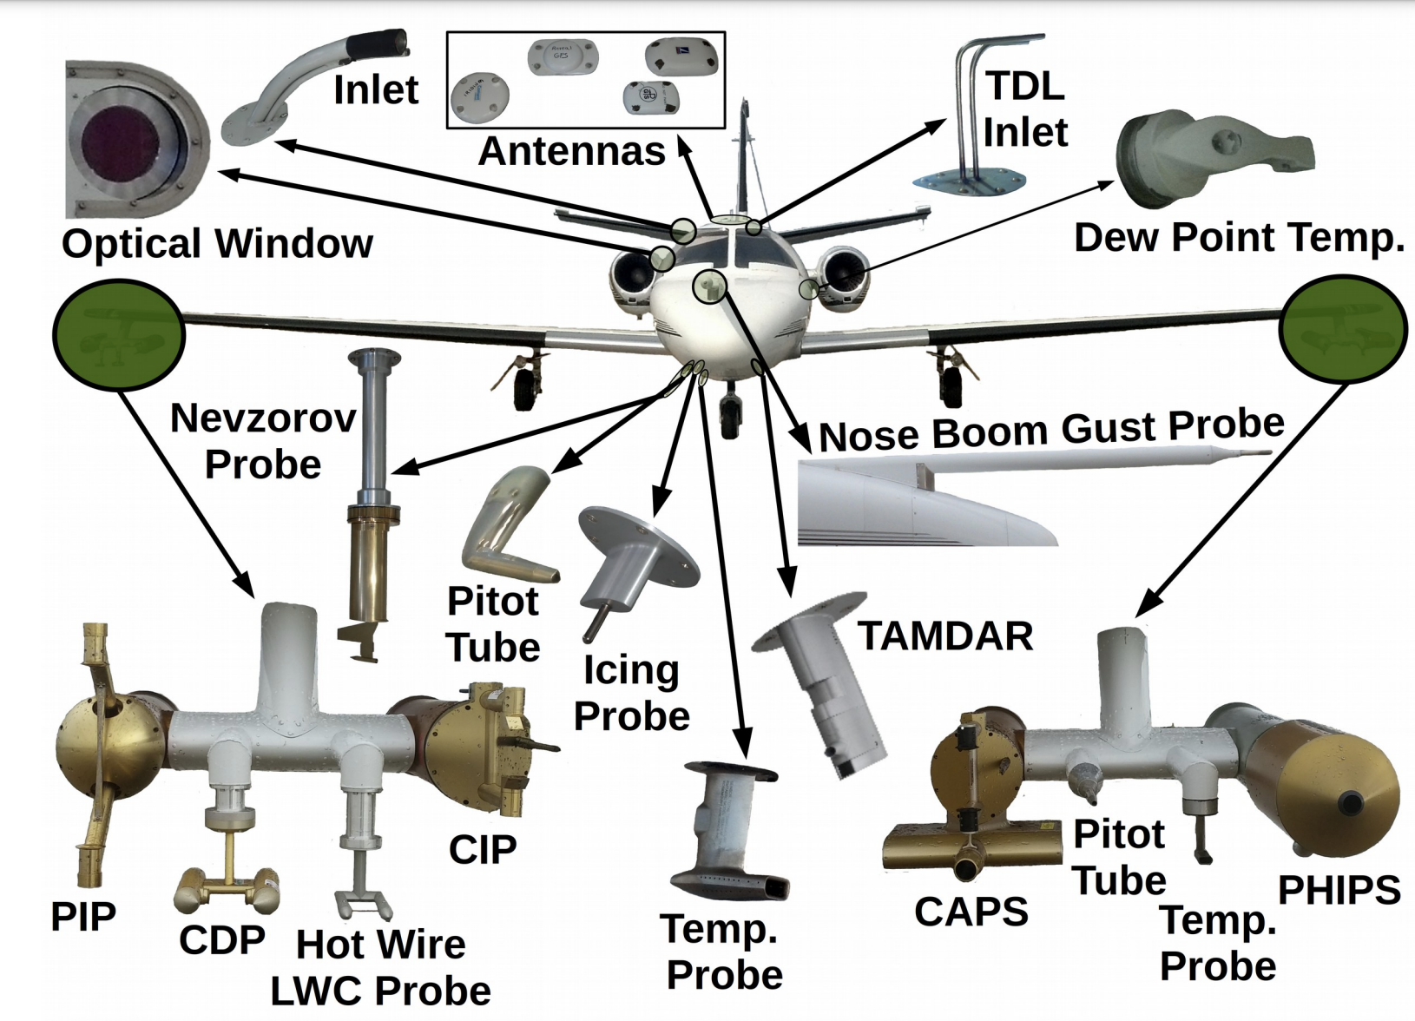
Data – CapeEx19
Will utilize the Nezorov Total Water Content Probe.
For inner-cloud threshold.
Aircraft applanix data.
Aircraft position, speed, heading angles, etc…
Radar data:
KMLB (Melbourne, FL) WSR-88D

Slide 6
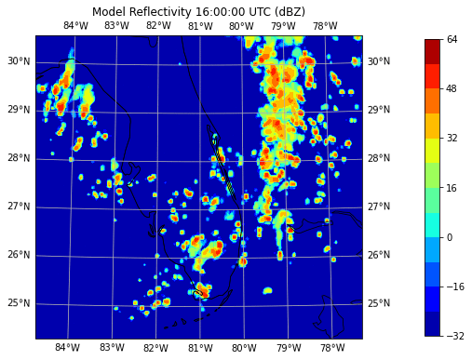
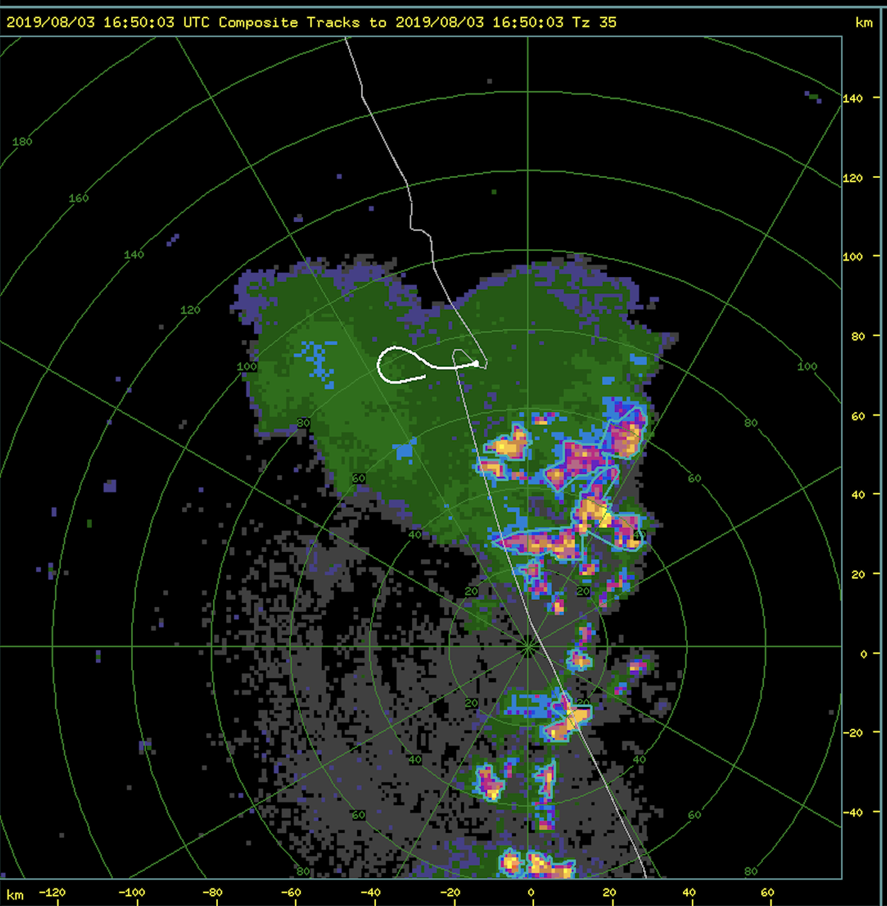
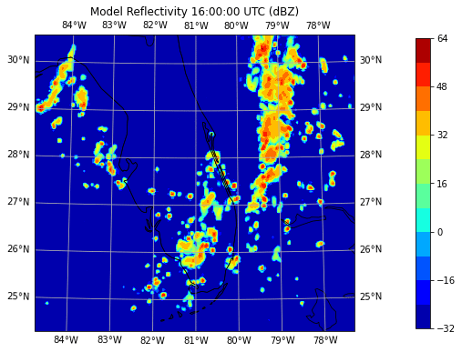
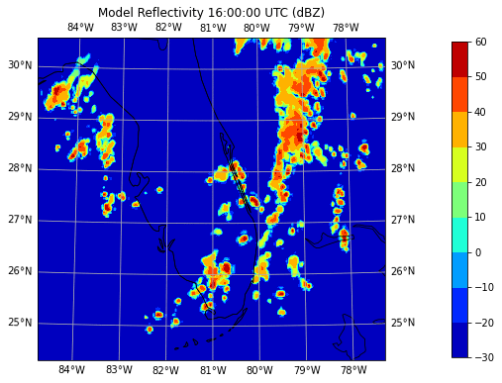
WDM6
Lin et al.
WSM5
WDM5

Slide 7
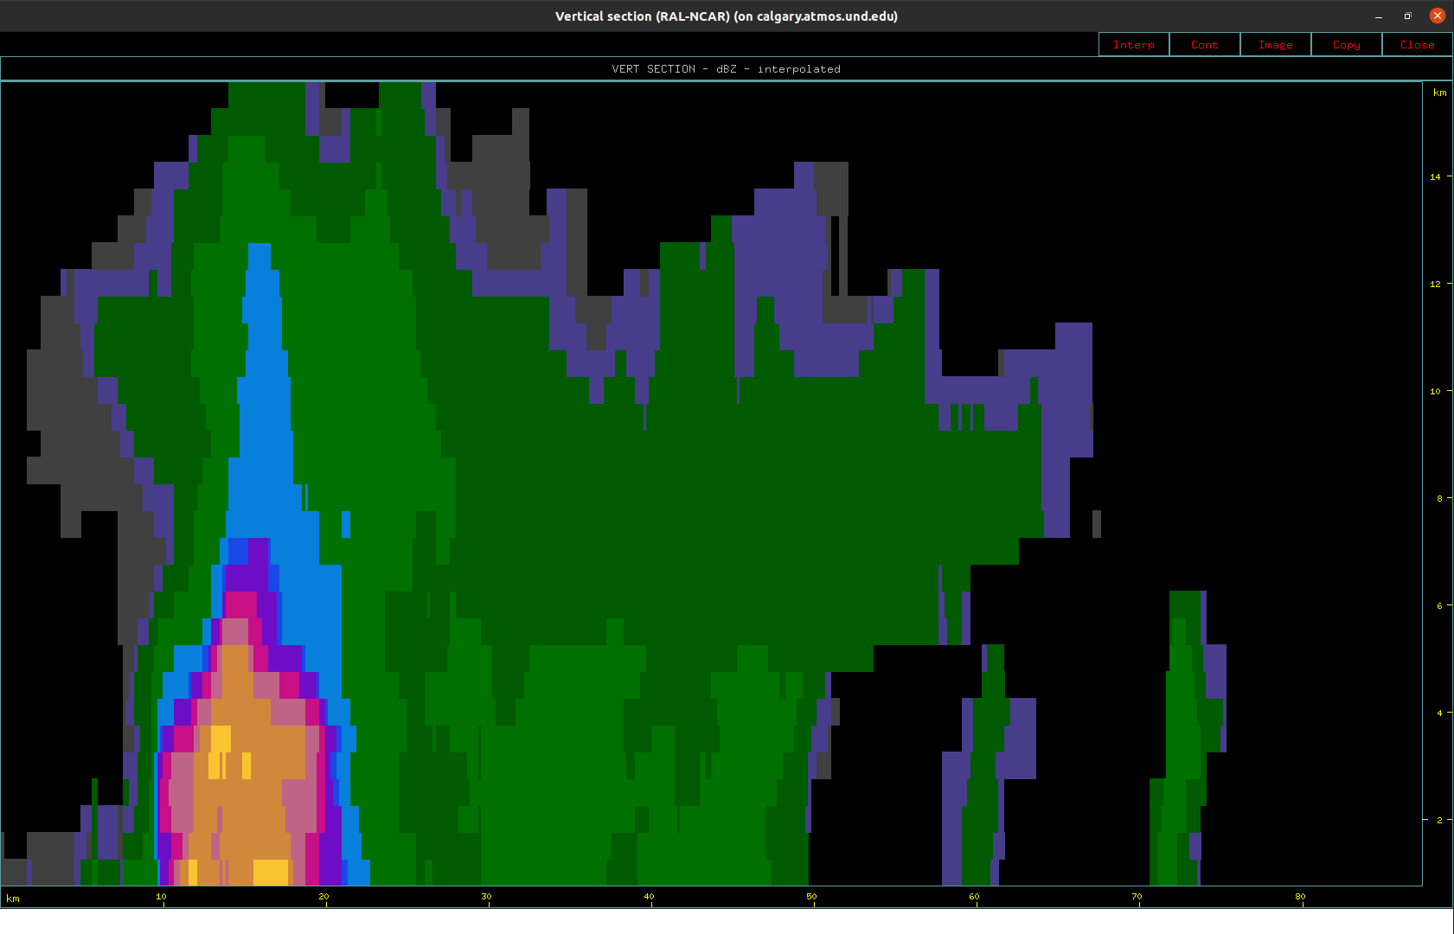
Real Life Case with Cross-Section – 2019/08/03
KMLB WSR-88D
Time-stamp where storm was most mature (15:38:57 UTC)
Maximum dbz: 51-54 dbz
Cloud top height (according to radar): 15km
Anvil extent (white line) based on radar: 54 km
Interestingly, anvil extent 10 minutes later (based on aircraft observations [Nev. Probe] : Approx. 90 - 100 km
Aircraft Measurements
Aircraft sampled this storm at (15:50:00 UTC)
Height: 10 km
Temperature Range: -34.5°C to -32.5°C

Slide 8
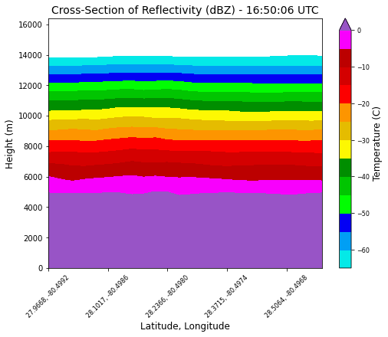
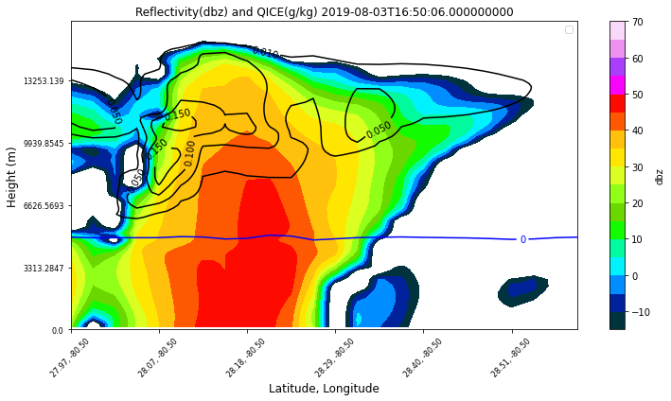
WDM 6
Max Reflectivity (vert. cross-section): 45 – 50 dbz
Anvil Extent: 37 km
Temperature at 10 km AGL: -35°C to -30°C

Slide 9
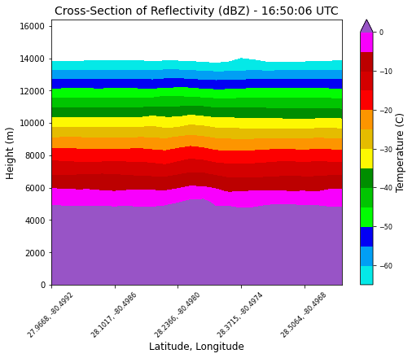
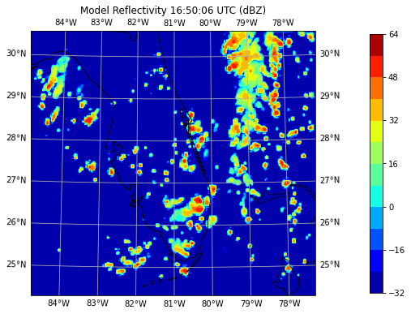
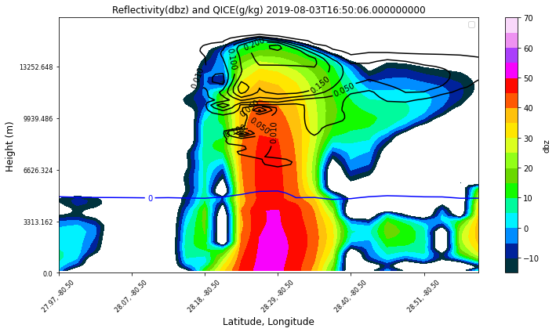
Lin et al.
Max Reflectivity (vert. cross-section): 55 – 60 dbz
Anvil Extent: 36 km
Temperature at 10 km AGL: -35°C to -30°C

Slide 10
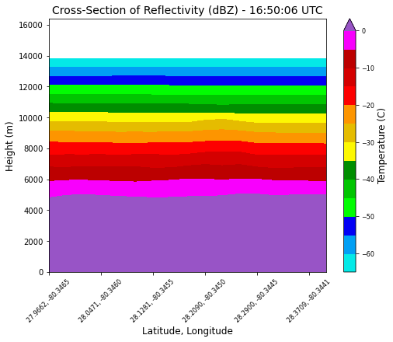
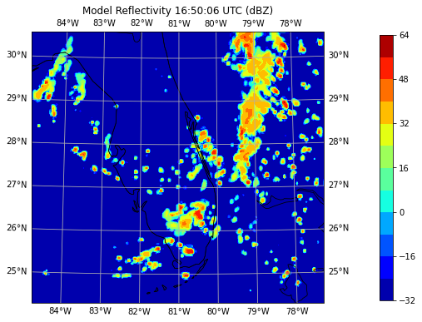
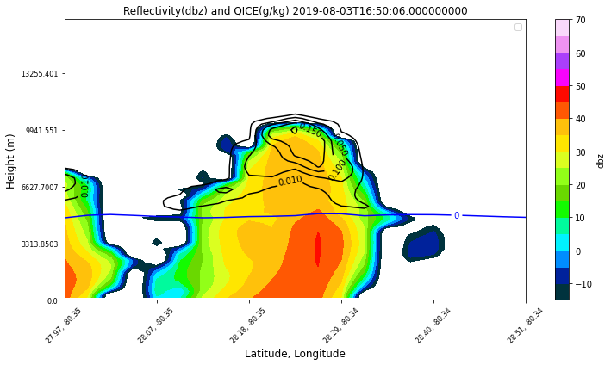
WSM 5
Max Reflectivity (vert. cross-section): 45 – 50 dbz
Anvil Extent: No abundant anvil signature
Temperature at 10 km AGL: -35°C to -30°C

Slide 11
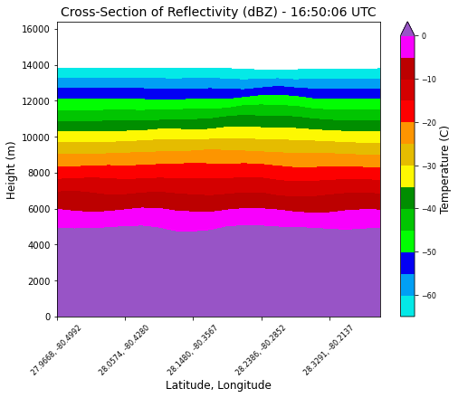
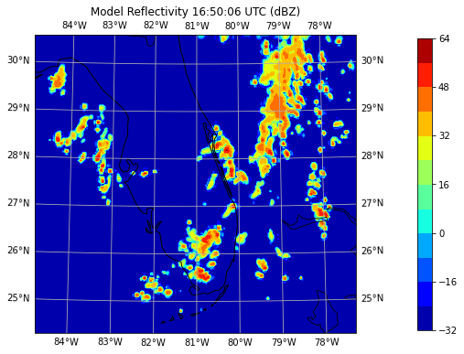
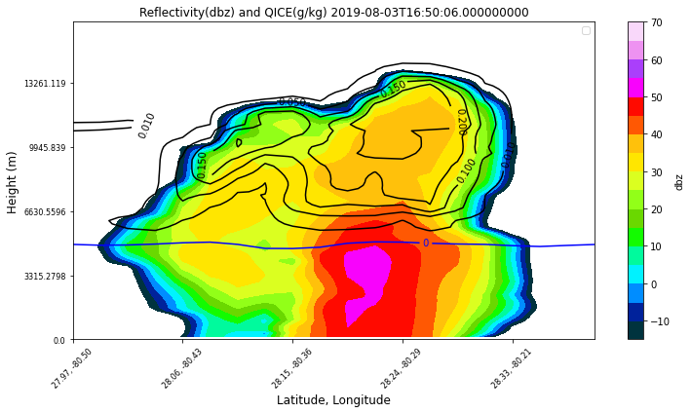
WDM 5
Max Reflectivity (vert. cross-section): 50 – 55 dbz
Anvil Extent: No abundant anvil signature at 10 km AGL
Cloud extent at 10 km: 19 km
Temperature at 10 km AGL: -35°C to -30°C

Slide 12
Results
Overall: WDM 6-class scheme outperformed the other microphysical schemes in terms of anvil extent at 10 km.
Lin et al. scheme was overall the best scheme where it accurately simulated the storm updraft height and intensity and anvil extent.
All schemes accurately represented the temperature at the 10 km AGL level
However, all schemes had the convection being mature much later than observed.
The cirrus anvil extent (for thin anvils) is still a major issue within numerical models.
If chain aggregates are abundant and not simulated before hand, this may cause issues for militaristic applications (nose cone cratering).
Future work would include manipulating surface characteristics (albedo) which may help the convection initiation issue (has shown to work with the COAMPS model).

Slide 13
References
﻿﻿﻿Hong, S.Y., 2004: A Revised Approach to Ice Microphysical Processes for the Bulk Parameterization of Clouds and Precipitation, Monthly Weather Review, 132, 103-120, https://doi.org/10.1175/1520-0493(2004)132<0103:ARATIM>2.0.CO;2
Mlawer, E. J., and Coauthors, 1997: Radiative transfer for inhomogeneous atmospheres: RRTM, a validated correlated-k model for the longwave, Journal of Geophysical Research Atmospheres, 102, no. D14 (16663-16682), https://doi.org/10.1029/97JD00237
Niu, G., and Coauthors, 2011: The community Noah land surface model with multiparameterization options (Noah-MP) 1. Model description and evaluation with local-scale measurements, Journal of Geophysical Research Atmospheres, 116, no. D12, https://doi.org/10.1029/2010JD015139
Liou, K. N., 1973: Transfer of Solar Irradiance through Cirrus Cloud Layers., J. Geophys. Res., 78, 1409–1418.
﻿Skamarock, W. C., and Coauthors, 2019: A Description of the Advanced Research WRF Model Version 4 (No. NCAR/TN-556+STR). doi:10.5065/1dfh-6p97

