Slide 1
Committee Meeting
5 April 2022
Christian Nairy

Slide 2
Updates
Participated in the 2022 IMPACTS field campaign
Current writing and preparing for defense (this summer)

Slide 3
Refresher
Thesis Title:
OBSERVATIONS OF CHAIN AGGREGATES IN FLORIDA CIRRUS CLOUD ANVILS ON 3 AUGUST 2019 DURING CAPEEX19
Objective:
To answer: Is chain aggregation occurring within the cirrus anvil region?
Methods:
Characterizing and analyzing observed chain aggregates with respect to distance from Florida thunderstorm cores from in-situ microphysical probes via aircraft.
Compare to microphysics to in-situ electric field observations and radar data from the CapeEx19 data set.
Expected Results:
Provide insight into the overall clouds processes responsible for creating chain-like crystals to enable improvement of cloud models.

Slide 4
Latest data and Results

Slide 5
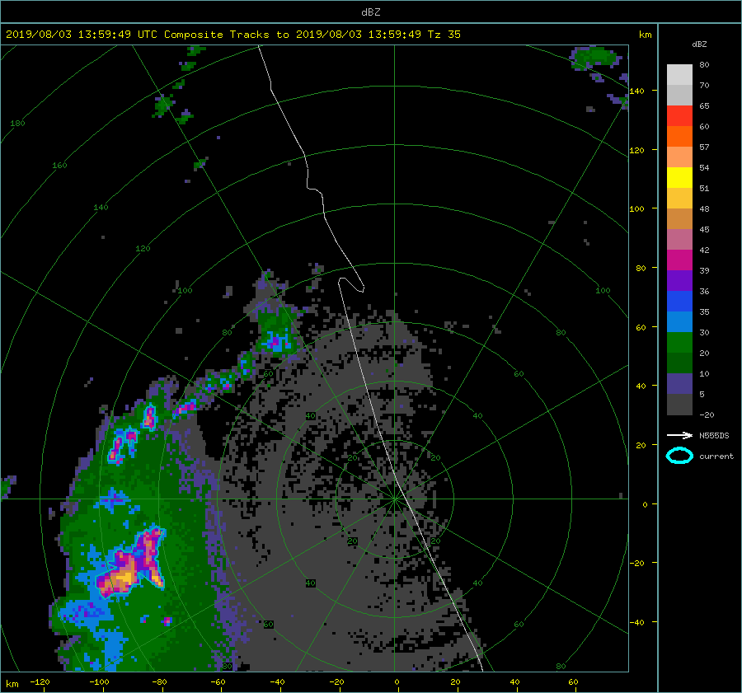
Messy & unorganized
convection.

Slide 6
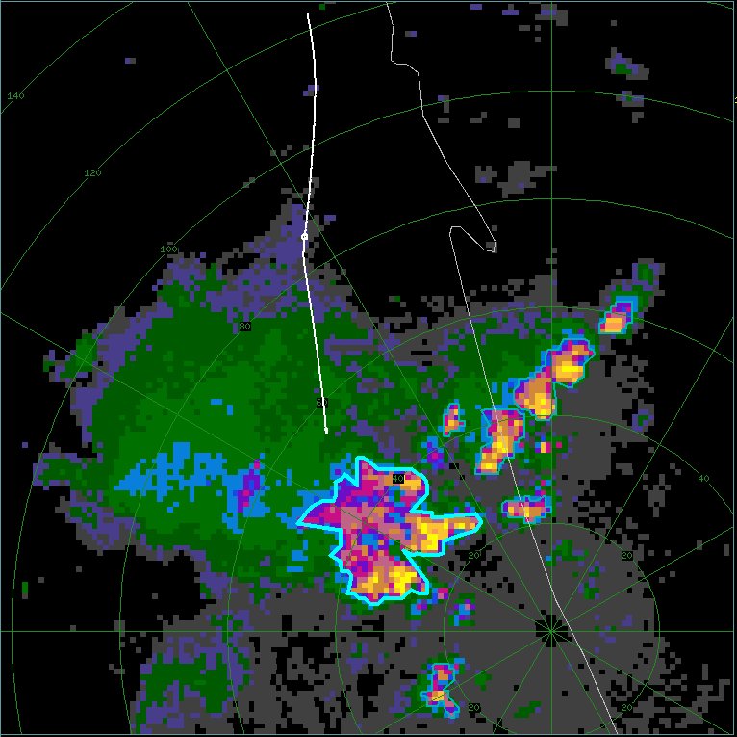
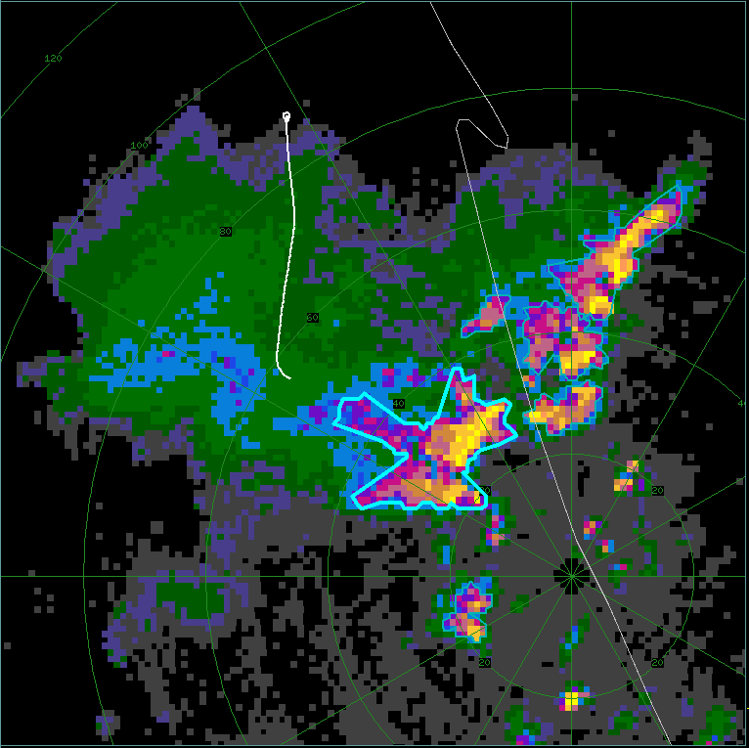
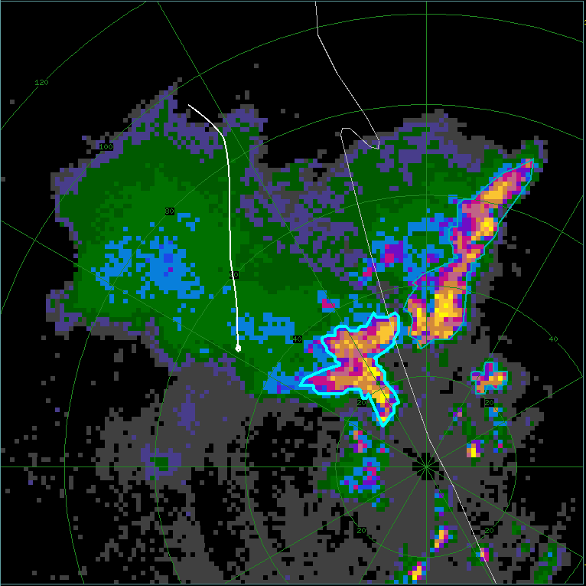
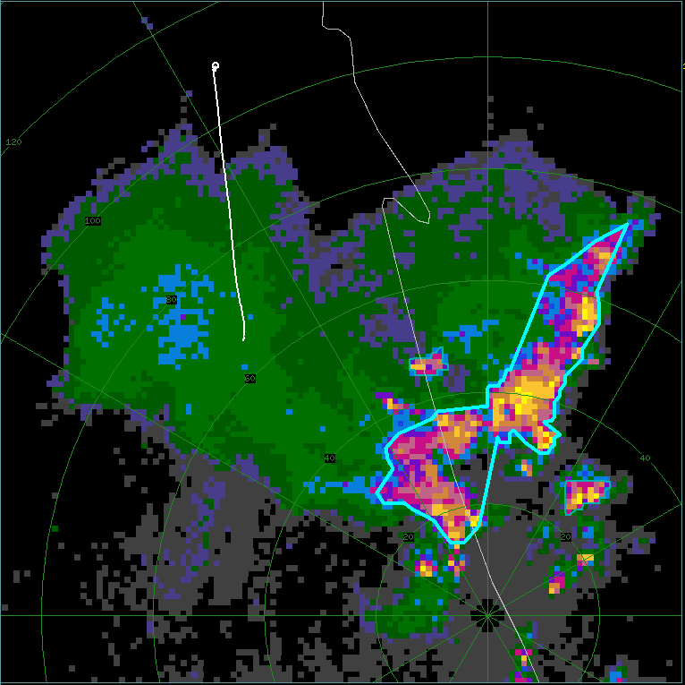
(a) – FL1: 15:51:15 - 16:01:00 UTC
(b) – FL2: 16:02:00 - 16:07:00 UTC
Omit FL5
FL1 – Other convective cells to the WNW and may have an influence on the in-situ data.
KMLB: 15:56:16 UTC
KMLB: 16:07:52 UTC
(c) – FL3: 16:09:00 - 16:17:00 UTC
(d) – FL4: 16:21:30 - 16:27:00 UTC
KMLB: 16:19:25 UTC
KMLB: 16:28:16 UTC

Slide 7
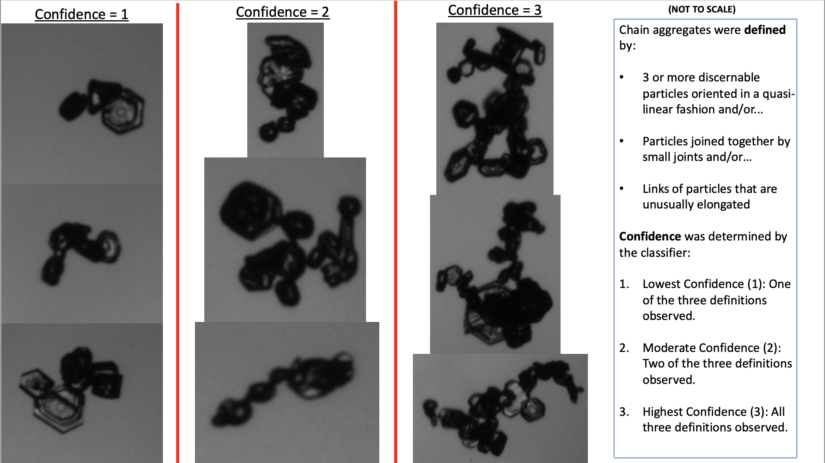

Slide 8
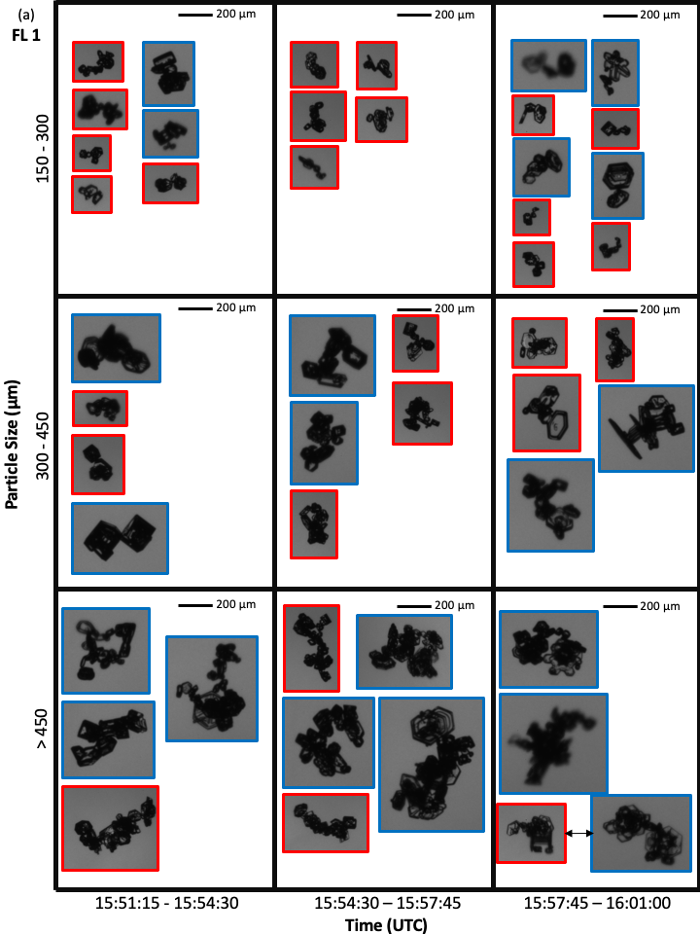
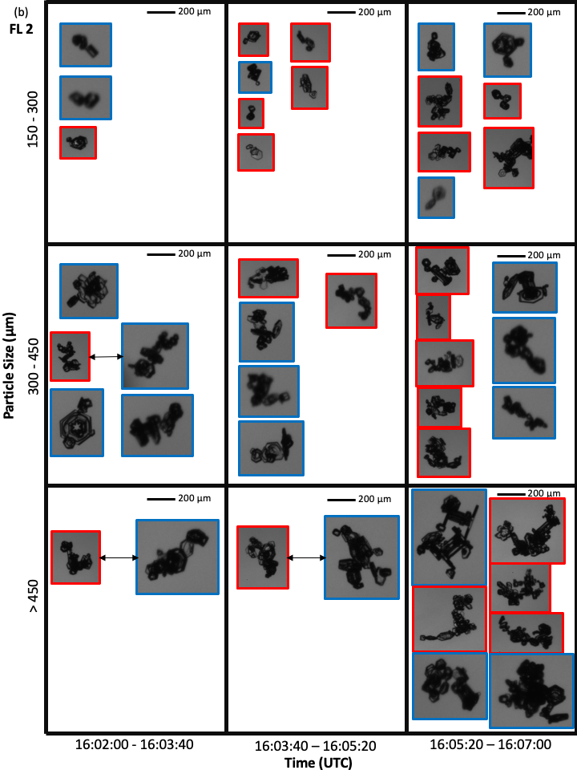

Slide 9
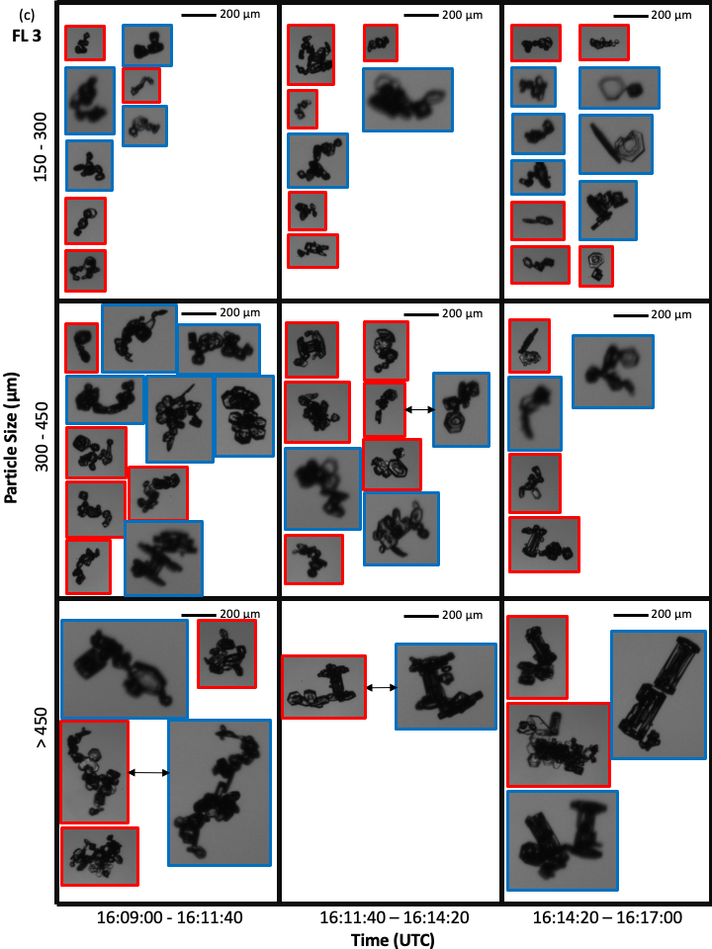
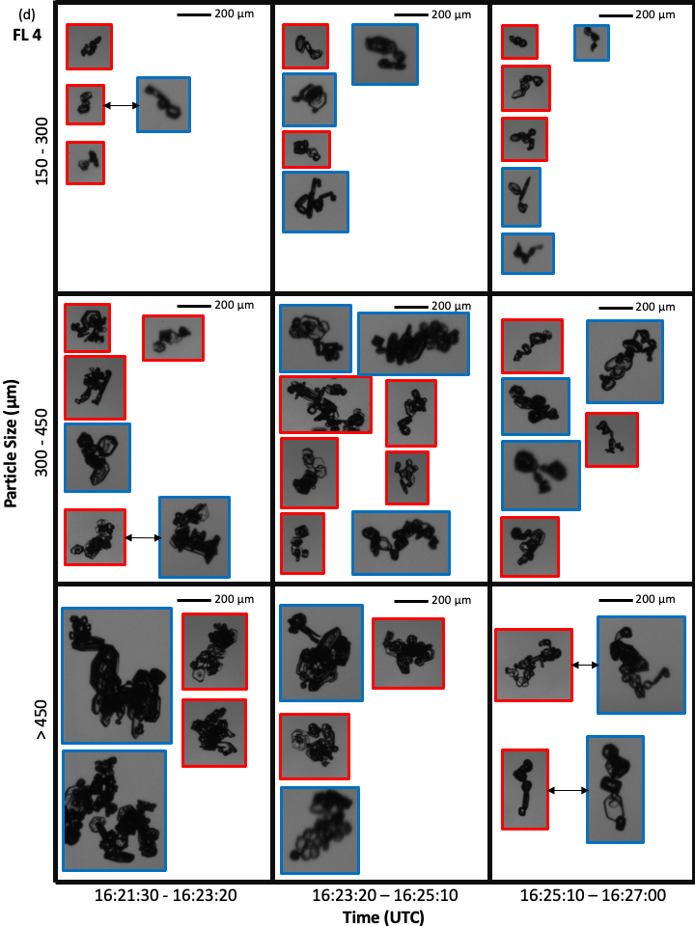

Slide 10
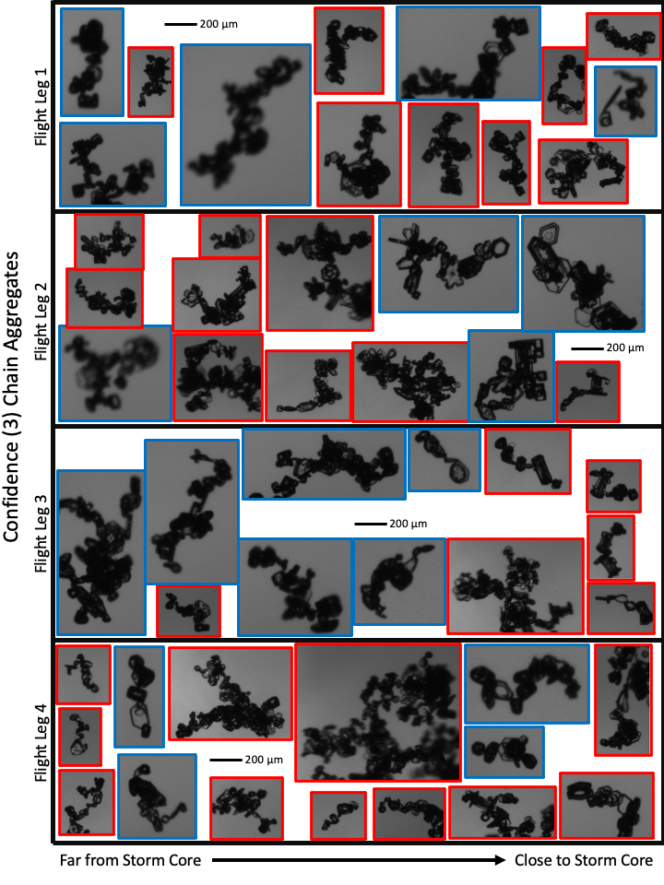

Slide 11
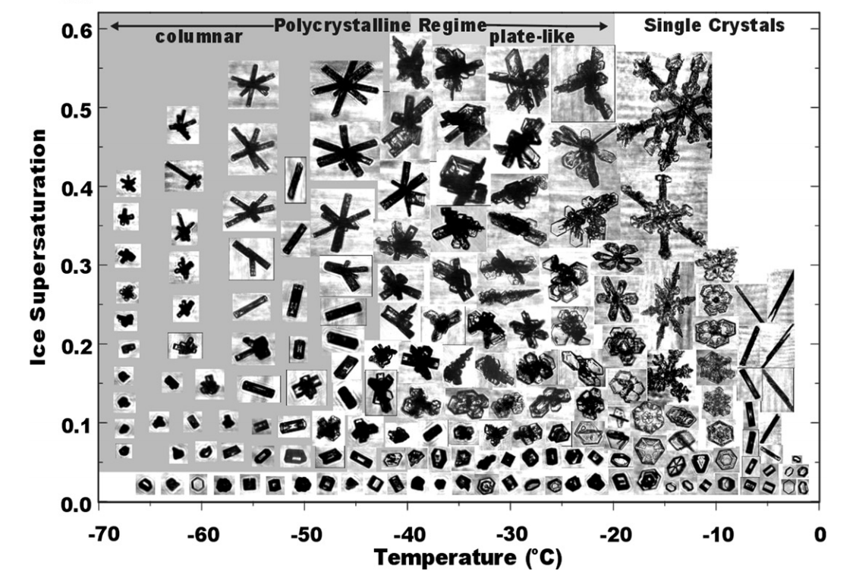

Slide 12
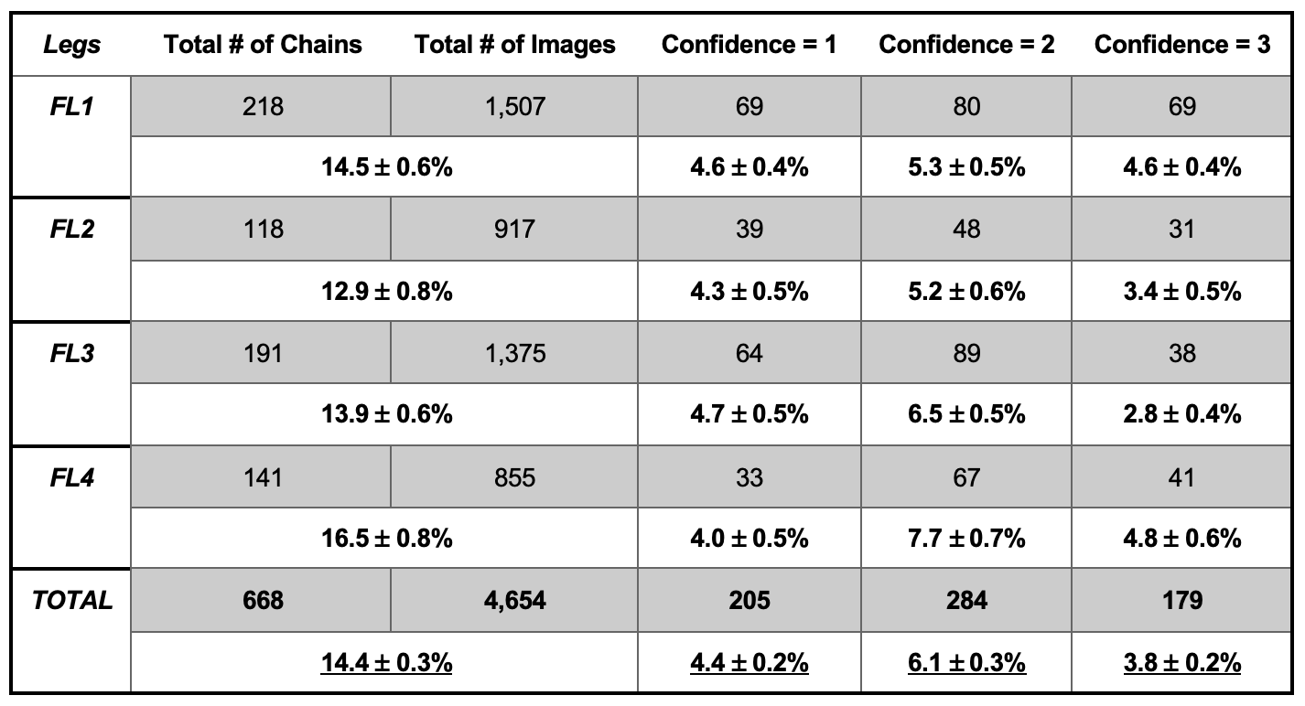
*PHIPS Data*

Slide 13
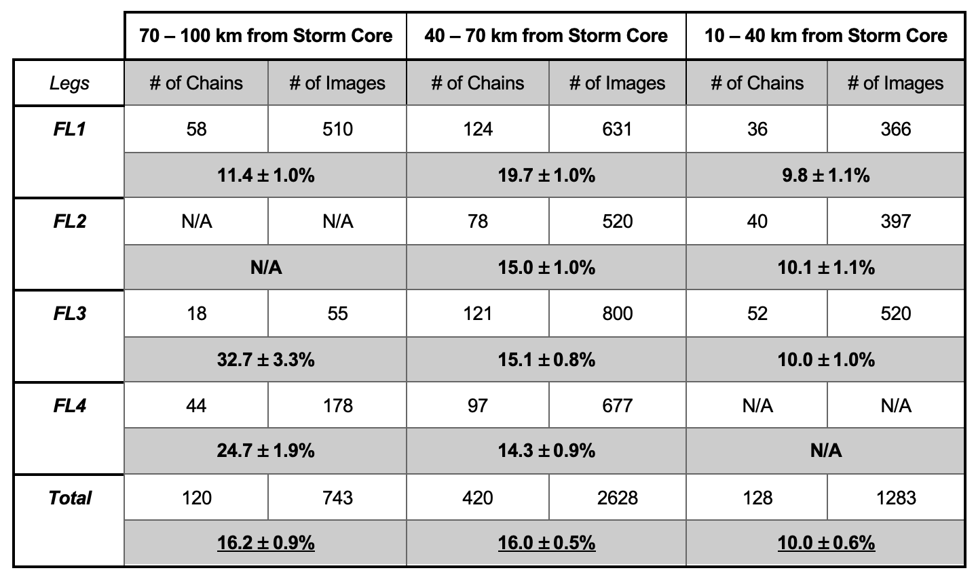
*PHIPS Data*

Slide 14
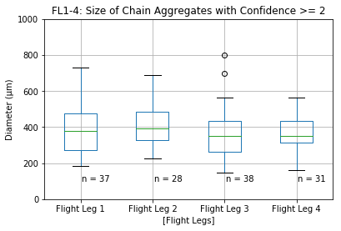
75%
50%
25%
*Using ‘all in’ PHIPS images*

Slide 15
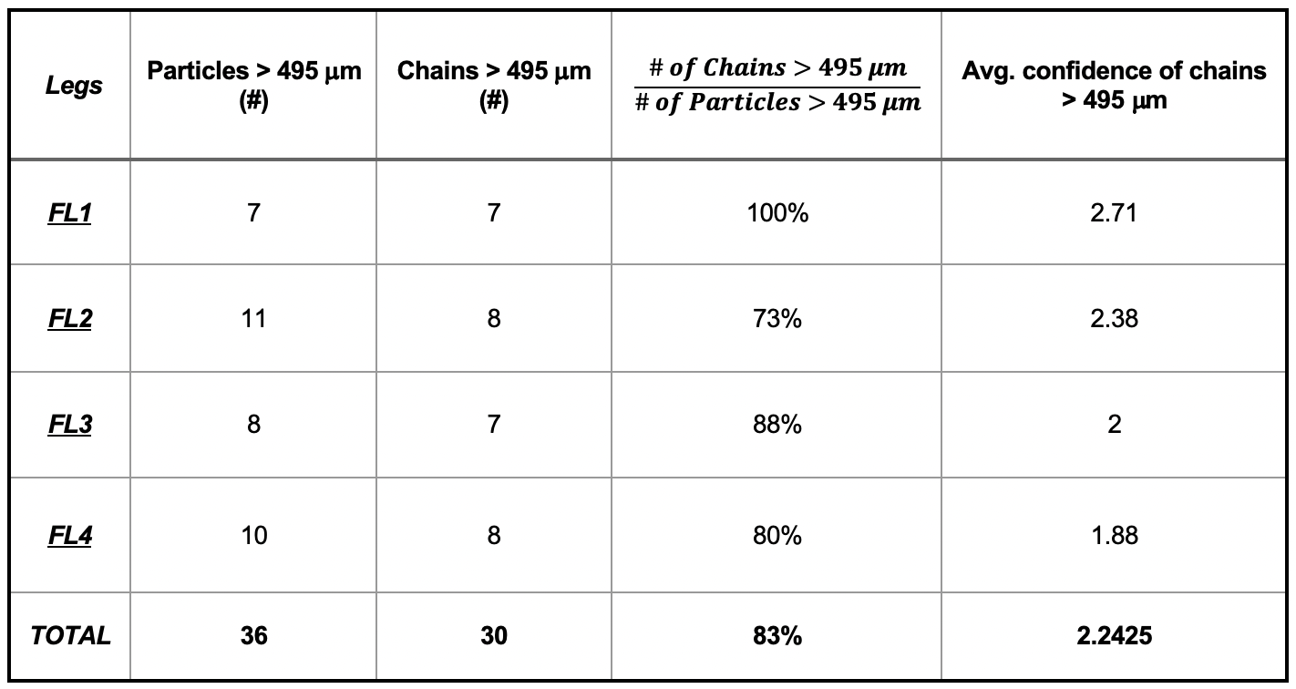
PHIPS Image Data of Particles with a Sizing (D_{max}) Attribute > 495 um
This give confidence to look at the CIP data (which has a higher sampling volume than the PHIPS) and pull the concentration of particles > 495 micro-meters.
Chain aggregates = CIP particle concentrations > 495 um; non-chain aggregates = CIP particle concentrations between 105 – 315 um; Particle buffer zone = CIP particle concentrations between 315 – 495 um.

Slide 16
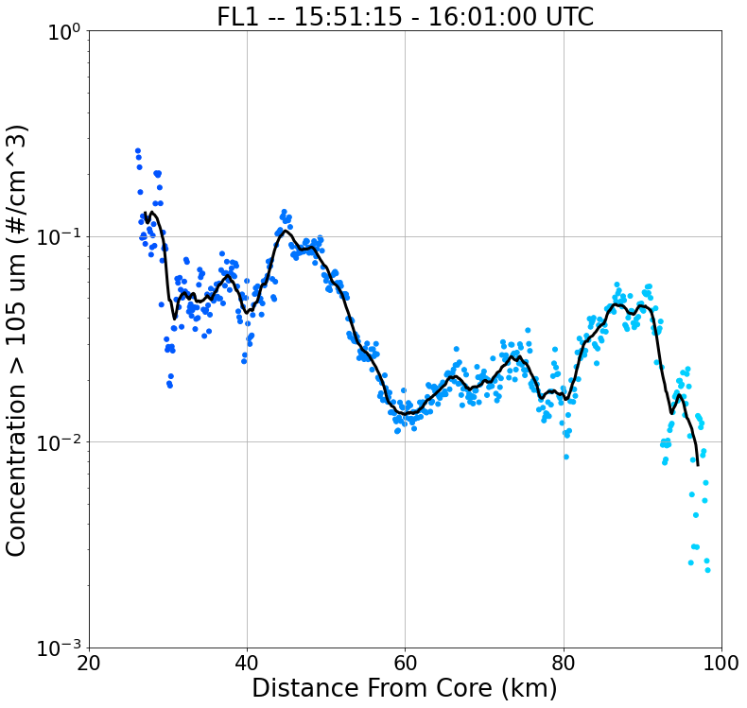
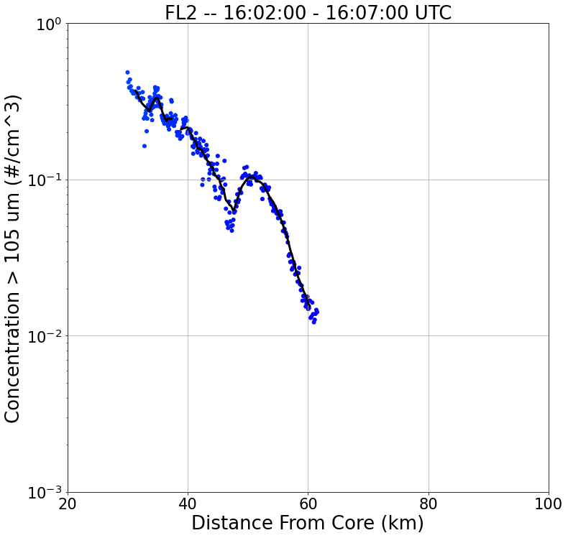
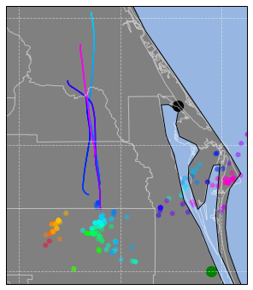
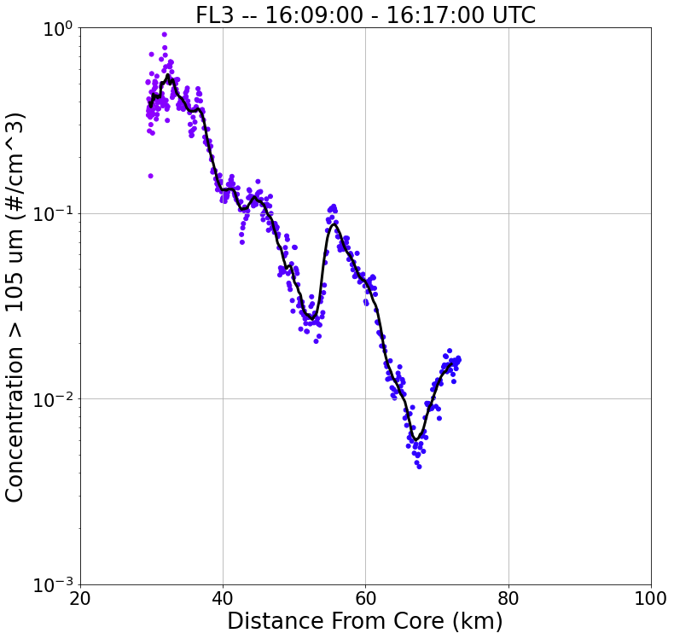
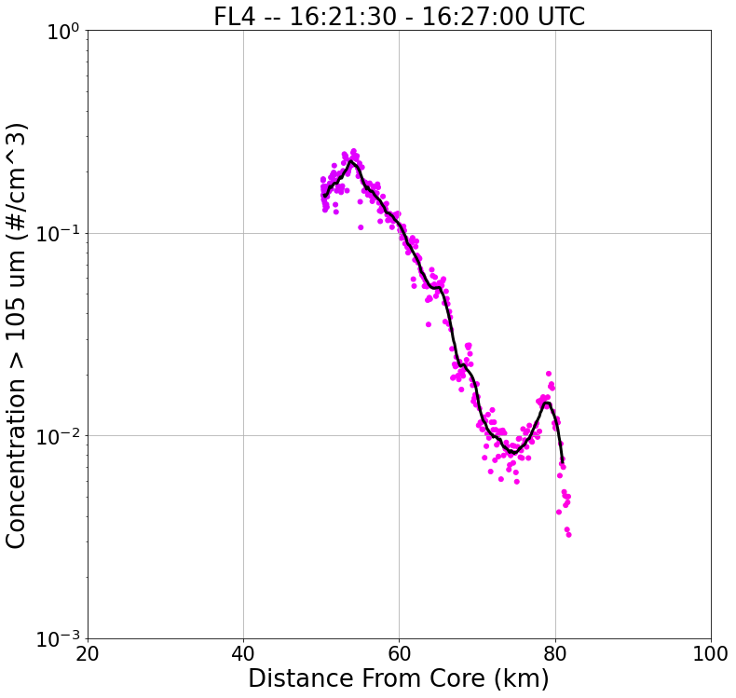
Total Particle Concentration
20 km
FL4
S
N
FL2
S
N
FL1
FL3
S
N
SR-Anvil Wind Direction
S
N

Slide 17
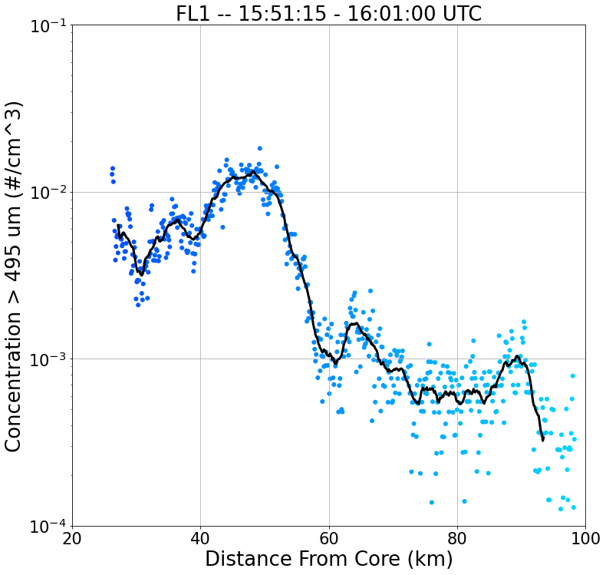
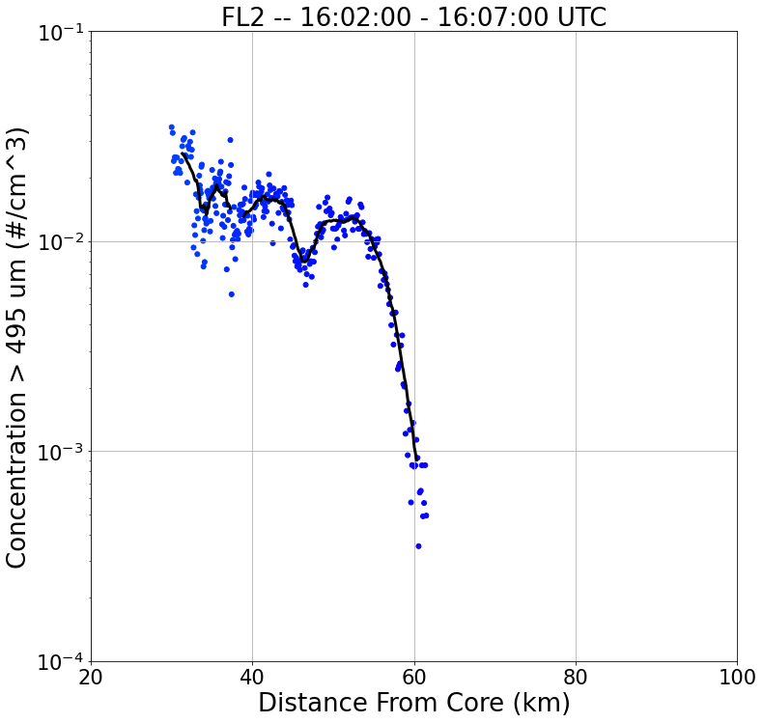
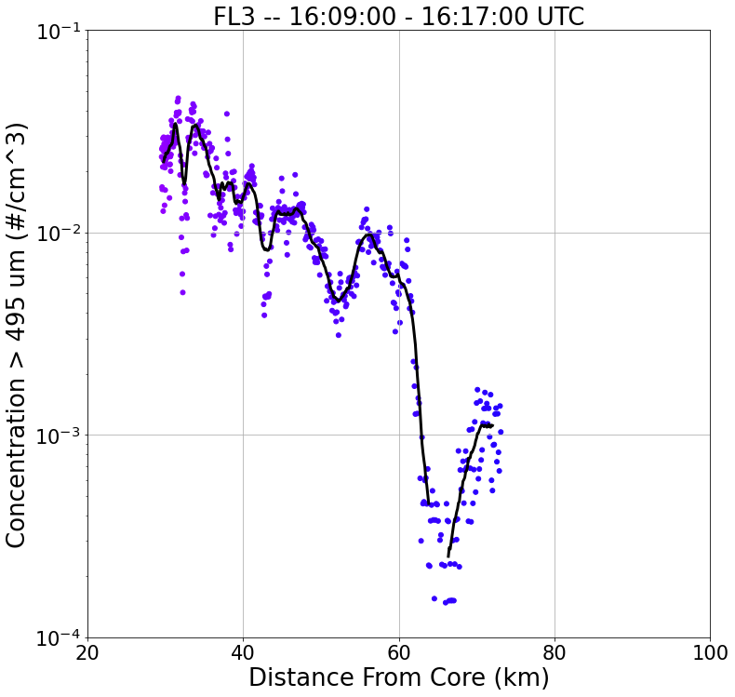
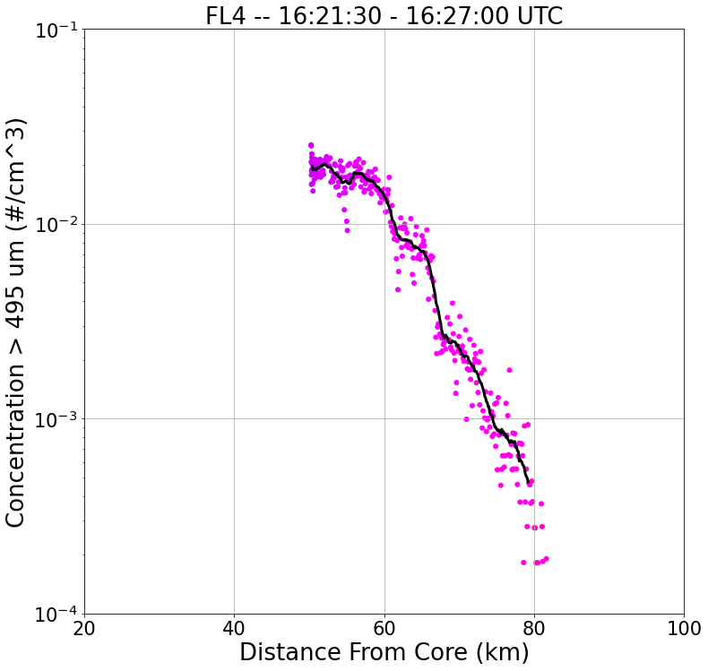
Chain Aggregate Concentration
20 km
FL4
S
N
FL2
S
N
FL1
FL3
S
N
SR-Anvil Wind Direction
S
N

Slide 18
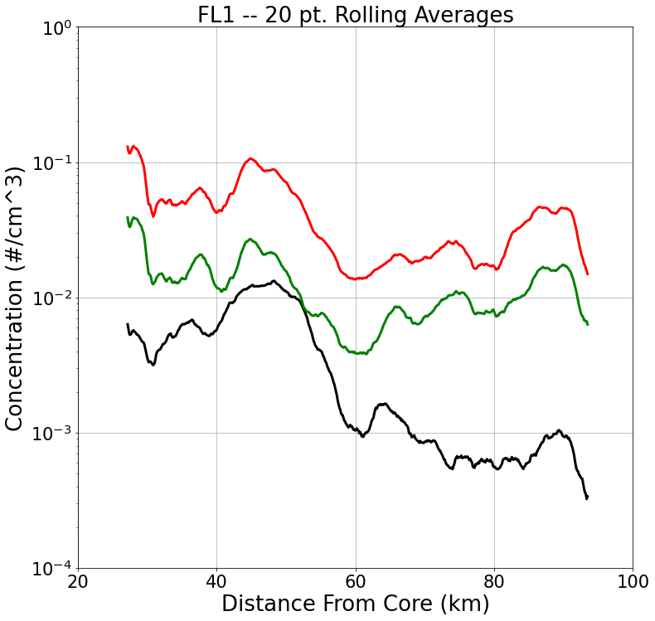
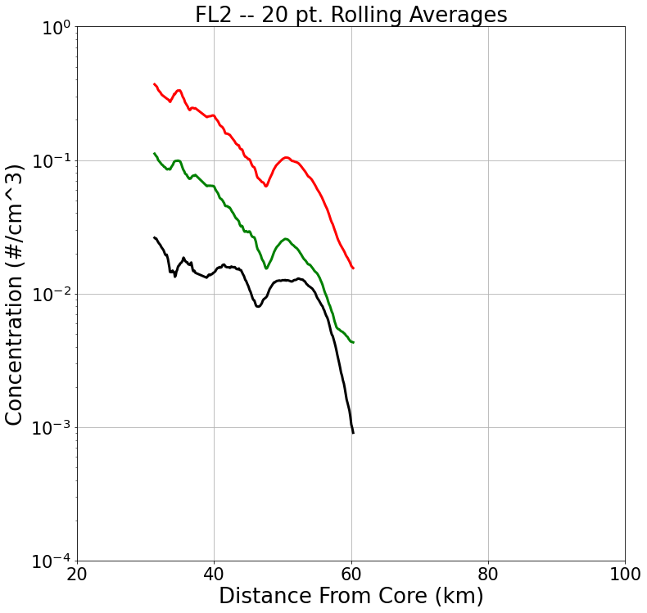
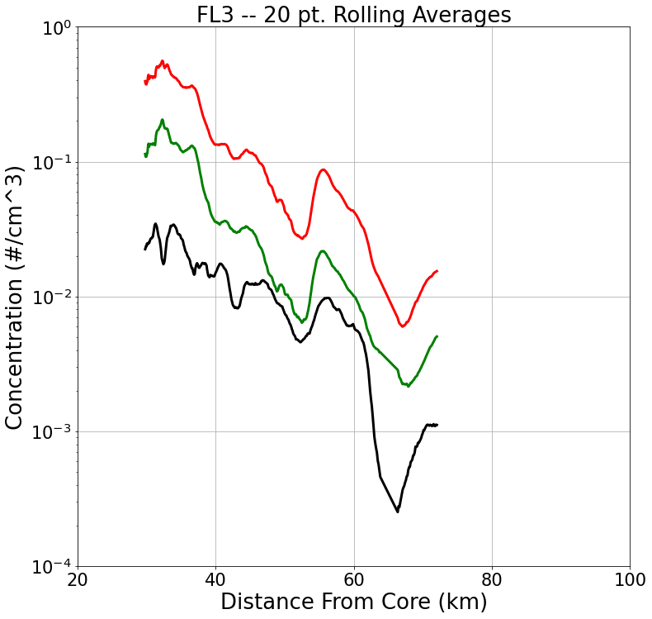
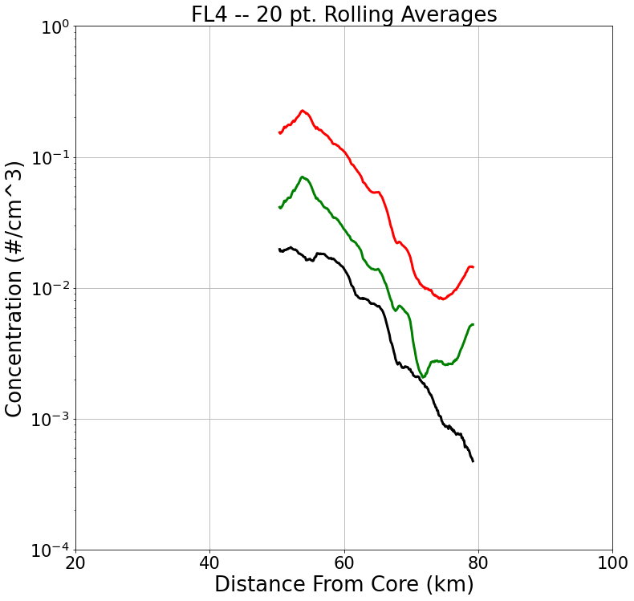
Convergence between the non-chain and chain Aggregate concentration (heading away from storm core
LEGEND
Total CIP Conc. (> 105 um)
Non-Chain Agg. Conc. (105-315 um)
Chain Agg. Conc (> 495 um)
Direction of Flight
S
N
S
N
S
N
S
N

Slide 19
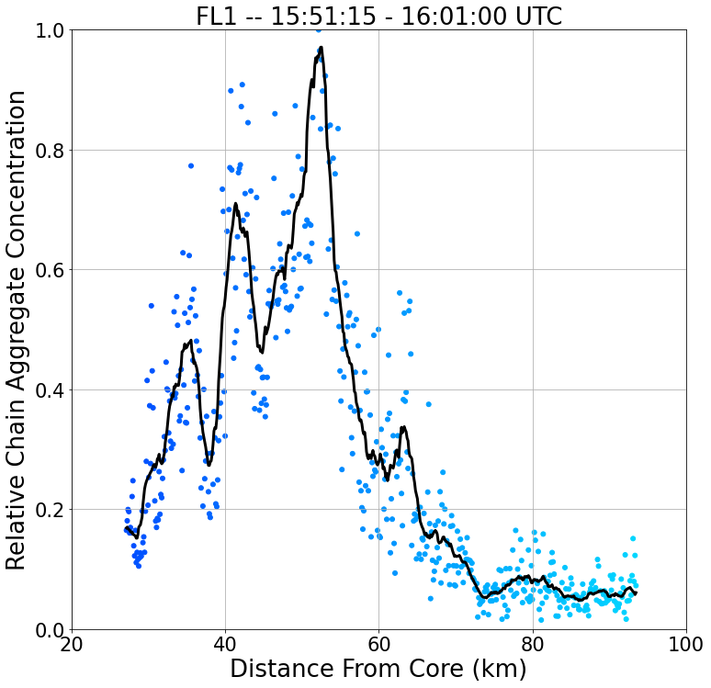
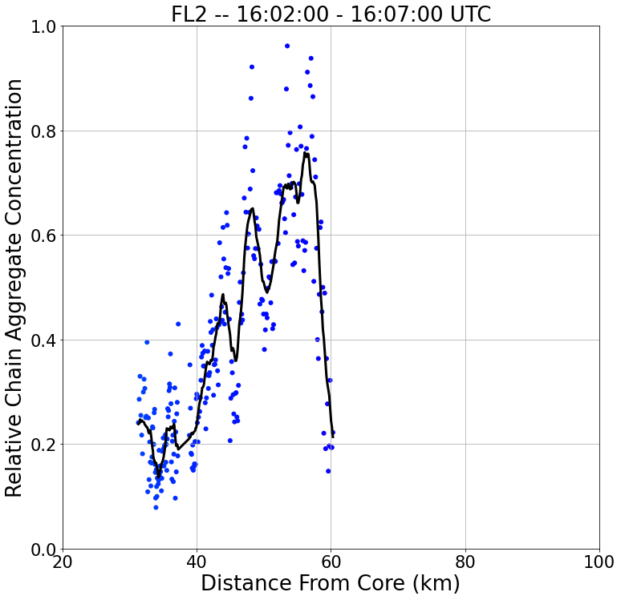
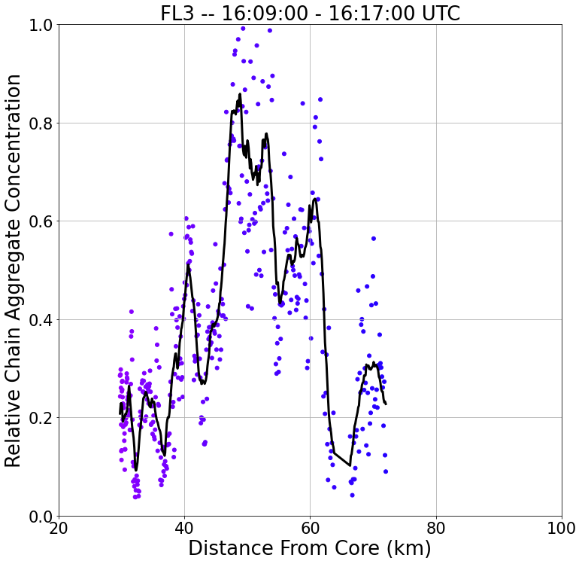
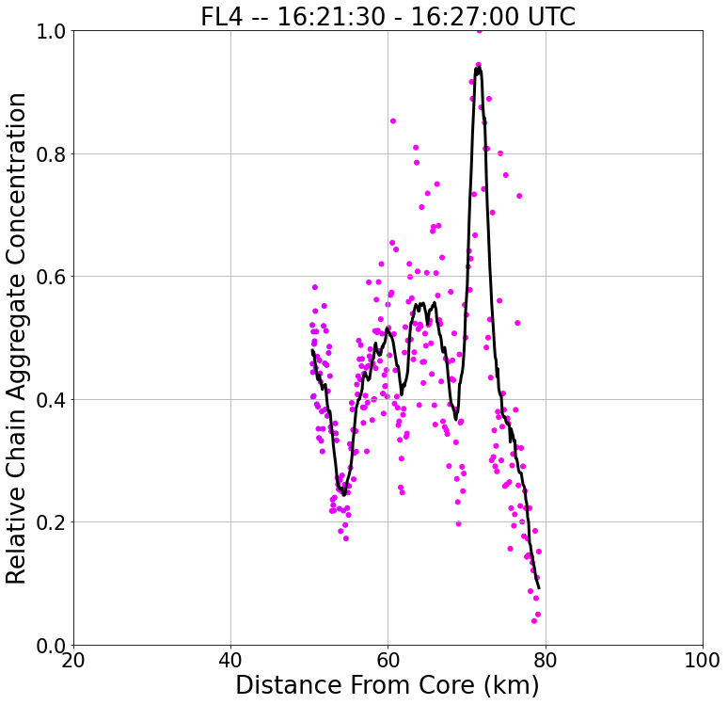
Relative Chain Aggregate Concentration
20 km
FL4
S
N
FL2
S
N
FL1
FL3
S
N
SR-Anvil Wind Direction
S
N
Notes:
Change y – axis to Relative chain aggregate concentration

Slide 20
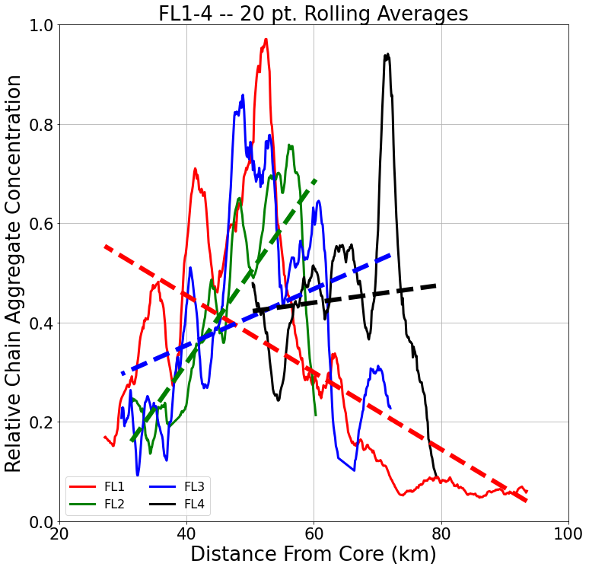
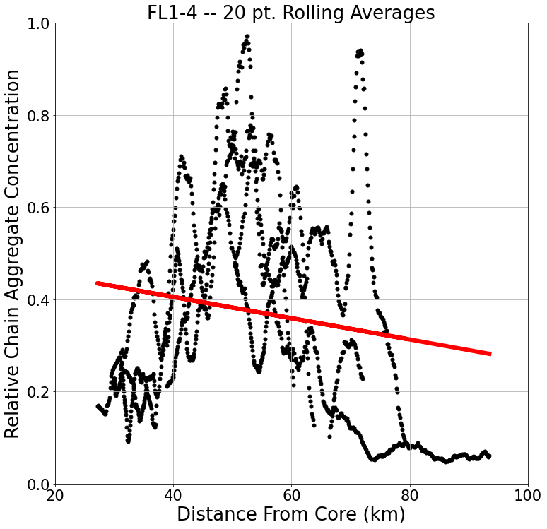

Slide 21
Conclusions
Observed chain aggregates contain particles from different temperature regimes.
Lack of rimed ice.
The general trend for chain and non-chain aggregate concentrations decrease with distance from core.
There is an increase in the relative chain aggregate concentration heading away from the core (to a certain distance – varies per flight leg).
Peaks in the relative chain aggregate concentration are never when the aircraft was closest to the core.
Periodicities in the relative chain aggregate concentration are observed.

Slide 22
Summary/Discussion
The lack of rimed ice and individual ice particles of different habits give confidence that chain aggregation may be occurring in colder regions of the storm.
Are the fluctuations in the particle sizes the product of storm convective growth and decay?
Possible interpretations of relative chain aggregate concentration increases:
(1) The smaller particles are taking part in the chain aggregation process allowing for less smaller particles and more larger particles.
(2) More of the non-chains are falling out, sublimating, and/or climbing within the cirrus anvil away from where the aircraft was sampling from.

Slide 23
Flight Leg 1 (FL1) 15:51:15 – 16:01:00 KMLB Vol Scan: 16:02:01 10 km CAPPI
B
A

Slide 24
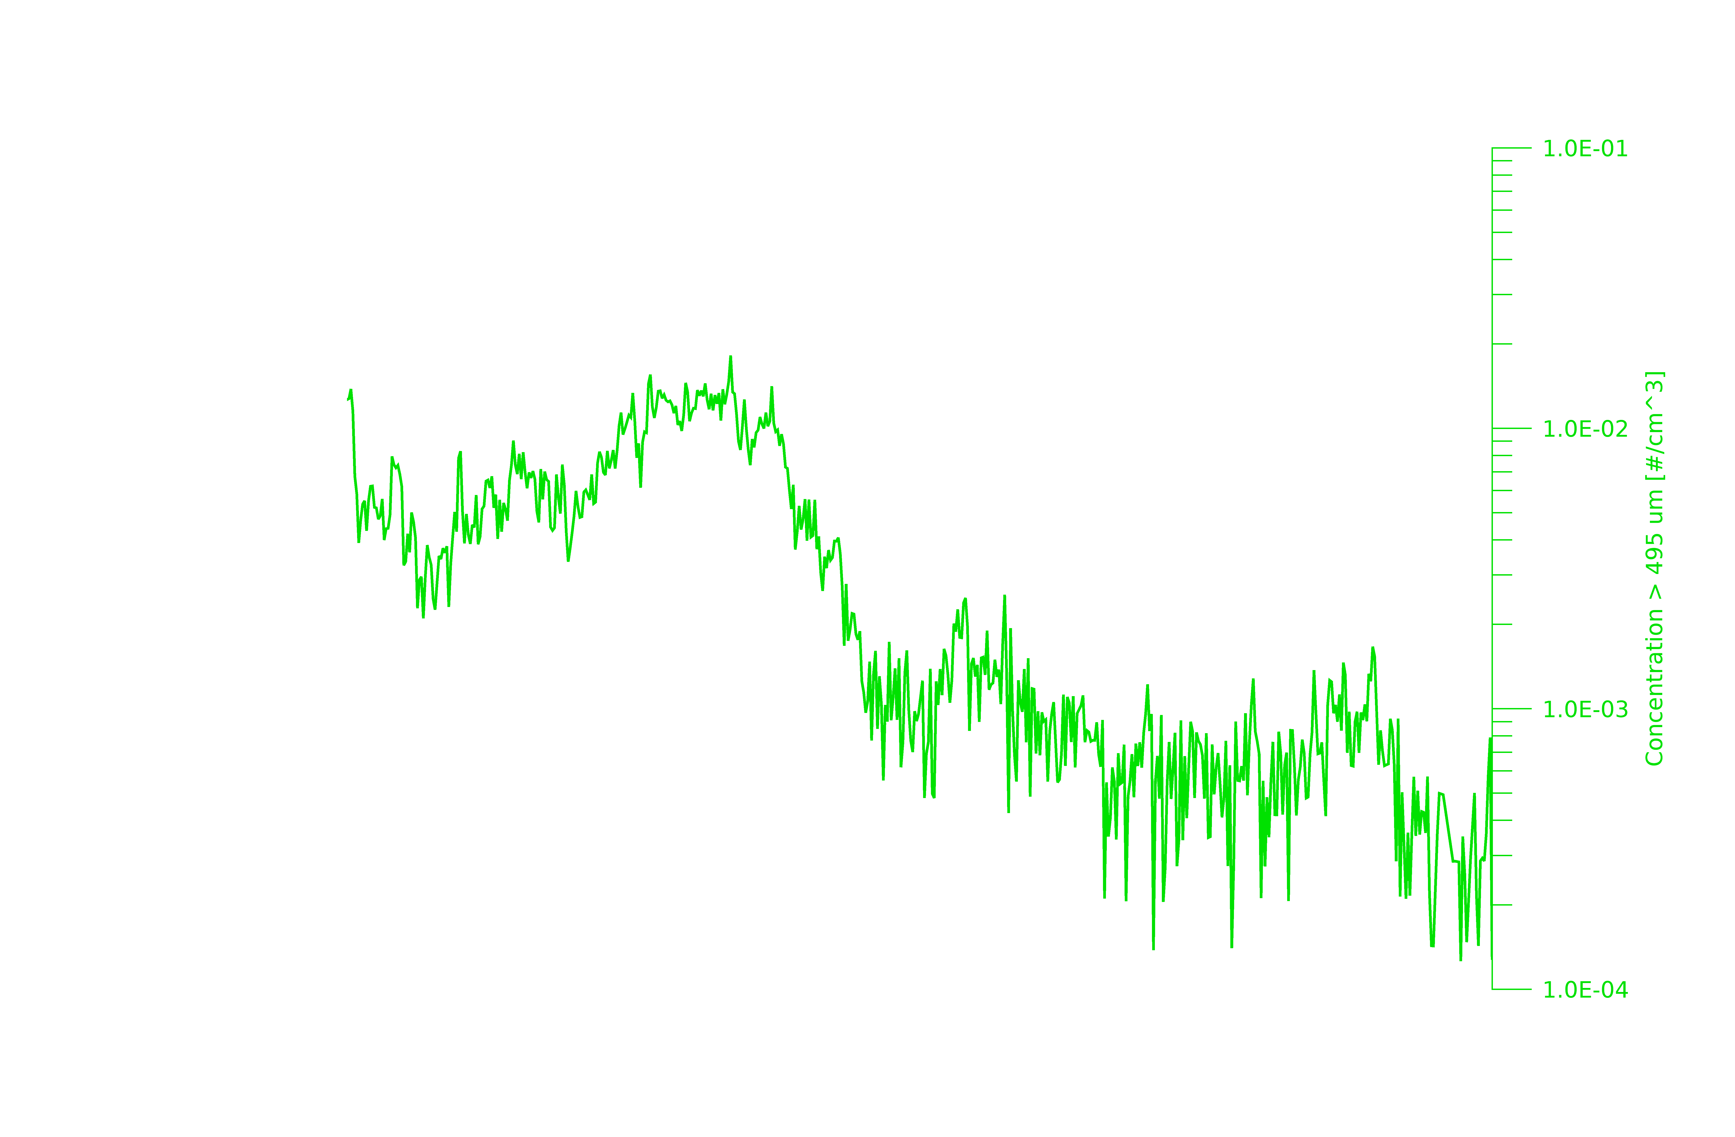
16
14
12
10
Altitude (km)
8
6
4
2
A
B

Slide 25
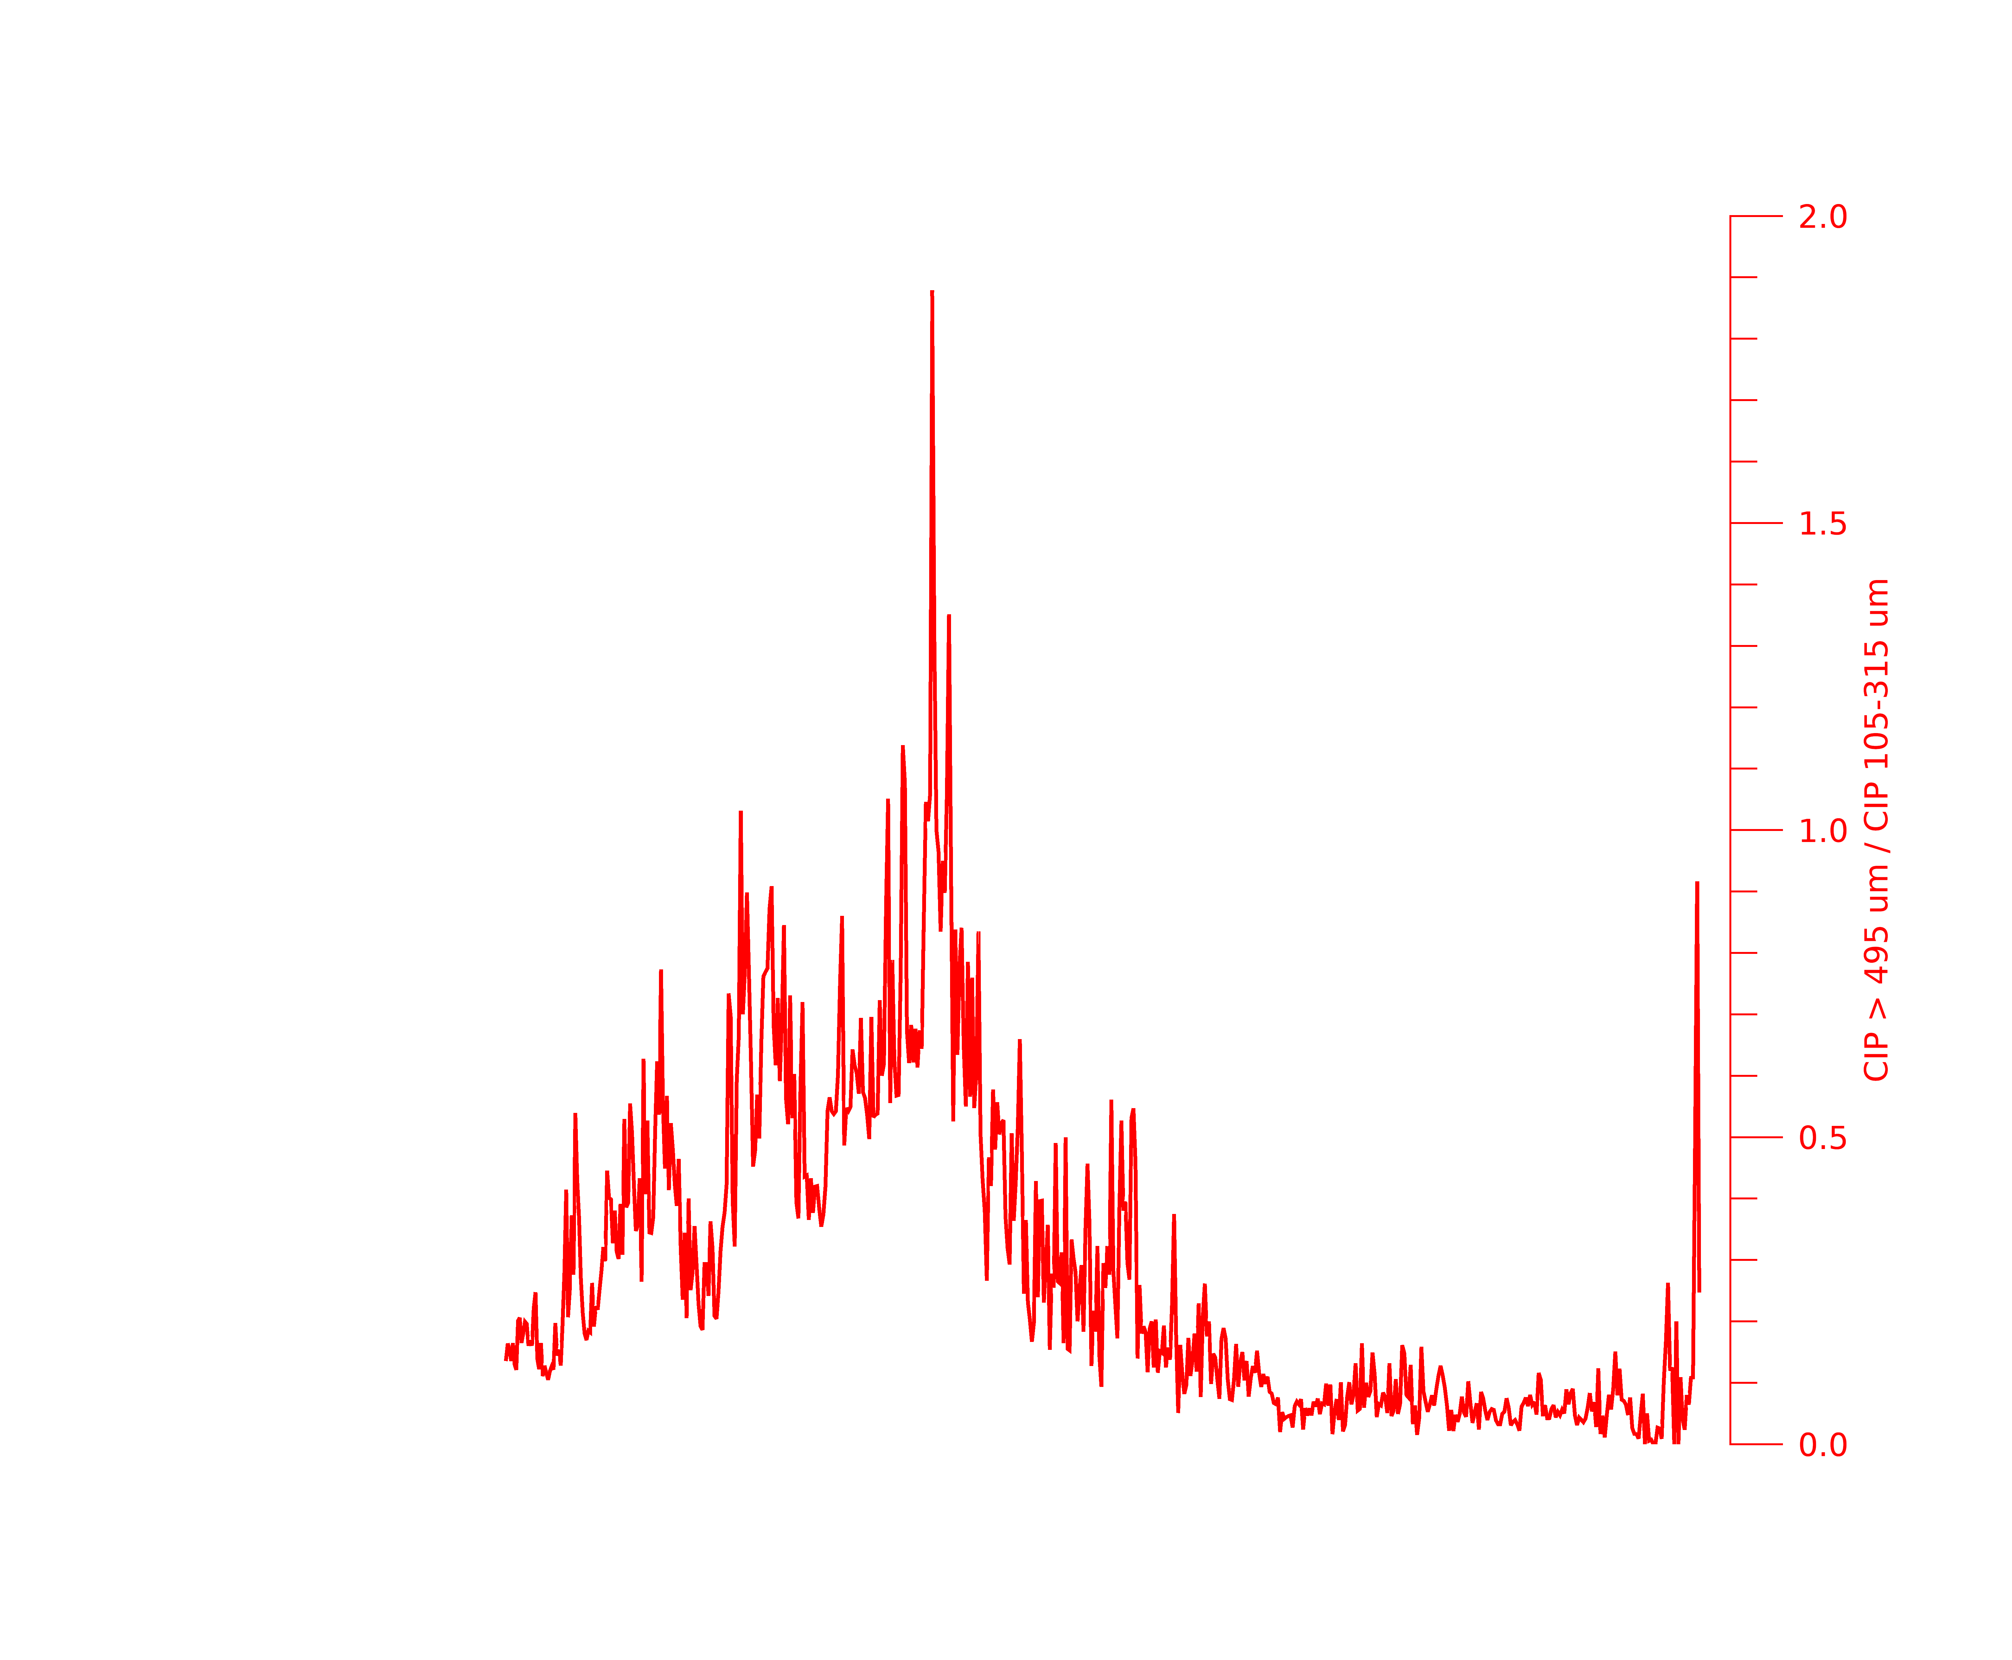
16
14
12
10
Altitude (km)
8
6
4
2
A
B

Slide 26
Flight Leg 4 (FL4) 16:21:30 – 16:27:00 KMLB Vol Scan: 16:23:55 10 km CAPPI
B
A

Slide 27
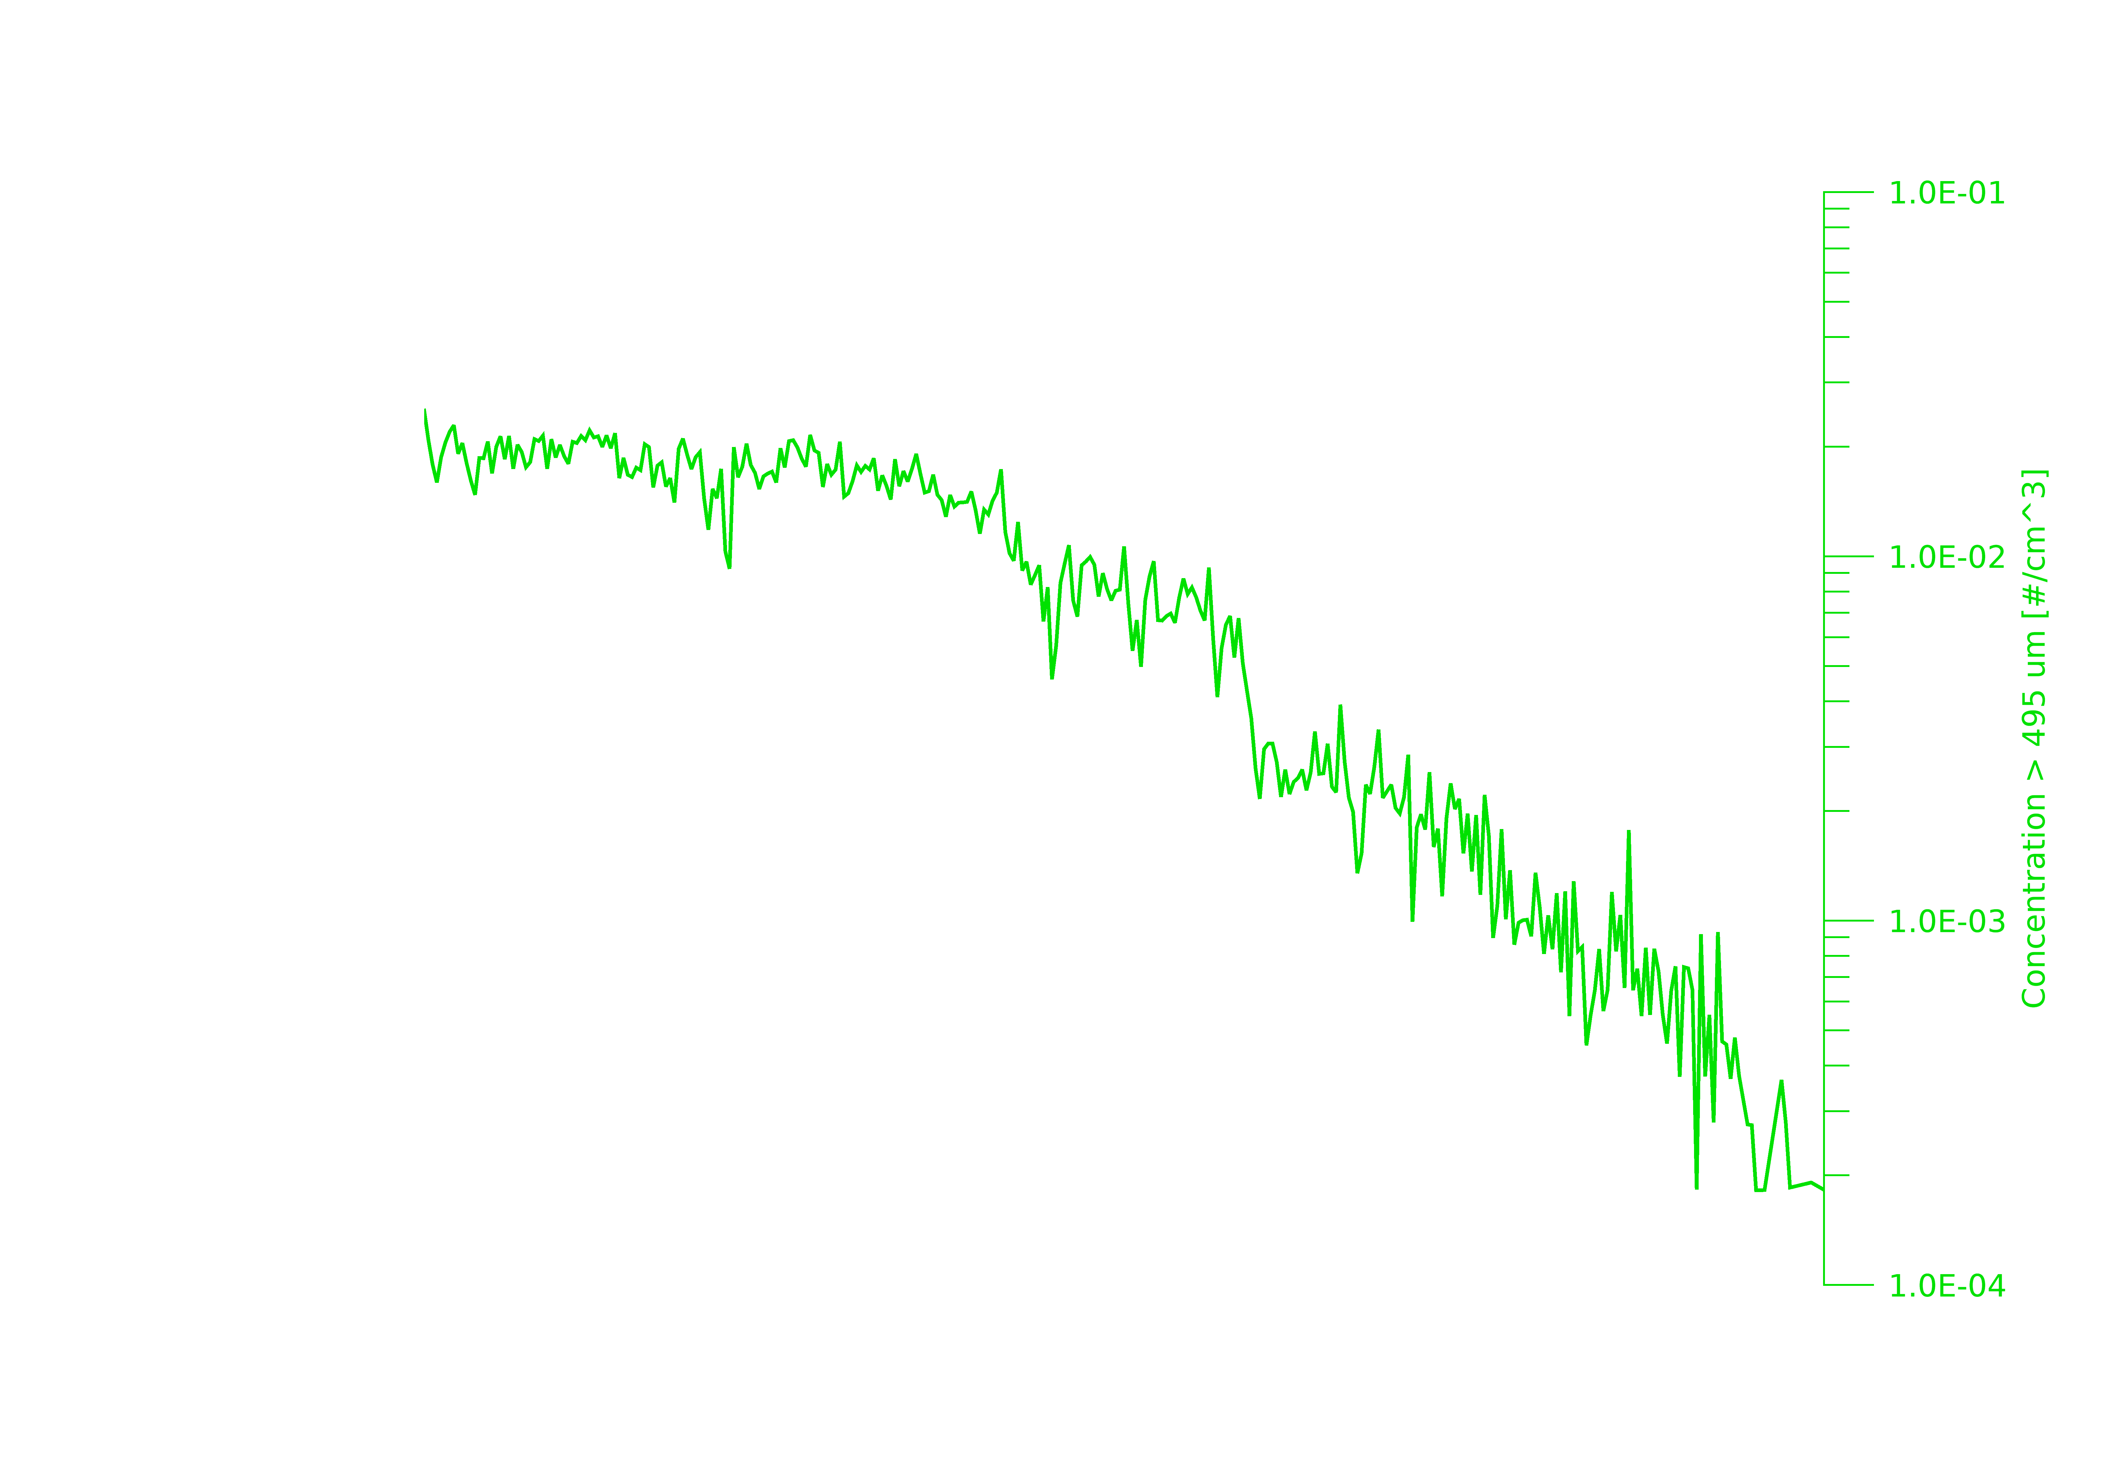
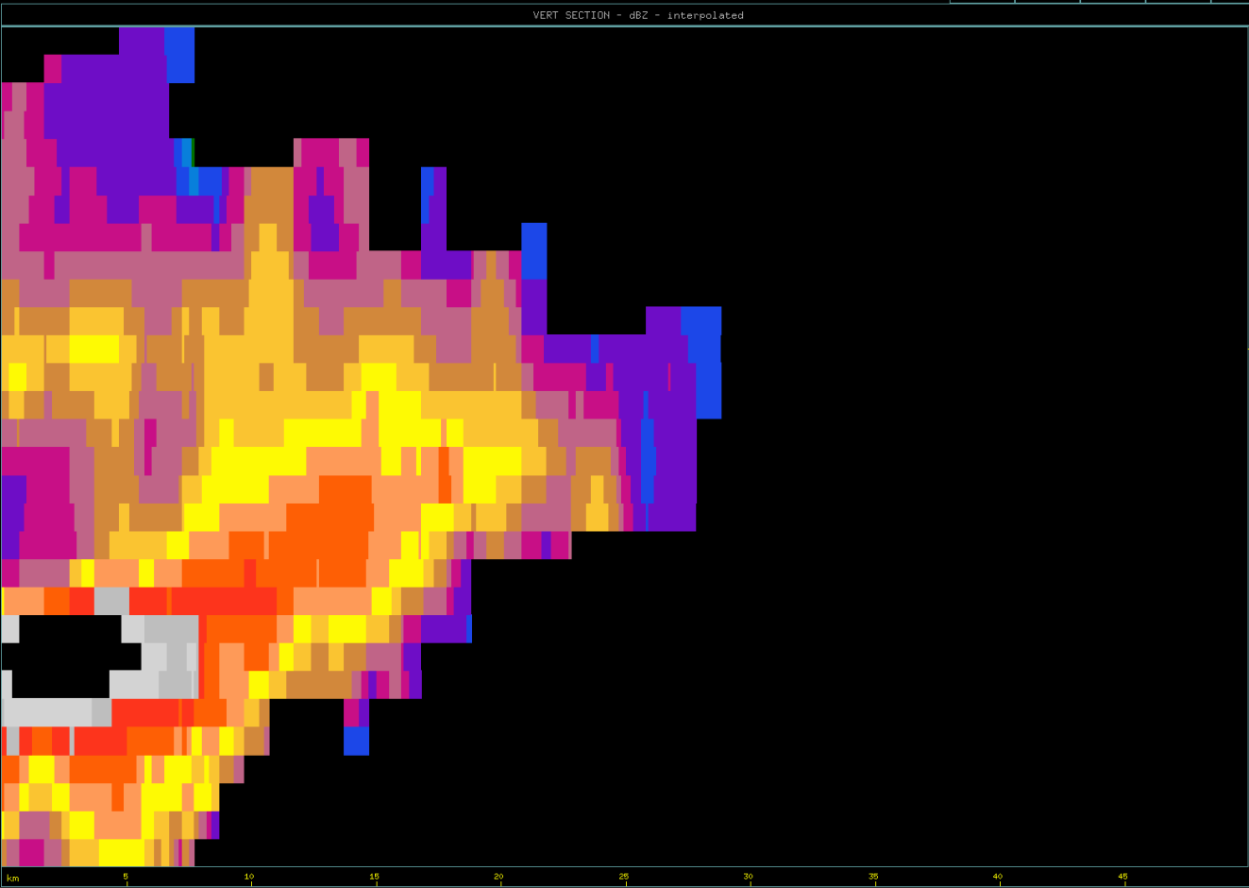
16
14
Approx. Aircraft Position @ 16:23:55 UTC
12
10
Altitude (km)
8
6
4
2
A
B

Slide 28
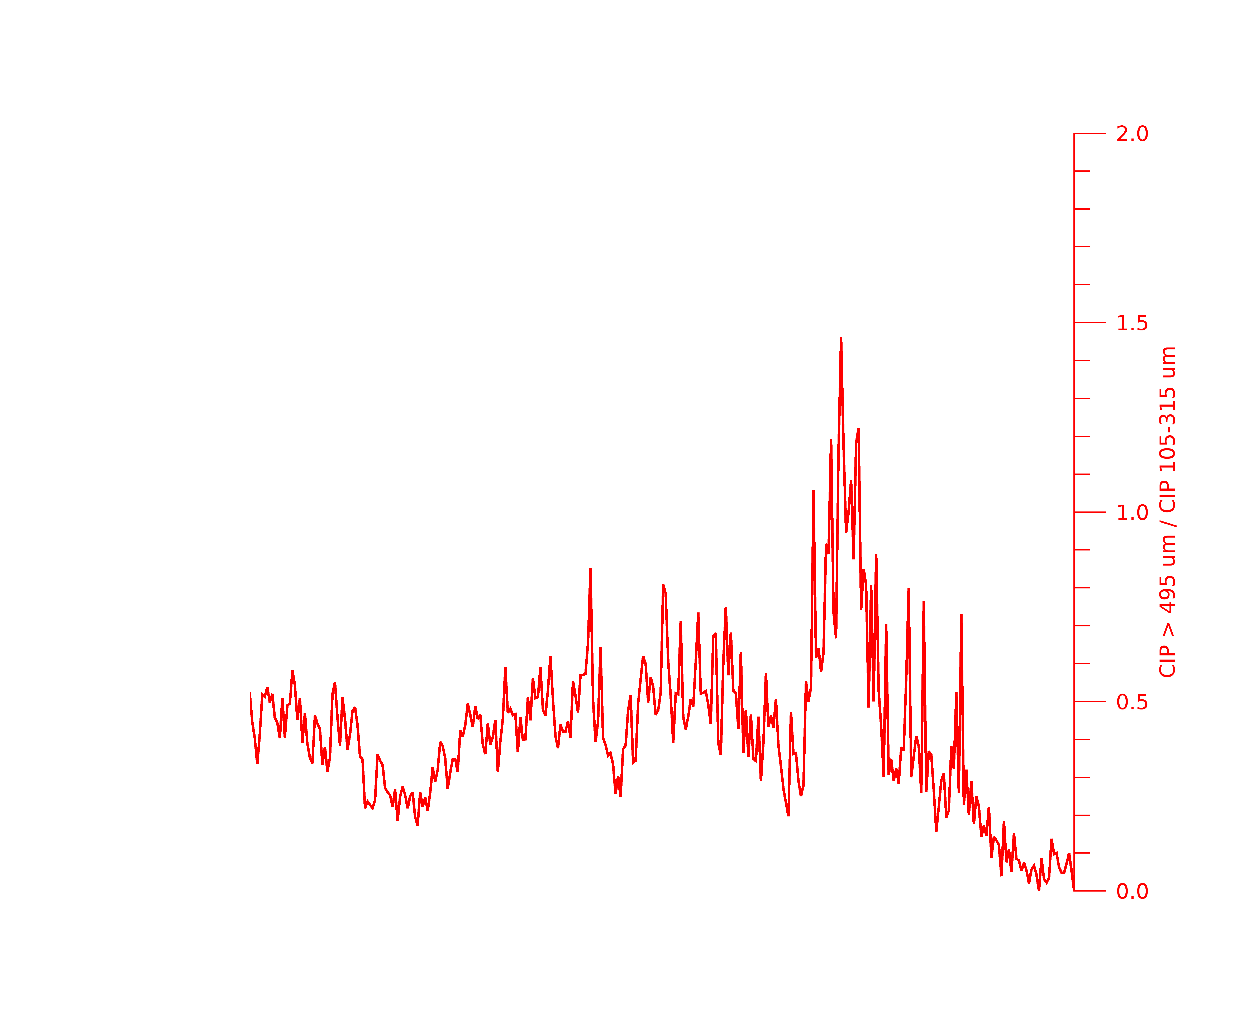
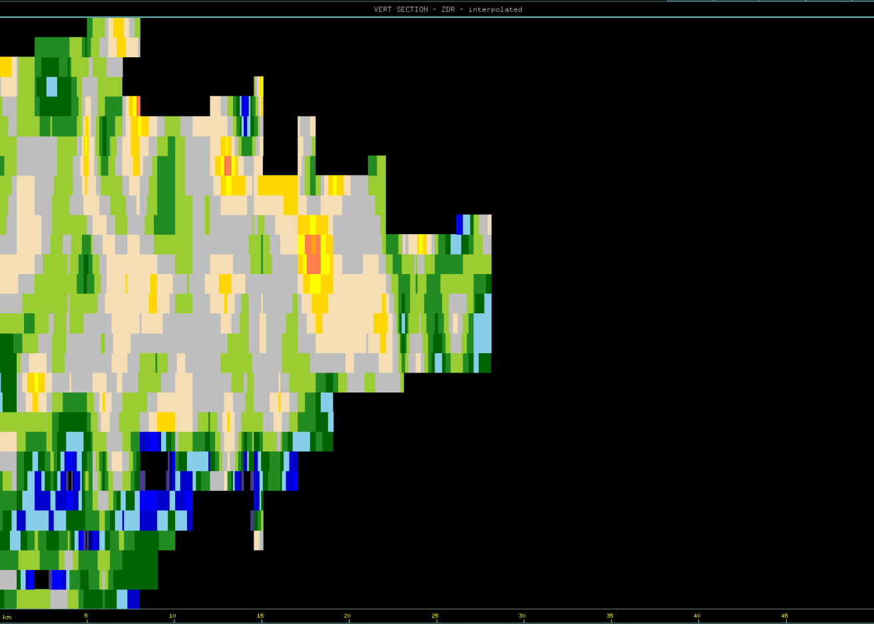
16
14
Approx. Aircraft Position @ 16:23:55 UTC
12
10
Altitude (km)
8
6
4
2
A
B

Slide 29
ELECTRIC FIELD DATA & KSCLMA ANALYSIS

Slide 30
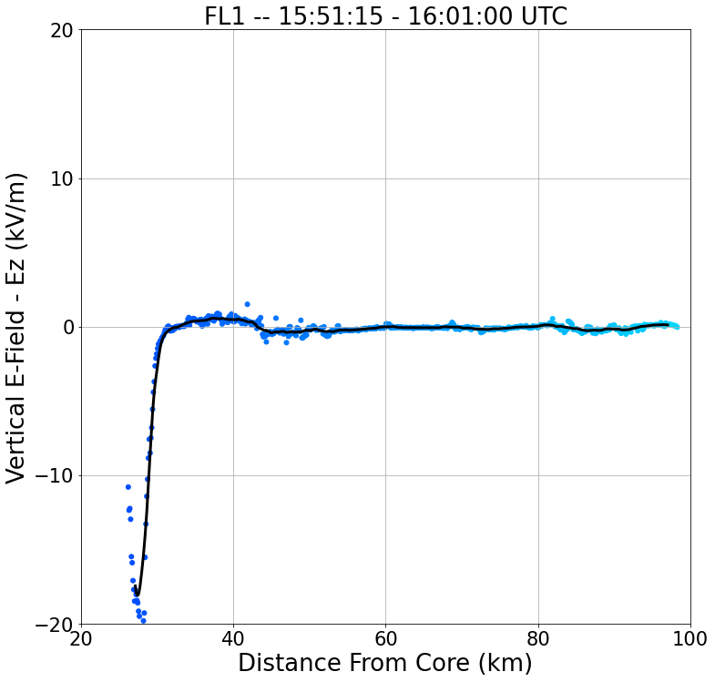
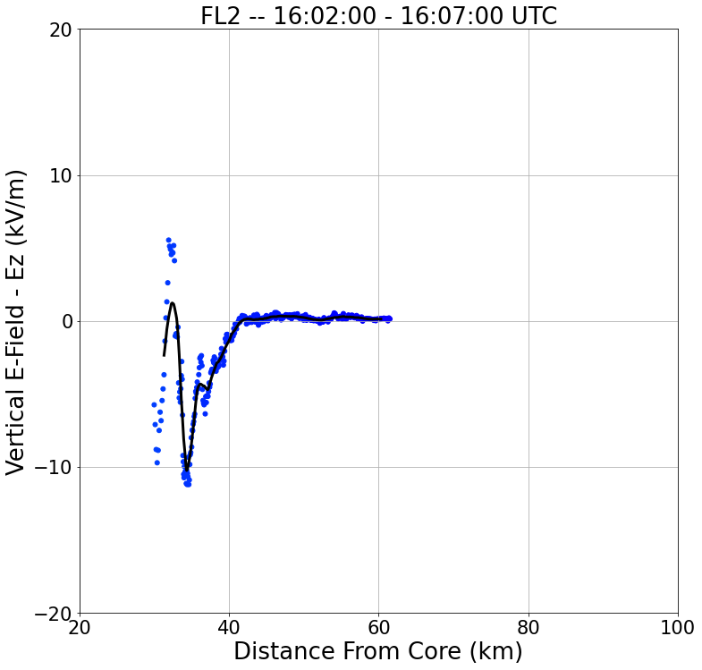
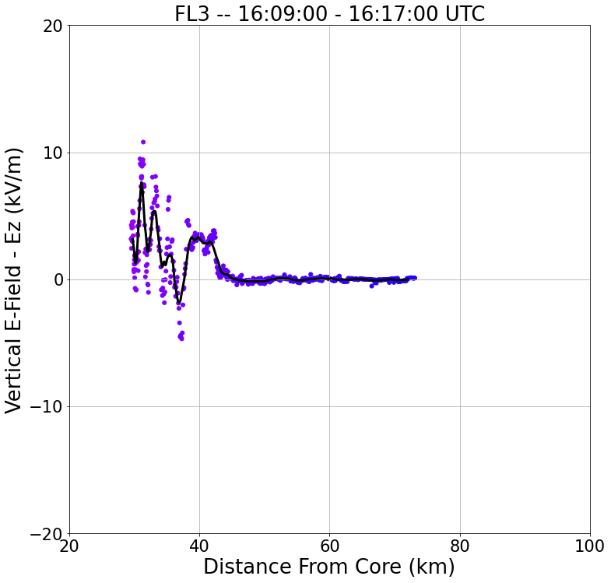
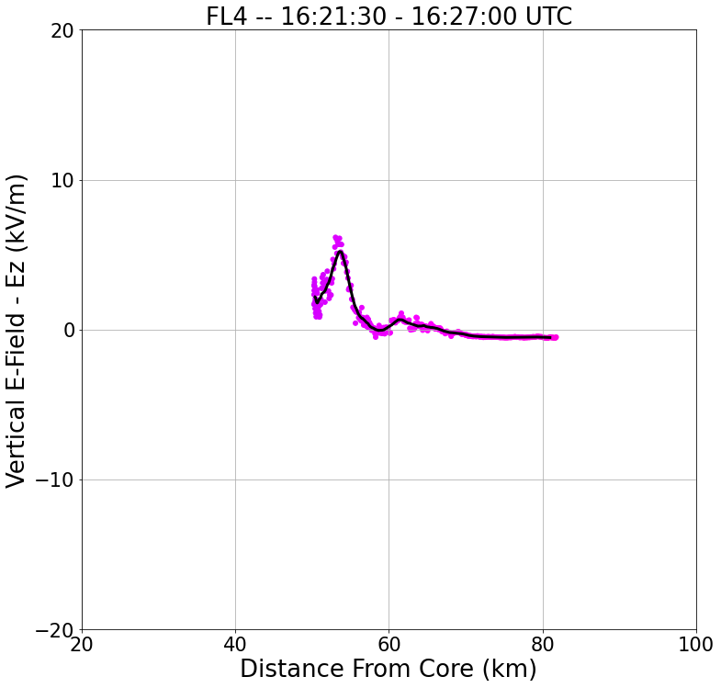
20 km
FL4
FL2
S
N
S
N
FL1
FL3
S
N
SR-Anvil Wind Direction
S
N

Slide 31
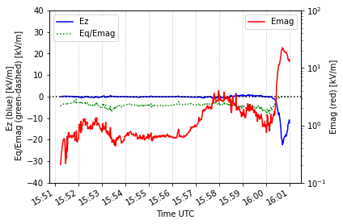
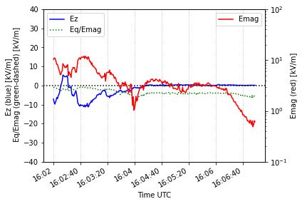
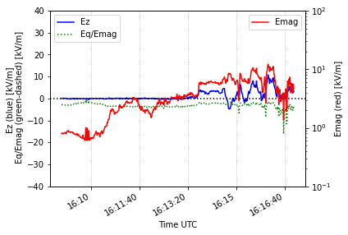
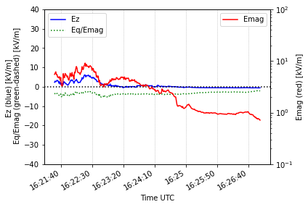
(a)
FL1 – 15:51:15 – 16:01:00 UTC
(b)
FL2 – 16:02:00 – 16:07:00 UTC
(c)
FL3 – 16:09:00 – 16:17:00 UTC
(d)
FL4 – 16:21:30 – 16:27:00 UTC

Slide 32
Flight Legs | Time [UTC] | Ex - Range [kV/m] | Ex - Mean [kV/m] | Ey - Range [kV/m] | Ey - Mean [kV/m] | Ez - Range [kV/m] | Ez - Mean [kV/m]
FL1 | 15:51:15 - 16:01:00 | [-4.01, 0.17] | -0.89 | [-0.16, 8.04] | 0.93 | [-22.37, 1.50] | -0.87
FL2 | 16:02:00 - 16:07:00 | [-5.63, 1.52] | -1.96 | [-4.93, 6.42] | 0.78 | [-11.22, 5.53] | -1.76
FL3 | 16:09:00 - 16:17:00 | [-6.59, -0.21] | -2.95 | [-3.43, 6.67] | 1.05 | [-4.70, 10.80] | 1.15
FL4 | 16:21:30 - 16:27:00 | [-4.86, -0.40] | -2.36 | [-5.86, 4.28] | -0.11 | [-0.58, 6.15] | 0.68

Slide 33
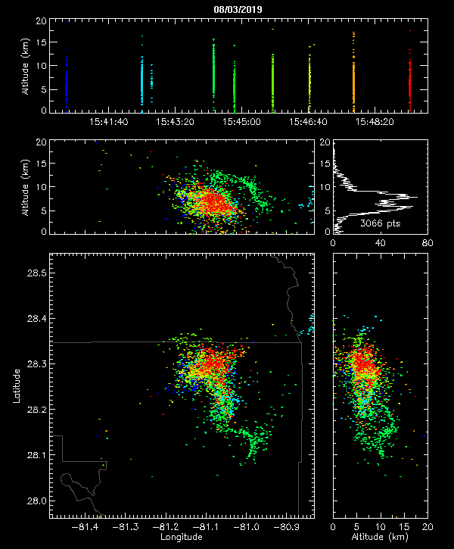

Slide 34
Lightning Strike @ 16:01:43 UTC
NOTE: According to NLDN data
This was the last lightning strike
associated with our storm of
Interest.
Upper + Charge Region
Lower - Charge Region

Slide 35
By the divergence of downward-pointing vectors near the end of Flight-leg-1 there is clearly a compact center of positive charge above the aircraft.
There is agreement in polarity in the LMA plot of the 16:01 UTC lightning event suggesting a layer of positive charge just above the aircraft.

Slide 36
Conclusions
The largest sources of electric fields are when the aircraft is in close proximity to the storm core.
Near the storm core the vertical electric field values are mainly on the order of 10⁰ kV/m for each FL.
Although, there is a strong E_{z} signal during the end of FL1 where E_{z} reached -22.37 kV/m, which is an order of magnitude higher than what is typically observed.
The temporal span (electric build-up) of this peak is on the order of seconds, and detection of electric discharges are on the order of micro – seconds, thus it is believed that this peak in electric field is due to the aircraft entering in a ‘high’ electric charge region and not by lightning.
The electric field magnitude (E_{mag}) for all flight legs peaked on the order of 10¹ kV/m.

Slide 37
Discussion
Based on the KSCLMA/E-field data, upper positive region seems to be the culprit for fluctuations in E_{z}.
The E_{mag} values are the same order of magnitude to what was used in cloud chamber experiments performed by Saunders and Wahab (1975).
However, in the cloud chamber experiments, chain aggregates were only generated while using an electric field greater than or equal to 60 kV/m.
Is the E-Field threshold smaller than previously tested?
Evidence from previous research (Dye et al. 2007) coupled with these results -> can propose that yes it may?

Slide 38
Overall Conclusions and Comments
PHIPS observations show chain aggregates throughout the anvil region, with different individual particle habit, and lack rimed ice
Relative chain aggregate concentrations suggest that in the cirrus anvil:
(1) The smaller particles are taking part in the chain aggregation process allowing for less smaller particles and more larger particles.
(2) More of the non-chains are falling out, sublimating, and/or climbing within the cirrus anvil away from where the aircraft was sampling from.
The fluctuations in the particle sizes cloud be the product of storm convective growth and decay.
Further radar analysis needed.
The E_{mag} values are the same order of magnitude to what was used in cloud chamber experiments performed by Saunders and Wahab (1975).
Similar values to other field projects where chain aggregates were also observed.
E-Field thresholds for chain aggregation in the cirrus anvil may be less than 60 kV/m.

Slide 39
Is Chain Aggregation Occurring in the Cirrus Anvil during FL4? Secondary Aggregation Sources?
Main support for yes:
Chains contain particles from different temperature regimes.
Lack of rimed ice.
There is an increase in the relative chain aggregate concentration heading away from the core (to a certain distance – varies per flight leg).
Peaks in the relative chain aggregate concentration are never when the aircraft was closest to the core.
The E_{mag} values are the same order of magnitude to what was used in cloud chamber experiments performed by Saunders and Wahab (1975).
‘Relatively’ close to the core
Main support for no:
Cross-convection cirrus anvil contamination – MAJOR INFLUENCE
Periodicies in the relative chain aggregate concentration may be due to storm cycles or different sources of convection.

Slide 40
Request
The scanning capabilities of the S-band NWS radar is extremely limited (especially during the 3 August 2019 flight).
With the scanning capabilities of the MCR (CPR-HD), the data will be extremely beneficial when comparing to the in-situ microphysical data.
The MCR (CPR-HD) data will be used to see if chain aggregation is occurring within the convection – induced, cirrus anvil region.
Due to FL4 being more oriented to the SR-anvil wind direction and occurring when there is only one CLEAR main source of convection, it is proposed to obtain the MCR (CPR-HD) data or flight leg 4 [16:21:30 – 16:27:00 UTC] for further radar analysis.

Slide 41
Extra Slides

Slide 42
Flight Leg 1 (FL1) 15:51:15 – 16:01:00 KMLB Vol Scan: 15:50:30 10 km CAPPI
B
A

Slide 43
16
14
12
10
Altitude (km)
8
6
4
2
A
B

Slide 44
16
14
12
10
Altitude (km)
8
6
4
2
A
B

Slide 45
Flight Leg 1 (FL1) 15:51:15 – 16:01:00 KMLB Vol Scan: 15:56:16 10 km CAPPI
B
A

Slide 46
16
14
12
10
Altitude (km)
8
6
4
2
A
B

Slide 47
16
14
12
10
Altitude (km)
8
6
4
2
A
B

Slide 48
Flight Leg 1 (FL1) 15:51:15 – 16:01:00 KMLB Vol Scan: 16:02:01 10 km CAPPI
B
A

Slide 49
16
14
12
10
Altitude (km)
8
6
4
2
A
B

Slide 50
16
14
12
10
Altitude (km)
8
6
4
2
A
B

Slide 51
Flight Leg 4 (FL4) 16:21:30 – 16:27:00 KMLB Vol Scan: 16:19:25 10 km CAPPI
B
A

Slide 52
16
14
12
10
Altitude (km)
8
6
4
2
A
B

Slide 53
16
14
12
10
Altitude (km)
8
6
4
2
A
B

Slide 54
Flight Leg 4 (FL4) 16:21:30 – 16:27:00 KMLB Vol Scan: 16:23:55 10 km CAPPI
B
A

Slide 55
16
14
12
10
Altitude (km)
8
6
4
2
A
B

Slide 56
16
14
12
10
Altitude (km)
8
6
4
2
A
B

Slide 57
Flight Leg 4 (FL4) 16:21:30 – 16:27:00 KMLB Vol Scan: 16:28:16 10 km CAPPI
B
A

Slide 58
16
14
12
10
Altitude (km)
8
6
4
2
A
B

Slide 59
16
14
12
10
Altitude (km)
8
6
4
2

