Slide 1
Committee Meeting #2
Christian Nairy
2020/11/13

Slide 2
Overview
Work done since last meeting.
Review of possible thesis topics.
PHIPS Particle Classifications
LROSE-TITAN Analysis
Electric Field & NLDN Lightning Analysis
Latest Results (Poster and Presentation)
Thesis Topic Proposal
Plan of Study

Slide 3
Work Done Since Last Meeting - Possible Thesis Topics (discussed last meeting)
Electric Fields & chain-like particles from CapeEx19 (2019 flights).
Working with Cloud Imaging Probe/PHIPS Probe & classifying particles from 2015 and 2019 flights.
Extension to Nick Gapp’s research but looking at different flights.

Slide 4
Work Done Since Last Meeting - PHIPS Particle Classifications
Classified CapeEx19 PHIPS particles from flights:
2019/07/25
2019/08/02b – Take off: 19:29:15 UTC
2019/08/03a – Take off: 14:24:55 UTC
2019/08/03b – Take off: 20:38:40 UTC
Used MATLAB software provided by Emma Järvinen, Martin Schnaiter, and Waltz Fritz [Karlsruhe Institute of Technology].
Wrote Python code to organize and filter the chain aggregates.

Slide 5
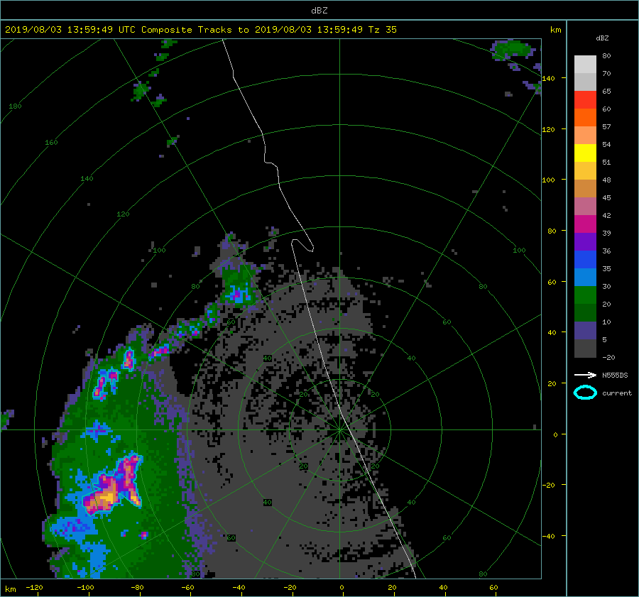
Work Done Since Last Meeting - LROSE-TITAN Analysis
Rview was used to visualize NWS composite radar with the Citation II flight track overlaid.
Animations were created for ALL 2019 flights.
CAPPI plots were also generated.
LROSE-TITAN was able to depict storm core info.
Found that 35 dBZ worked best for the 20190803a flight.
Code was generated to calculate aircraft
distance from storm core reflectivity centroid.
Rview animation using NWS KMLB composite reflectivity for the 2019/08/03a flight. Overlaid is the Citation II flight track (5 min of flight data per scan). LROSE-TITAN storm core is depicted by the blue outline – 35 dBZ threshold.

Slide 6
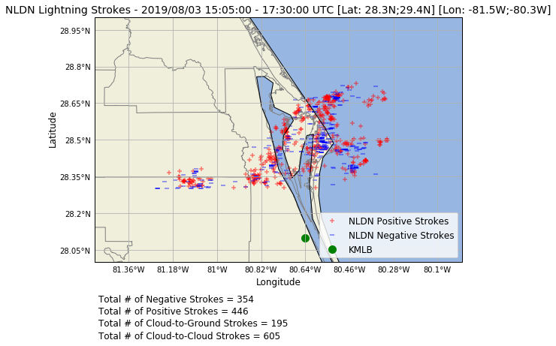
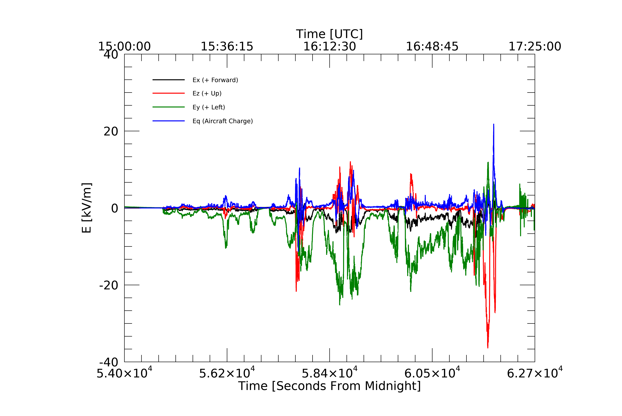
Work Done Since Last Meeting - Electric Field & NLDN Lightning Analysis
More focused on 20190803a
Aircraft sampling of continental and maritime convection shows possible evidence of electrical effects on hydrometeor aggregation (Connolly et al., 2005).
Aircraft sampling from Florida cirrus anvils (Connolly et al., 2005, Dye et al., 2007) mostly agree with past lab experiments (Saunders & Wahab 1975) where electric fields can alter microphysical processes.
NLDN data (provided by Dr. Ron Holle [Vaisala]) was gathered for all flight days in 2019.
Electric Field data was gathered by the Citation II during all flights.
Electric Field Mill data from the 20190803_142455 flight.

Slide 7
Latest Results - Introduction
Chain aggregates were observed during research flights over Florida in 2019 (CapeEx19). The airborne Particle Habit Imaging and Polar Scattering (PHIPS) probe was implemented on the Weather Modification International (WMI) Citation II Research Aircraft to obtained higher resolution stereographic images.
Surface radar and aircraft instrumentation are utilized to determine the location and characteristics of the chain aggregates.
An analysis of the CapeEx19 flight on August 3, 2019 showed that of a total of 17,146 PHIPS images, 7,151 where classified as chain aggregates.

Slide 8
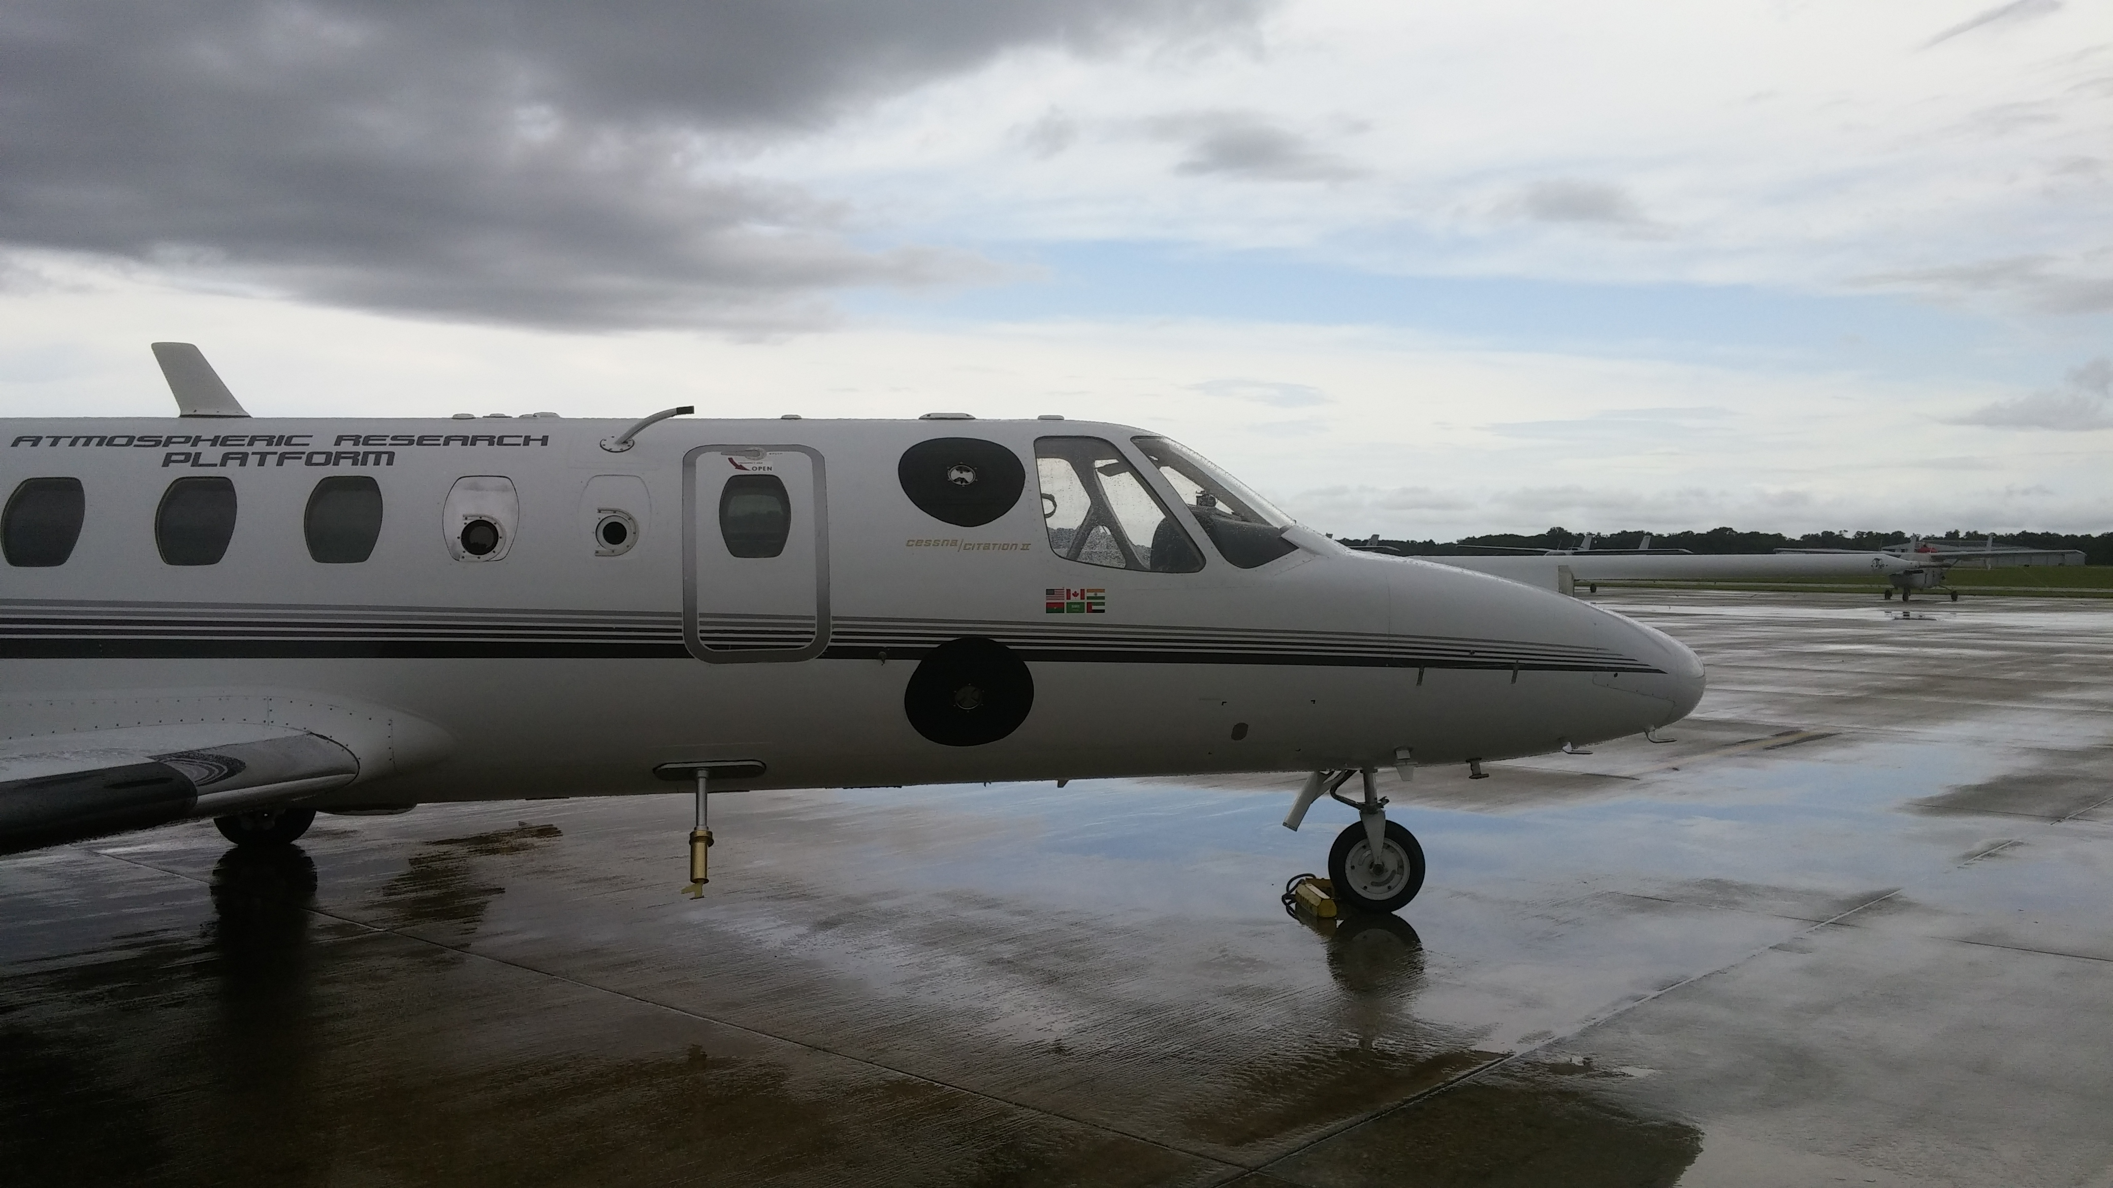
Latest Results Introduction/Background
Multiple airborne field projects have been performed to obtain in-situ measurements within Florida thunderstorms (Bringi et al., 1997, Schmidt et al., 2012).
Aircraft/balloon sampling of continental and maritime convection show differences in electrical structure (Connolly et al., 2005).
As well as microphysical properties.
Aircraft sampling from Florida cirrus anvils (Connolly et al., 2005) mostly agree with past lab experiments (Saunders & Wahab, 1975) where electric fields can alter microphysical processes.

Slide 9
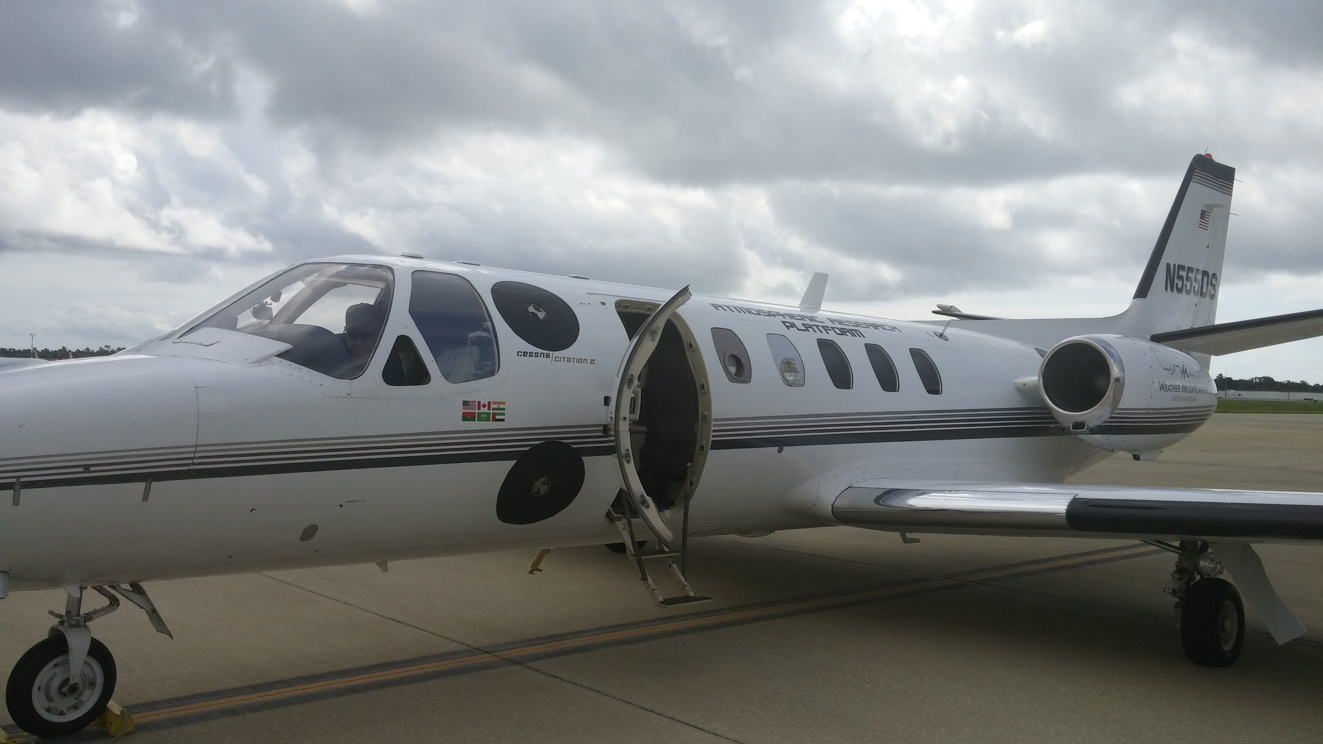
Motivation
State-of-the-art in-situ observations of electric fields, radar, particle, microphysical, and environmental observations by aircraft through Florida cirrus anvils were obtained during the CapeEx19 Field Campaign.
Newly obtained data may provide further insight in the electrical structure and microphysical characteristics in the upper-levels of Florida Thunderstorms.
Determining the process which generate these large chain aggregates in cirrus cloud anvils should enable models to predict their occurrence.
implementing chain aggregates in models should provide increased knowledge for the radiative impacts of cirrus anvils as well as for militaristic applications such as projectile re-entry impacts.

Slide 10
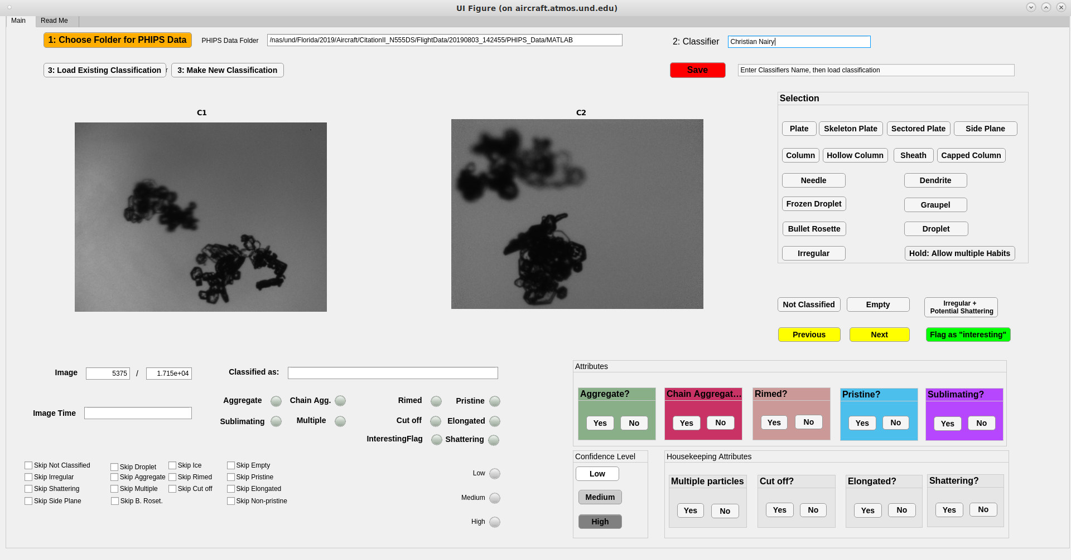
Latest Results - Methodology & Data
1.) Collect in-situ environmental and microphysical observations as well as photographic (PHIPS probe) imagery within the Florida cirrus anvils through the use of aircraft sampling.
2.) Classify particles and pick out the chain aggregates observed in the cirrus anvil.
Chain aggregates were defined by:
3 or more particles oriented in a linear fashion and/or...
Multiple particles joined by small joints and/or…
Elongated
Confidence was determined by the classifier:
Lowest Confidence (1): One of the three definitions observed.
Moderate Confidence (2): Two of the three definitions observed.
Highest Confidence (3): All three definitions observed.
3.) Using flight-leg intervals (where the aircraft was level at a constant altitude) shown in the figure above, calculate the amount of the chain aggregates per flight-leg, location (distance from storm core), and compare to in-situ environmental conditions.

Slide 11
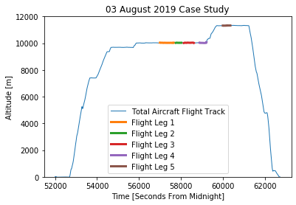
Latest Results - Methodology & Data
TITAN-Rview Radar Animation (figure above) using data from the NWS KMLB WSR-88D. Aircraft track is depicted as the white line where the slightly apparent buldge in the line is the current aircraft postion with the line being 5 minutes of past flight track with repect to the time stamp. Blue circles represent the TITAN storm tracking algorithm (35 dBZ threshold).

Slide 12
2019/08/03
Weak upper-level low pressure to the NW of Florida (FL)
Storms initiate on the west side of the FL peninsula (sea-breeze circulation)
Then storms are enhanced by the sea-breeze circulation of the east side of the FL peninsula.

Slide 13
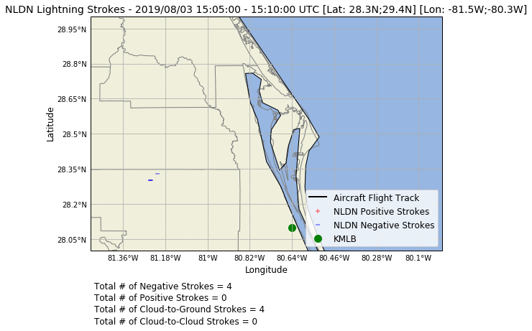
NLDN Data⁵

Slide 14
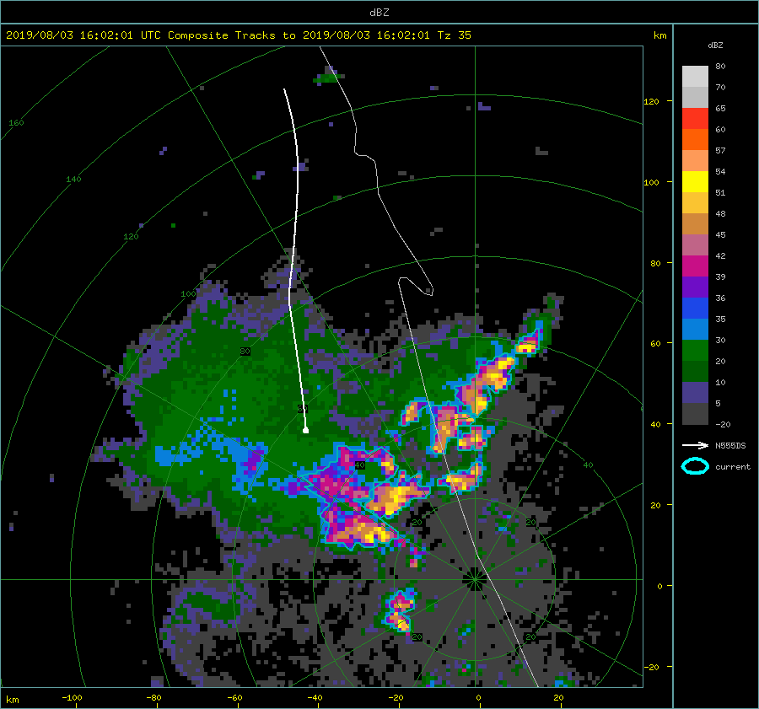
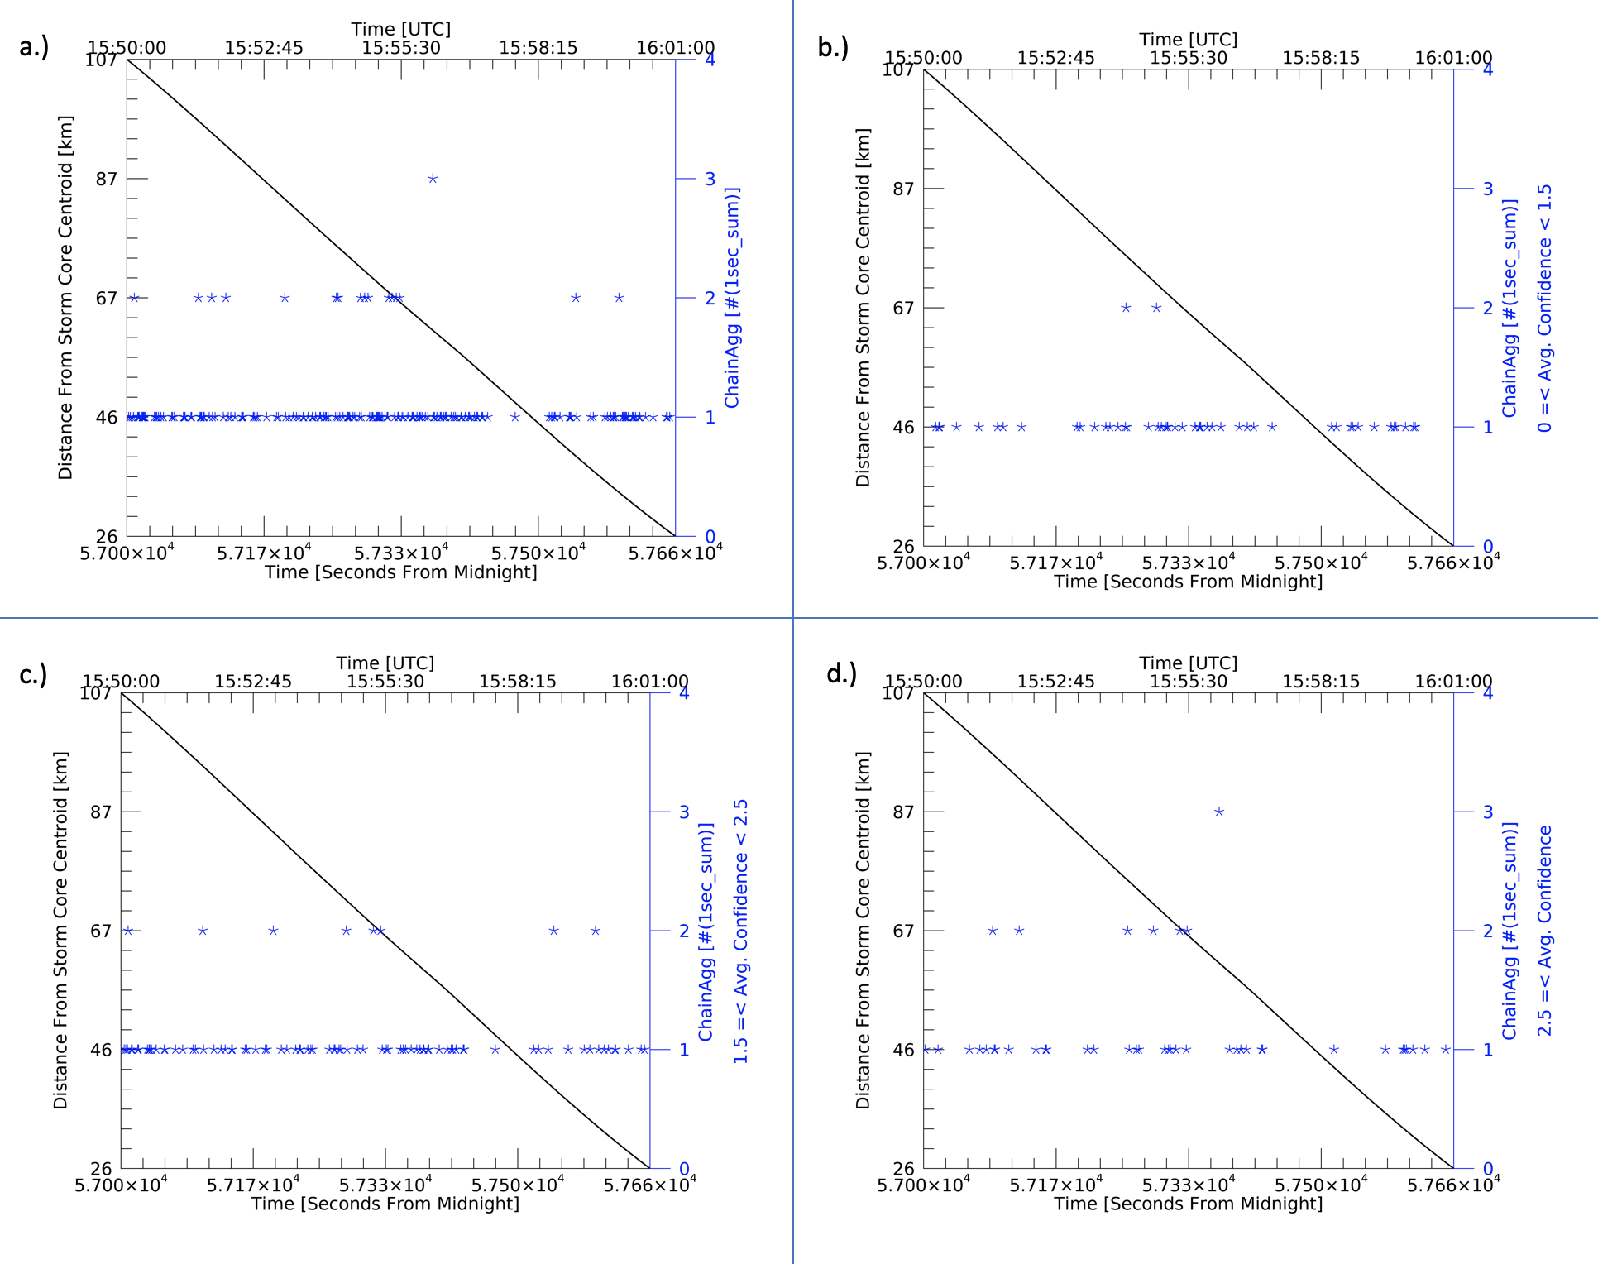
Latest Results
First Flight Leg: 15:50:00 - 16:01:00 UTC
Rview image (figure above) depiciting NEXRAD KMLB WSR-88D Level II composite refelctivity (dBZ) as well as airfcraft flight track data (white line) and TITAN storm tracking data (blue outlines - 35 dBZ threshold [Tz]). White aircraft line showing 11 minutes of previous aircraft track. White buldge at the bottom point of the white line is the aircraft's position at 16:01:00 UTC.

Slide 15
Latest Results
First Flight Leg: 15:50:00 - 16:01:00 UTC
Figure to the right showing total amount of chain aggregates in flight leg 1 (a), while (b-d) show chain aggregates in varying average confidence intervals.
(a) Total Chain Aggregates = 198
(b) 0 ≤ Avg. Confidence < 1.5 = 52
(c) 1.5 ≤ Avg. Confidence < 2.5 = 96
(d) 2.5 ≤ Avg. Confidence = 50

Slide 16
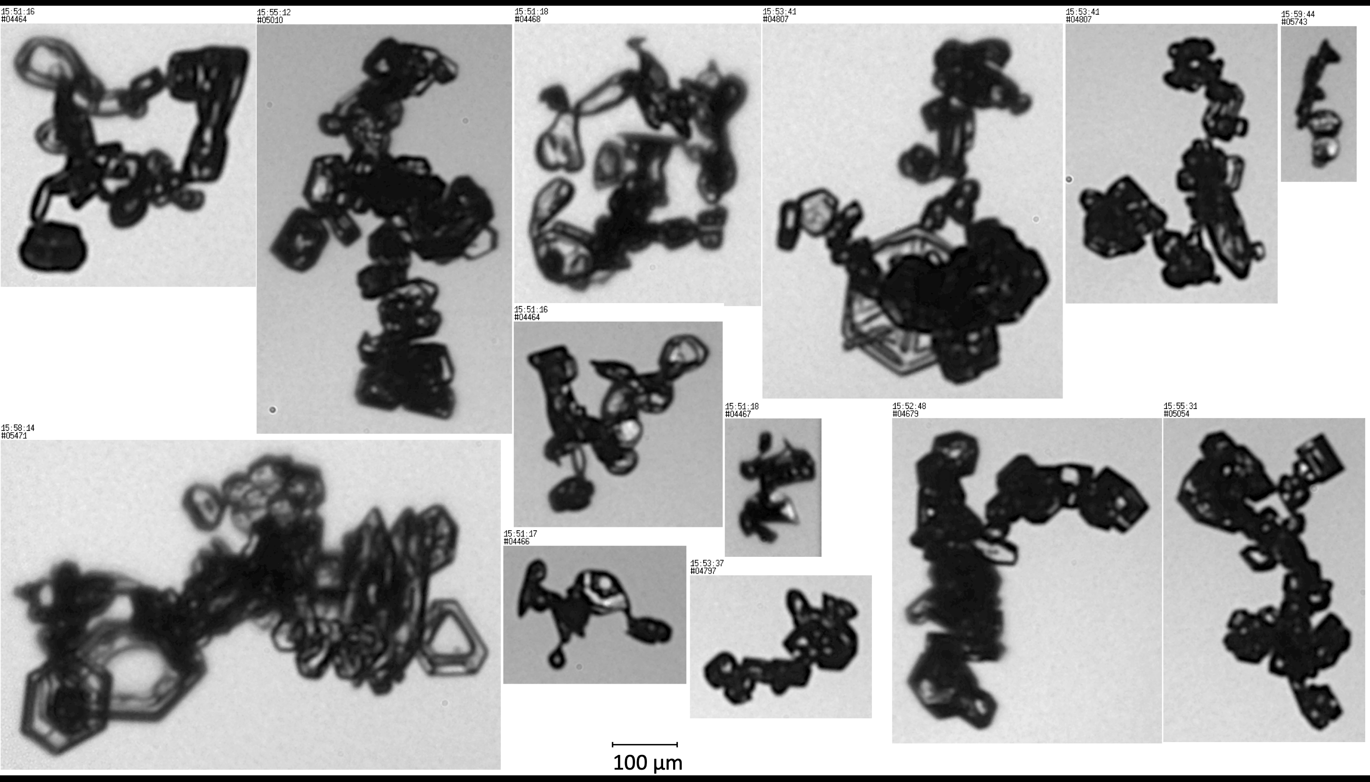
Latest Results
PHIPS Images
First Flight Leg: 15:50:00 - 16:01:00 UTC

Slide 17
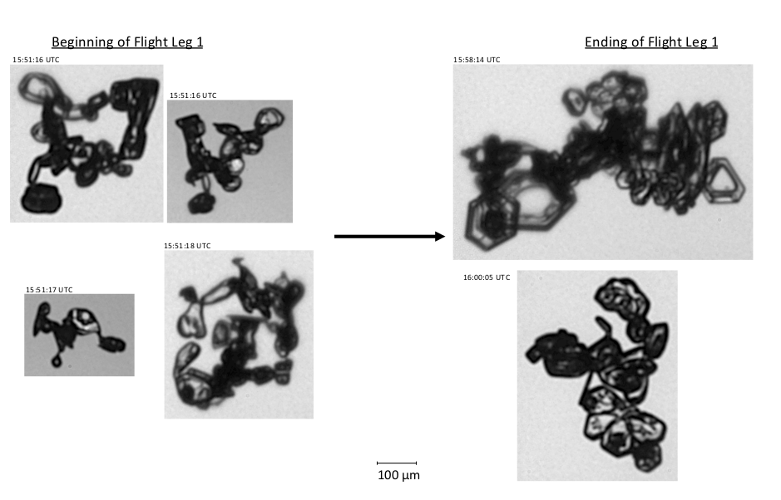
Latest Results
PHIPS Images
First Flight Leg: 15:50:00 - 16:01:00 UTC
Figure showing a few particles images taken in the early stage verses the later stage of the first flight leg.

Slide 18
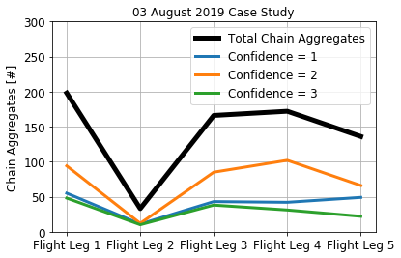
Latest Results
All Flight Legs Summary

Slide 19
Flight Leg 1 (FL1) 15:50:00 – 16:01:00

Slide 20
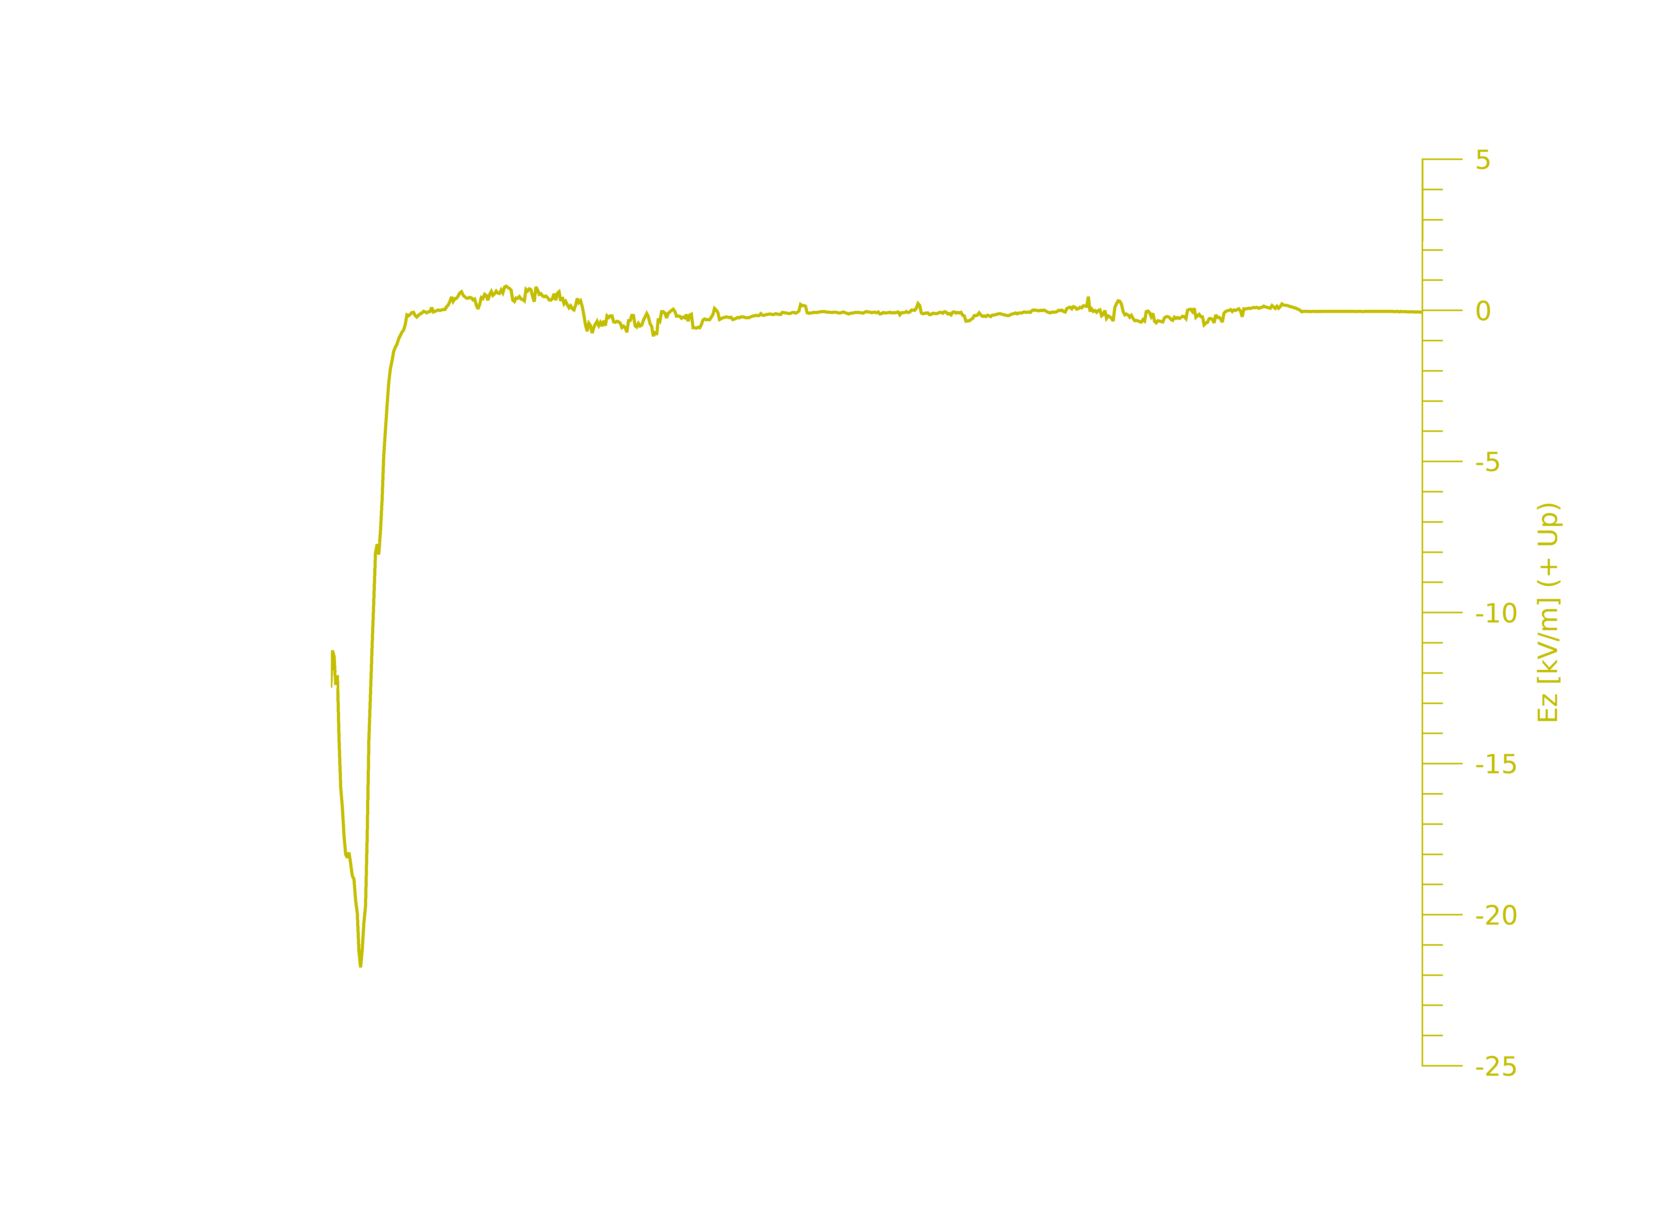
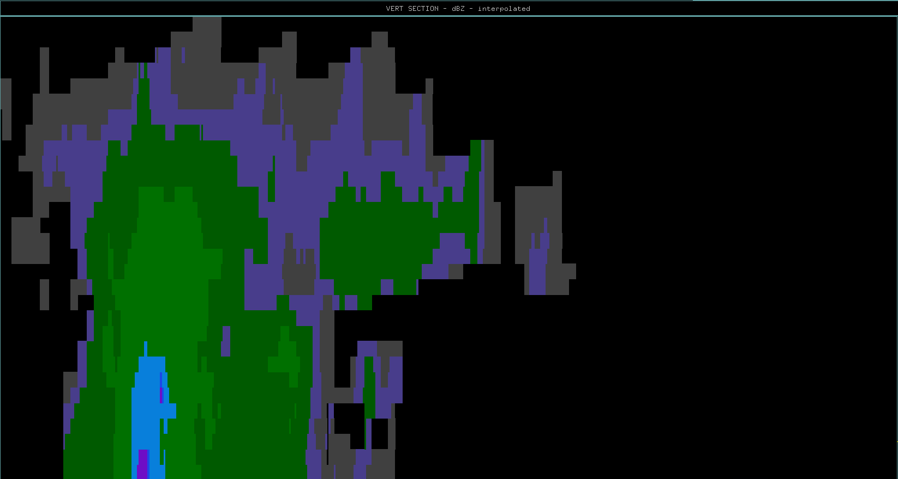
10
20
30
40
50
60
70
80
90
100
110
Distance (km)
Aircraft Flight Track & Direction
Flight Legs | Time Span (hh:mm:ss) UTC | Time Span (SFM) | Average Altitude (m) | Average Temperature (degrees C)
Flight Leg 1 | 15:50:00-16:01:00 | 57000-57659 | 10032 (+/- 10) | -33.65 (+/- 1)

Slide 21
Microphysical Data Flight Leg 1 15:50:00 – 16:01:00
15:53:34 – 15:53:37 UTC
16:00:20 – 16:00:23 UTC

Slide 22
Flight Leg 3 (FL3) 16:09:00 – 16:17:00
Aircraft sampling farther
away from storm core but in the
same relative sampling locations as
Flight Leg 1.

Slide 23
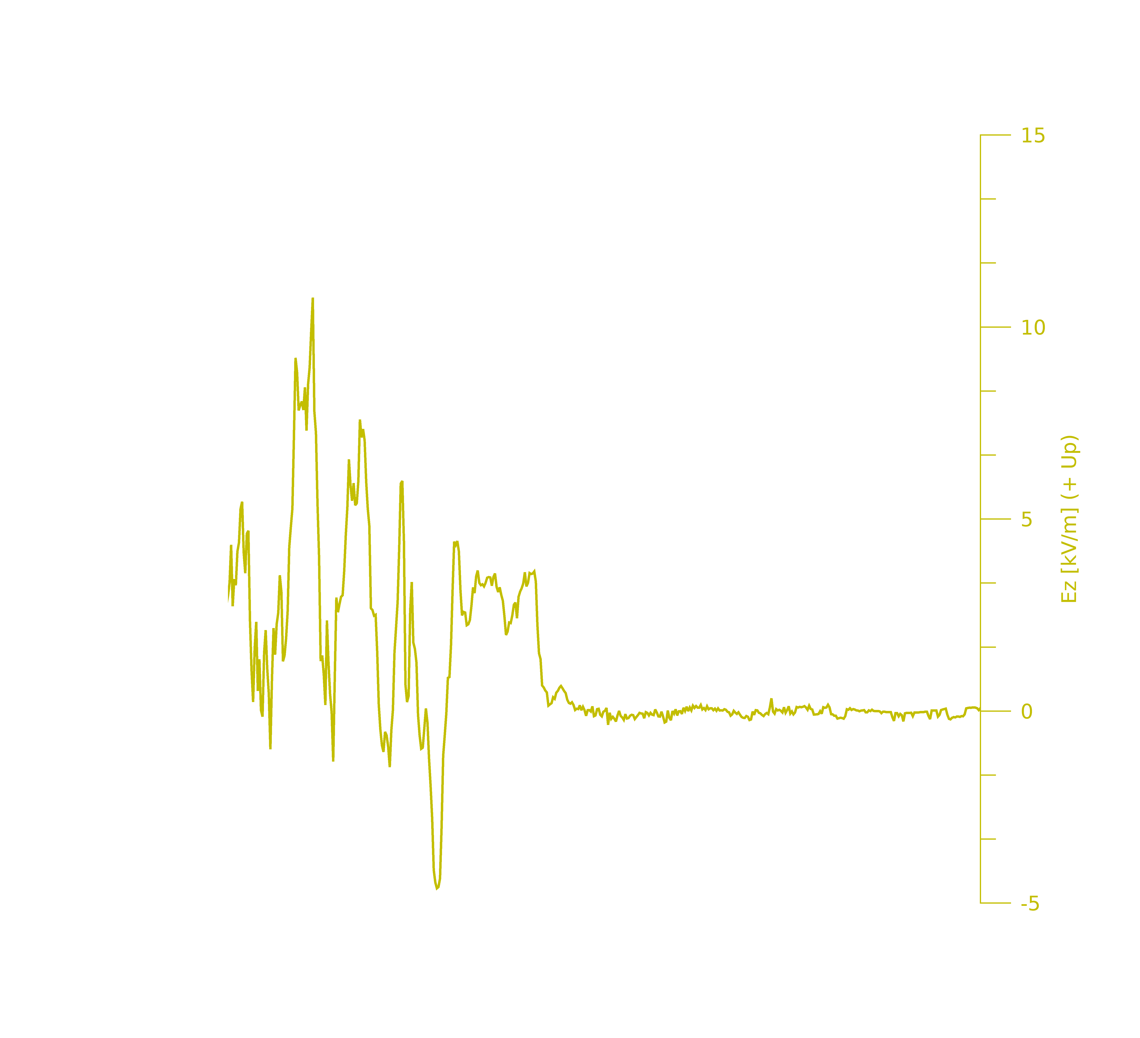
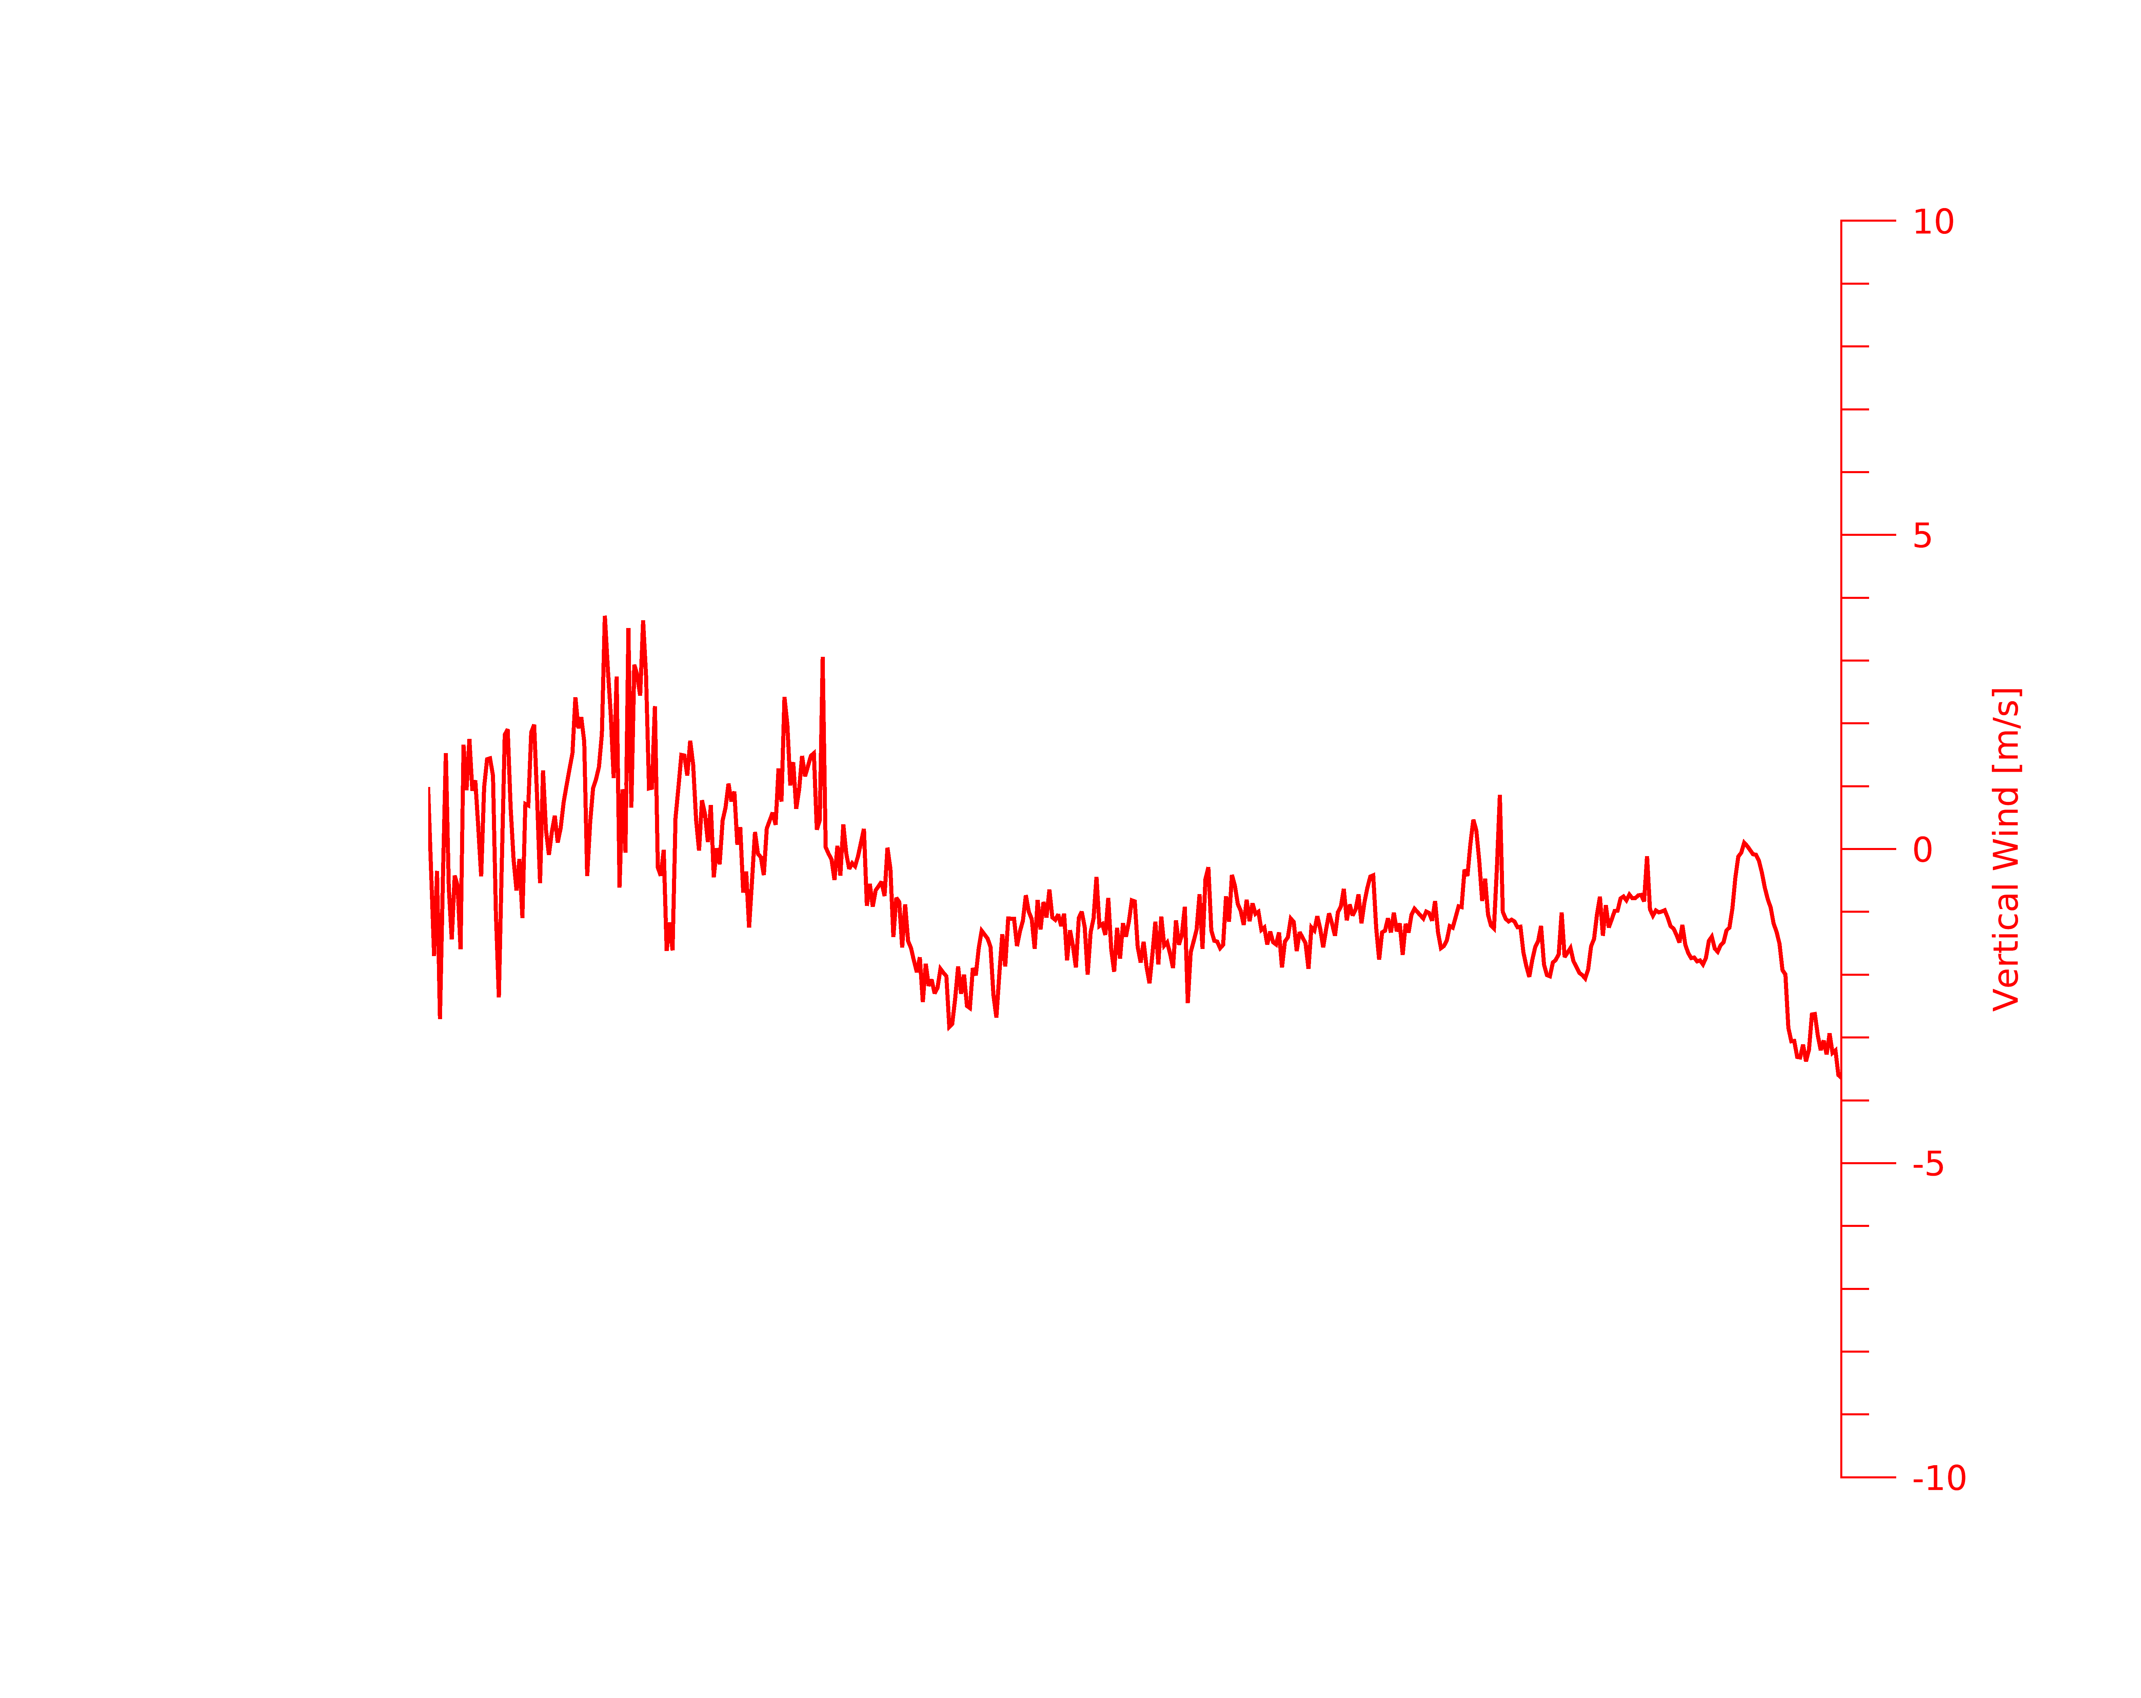
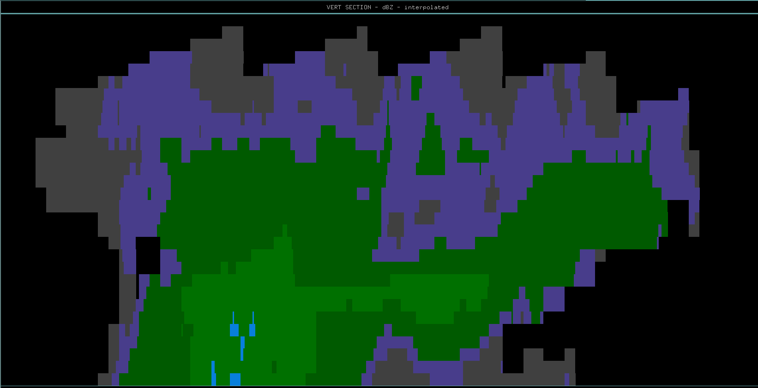
10
20
30
40
50
60
70
Distance (km)
Aircraft Flight Track & Direction
Flight Legs | Time Span (hh:mm:ss) UTC | Time Span (SFM) | Average Altitude (m) | Average Temperature (degrees C)
Flight Leg 3 | 16:09:00-16:17:00 | 58140-58619 | 10032 (+/- 10) | -32.62 (+/- 1.5)

Slide 24
Microphysical Data Flight Leg 3 16:09:00 – 16:17:00
16:10:48 – 16:10:51 UTC
16:16:00 – 16:16:03 UTC

Slide 25
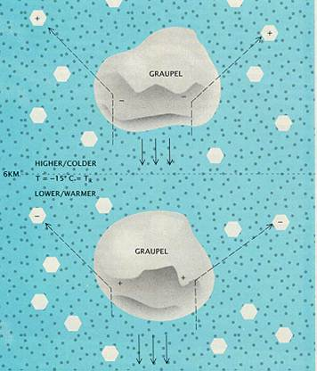
Graupel-Ice Collision Mechanism⁶

Slide 26
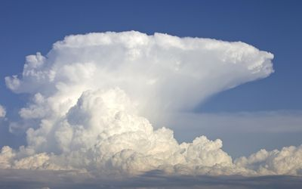
(Not the actual sampled storm –
for visual reference)
Screening Layer
U.P. Charge Region
( Graupel/Cloud Ice)
Updrafts carry some charged
graupel upwards above the -30°C
level.
-30°C
Aircraft Track
N Charge Region
( Graupel)
Downdraft
Downdraft
-15°C
FL1 PHIPS Imagery - 16:00:02 UTC
100 μm
L.P. Charge Region
( Graupel)
Updraft
Updraft

Slide 27
Remarks
We theorize that negatively charged graupel is being lofted higher in Florida thunderstorms by updrafts (~10 km // < -30°C).
While positively charged particles may be descending lower into the storm by downdrafts.
CIP and PHIPS imagery add confidence to our hypothesis.
More investigating needs to be performed on other flights from the CapeEx19 Campaign.

Slide 28
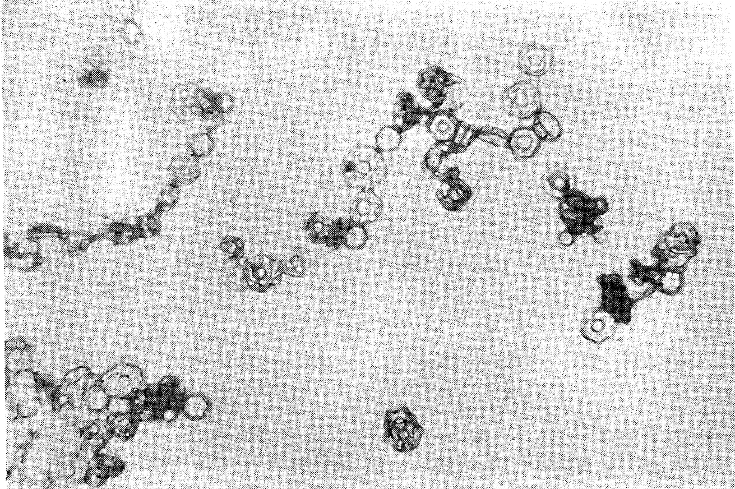
Future Work
Compare locations of chain aggregates verses electric fields observed during sampling.
Literature suggest high crystal concentrations and E-fields necessary for chain aggregates^{4,5}.
Compare results from this case study to other flights during the CapeEx19 field campaign.
Origin of chain aggregates are still unknown.
Additional aircraft flights through and around the vicinity of the storm core may provide further insight.
More microphysical analyzation of chain aggregates needed before implementation into cloud microphysical aggregation models.
⁴Saunders & Wahab (1975) laboratory image.

Slide 29
References
﻿Bringi, V. N., K. Knupp, A. Detwiler, L. Liu, I. Caylor, and R. Black, 1997: Evolution of a Florida Thunderstorm during the Convection and Precipitation/Electrification Experiment: The Case of 9 August 1991. Monthly Weather Review - MON WEATHER REV, 125, https://doi.org/10.1175/1520-0493(1997)125<2131:EOAFTD>2.0.CO;2.
Schmidt, J. M., and Coauthors, 2012: Radar observations of individual rain drops in the free atmosphere. PNAS, 109, 9293–9298, https://doi.org/10.1073/pnas.1117776109.
Connolly, P. J., C. P. R. Saunders, M. W. Gallagher, K. N. Bower, M. J. Flynn, T. W. Choularton, J. Whiteway, and R. P. Lawson, 2005: Aircraft observations of the influence of electric fields on the aggregation of ice crystals. Quarterly Journal of the Royal Meteorological Society, 131, 1695–1712, https://doi.org/10.1256/qj.03.217.
Saunders, C. P. R., and N. M. A. Wahab, 1975: The Influence of Electric Fields on the Aggregation of Ice Crystals. Journal of the Meteorological Society of Japan, 53, 121–126, https://doi.org/10.2151/jmsj1965.53.2_121.
NLDN lightning data was provided by Dr. Ron Holle (Viasala), 3 August 2019. https://www.vaisala.com/en/products/national-lightning-detection-network-nldn
Williams, E. R., 1988: The Electrification of Thunderstorms. Scientific American, 259, 88–99.

Slide 30
Thesis Topic Proposal
Case study on 2019/08/03
FOCUS: Chain aggregates & Electric Fields

Slide 31
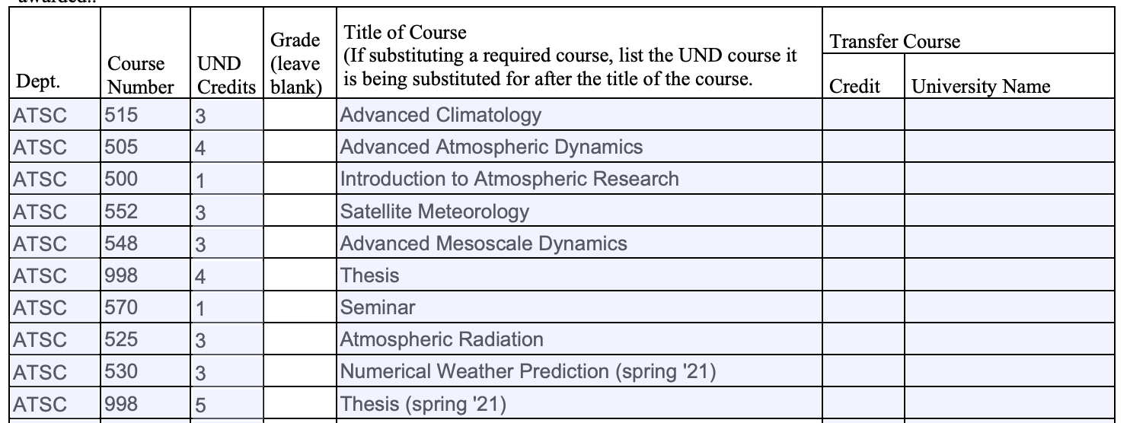
Plan of study
Need 8 more credits
Plan on taking NWP and Thesis credits to finish out.

